Slide 1
Futurism
De Stijl
Constructivism
Art Deco
Modernism

Slide 2
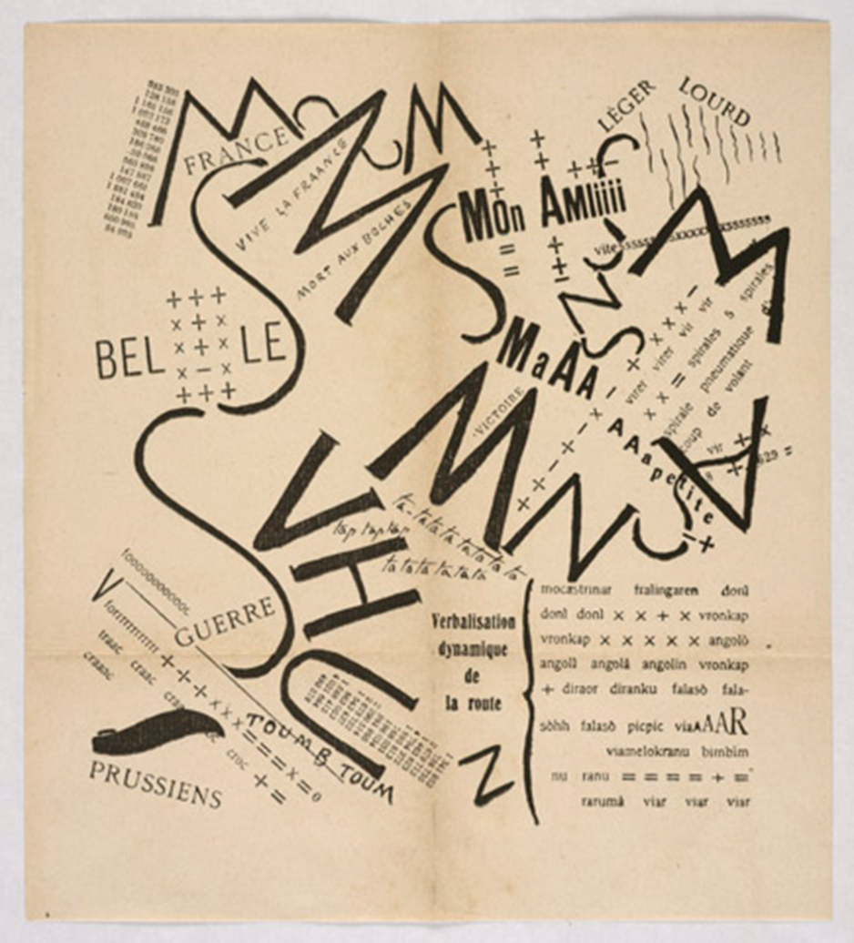
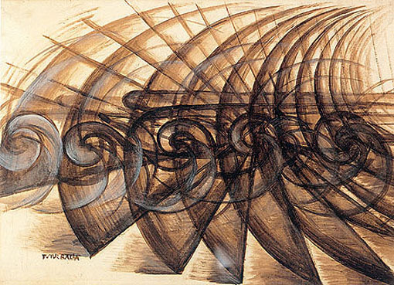
Futurism (Futurismo!)

Slide 3
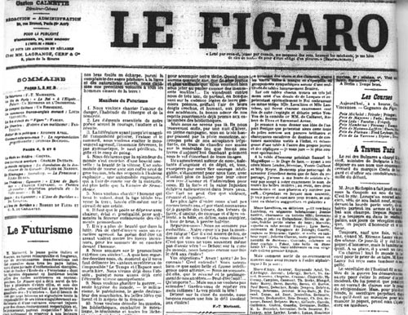
Futurismo! Futurism
Term invented by Flippo Tommaso Marinetti.
Announced on the front page of Le Figaro in Paris on February 20, 1909.
Futurism
Term invented by Flippo Tommaso Marinetti.
Announced on the front page of Le Figaro in Paris on February 20, 1909.

Slide 4
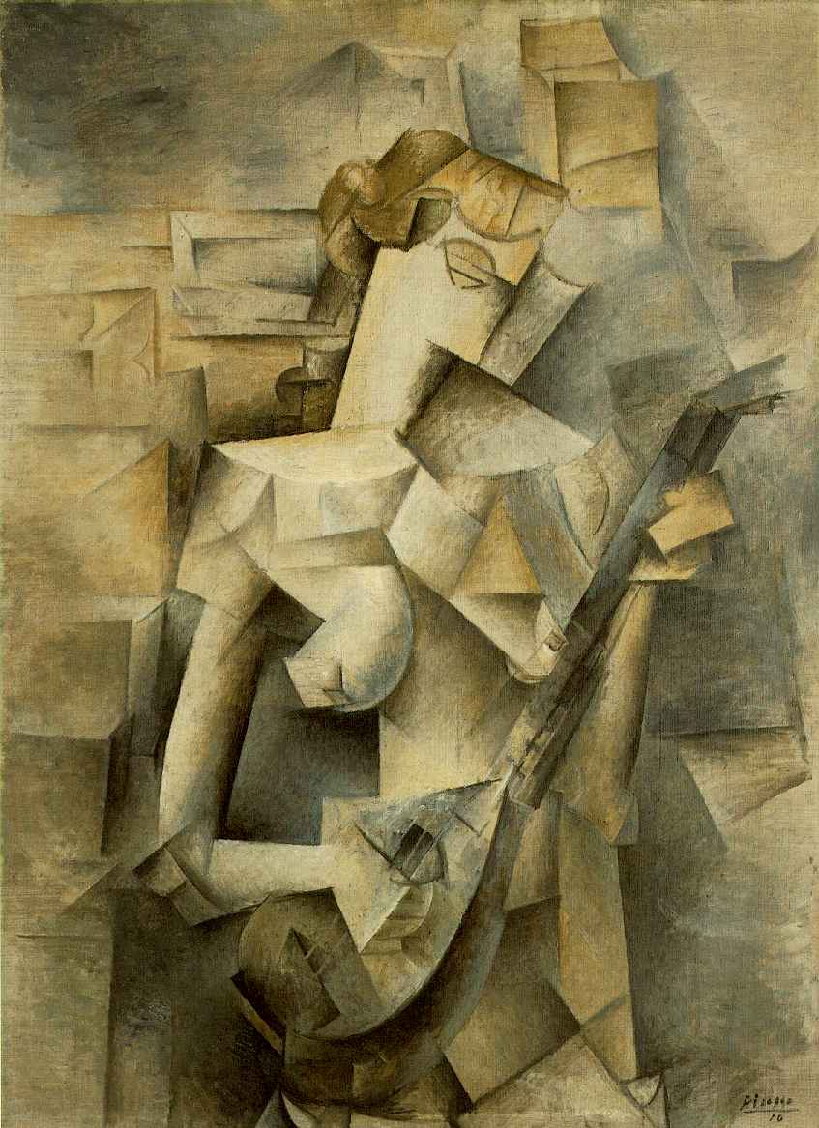
Picasso,
Woman Playing the Mandolin,
1909
Giacomo Balla,
Speed of a Motorcycle,
1913, Oil on Canvas

Slide 5
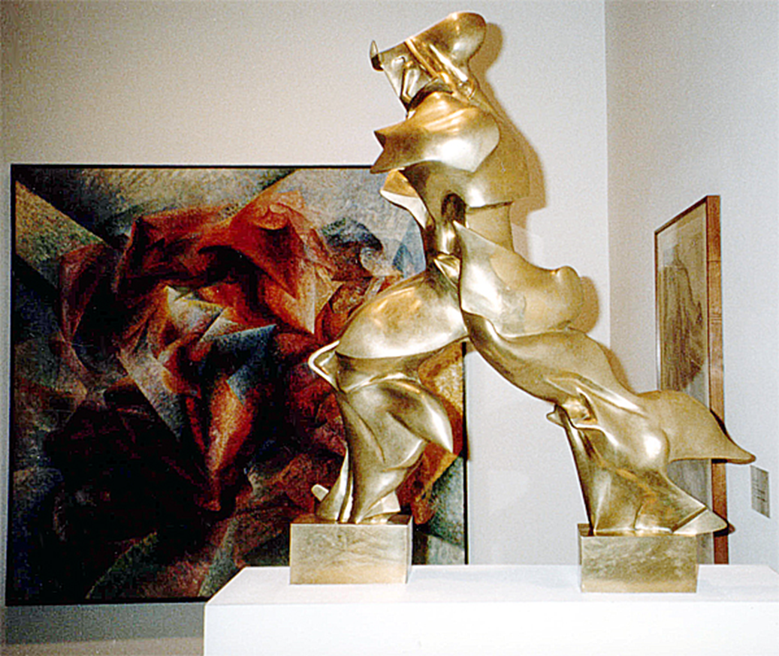
Umberto Boccioni, Unique Forms of Continuity in Space,
1913 (cast 1931), bronze, 43 7/8 x 34 7/8 x 15 3/4"

Slide 6
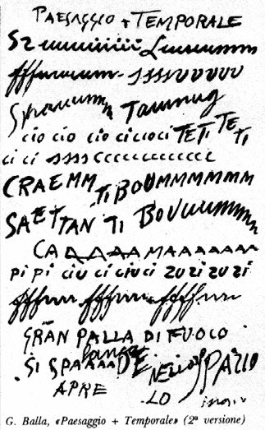
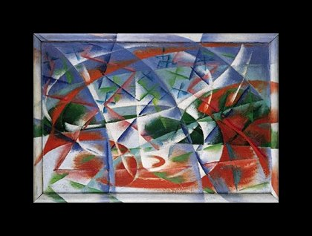
Balla, Speed + Sound, 1913-1914

Slide 7
Typography and modernism:
Conventional Theory: Typography honors content
    Related theory: typography honors industry and content
Modernist theory: Typography functions with/as content
    Modernist era: late 19th - early 20th century
    Political potential of (experimental) typography
    Different “rules” of typographic design - to encourage and discourage certain values in the reading public

Slide 8


Filippo Marinetti, Mountains + Valleys + Streets x Joffre, 1915

Slide 9
Filippo Marinetti, Mountains + Valleys + Streets x Joffre, 1915
Words as images; writing as visual form

Slide 10
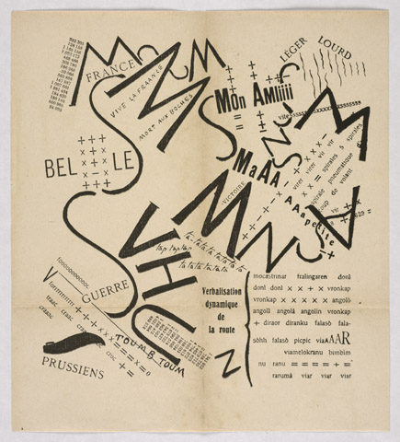
Visual and
Auditory elements

Slide 11
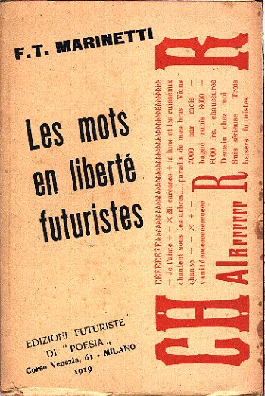
F.T. Marinetti
Italian poet and founder of Futurism
from Les mots en liberté futuristes, 1919
“I am starting a typographic revolution, directed above all against the idiotic, sick-making conception of the old-fashioned Poetry Book, with its hand-made paper, its sixteenth century style, decorated with galleons, Minervas, Apollos, great initials …”
“The book must be the futuristic expression of our futuristic thought. Better: my revolution is against among other things the so-called typographic harmony of the page, which is in complete opposition to the style which the page allows.”

Slide 12
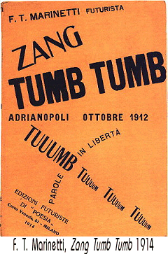
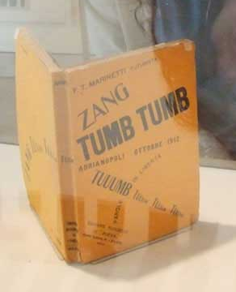
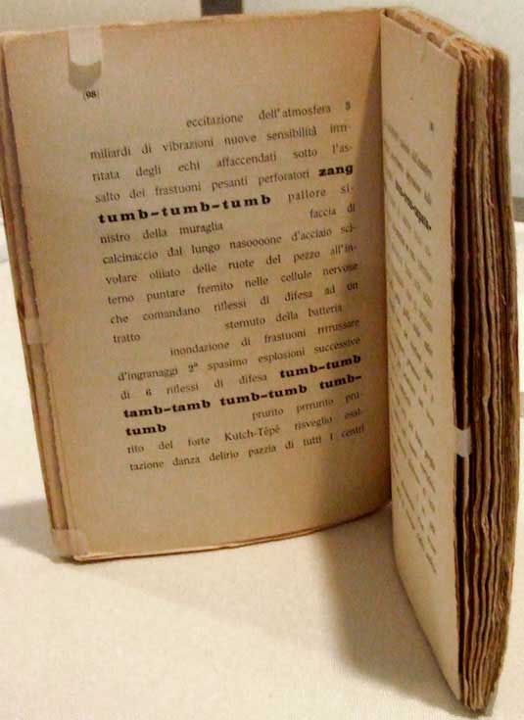

Slide 13
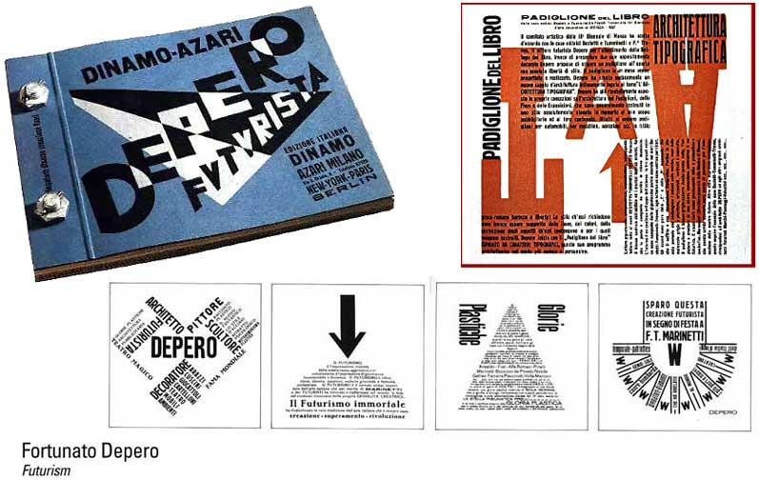

Slide 14
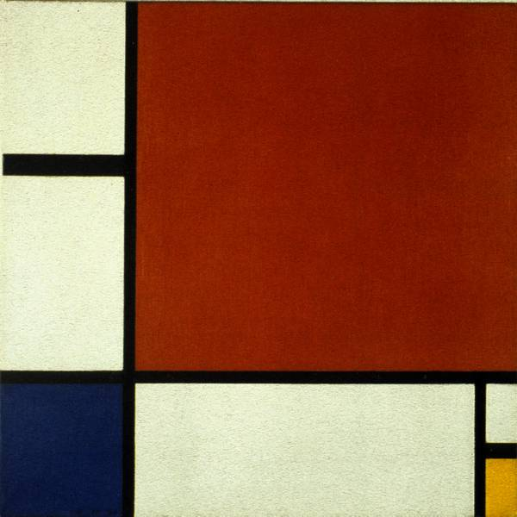
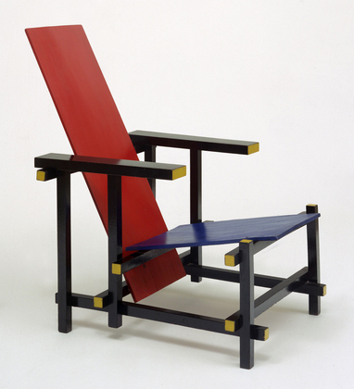
De stijl (The style)
1917 – 1920s

Slide 15
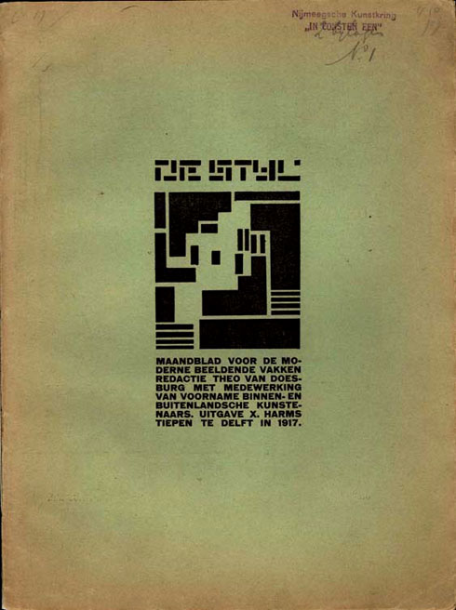
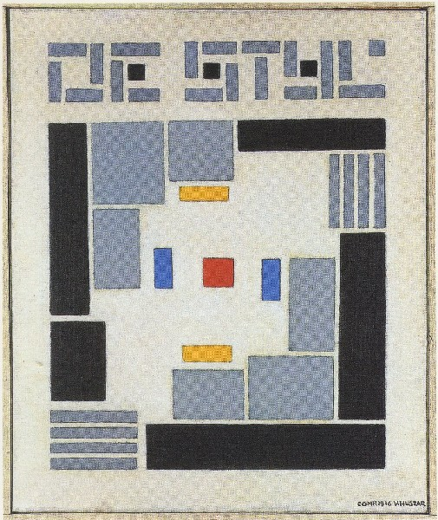
Die Stijl, Number 1, 1917

Slide 16
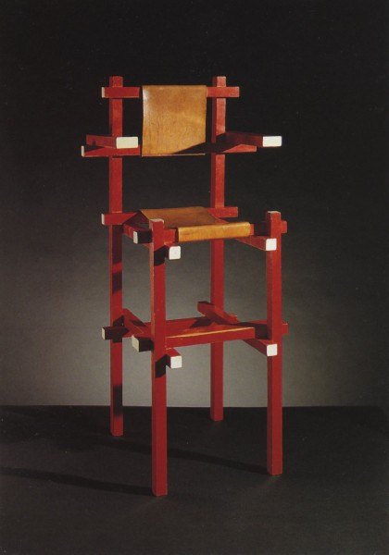
Gerrit Rietveld, chair designs, c. 1923

Slide 17
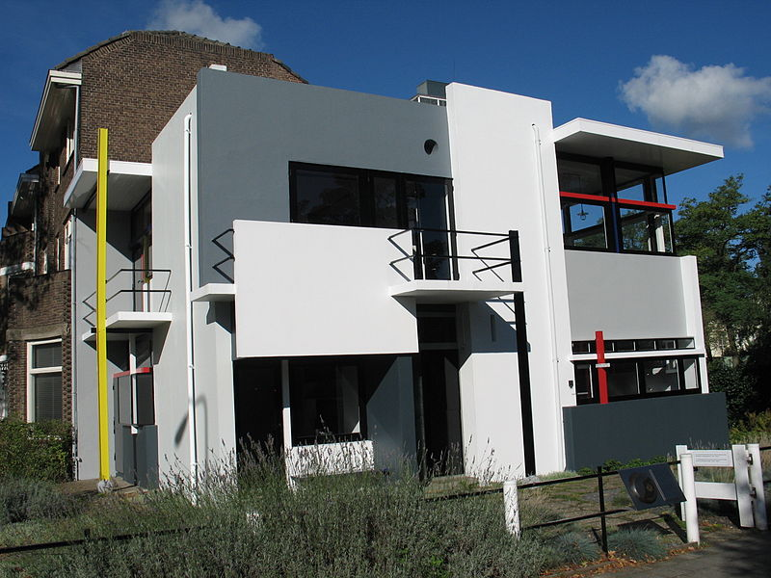
The Rietveld Schröder House

Slide 18
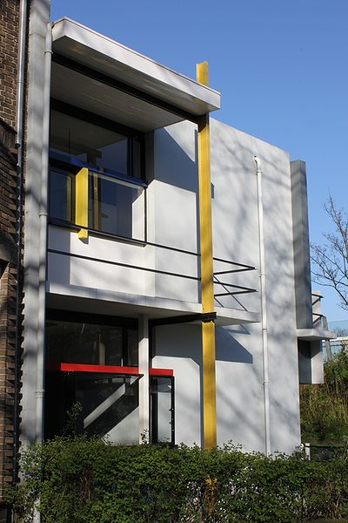
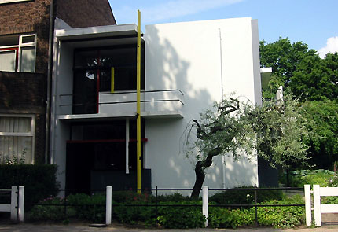
http://www.youtube.com/watch?v=qLHCYeswxuI

Slide 19
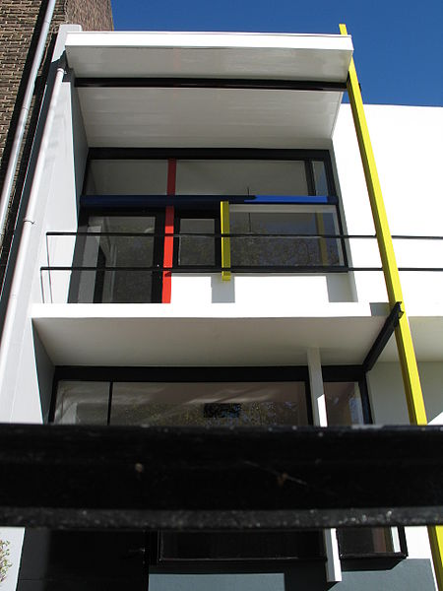

Slide 20
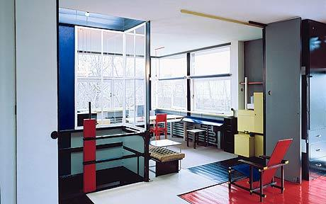

Slide 21
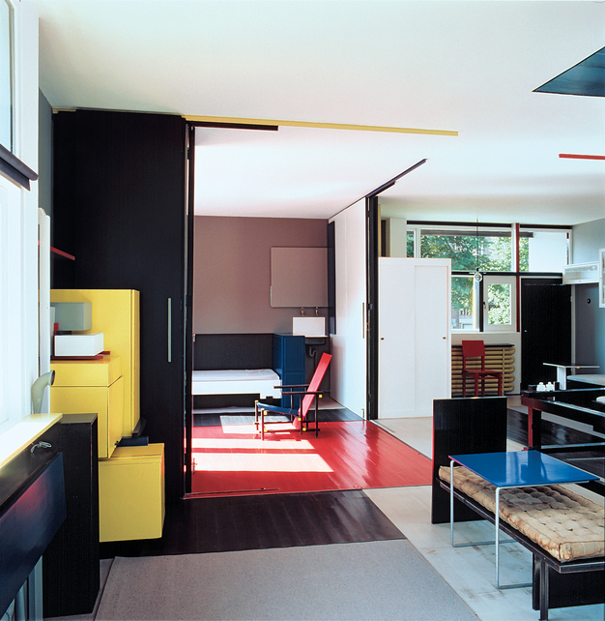
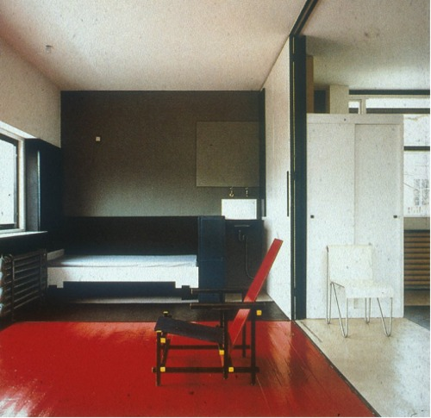

Slide 22
Piet Mondrian,
Composition II in Red, Blue, and Yellow, 1930

Slide 23
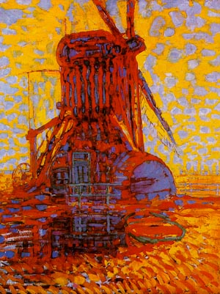
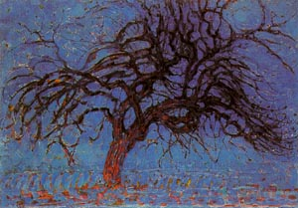
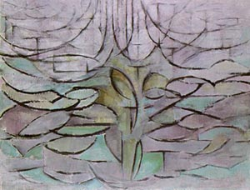
Piet Mondrian (Pieter Mondriaan), Dutch
The Mill Under the Sun, 1908
The Red Tree, 1908
The Blooming Apple Tree, 1912

Slide 24
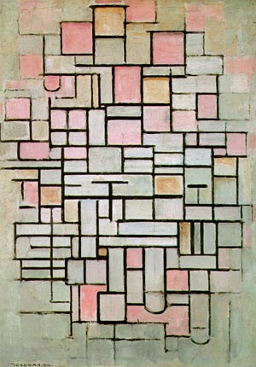
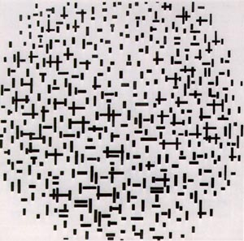
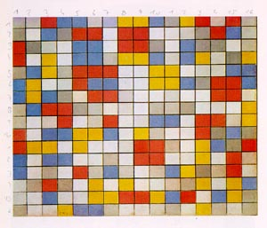
Composition No. 6, 1914
Composition with lines, 1917
Composition, 1919

Slide 25
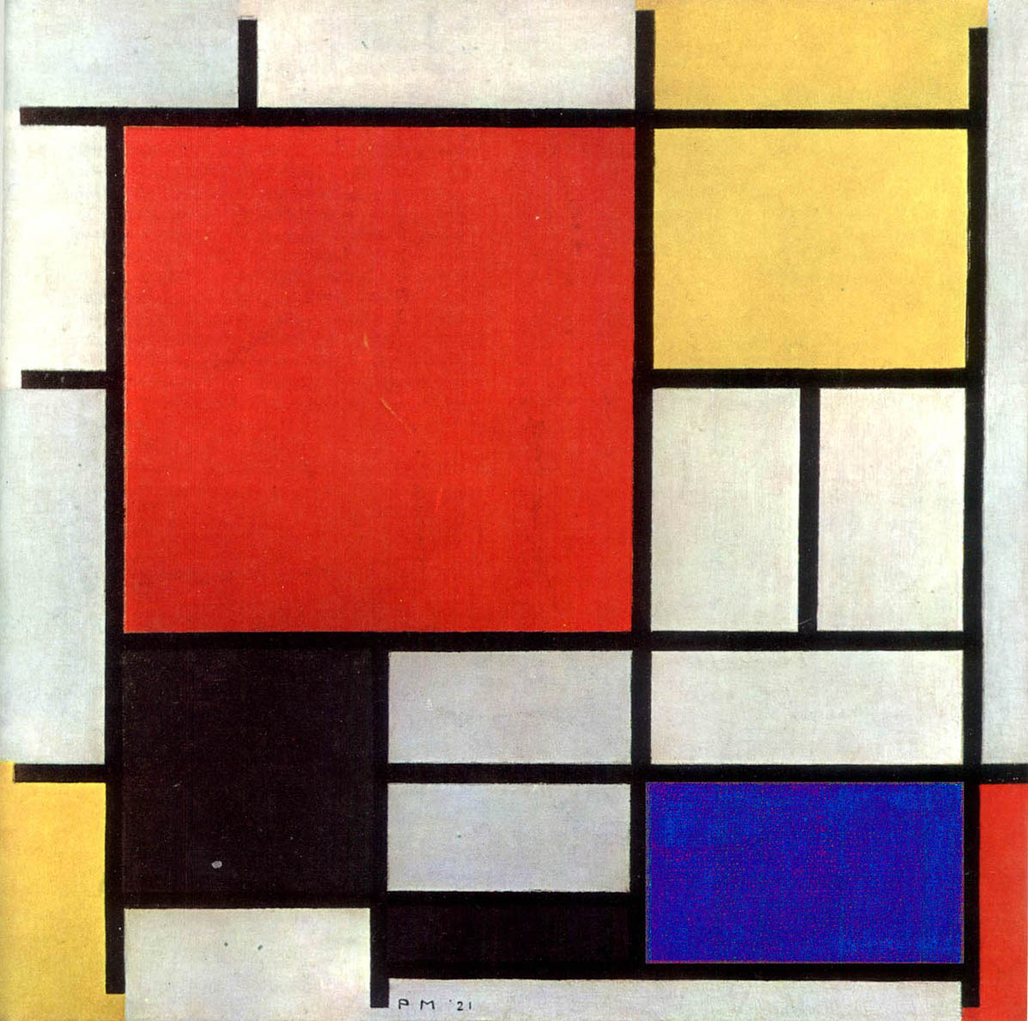
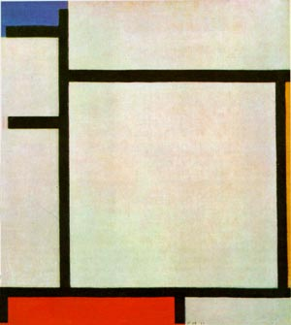
1921
1922

Slide 26
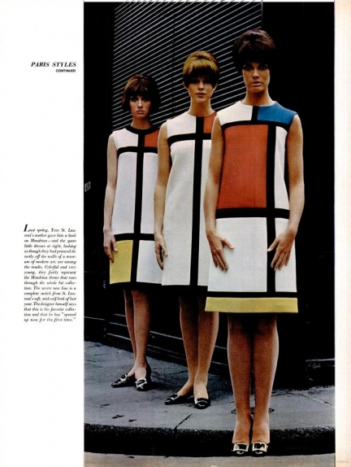
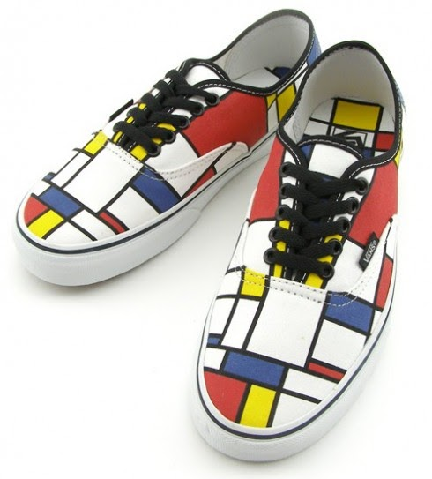

Slide 27
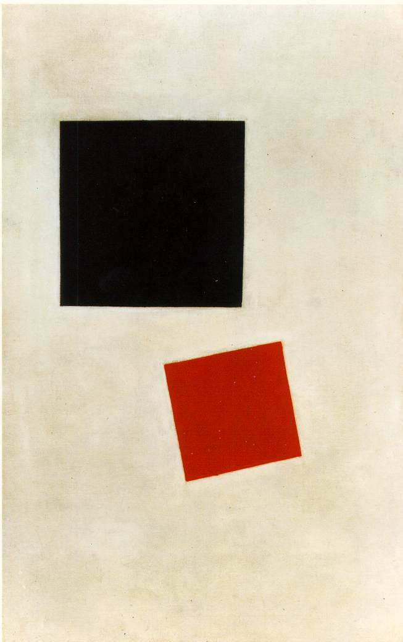
Kasimir Malevich,
Black Square and Red Square
1915; Oil on canvas, (28 x 17 1/2 in)
Piet Mondrian,
Composition II in Red, Blue, and Yellow, 1930

Slide 28

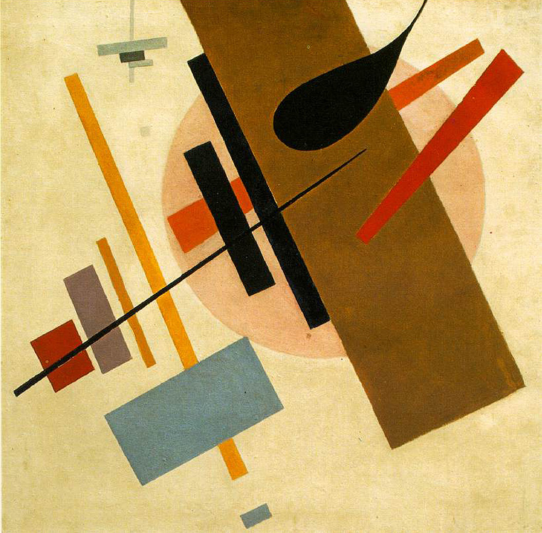
Constructivism 1917 - 1930s
El Lissitzky

Slide 29
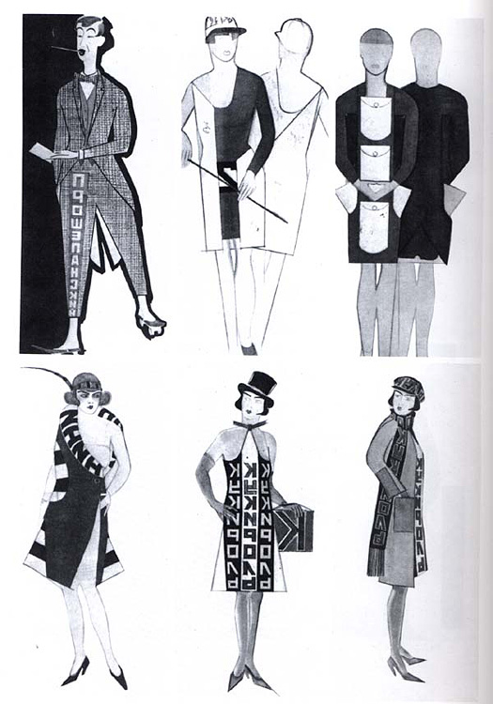

The Constructivist Culture

Slide 30
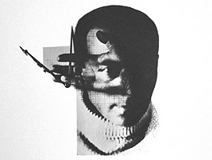
El Lissitzky
Self-Portrait

Slide 31
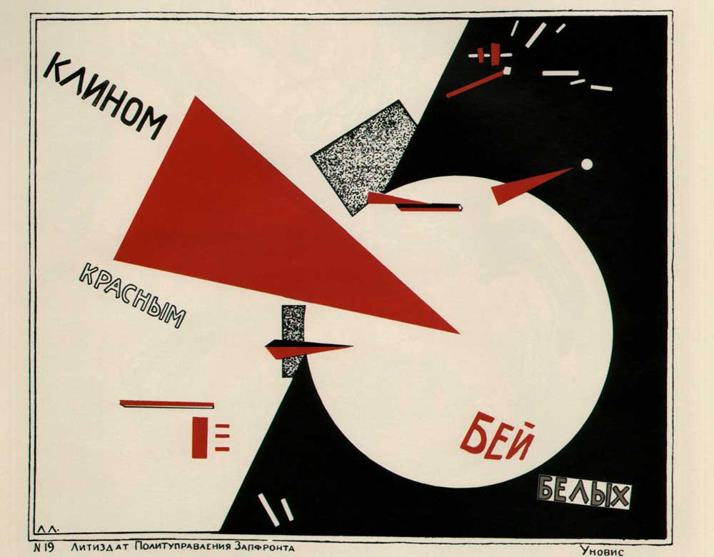
1919, Lithograph

Slide 32
Beat the Whites with the Red Wedge, 1919, Lithograph

Slide 33
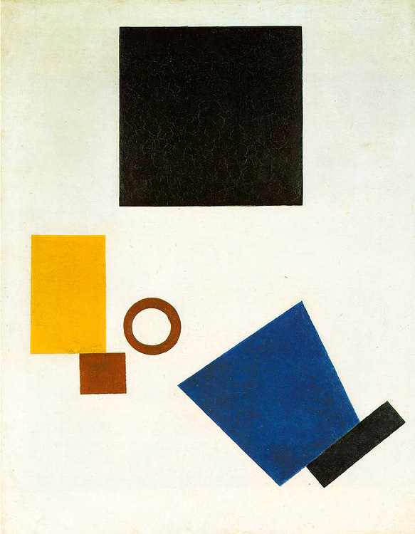

"The artist constructs a new symbol with his brush. This symbol is not a recognizable form of anything which is already finished, already made, already existing in the world - it is a symbol of a new world, which is being built upon and which exists by way of people."

Slide 34
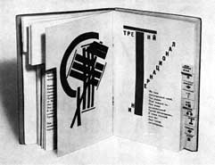
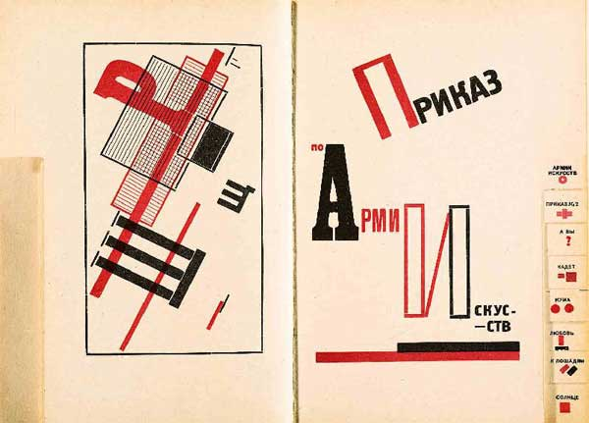
pages from For the Voice (1923)
Poem by Mayakovsky

Slide 35
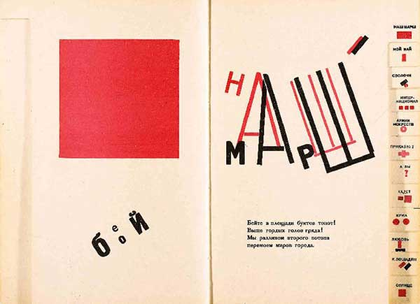

Slide 36
"The space must be a kind of showcase, a stage, on which the pictures make their appearance as actors in a drama (or comedy). It should not imitate a living space."

Slide 37
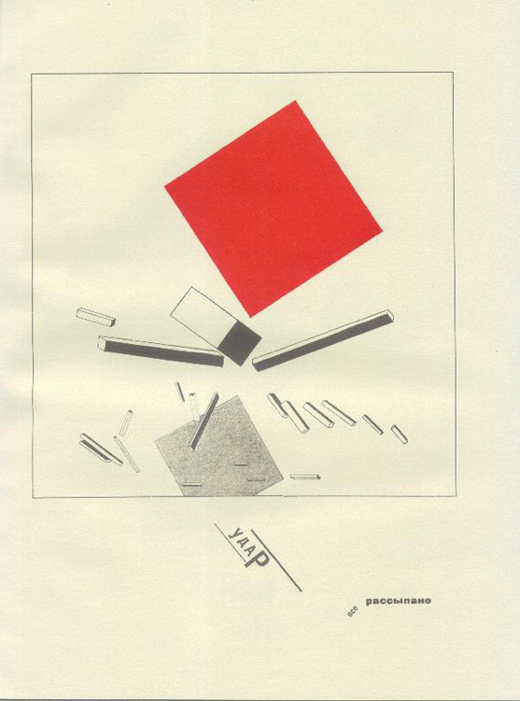
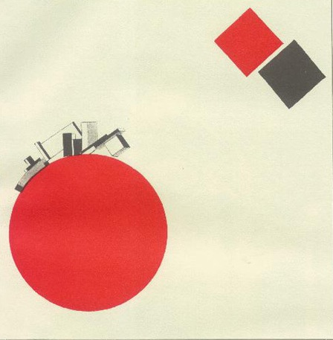
The Story of the Little Red Square

Slide 38

  Distinct break from old typography:
  discarding of decorative concepts
  a turn to functional design (design functions as content)

Slide 39
  Distinct break from old typography:
  discarding of decorative concepts

Slide 40
  Distinct break from old typography:
  discarding of decorative concepts
Sans-serif
Bold, basic colors
Use of photography
(new-ish technology)

Slide 41
  Distinct break from old typography:
  a turn to functional design (design functions as content)

Slide 42
El Lissitzky
major contributor to “new typography”
“Topography of Typography,” from the magazine Merz, 1922
“On the printed page words are seen, not heard.”
“Economy of Expression - visual, not phonetic.”
“The new book demands the new writer. Ink-pots and goose-quills are dead.”
“The printed page transcends time and space. The printed page, the infinity of the book, must be transcended. THE ELECTRO-LIBRARY.”

Slide 43
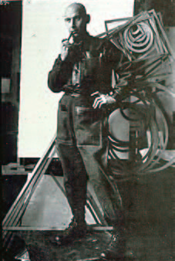
Aleksandr Rodchenko

Slide 44
Rodchenko, poster, 1924

Slide 45
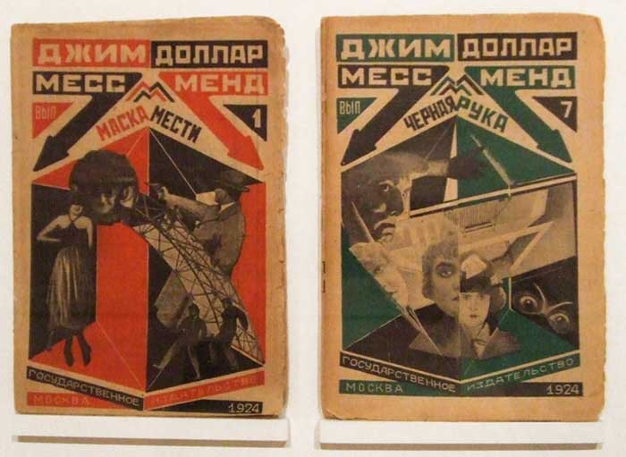
Paperback Book Covers, 1924

Slide 46

Poster, 1923,
Text by V.Mayakovsky.

Slide 47

Aleksandr Rodchenko and Vladimir Mayakovsky,
Box for Our Industry caramels, 1923

