Slide 1
Modern Design
The International Style

Slide 2
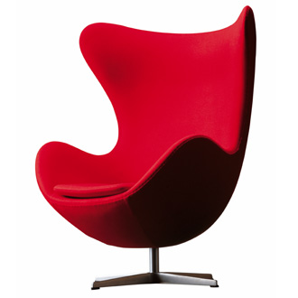
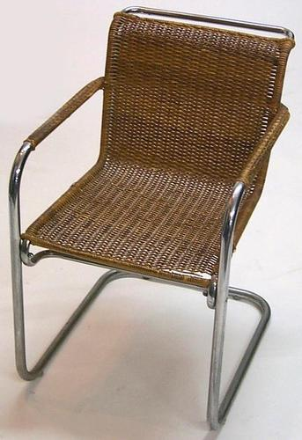
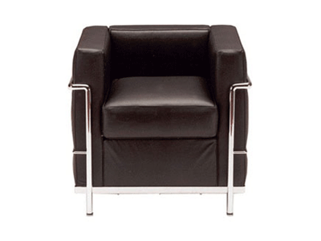
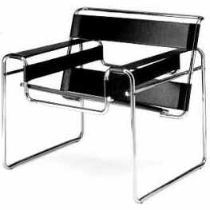
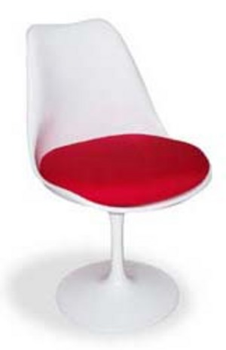
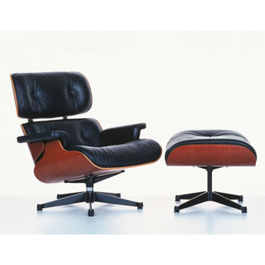
International Chairs
Egg Chair
Cesca
Le Petit Comfort
Wassily Chair
Tulip
Eames Lounge Chair

Slide 3

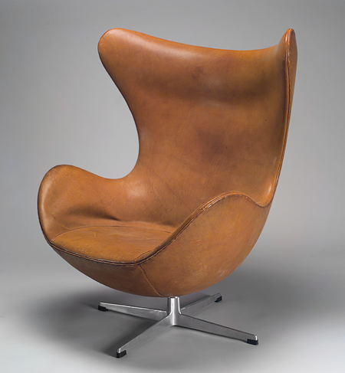

Slide 4
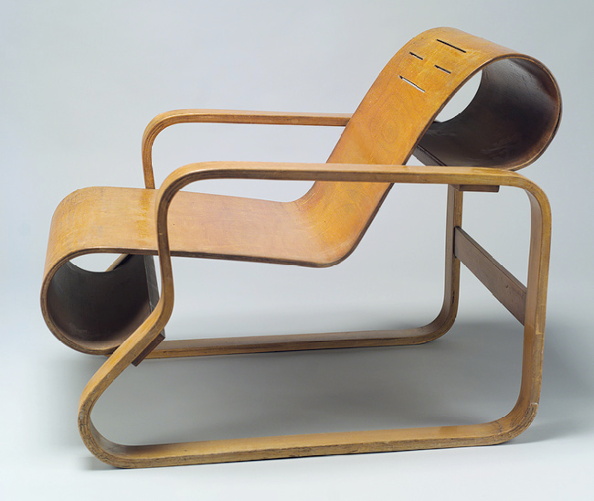
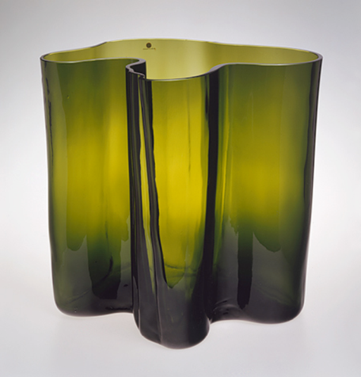
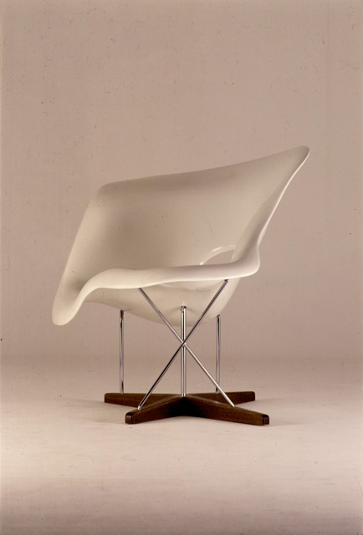
Organic Design

Slide 5
Scandinavian Design

Slide 6
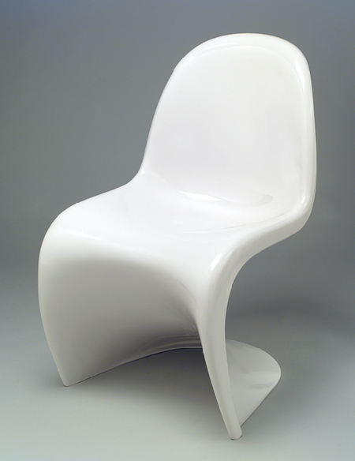
Alvar Aalto,
Model No. 41 lounge chair,
1931–32
Laminated birch, 36 x 24 in.
Verner Panton
Stacking chair, designed 1960
Luran-S plastic (acrylate-styrene-acrylonitrile)

Slide 7
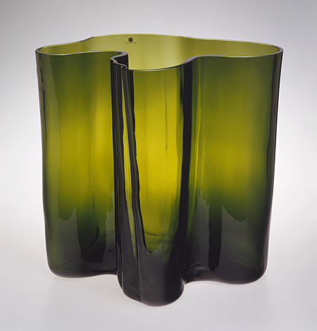
Alvar Aalto
(Finnish, 1898–1976),
Glass,
11 3/8 x 12 x 11 in.

Slide 8
Poul Henningsen, Artichoke hanging lamp, copper, approx. 27 in high, 1958

Slide 9
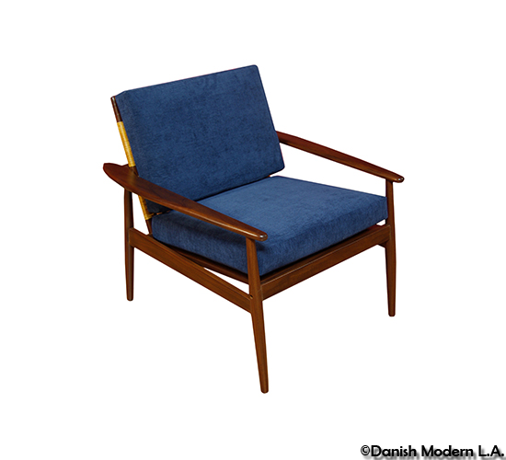
Danish Modern

Slide 10
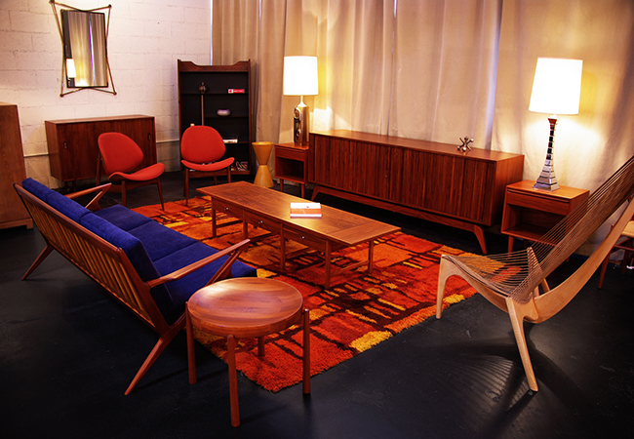

Slide 11
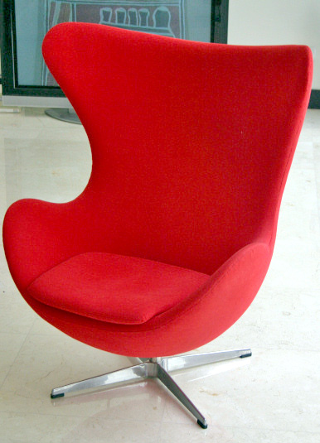
Arne Jacobsen (Danish, 1902–1971)
"Egg" armchair, 1957
Ox hide, plastic, aluminum

Slide 12
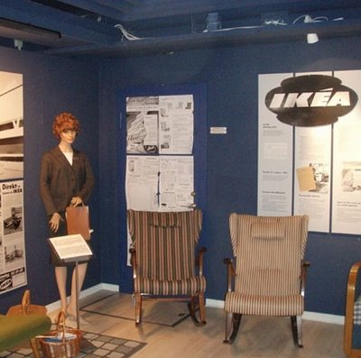
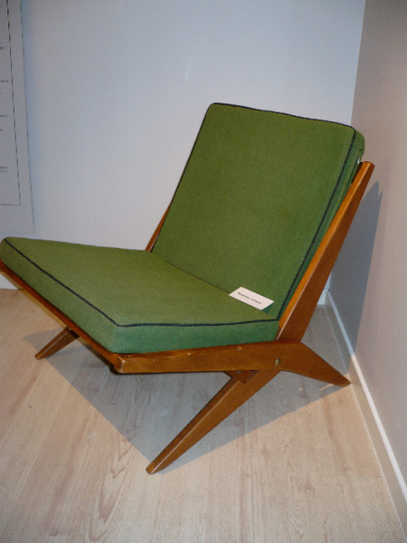
Swedish Design

Slide 13
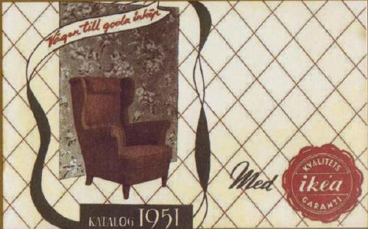
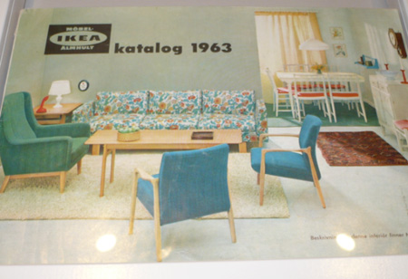

Slide 14
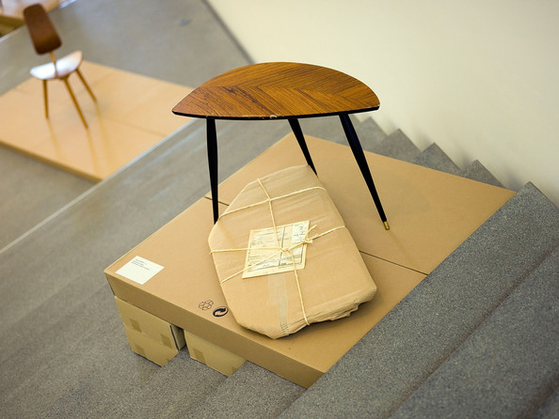

Slide 15
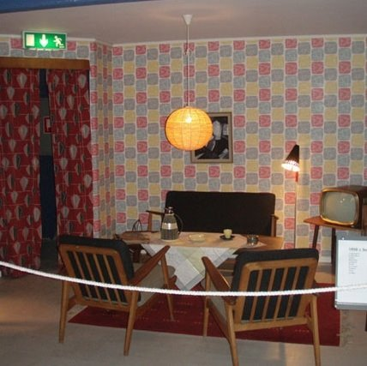
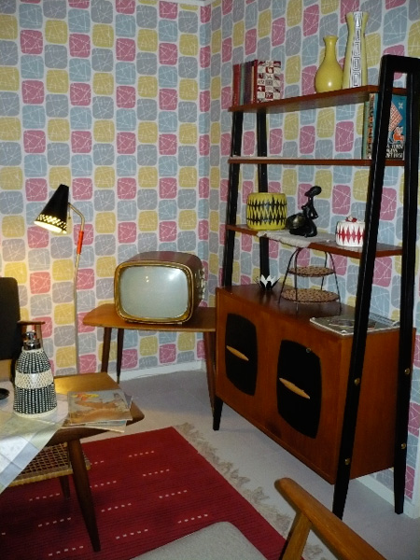

Slide 16
To re-cap:
Scandinavian Design
ORGANIC MODERNISM
emphasis on nature
wood and stone
wood is light in color
support structure is often exposed
pared down forms
tapering legs
finished edges
curved corners
an overall smoothness
warm colors
complementary contrasts (blue/orange)

Slide 17
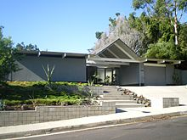
Mid-Century Modern
(American Modernist Design)
Eichler Home Granada Hills, CA
Evolved from the International and Bauhaus movement & designs
Scandinavian/Danish Modern influence of clean simplicity
Outgrowth of Frank Lloyd Wright’s organic design
More organic in form and less formal than International Style
Function as important as Form

Slide 18
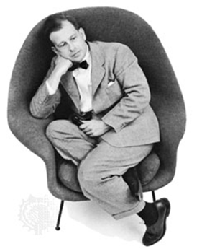
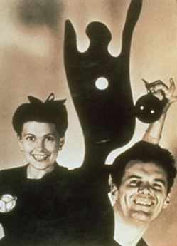
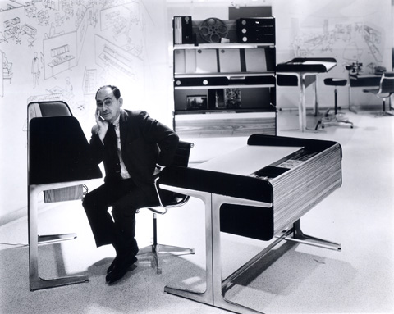
WHO IS THE GREATEST AMERICAN
MID-CENTURY MODERN DESIGNER?
Eero Saarinen Ray and Charles Eames
George Nelson

Slide 19
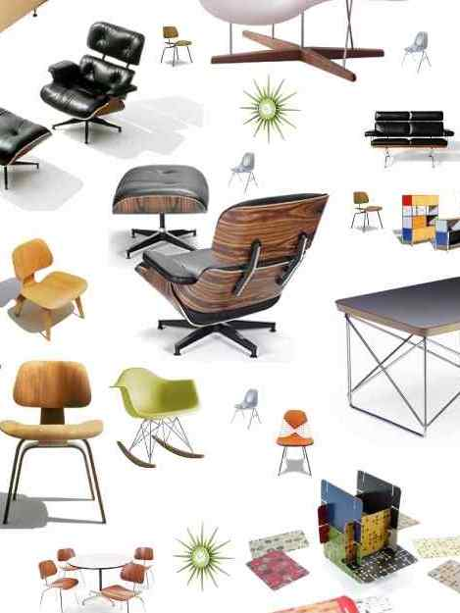
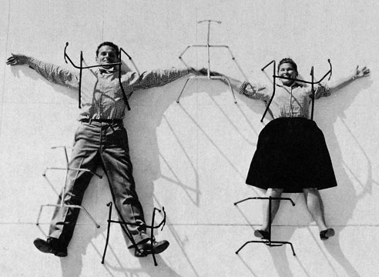
Charles and Ray Eames

Slide 20
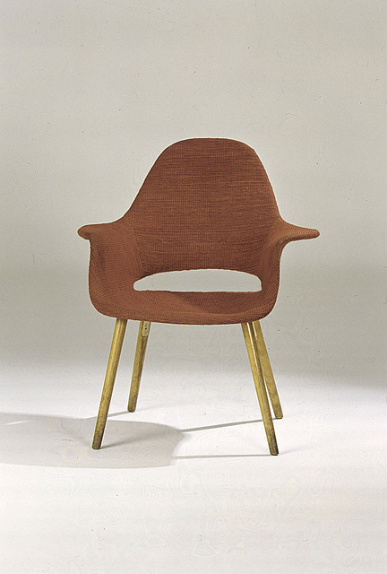
Chair Designed by
Charles Eames and Eero Saarinen for the "Organic Design in Home Furnishings" Competition, designed 1940, molded plywood, wood, foam rubber, and fabric
(“NON-ESSENTIAL MATERIALS”)

Slide 21
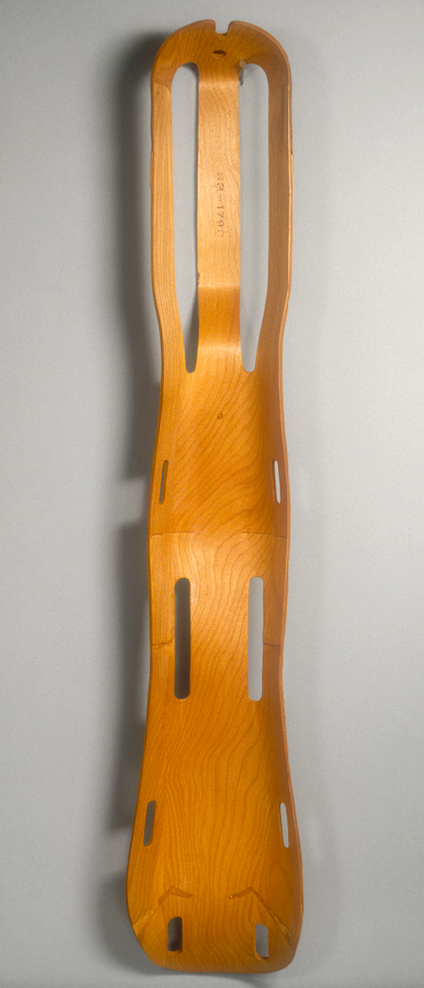
Charles Eames,
Ray Eames
Leg splint, 1942
Molded plywood

Slide 22
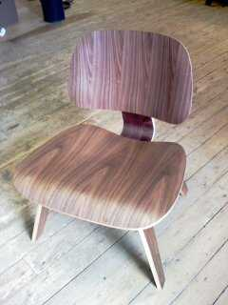
ECW

Slide 23
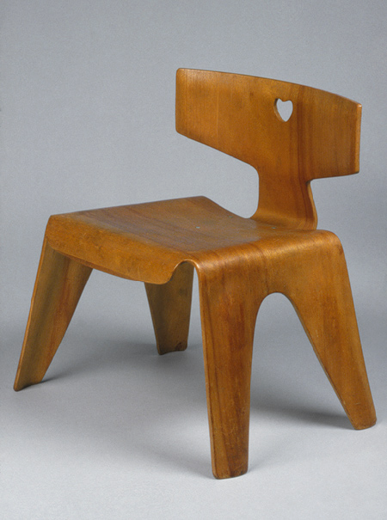
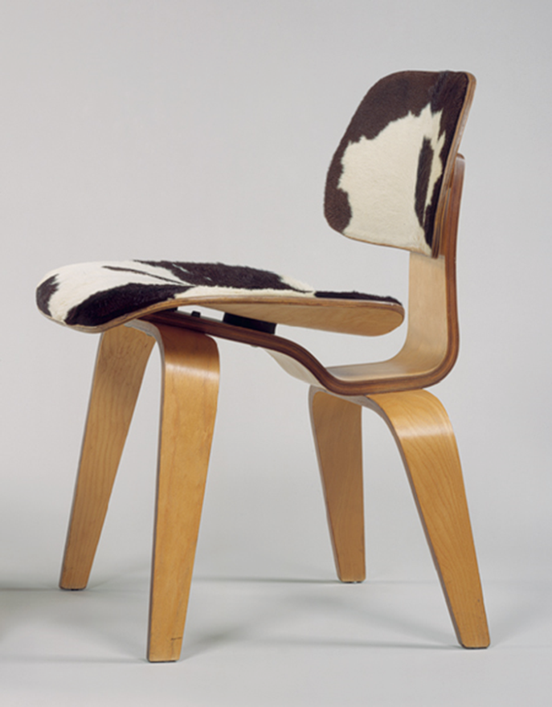

Slide 24
La Chaise, designed 1948, contemporary production, fiberglass-reinforced plastic, metal, and wood.

Slide 25
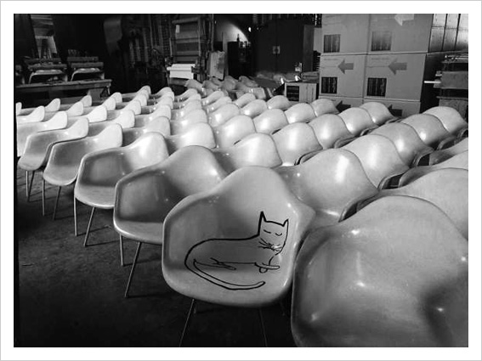

Slide 26
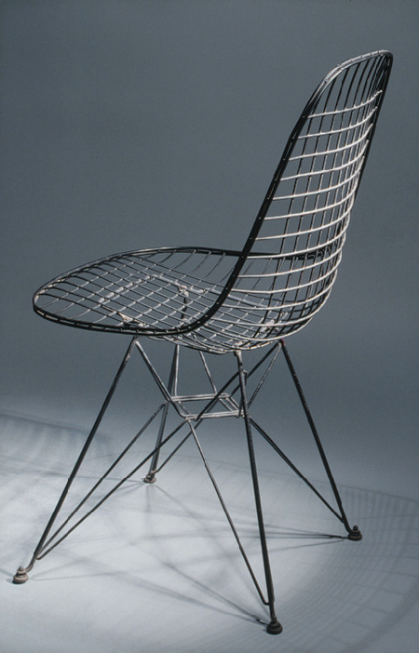
Charles and Ray Eames,
Wire side chair, 1951, Metal wire, painted black,
H. 33 in., W. 18 in. , D. 19 in.

Slide 27
Eames Storage Unit (ESU), manufactured by Herman Miller, 1950

Slide 28
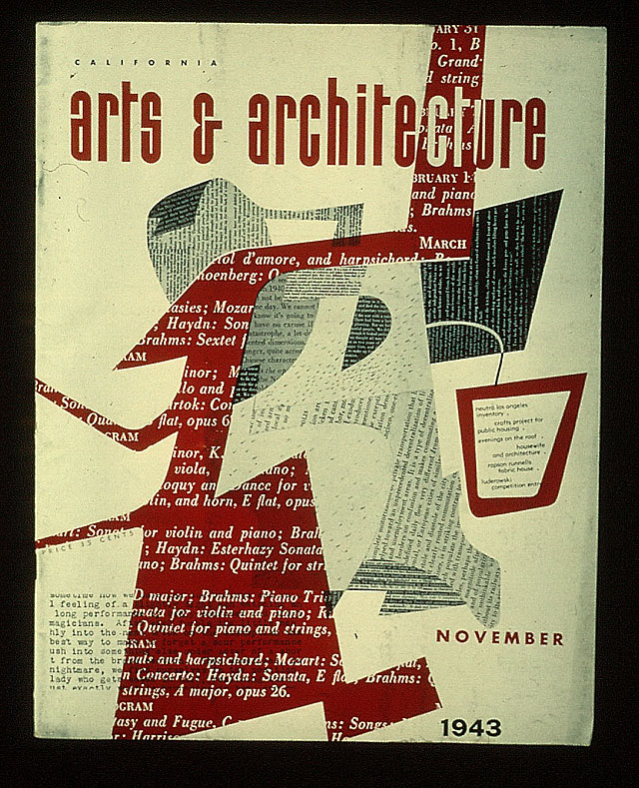
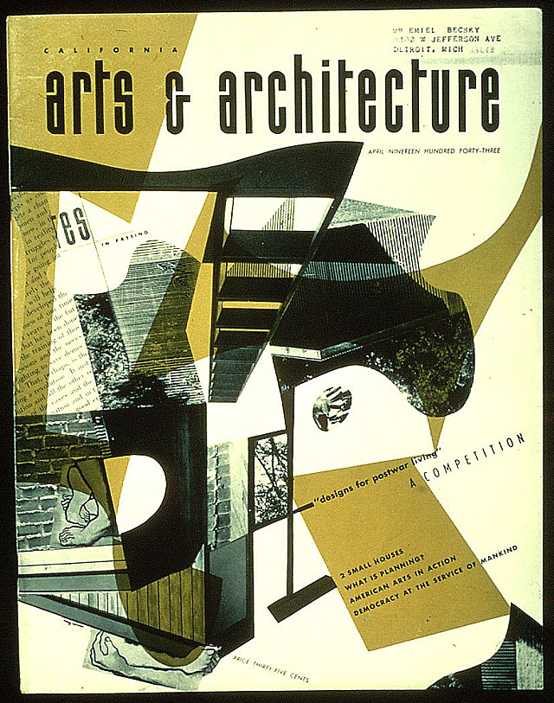
Ray Eames, covers of Arts & Architecture magazine, 1942-44

Slide 29
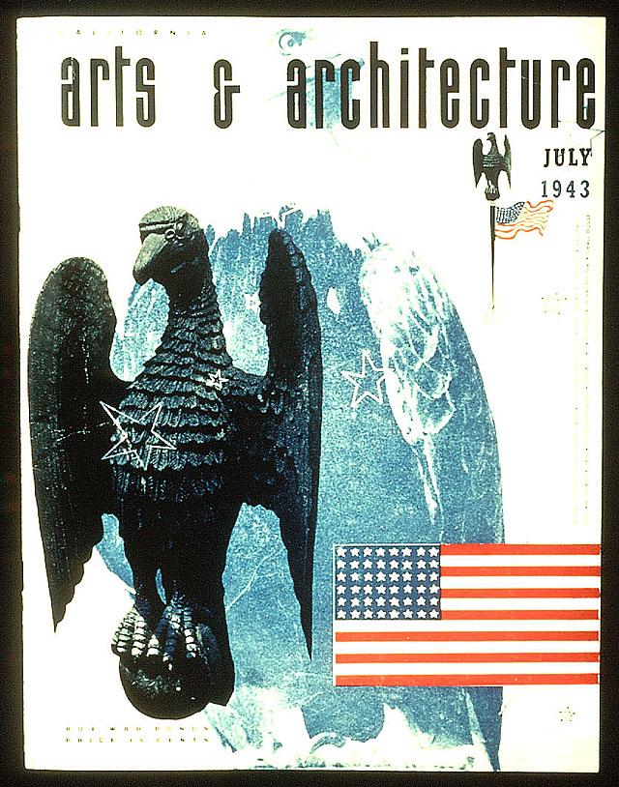
Influence of New Typography

Slide 30
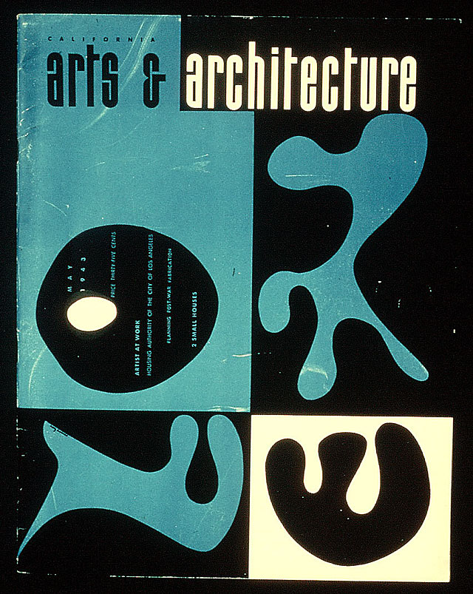
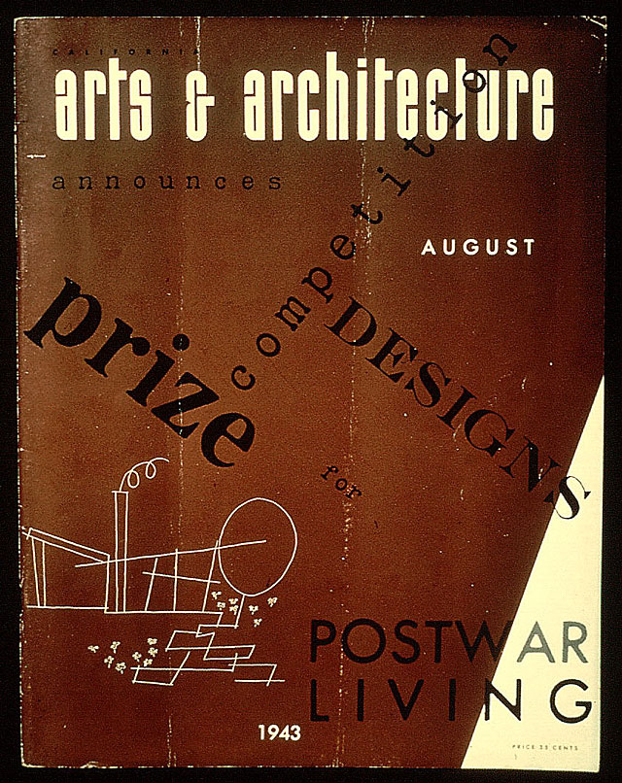

Slide 31
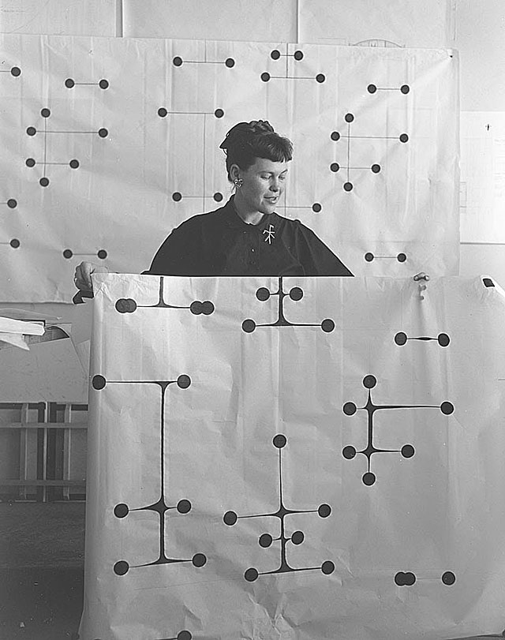
Ray Eames, textile design

Slide 32
WHO IS THE GREATEST AMERICAN
MID-CENTURY MODERN DESIGNER?
Eero Saarinen Ray and Charles Eames
George Nelson

Slide 33

Eero Saarinen

Slide 34
Chair Designed by
Charles Eames and Eero Saarinen for the "Organic Design in Home Furnishings" Competition, designed 1940, molded plywood, wood, foam rubber, and fabric
(“NON-ESSENTIAL MATERIALS”)

Slide 35
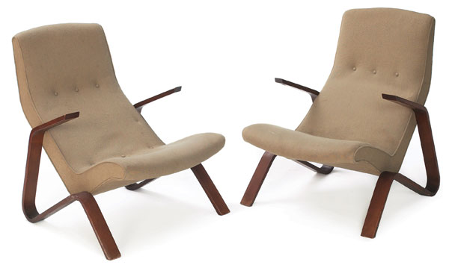
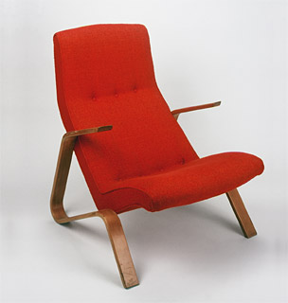
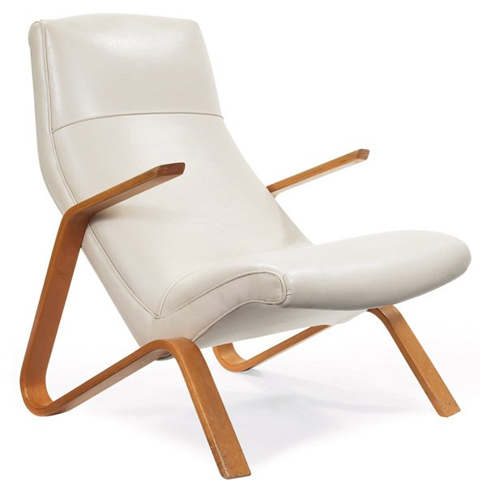
Grasshopper chair, designed 1946/47, laminated, birch bentwood frame
1950s version with
white vinyl upholstery

Slide 36
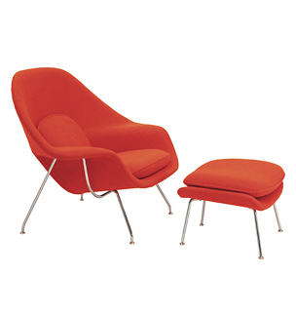
Womb chair, designed 1946. In production 1948-today

Slide 37
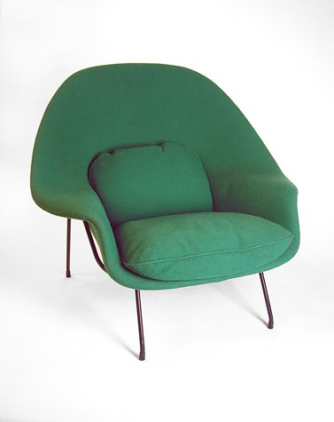
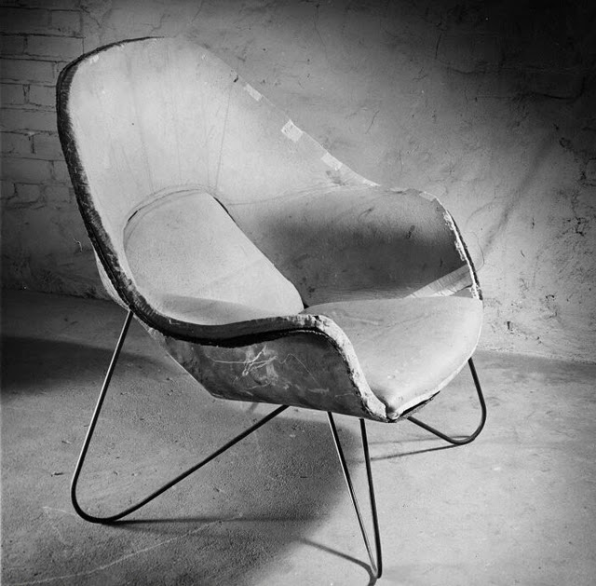

Slide 38
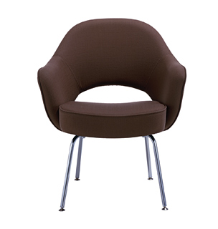
molded reinforced polyurethane shell with a contoured plywood seat. Legs of seamless tubular steel

Slide 39
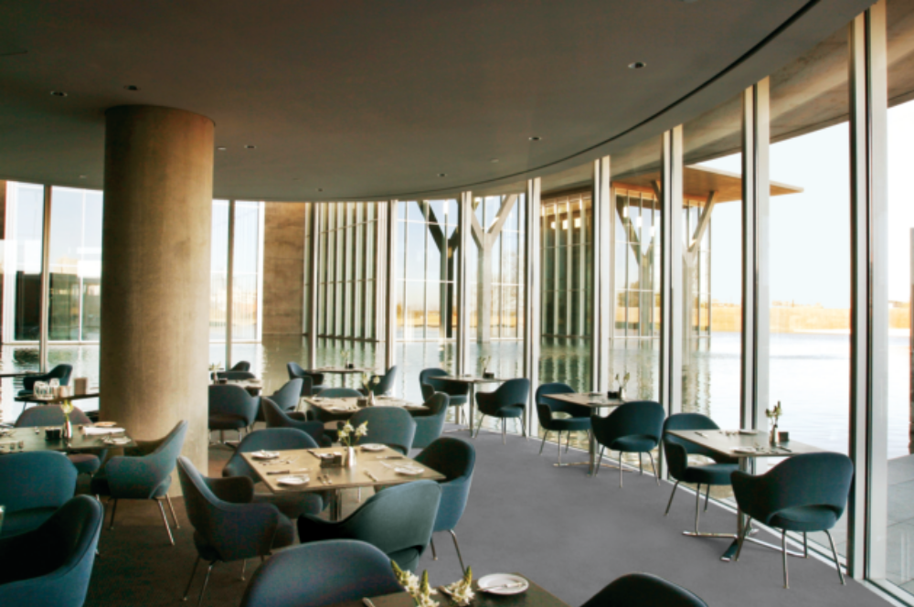

Slide 40
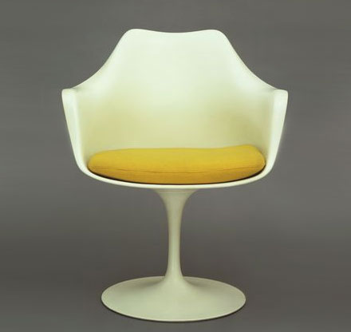
Eero Saarinen,
Tulip Armchair , Knoll, 1957

Slide 41


Tulip Table, 1960-70

Slide 42

white marble top,
chairs, light gray finish

Slide 43

Eero Saarinen,
Trans World Airlines Terminal, John F. Kennedy Airport,
1956-63

Slide 44


Slide 45


Slide 46


Slide 47
Charles Nelson

Slide 48


Slide 49


Slide 50

Two staff members in Nelson's office with a model for the American National Exhibition "jungle gym", Moscow, 1959.

Slide 51


Slide 52

Action Office 1, 1964

Slide 53

L-Shaped desk

Slide 54


Marshmallow Sofa

Slide 55


Slide 56



Coconut chair

Slide 57
George Nelson Associates, Bubble hanging lamps, 1952, steel wire and sprayed plastic shell, largest lamp 33 in.

Slide 58

Nelson clocks

Slide 59


Slide 60
End of designer smack-down

Slide 61

Lounge Chair and Ottoman , 1955

Slide 62
Mid-Century Modern
(American Modernist Design)
Eichler Home Granada Hills, CA
Evolved from the International and Bauhaus movement & designs
Scandinavian/Danish Modern influence of clean simplicity
Outgrowth of Frank Lloyd Wright’s organic design
More organic in form and less formal than International Style
Function as important as Form

Slide 63


Slide 64


Charles Eames and
Eero Saarinen,
Case Study House #9

Slide 65


Slide 66


Slide 67


Charles Eames and Eero Saarinen Case Study House #9

Slide 68

Charles and Ray Eames,
Case Study House # 8 http://www.youtube.com/watch?v=hv7ipQdUrk

Slide 69

Stahl House, designed by Pierre Koenig

Slide 70

Richard Neutra, Miller House, 1937, Palm Springs, CA

Slide 71
Feature in Life magazine, 1948

Slide 72
Feature on prefabricated homes from Better Homes and Gardens, 1954

