Slide 1
Mass Demand, Mass Production, Efficiency, Modularity

Slide 2
Feature in Life magazine, 1948

Slide 3
Feature on prefabricated homes from Better Homes and Gardens, 1954

Slide 4
Frigidaire Company ad, Good Housekeeping, 1950
Efficiency
Modularity
Mass Demand
Mass Production

Slide 5
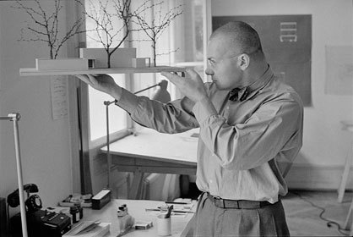
Max Bill and Gute Form

Slide 6
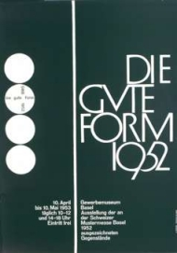
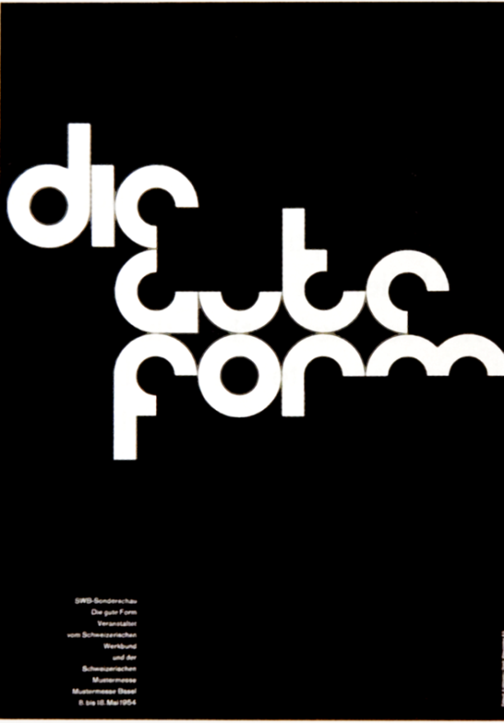
Max Bill,
exhibition poster
Armin Hofmann,
exhibition posters

Slide 7
Gute Form (Good Design)
an economical (efficient) use of resources
functionality
durability
versatility (modularity)
Fulfills consumers’ needs for new housing/homewares while contradicting the concept of disposability

Slide 8
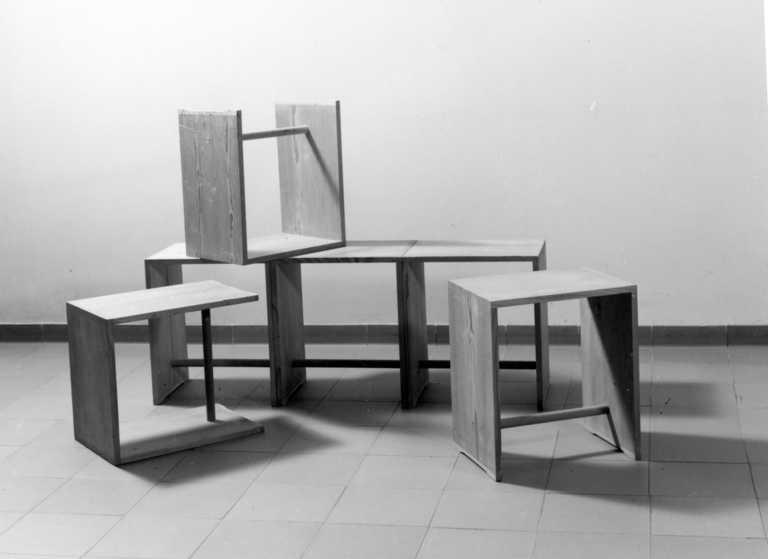
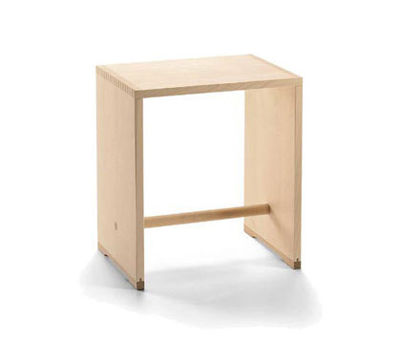
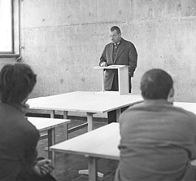
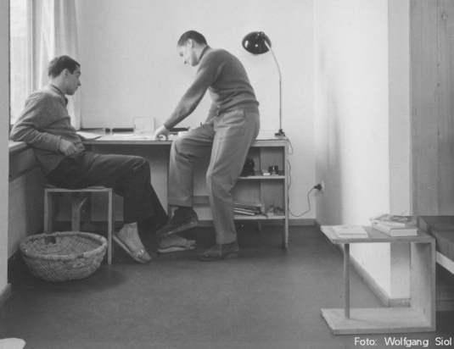

Slide 9
Max Bill (and Hans Gugelot; Paul Hildinger)
Ulmer Hocker (stool from Ulm), 1950
multi-functional furniture piece
material: spruce and beech wood
unpainted
two different heights

Slide 10
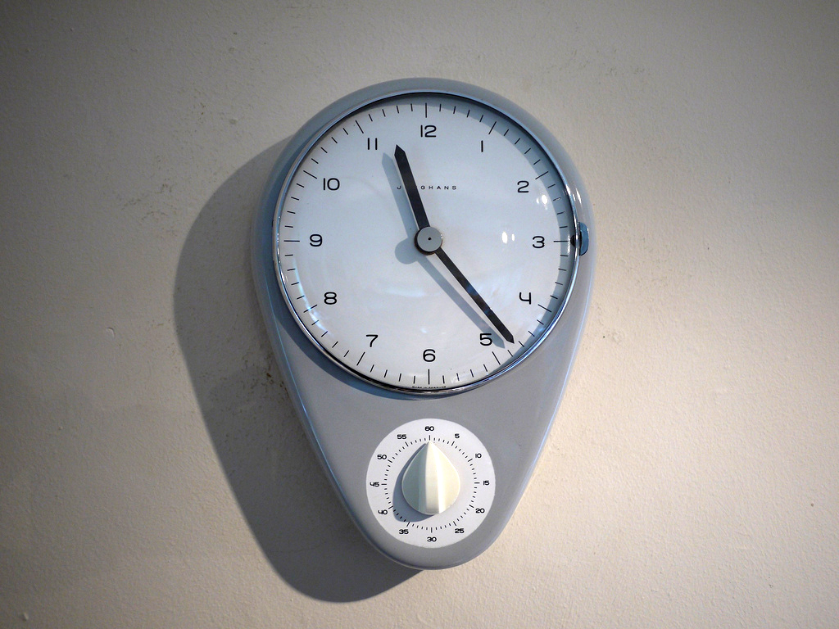
Timekeeping and efficiency
Max Bill,
Kitchen clock with timer,
1956-7

Slide 11
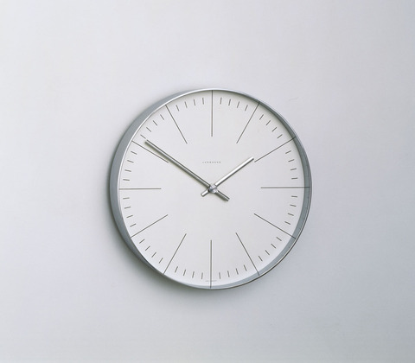
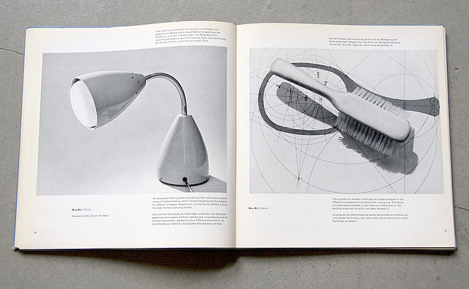
Bill,
Lamp, brush, clock

Slide 12
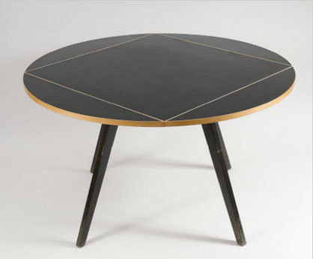
Bill,
Quadratrundtisch
(square round table),
1949

Slide 13
Terms and Concepts
• Fordism
• Model T
• standardization
• Efficiency
• Modern kitchen design
• Circular motion
• Home economics
• Ergonometrics (ergonomics, ergonometry)
• Electric appliances
• The role of women as designers for the home
• The Frankfurt Kitchen
• The role of women as consumers

Slide 14
http://www.youtube.com/watch
?v=z8MhAm-FwX4 efficiency and design
Begin 4 - 16 Henry Ford
35.57 Efficiency studies

Slide 15
International Typographic Style
The Swiss Style
Swiss Graphic
begun in the 1940s in Switzerland and Germany
Influenced by The New Typography

Slide 16
Max Bill,
exhibition poster

Slide 17
Armin Hofmann,
Exhibition poster,
1954

Slide 18
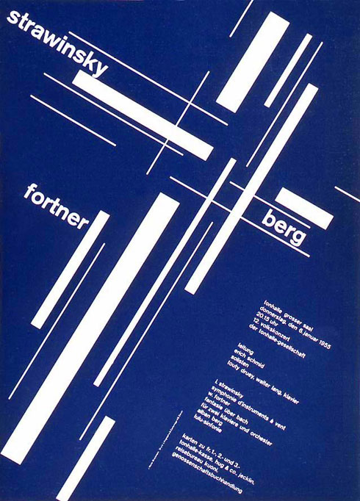
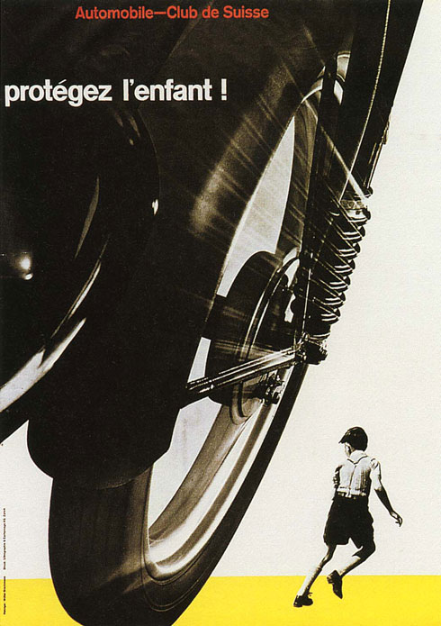
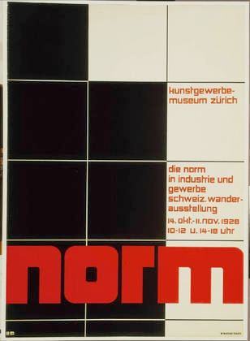

Slide 19
International typographic style
unity of design
asymmetrical organization on a mathematically constructed grid
sans serif typography expressed the spirit of a more progressive age
personal expression were rejected for a more universal and scientific approach to design problem solving
stressed clarity and order

Slide 20
Max Bill exhibition poster, 1945
“It is possible to develop art largely on the basis of mathematical thinking.”

Slide 21
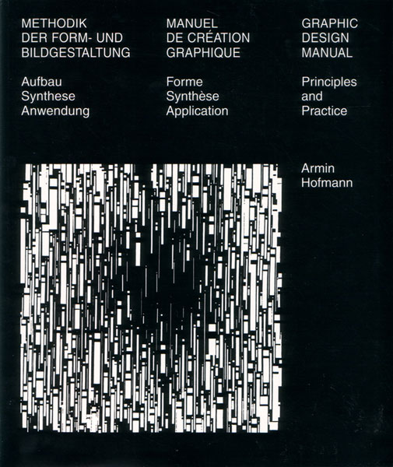

Slide 22
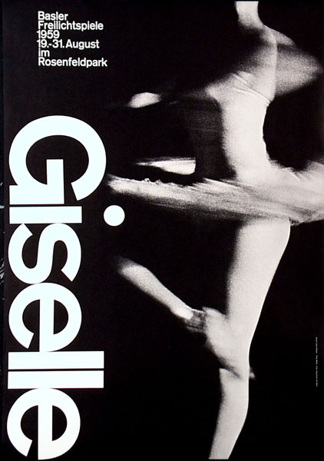
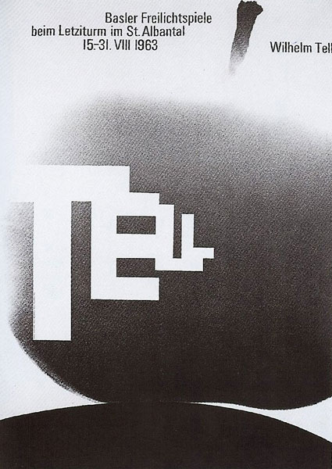
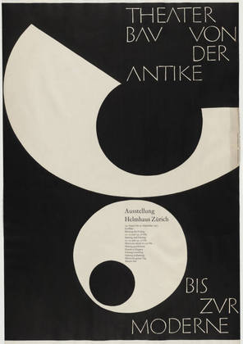
The International Typographic Style and cultural organizations
Armin Hofmann designs

Slide 23
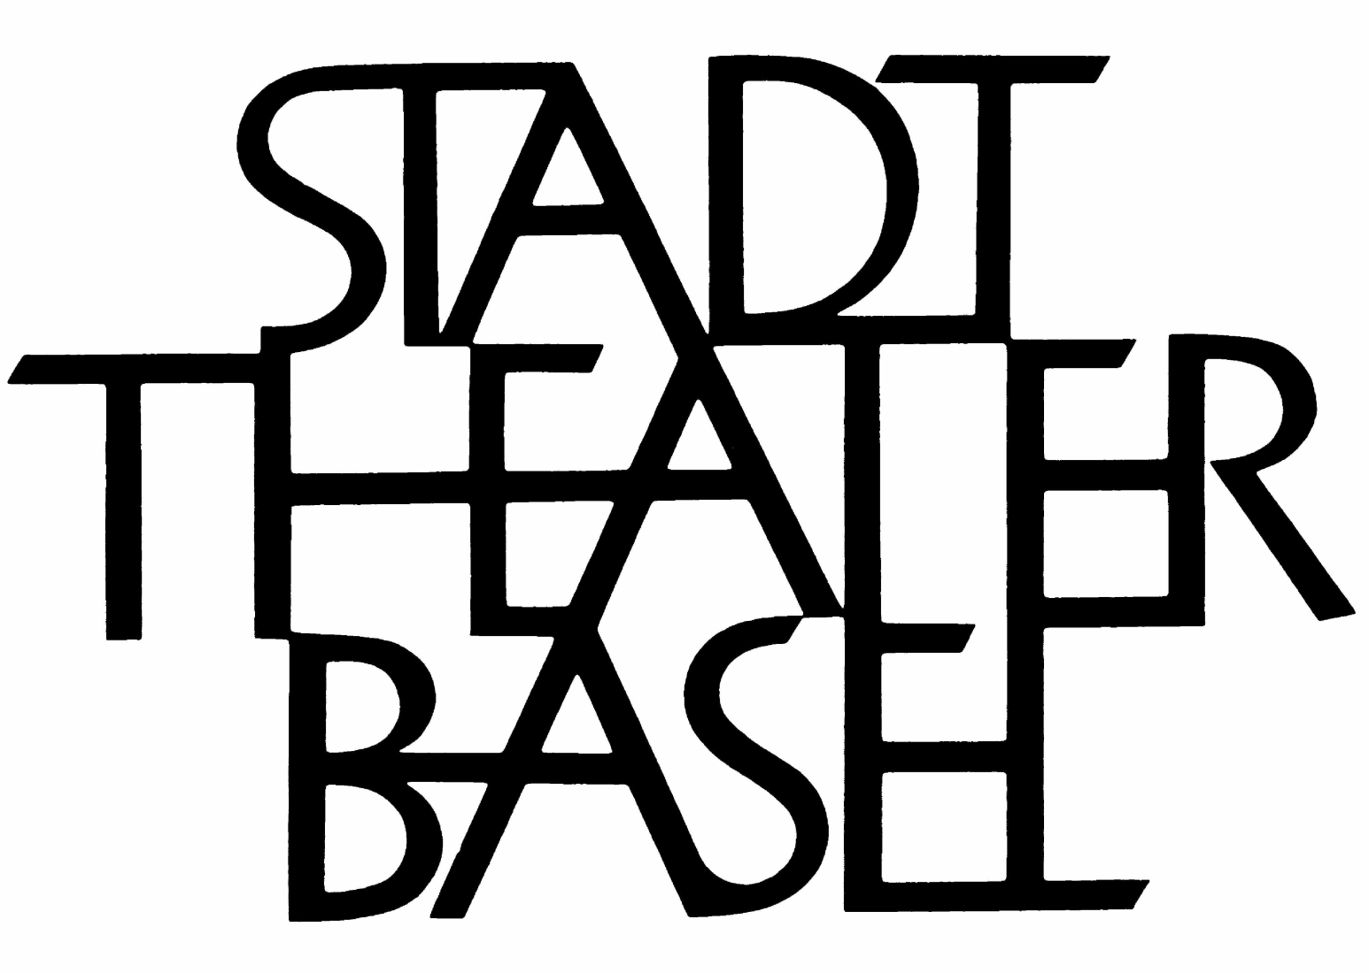
Armin Hofmann design

Slide 24
Armin Hofmann,
Exhibition poster,
1954

Slide 25
The International Typographic Style and an informed public

Slide 26
Anton Stankowski
• German designer
• use of visual forms to communicate invisible processes and physical forces

Slide 27
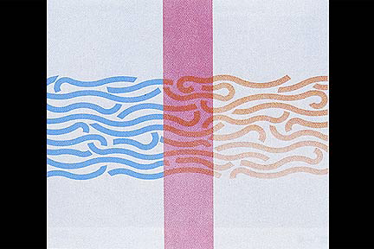
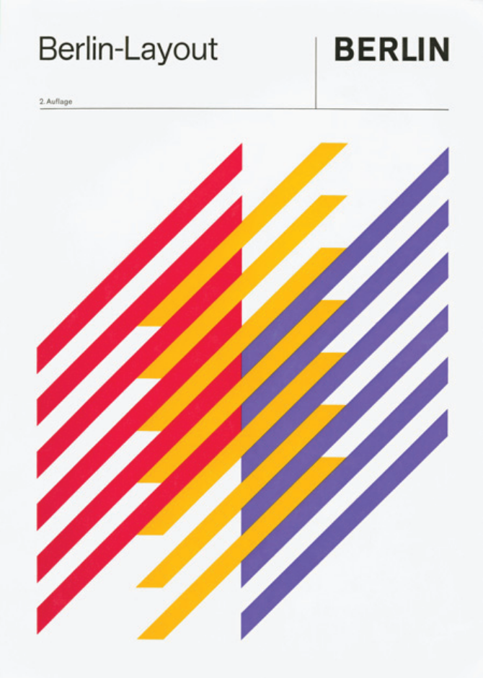
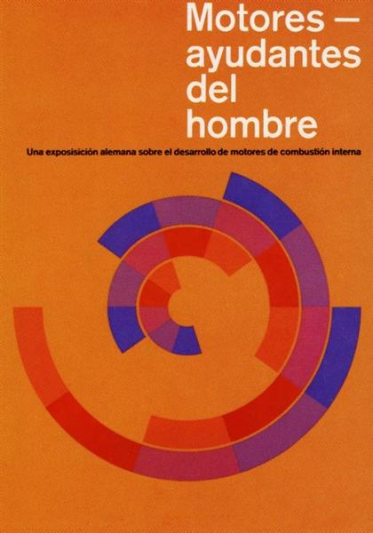
Anton Stankowski
designs

Slide 29


Slide 30
Adrian Frutiger, Univers typeface

Slide 31
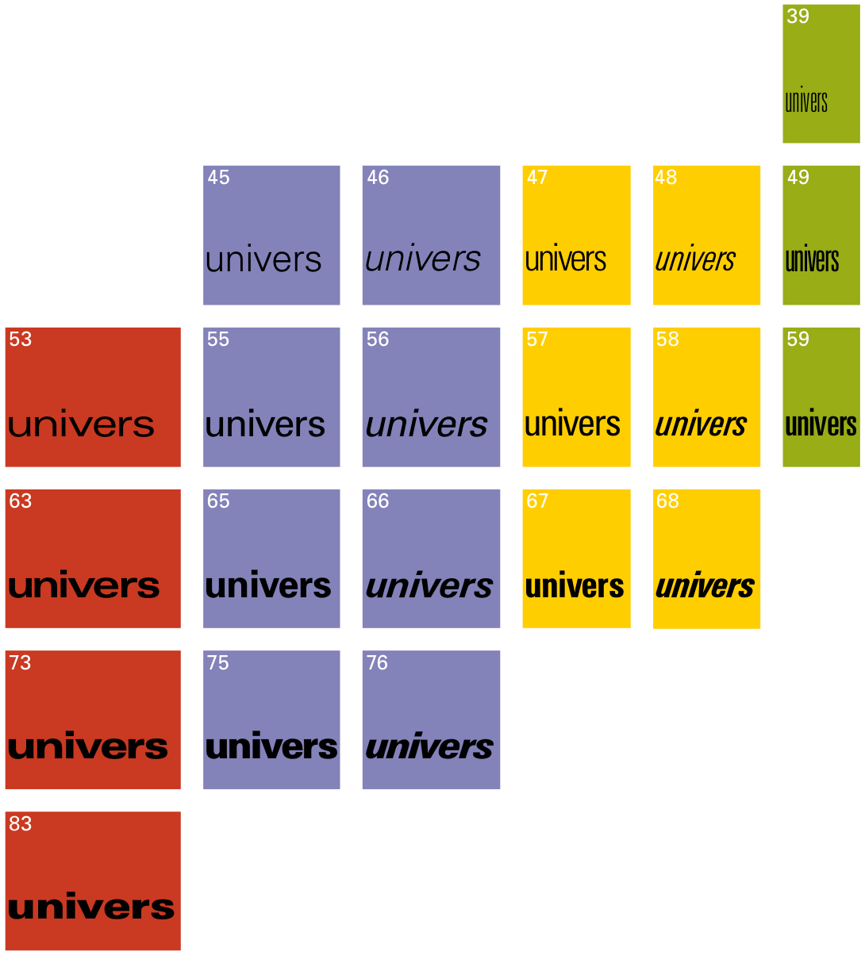

Slide 32
Adrian Frutiger
Univers, a 21 font family of sans serif typography
all have the same x-height
(the height of the body of lower case letters)
all have identical ascenders and descenders

Slide 33
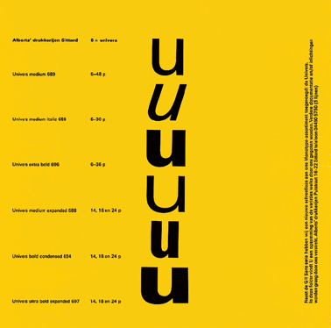
Frutiger designed five weights and five widths
Whereas some type families grow over time, Univers was conceived as a total system from its inception.

Slide 34
Paul Renner,
Futura
typeface,
1927
univers,
1957

Slide 35



Slide 36
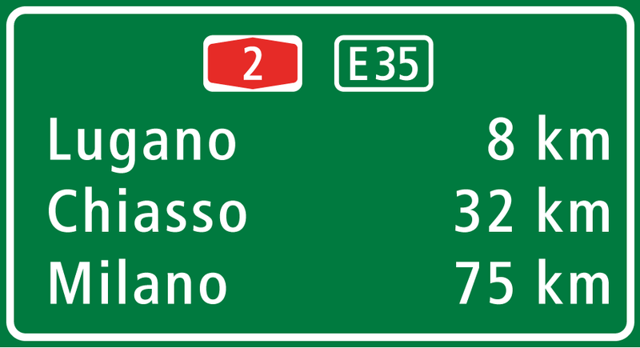
road sign Near Lugano (Switzerland) using Astra Frutiger

Slide 37
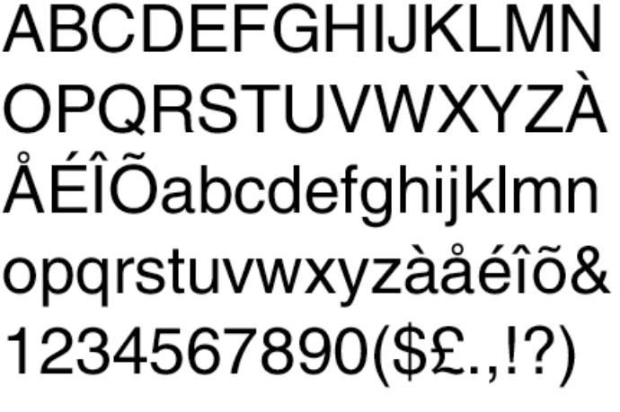
Edouard Hoffman and
Max Miedinger
HELVETICA!
• renamed Helvetica,
the latin name for
Swiss.

Slide 38
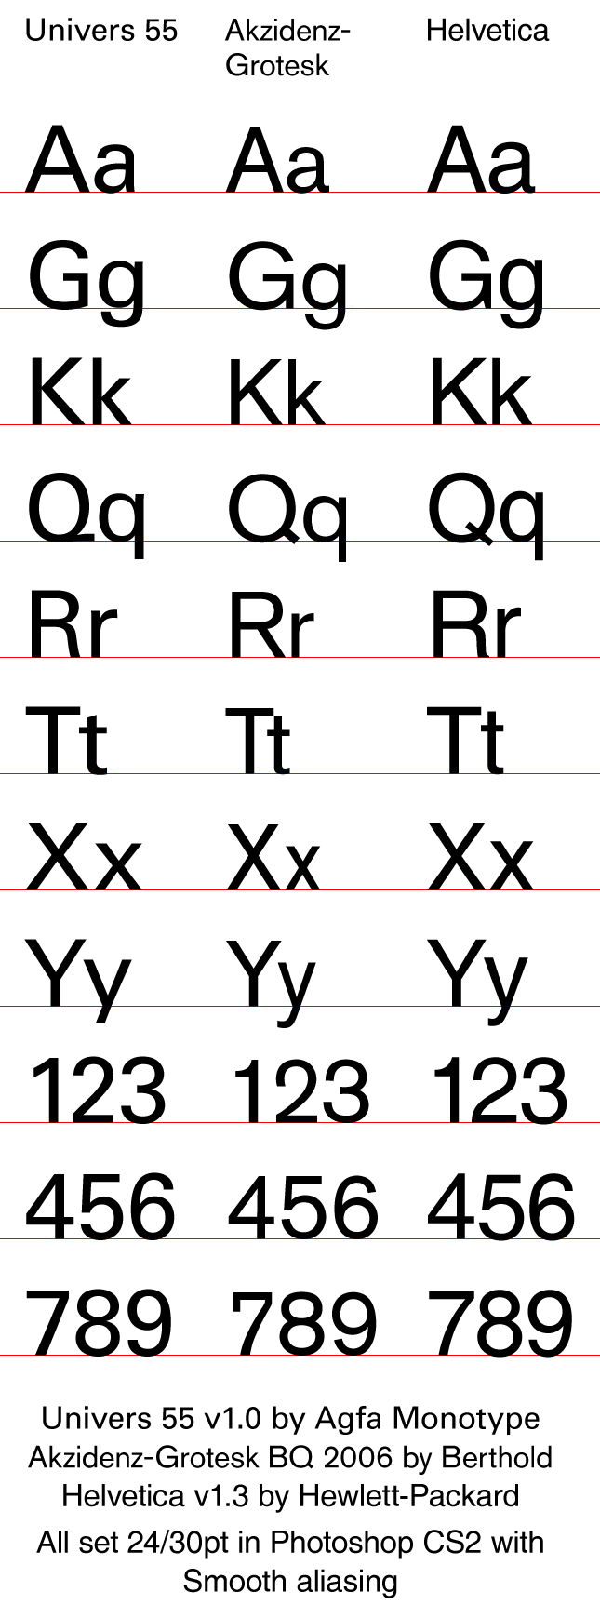

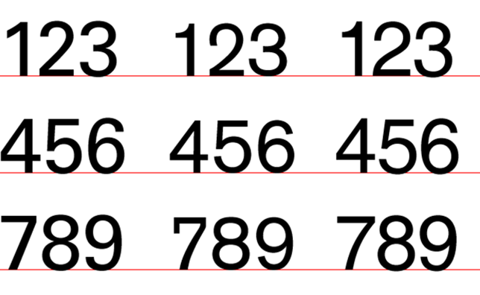

Slide 39
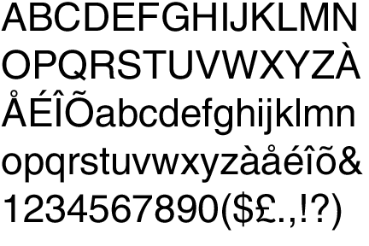
Edouard Hoffman and
Max Miedinger
HELVETICA!
• larger x-height
even positive
and negative shapes

Slide 40
http://www.youtube.com/watch?v=yhKKIXDypxk
Helvetica – The Everyday Font

