Slide 1
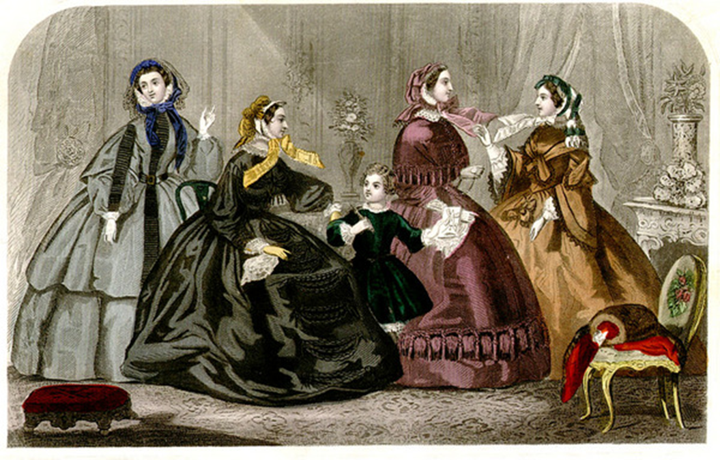

Instructor: Gayle Clemans
History of Design
1850s-1960s

Slide 2
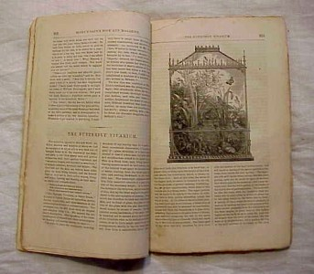


Godey's Lady's Book,
October 1859
Screenshot,
September 6, 2012

Slide 3
A Culture of Industry and Progress…and Taste!
Godey's Lady's Book,
October 1859

Slide 4
Relationship between design and new technology/new materials
Expansion of production
Growing demand for goods and furnishings
Expanded and elevated role of The Designer

Slide 5
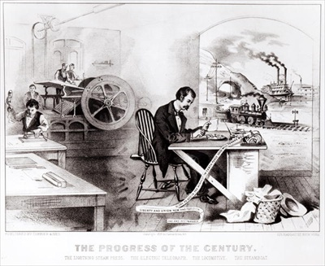
lithograph by Currier & Ives

Slide 6
lithograph by Currier & Ives
The Industrial Revolution generated a totally new social structure in America and Europe.
The forces of industrialization and urbanization dictated a new way of life for the population as a whole.

Slide 8
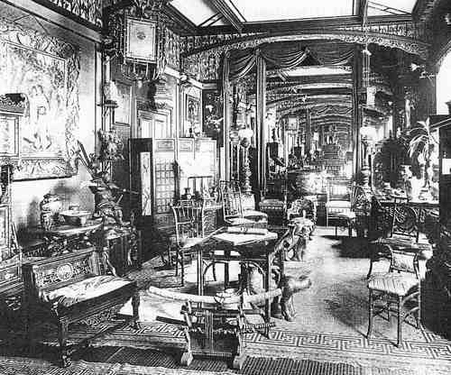
By the mid-nineteenth century, Britain led the world in terms of trade and enjoyed great prosperity.
America and many European nations also experienced increased industrialism and capitalism.
The foundation of a capitalist economy spawned a thriving middle class anxious to express its new found prosperity in terms of visual culture.

Slide 9


Slide 10

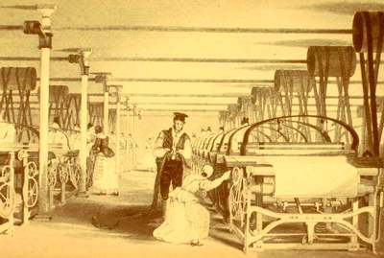
1793, invention of cotton gin by Eli Whitney early 1800s, introduction of steam power to spinning

Slide 11
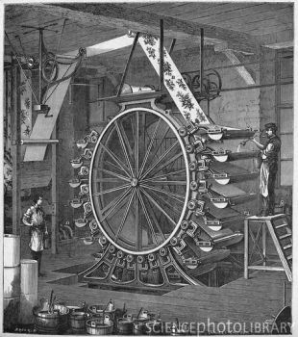
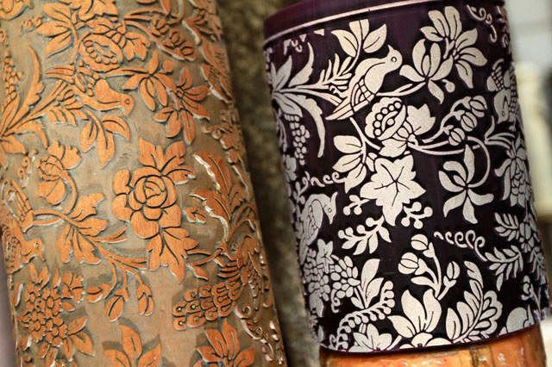
Steam-powered cylinder presses were used both in paper printing and in fabric printing

Slide 12
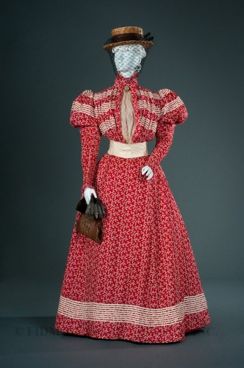
Printed cottons were at the center of the Industrial Revolution in fabrics.
Many more printed patterns and colors became available.
Improved transportation and communications combined with lower costs to allow fashions to be more widely adopted by those in the middle and lower classes, and encouraged fashions to change more quickly than before.

