Slide 1
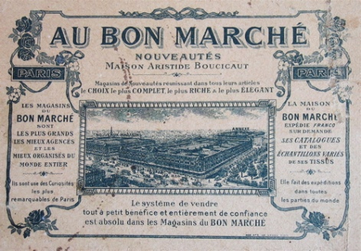
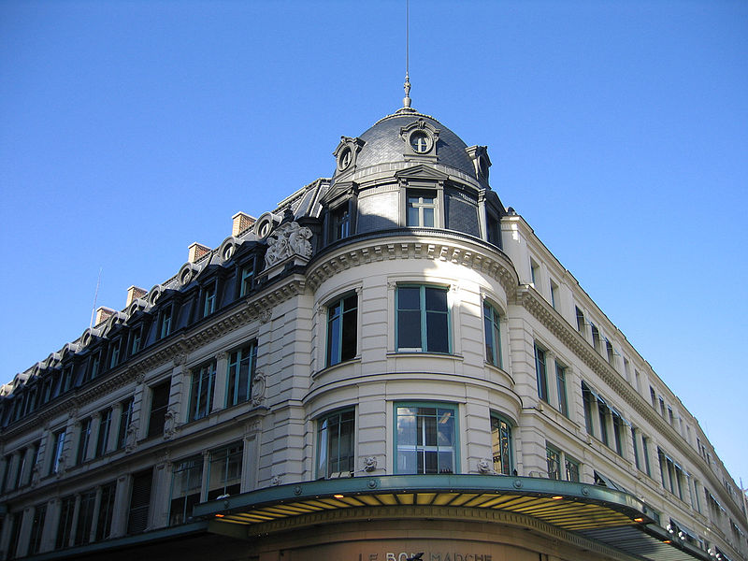
Rise of consumerism
Transition from making to buying
Transformation of retail shopping

Slide 2
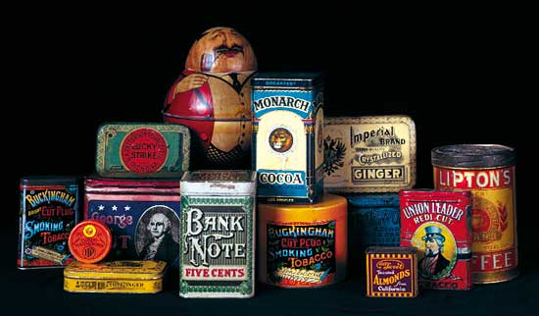
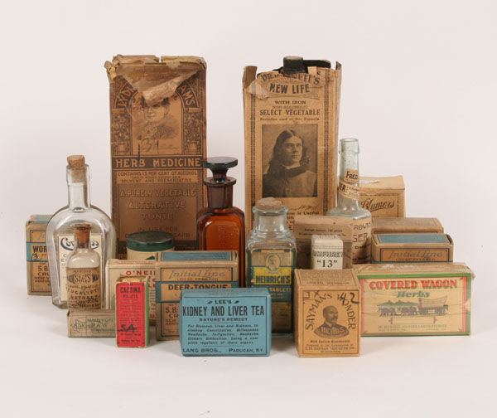
  Tin containers
  Paper labels

Slide 3
How do you encourage this new buying public to buy?

Slide 4
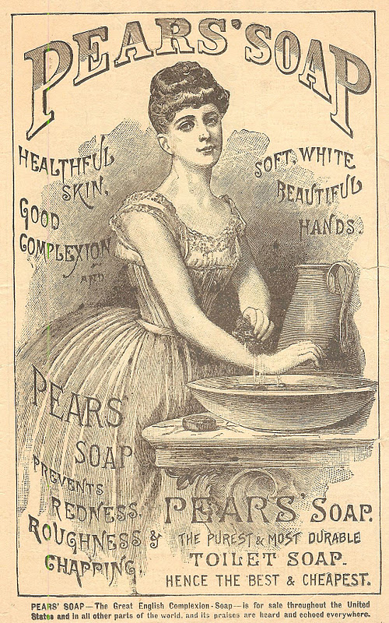
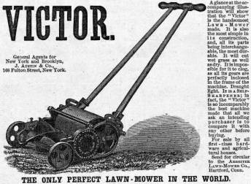
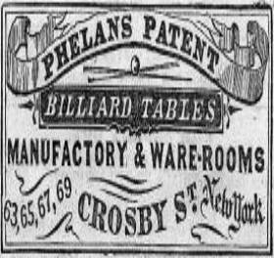


Slide 5
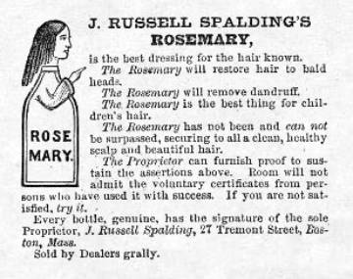
1886
Rosemary Hair Dressing
Harper's Weekly, March 26, 1859

Slide 7
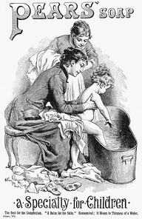
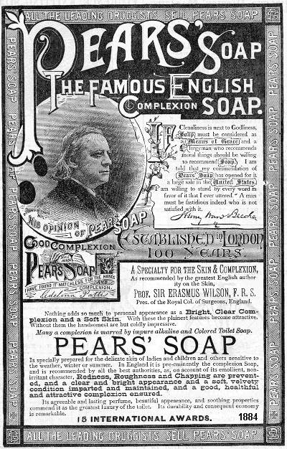

Slide 8
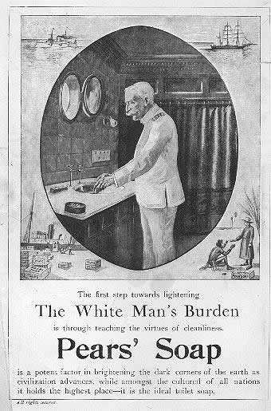
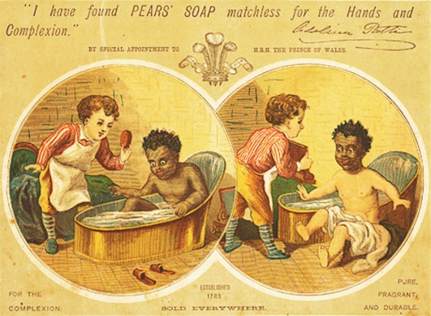

Slide 9
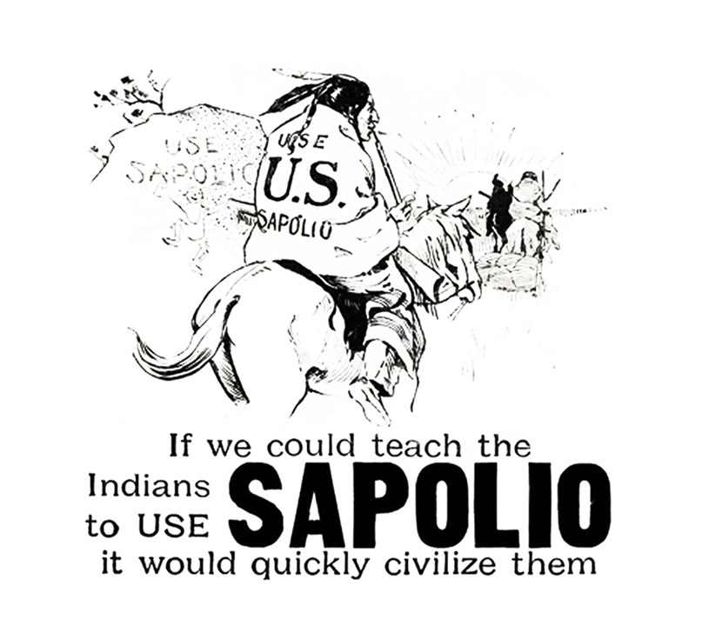

Slide 10
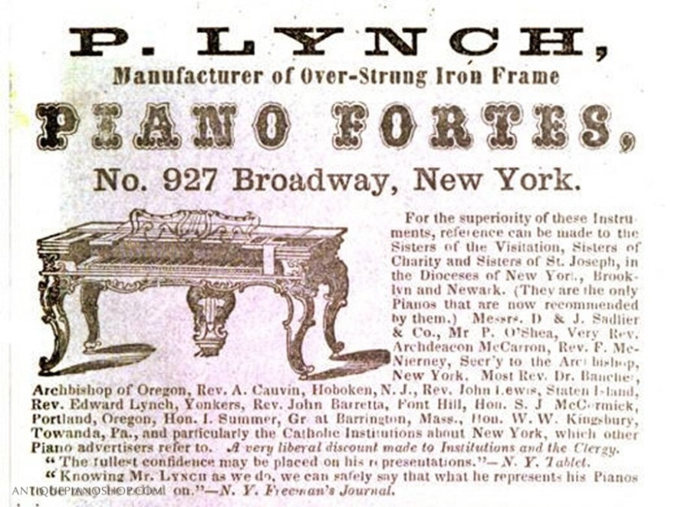
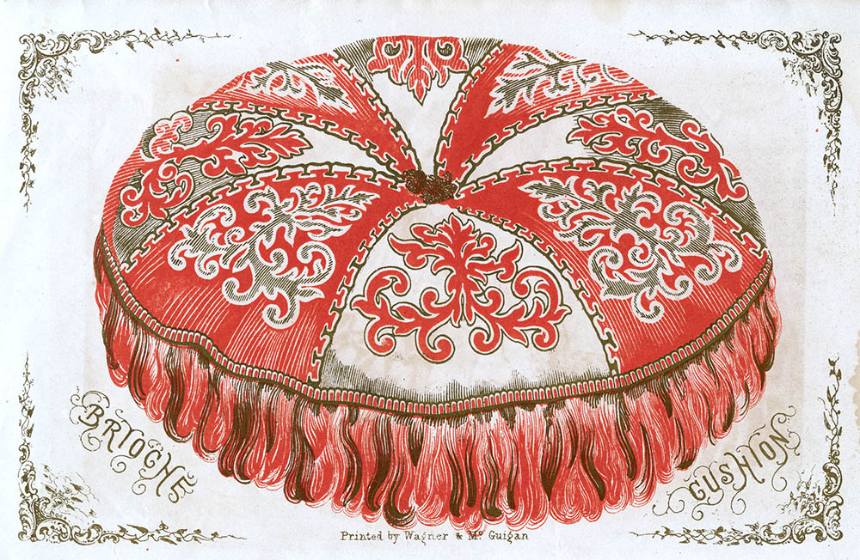
advertisement purchased by business owner for display in a periodical
“Editorial” image of cushion

Slide 11
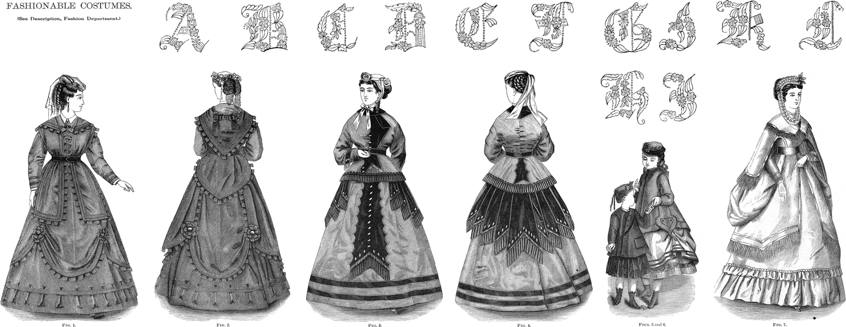
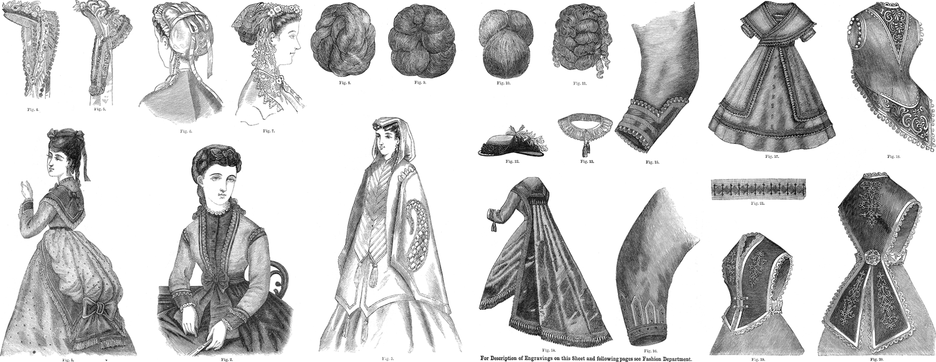

Slide 12
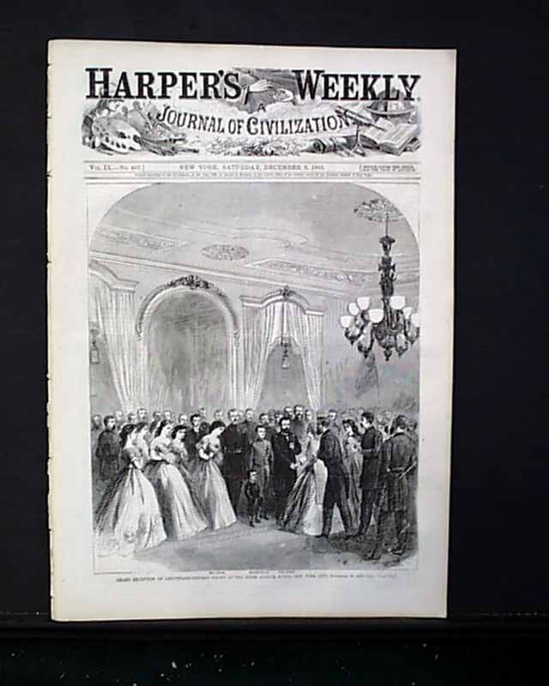
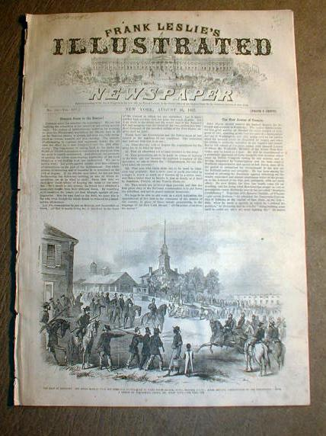
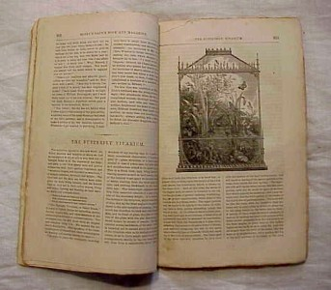

Slide 13
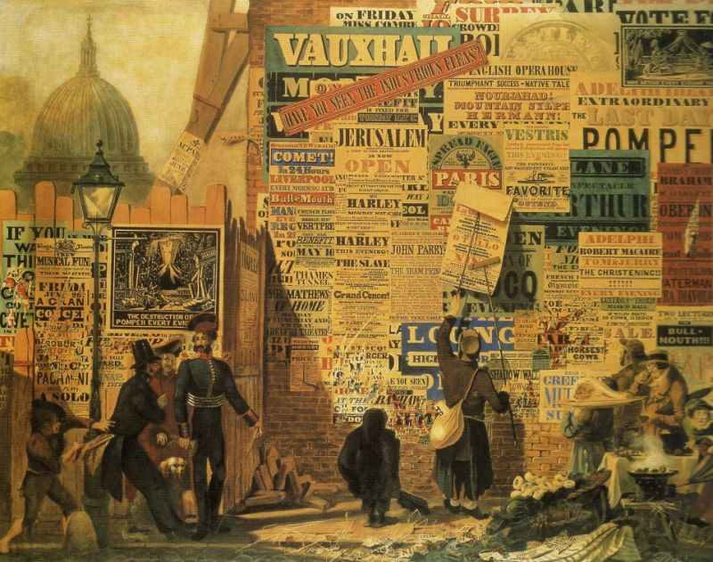
John Parry, London Street Scene, watercolor 30 x 43 in., 1835

Slide 14
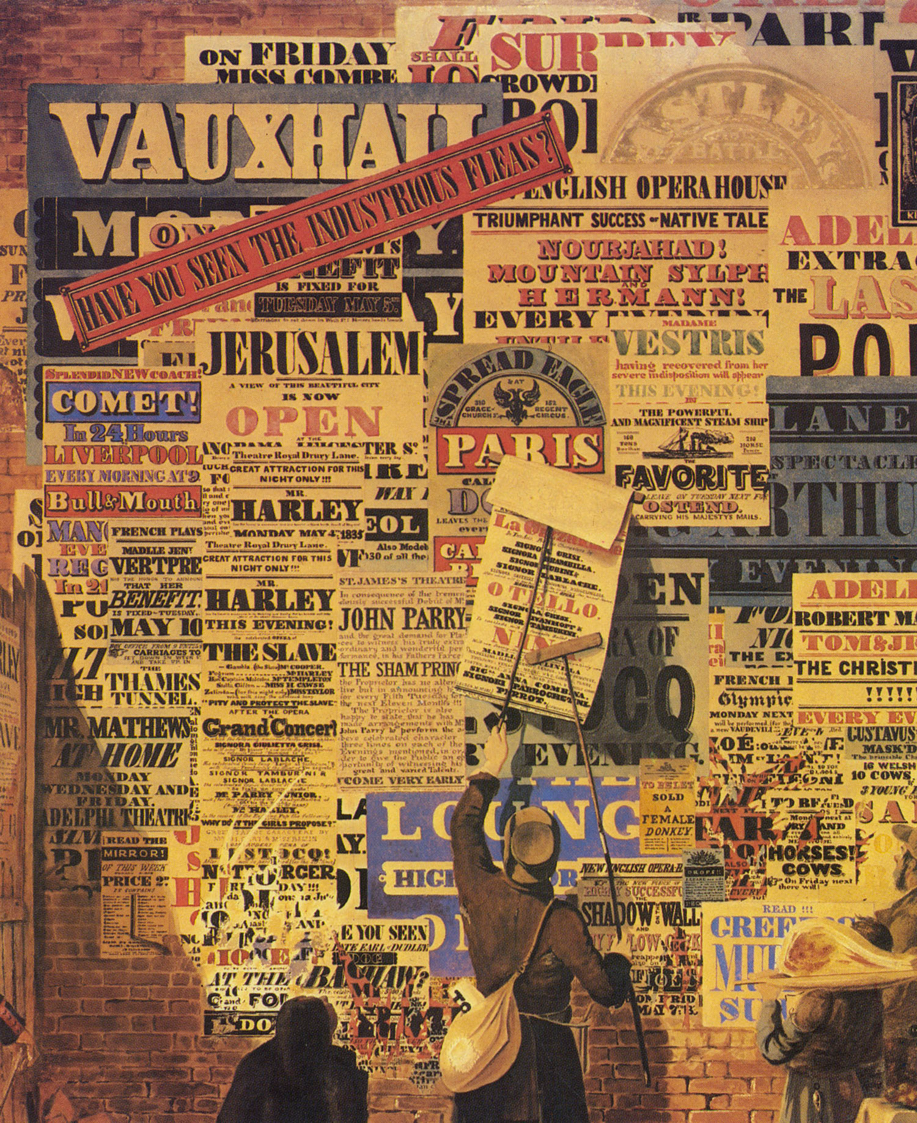

Slide 15
To look for:
Slab Serif
Fat Face
Sans Serif
Reversing
(white letters on black - or other color - background)
Shadowing
Outlining
Weighty, solid appearance
Vertical stress

Slide 16
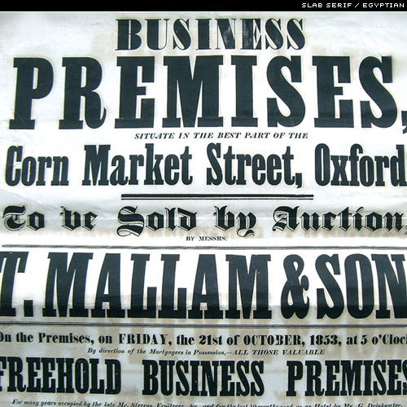
Slab Serif

Slide 17
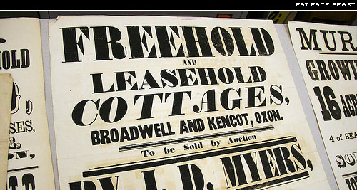
Slab Serif – Fat Face

Slide 18
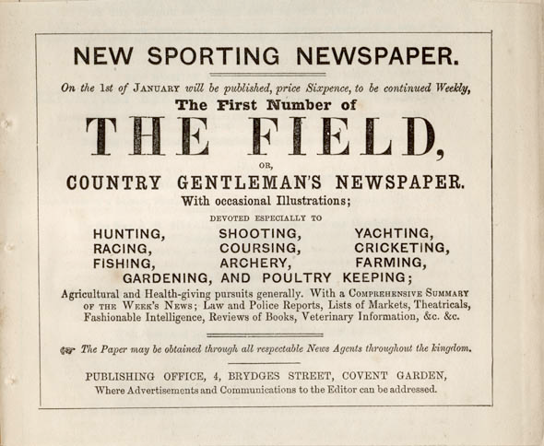
Includes Sans-serif
Can you spot it?
advertisement for a “The Field.”
Ad was published in a magazine, 1853

Slide 19
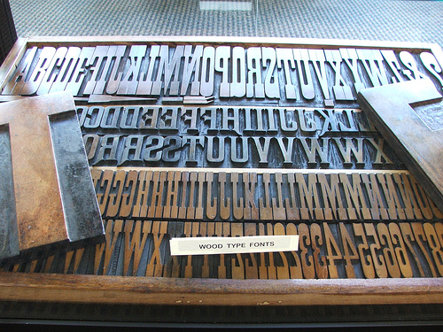

Slide 20
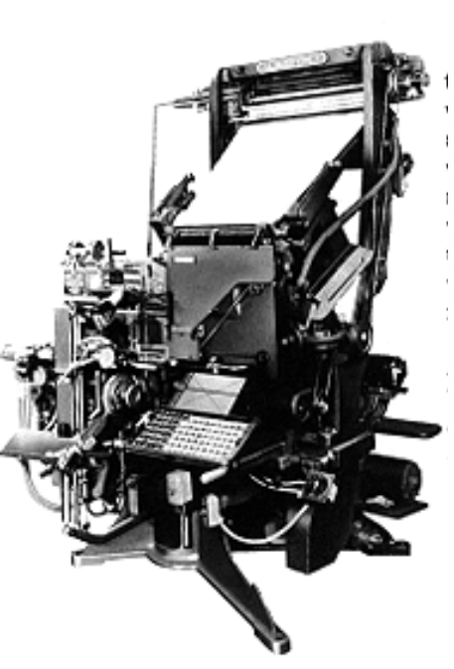
Typography and Printing
in the Industrial Age
Improvements to printing processes :
steam-power, cylinder presses, continuous –feed presses.
Paper-making machines
Mechanized typography (vs. setting type by hand)
as with the Linotype -
Typewriter like keys
  released a matrix that was put in a line
  and filled with melted lead, creating type!
  http://www.youtube.com/watch?v=G8cCS3o62iI

Slide 21
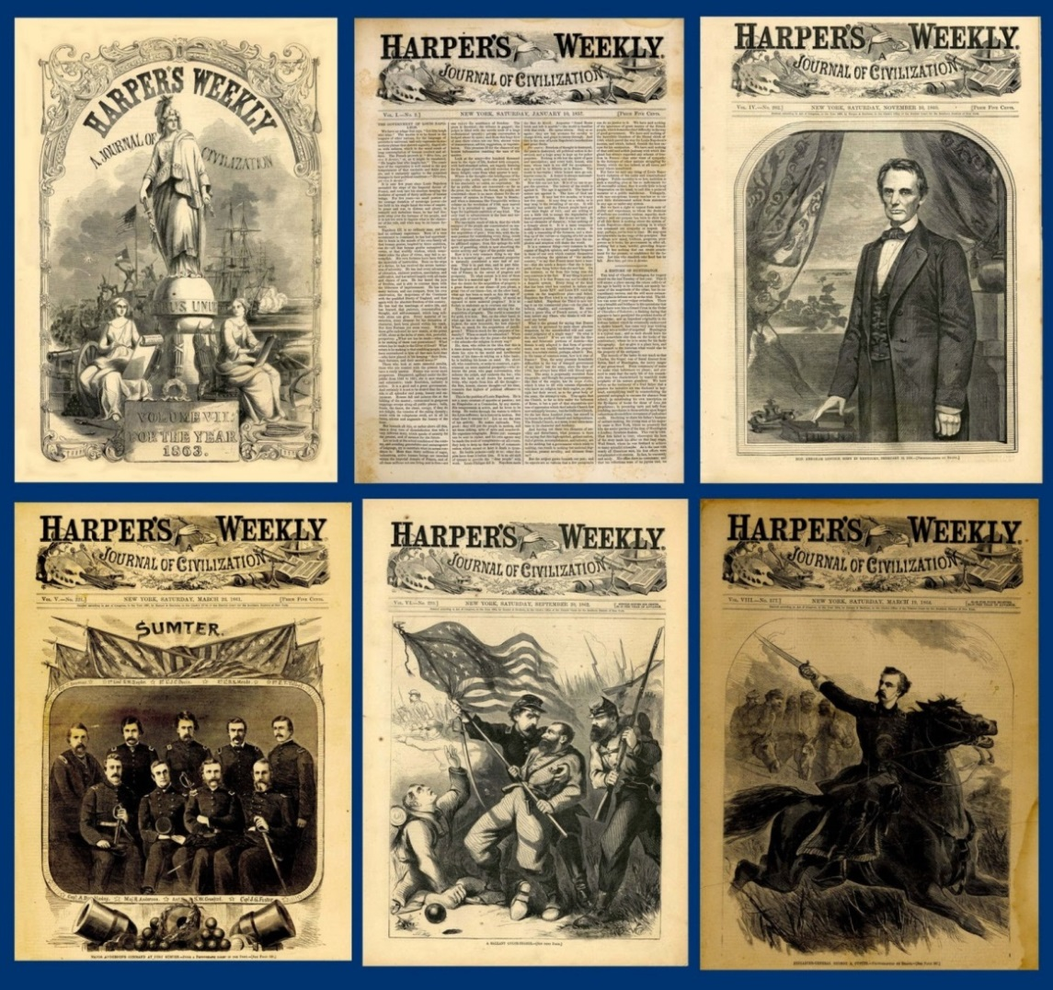
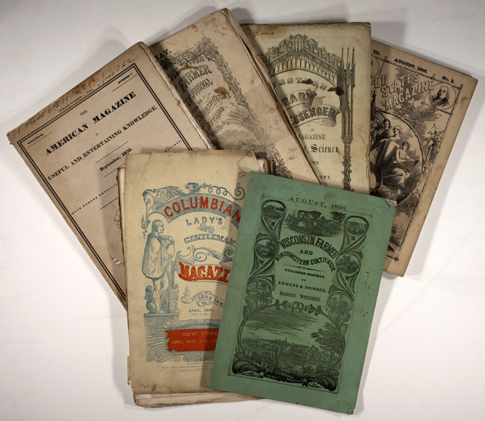
Taxes on paper and paper products were reduced.
Cost to consumers -- of newspapers, periodicals, and books --
was reduced.
Circulations increased.
Led to an age of mass communication

Slide 22
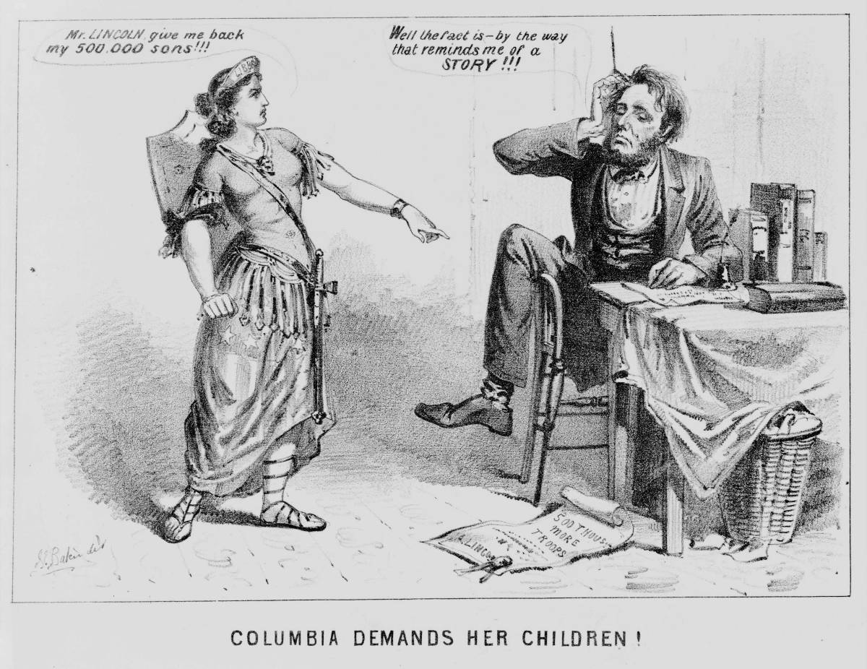

Slide 23
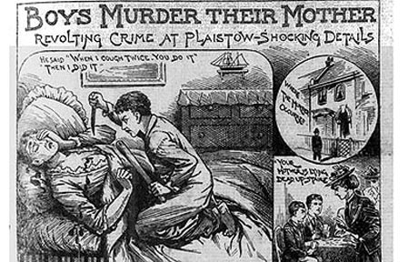

Slide 24
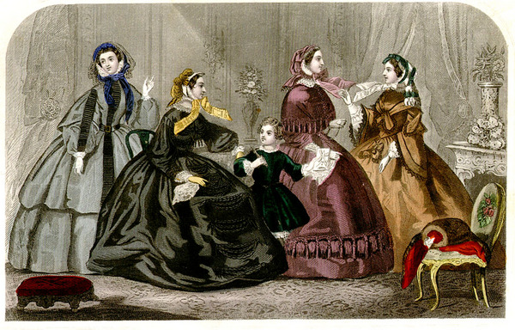
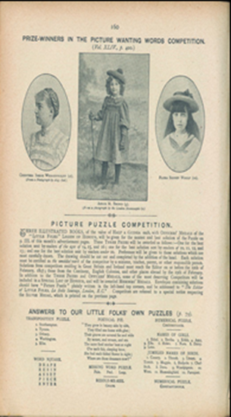
Boom in publications marketed toward women and children
Women as consumers
Changing concepts of childhood

Slide 25
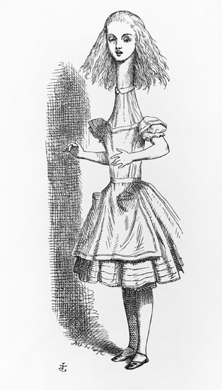
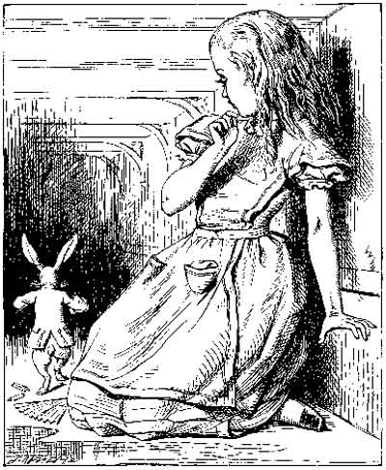

Slide 26
John Tenniel, illustrations from
Alice's Adventures in Wonderland,
by Lewis Carroll, 1866

Slide 27
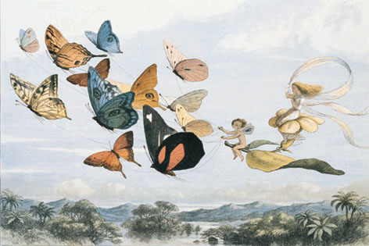
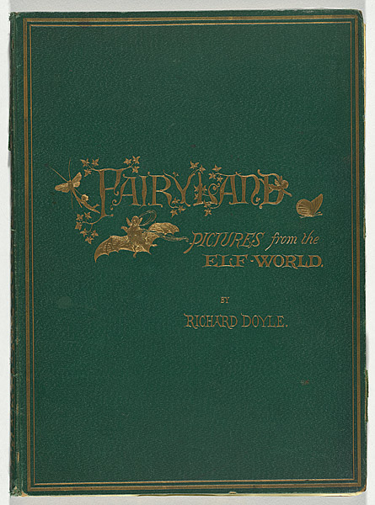
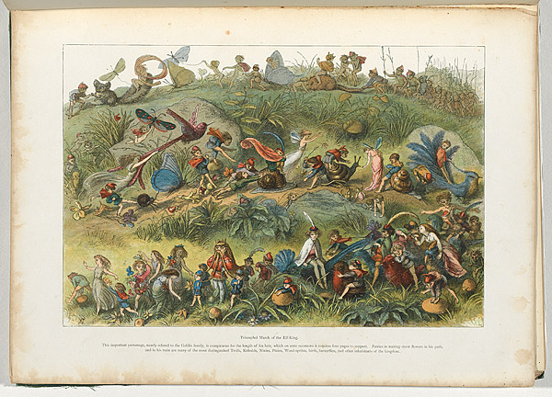
In Fairyland, by William Allingham, 1870
Illustrations by Richard Doyle,
wood engraving s

Slide 28
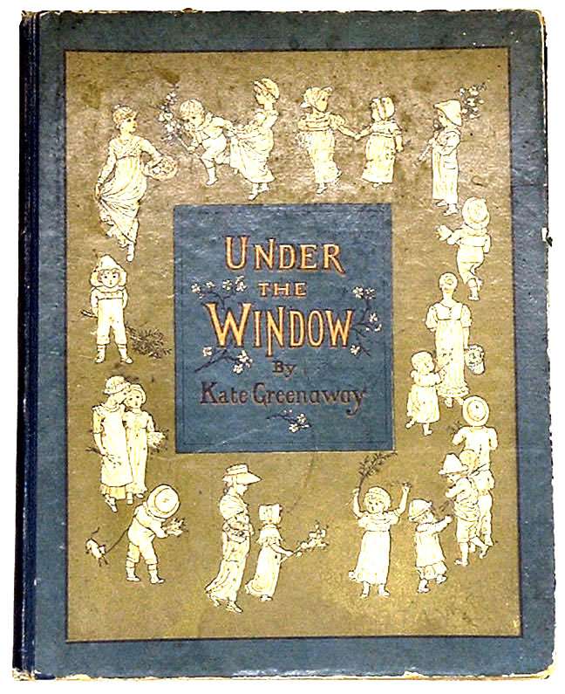
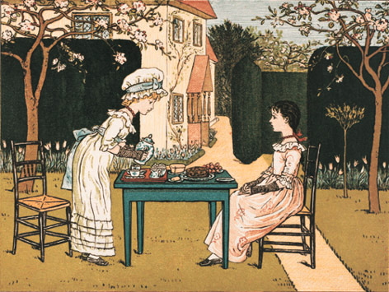
Kate Greenaway, author/illustrator
Under the Window, 1878

Slide 29
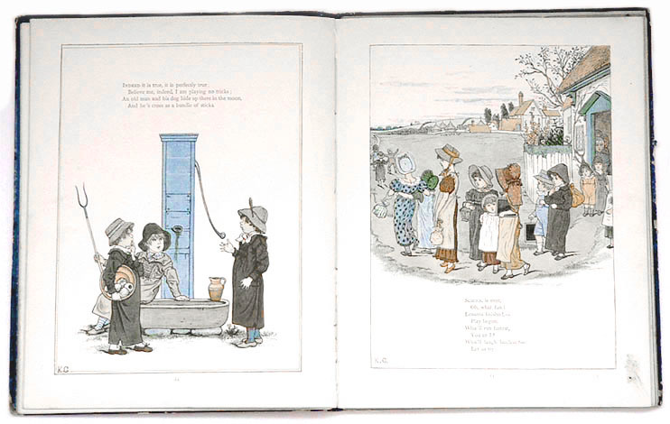


Slide 30
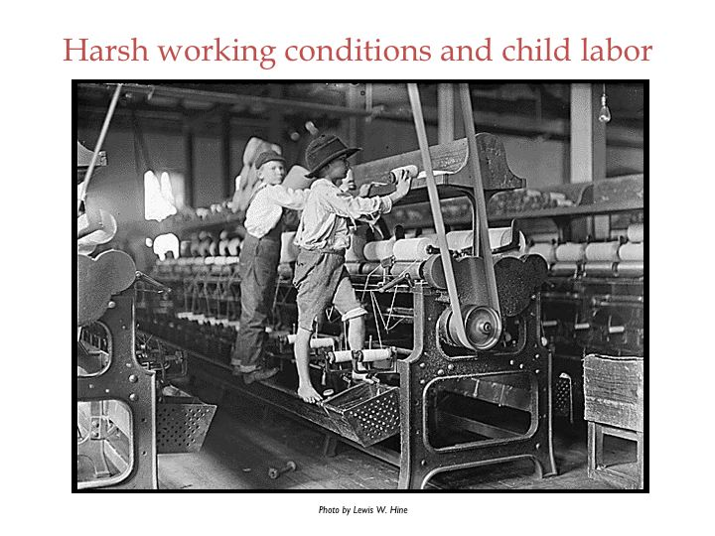

Slide 31
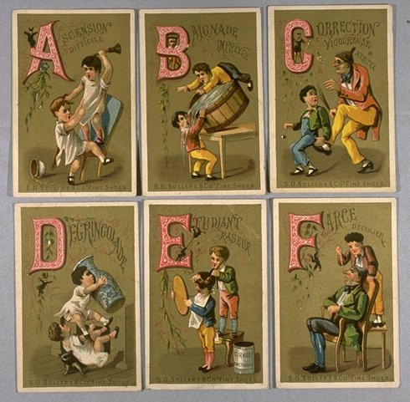

Slide 32
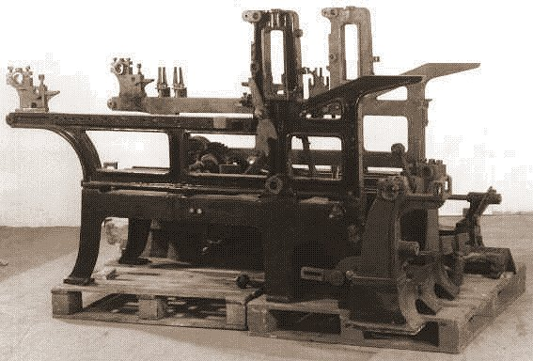
Other advances in printing technology:
Lithography
chromolithography

Slide 33
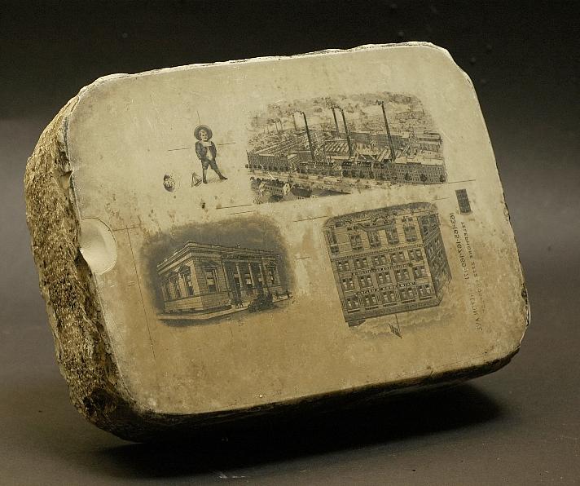

Slide 34
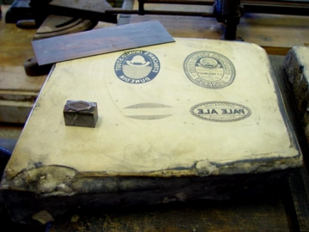

Slide 35
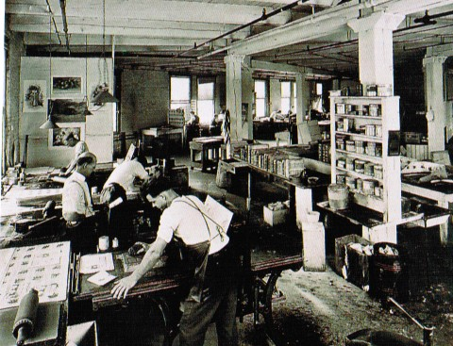
http://www.youtube.com/watch?v=JHw5_1Hopsc

Slide 36
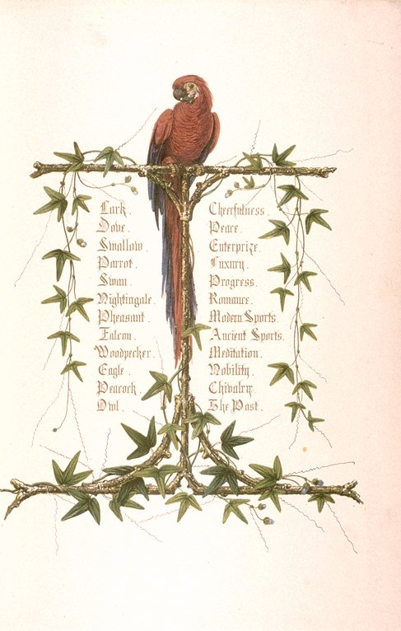
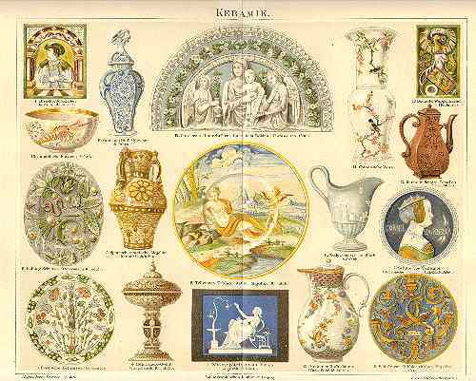
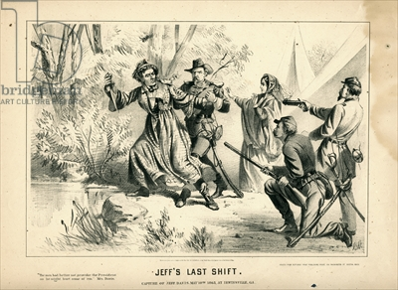


Slide 37
Other forces/events that reflected and generated design

Slide 38

Railroads – construction boom in early to mid 1800s
Effects?

Slide 39
Railroads – construction boom in early to mid 1800s
Effects?
Increased ability to transport raw materials, factory equipment, and new consumer goods
Increase in travel/tourism
Contributed to growth of the new advertising industry
Contributed to the decline of the cottage and farming industries

Slide 40


Slide 41

“Its grandeur does not consist in one thing, but in the unique assemblage of all things. Whatever human industry has created you find here.“
Charlotte Brontë, letter of 1851

Slide 42


1851
The first World’s Fair
“The Crystal Palace”
http://vimeo.com/16886912
http://www.youtube.com/watch?v=eqM6PXyp5MA&feature=related

