Slide 1
Rietveld, Shroder house
http://www.youtube.com/watch?v=qLHCYeswxuI

Slide 2
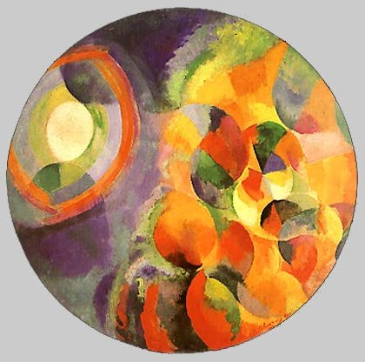
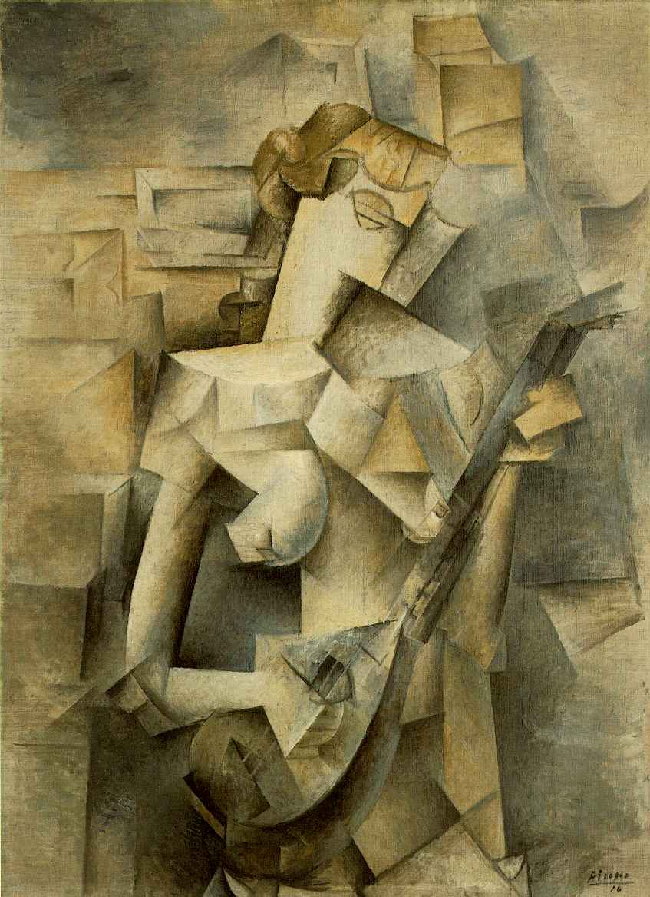
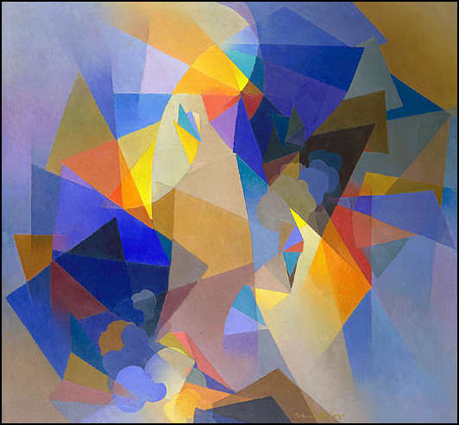
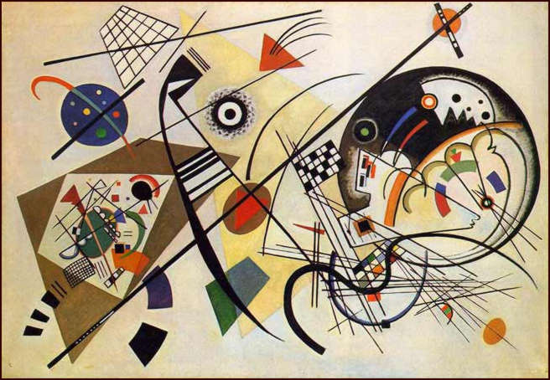
Modernism
Notes:
http://encarta.msn.com/encnet/refpages/refarticle.aspx?refid=761568672
http://www.artcyclopedia.com/history/abstract-expressionism.html
Abstract Expressionism is a form of art in which the artist expresses himself purely through the use of form and color. It is form of non-representational, or non-objective, art, which means that there are no concrete objects represented.
Abstract expressionists emphasized the process of painting, by allowing evidence of the artist’s gestures to remain visible on the canvas surface. Among the leaders of this movement were Jackson Pollock, Franz Kline, Willem de Kooning, Robert Motherwell, and Hans Hofmann. They also introduced all-over composition, in which visual marks are distributed in such a way as to produce no visual center of attention.

Slide 3
Futurism
De Stijl
Constructivism

Slide 4
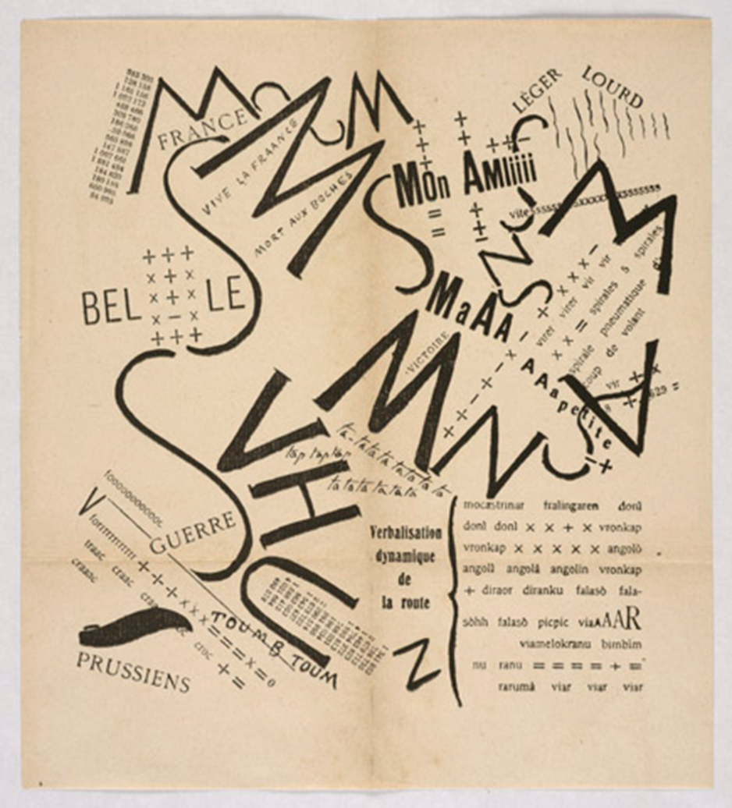
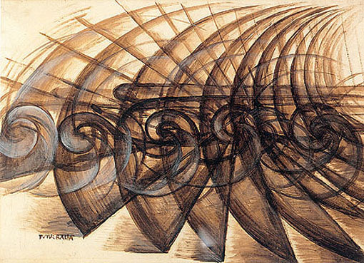
Futurism (Futurismo!)

Slide 5
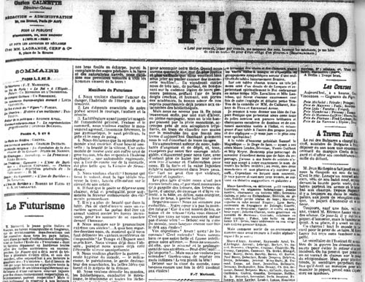
Futurism
Term invented by Filippo Marinetti.
Announced on the front page of Le Figaro in Paris on February 20, 1909.
Futurism
Term invented by Flippo Tommaso Marinetti.
Announced on the front page of Le Figaro in Paris on February 20, 1909.

Slide 6
Picasso,
Woman Playing the Mandolin,
1909
Giacomo Balla,
Speed of a Motorcycle,
1913, Oil on Canvas

Slide 7
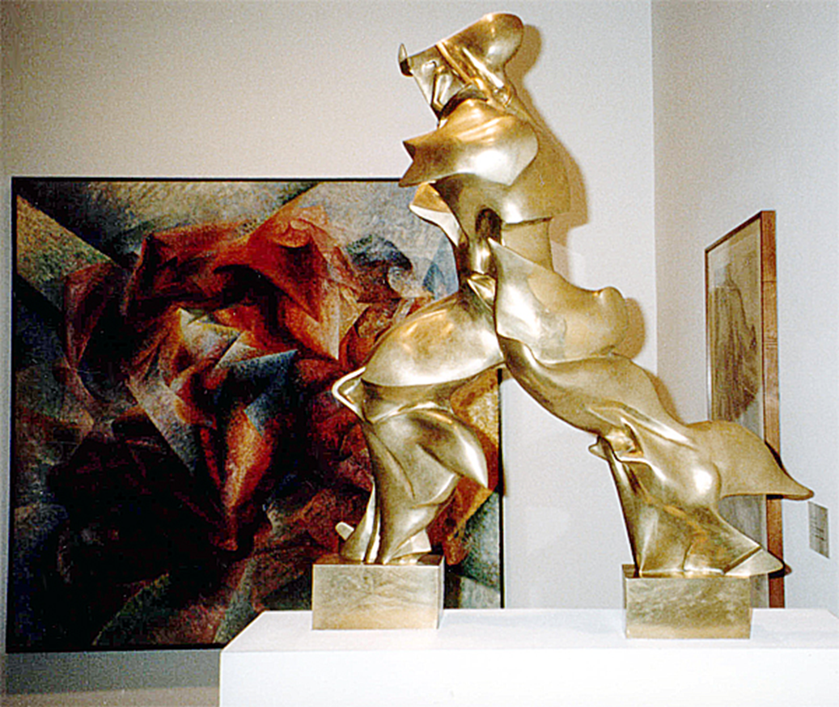
Umberto Boccioni, Unique Forms of Continuity in Space,
1913 (cast 1931), bronze, 43 7/8 x 34 7/8 x 15 3/4"

Slide 8
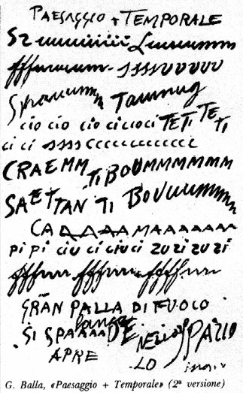
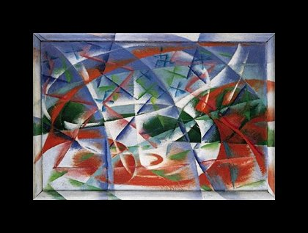
Balla, Speed + Sound, 1913-1914

Slide 9
Typography and modernism:
Conventional Theory: Typography honors content
Modernist theory: Typography functions with/as content
    Modernist era: late 19th - early 20th century
    Political potential of (experimental) typography
    Different “rules” of typographic design - to encourage and discourage certain values in the reading public

Slide 10


Filippo Marinetti, Mountains + Valleys + Streets x Joffre, 1915

Slide 11
Filippo Marinetti, Mountains + Valleys + Streets x Joffre, 1915
Words as images; writing as visual form

Slide 12
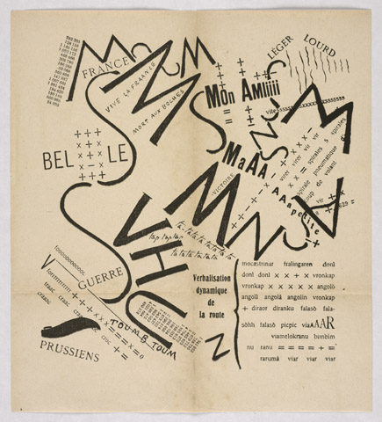
Visual and
Auditory elements

Slide 13
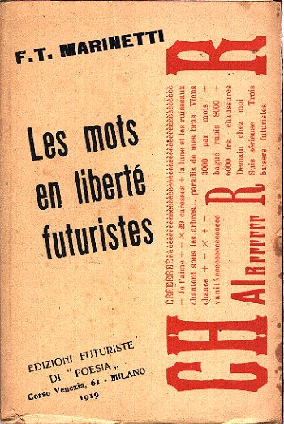
F.T. Marinetti
Italian poet and founder of Futurism
from Les mots en liberté futuristes, 1919
“I am starting a typographic revolution, directed above all against the idiotic, sick-making conception of the old-fashioned Poetry Book, with its hand-made paper, its sixteenth century style, decorated with galleons, Minervas, Apollos, great initials …”
“The book must be the futuristic expression of our futuristic thought. Better: my revolution is against among other things the so-called typographic harmony of the page, which is in complete opposition to the style which the page allows.”

Slide 14
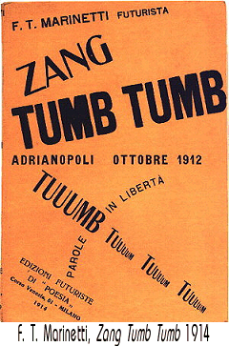
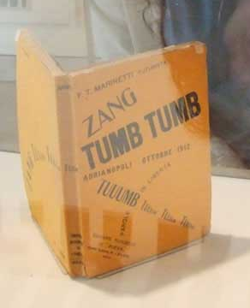
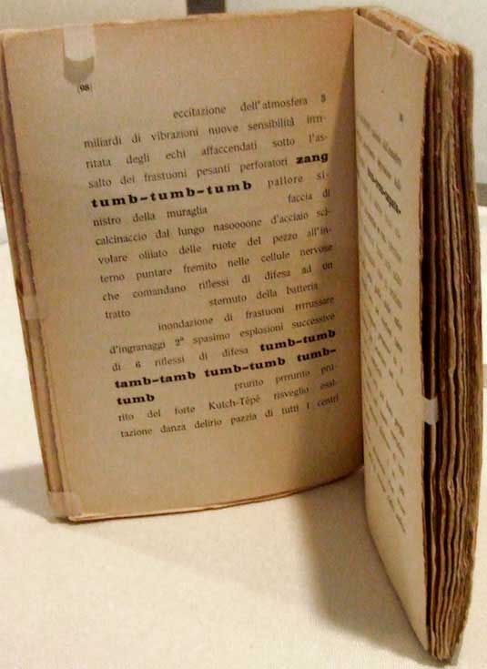

Slide 15
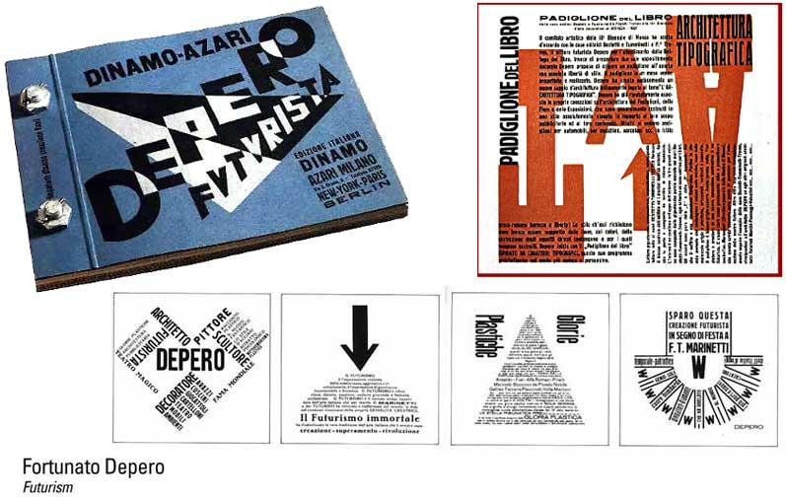

Slide 16
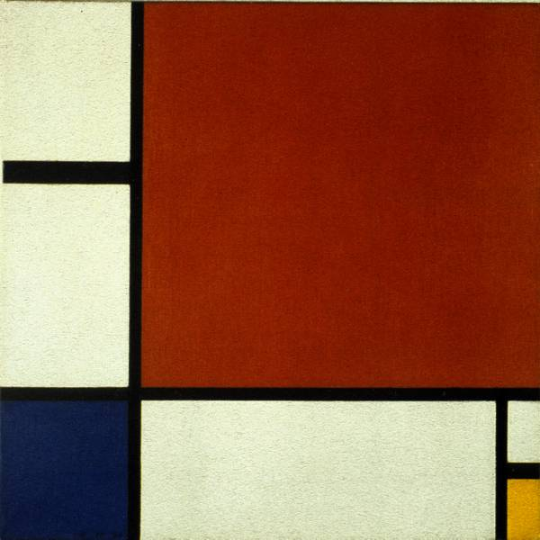
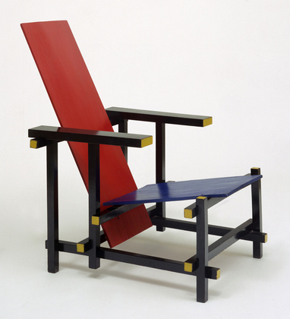
De stijl (The style)
1917 – 1920s

Slide 17
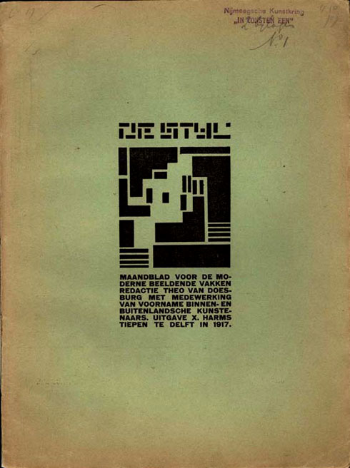
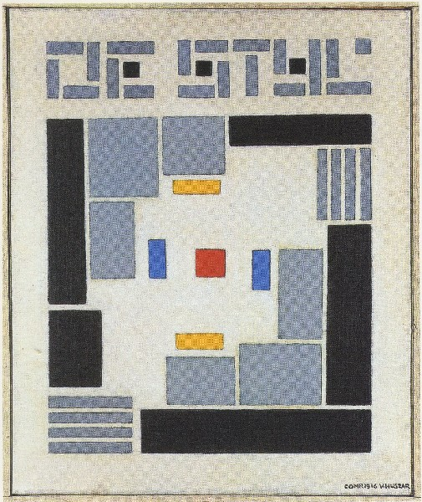
Die Stijl, Number 1, 1917

Slide 18
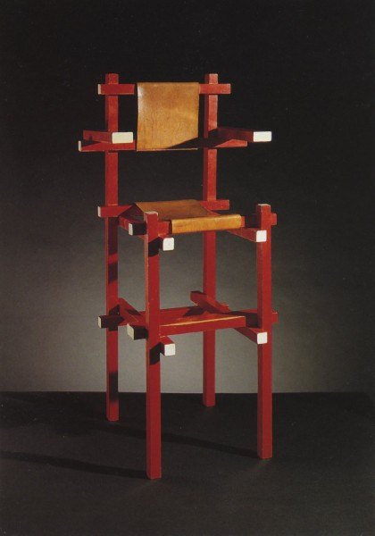
Gerrit Rietveld, chair designs, c. 1923

Slide 19
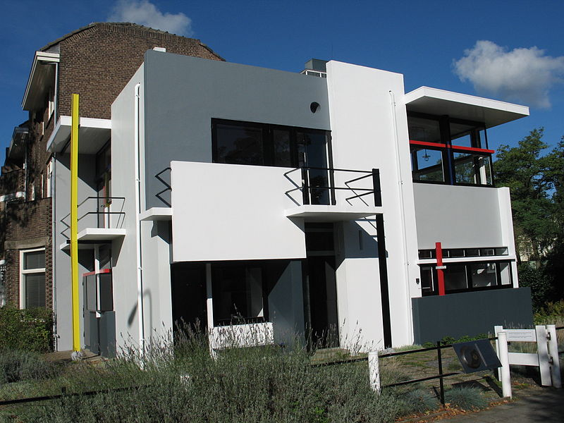
The Rietveld Schröder House

Slide 20
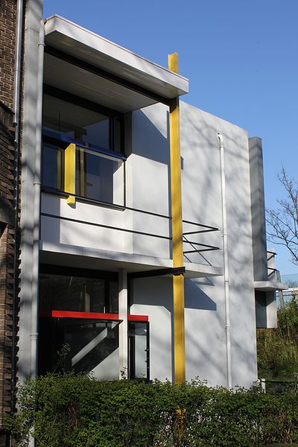
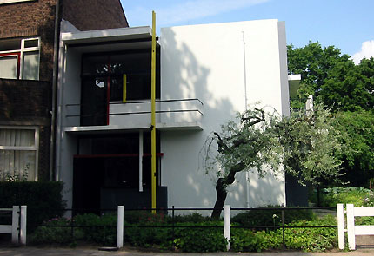
http://www.youtube.com/watch?v=qLHCYeswxuI

Slide 21
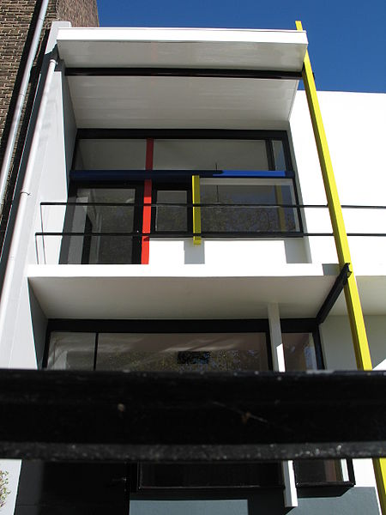

Slide 22
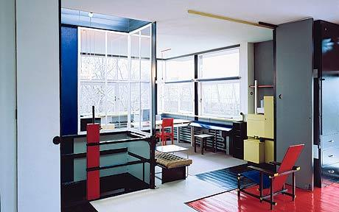

Slide 23
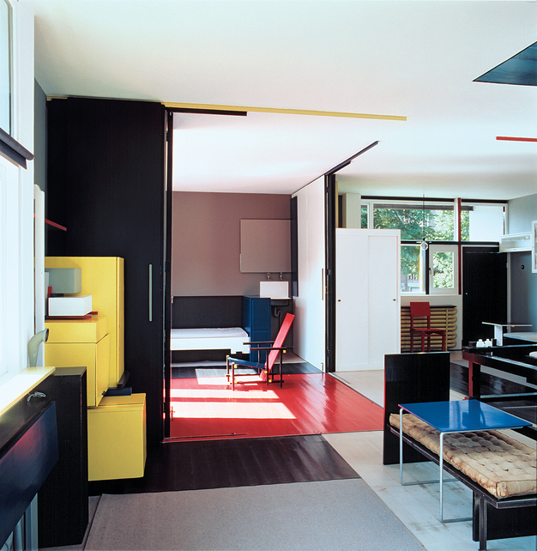
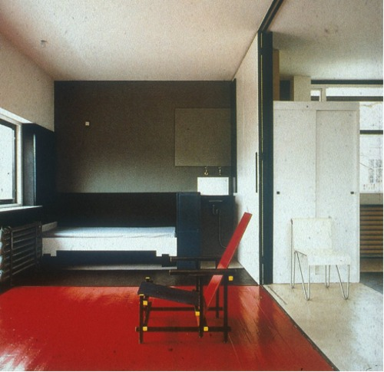

Slide 24
Piet Mondrian,
Composition II in Red, Blue, and Yellow, 1930

Slide 25
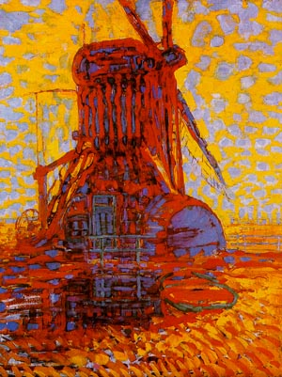
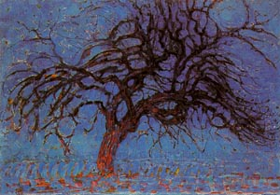
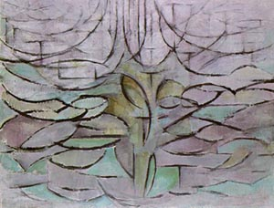
Piet Mondrian (Pieter Mondriaan), Dutch
The Mill Under the Sun, 1908
The Red Tree, 1908
The Blooming Apple Tree, 1912

Slide 26
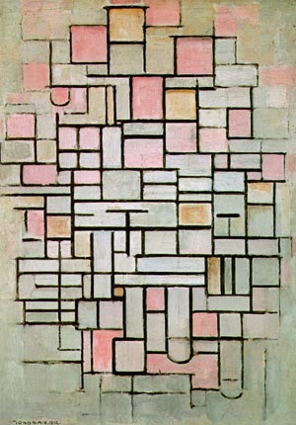
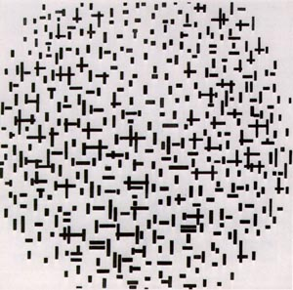
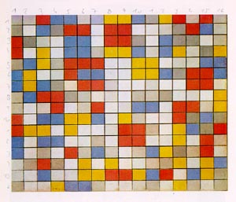
Composition No. 6, 1914
Composition with lines, 1917
Composition, 1919

Slide 27
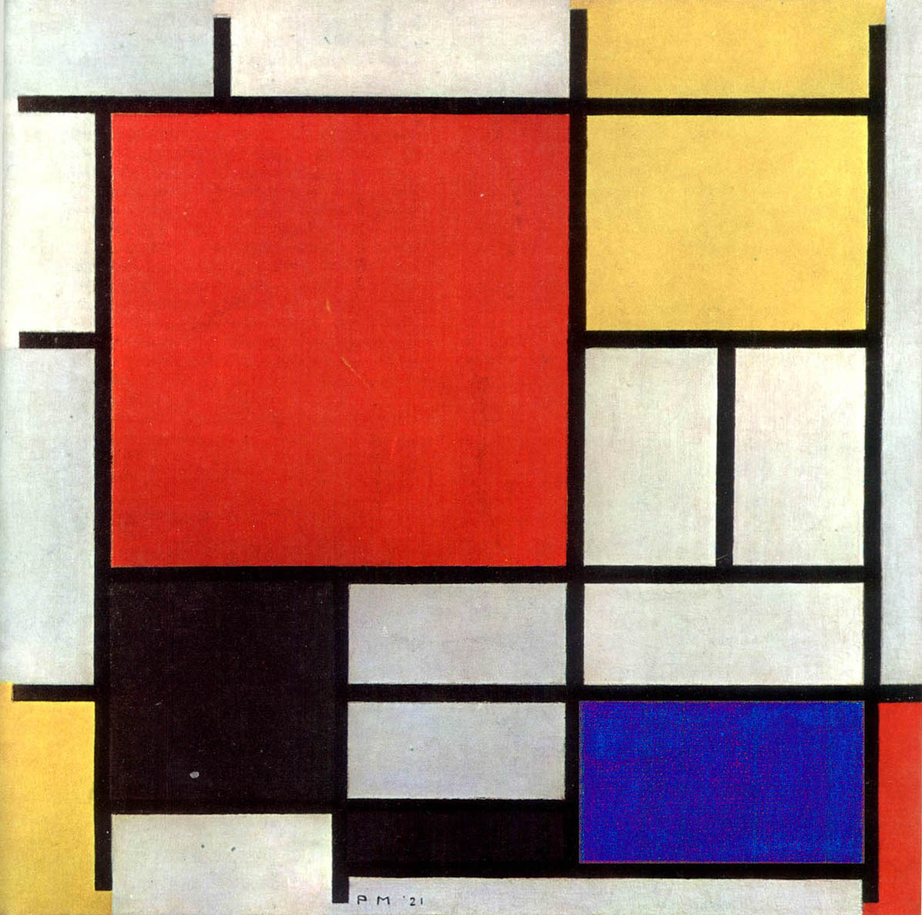
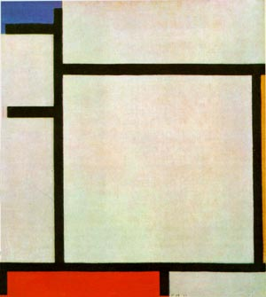
1921
1922

Slide 28
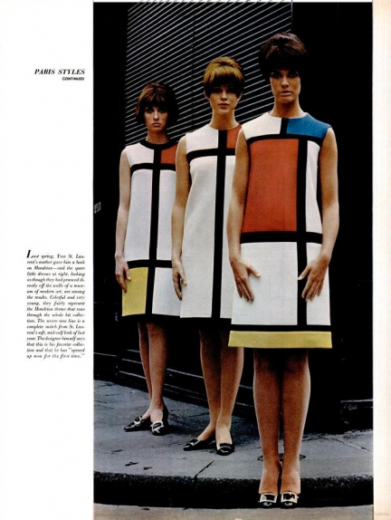
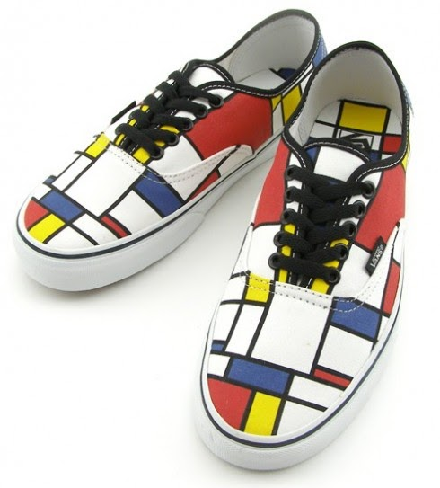

Slide 29
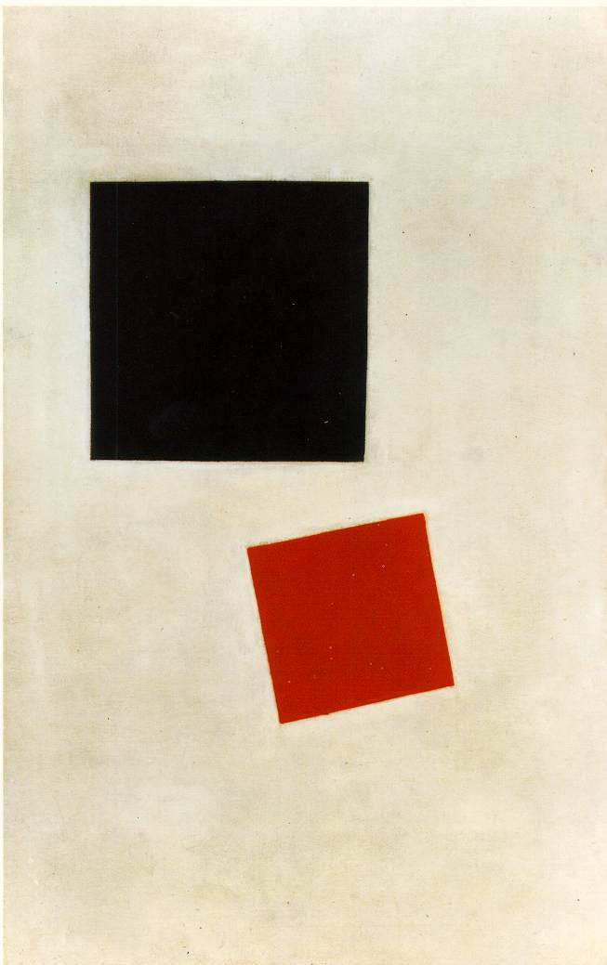
Kasimir Malevich,
Black Square and Red Square
1915; Oil on canvas, (28 x 17 1/2 in)
Piet Mondrian,
Composition II in Red, Blue, and Yellow, 1930

Slide 30

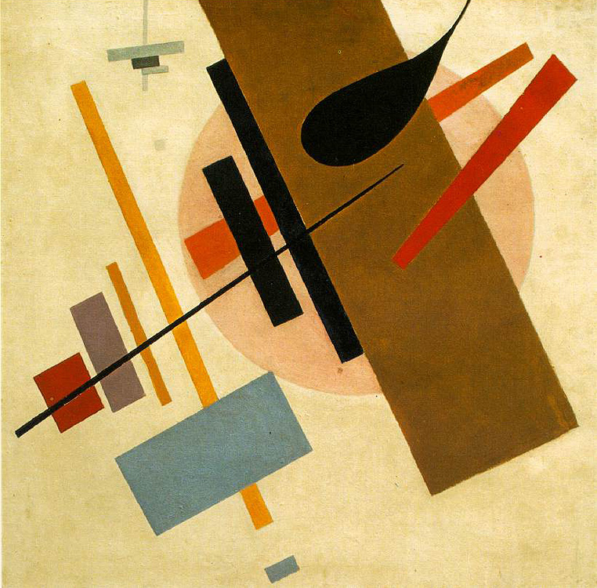
Constructivism 1917 - 1930s
El Lissitzky

Slide 31
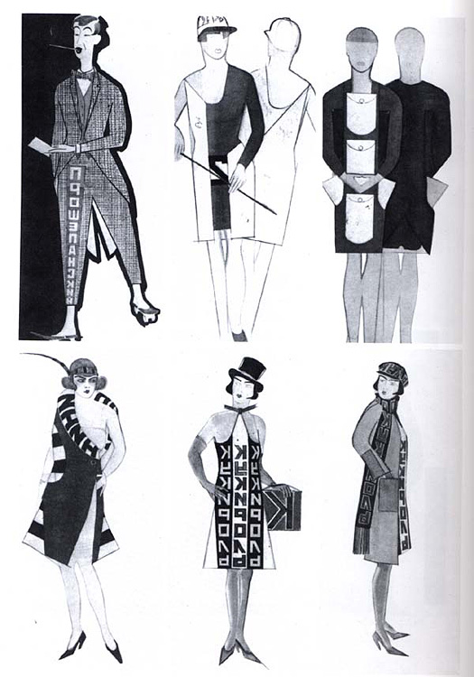
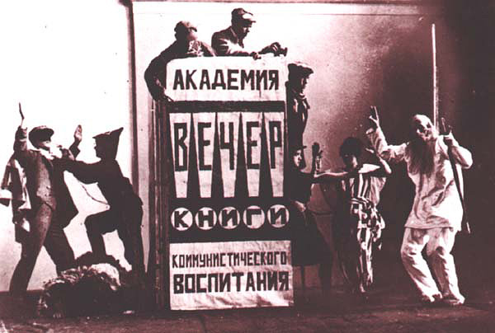
The Constructivist Culture

Slide 32
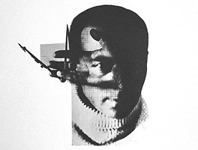
El Lissitzky
Self-Portrait

Slide 33
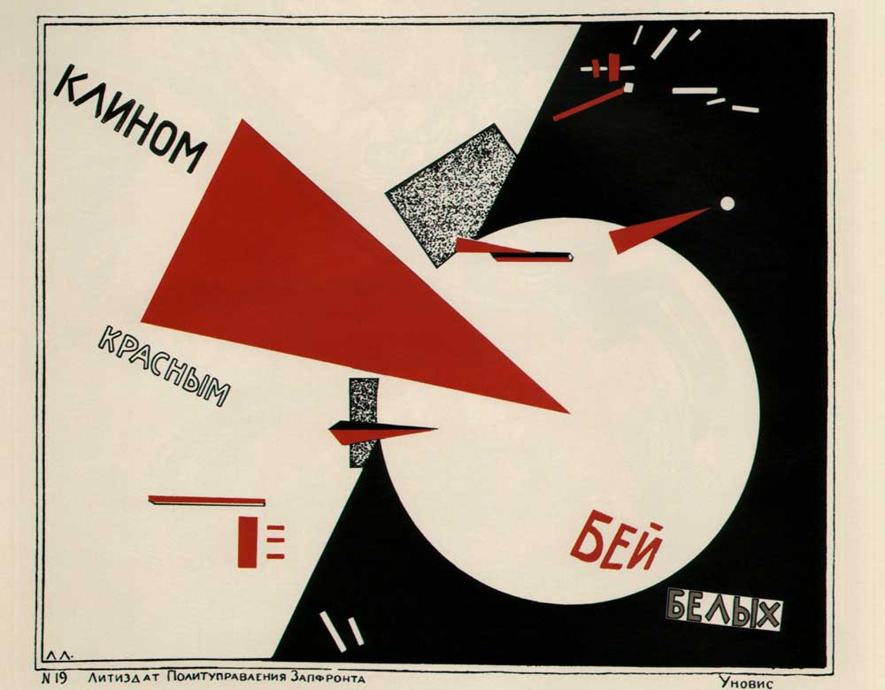
1919, Lithograph

Slide 34
Beat the Whites with the Red Wedge, 1919, Lithograph

Slide 35
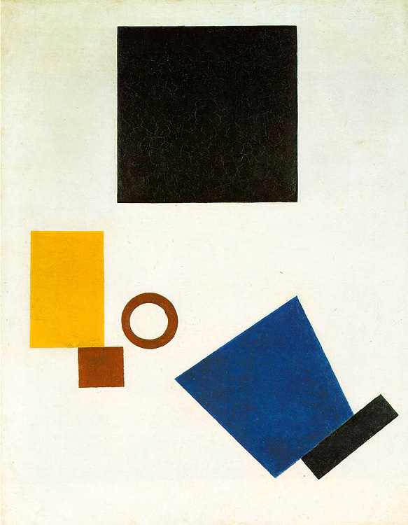

"The artist constructs a new symbol with his brush. This symbol is not a recognizable form of anything which is already finished, already made, already existing in the world - it is a symbol of a new world, which is being built upon and which exists by way of people."

Slide 36
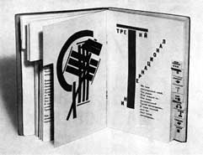
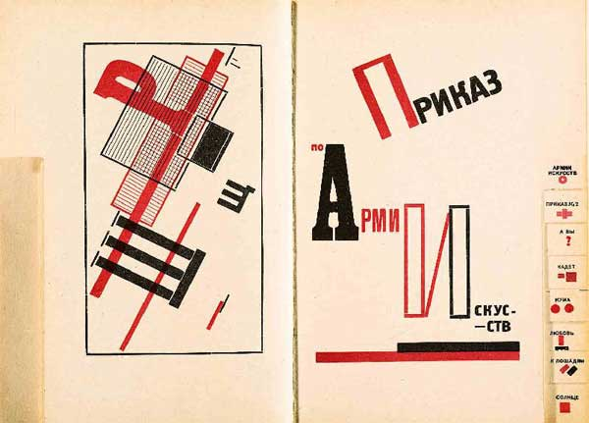
pages from For the Voice (1923)
Poem by Mayakovsky

Slide 37
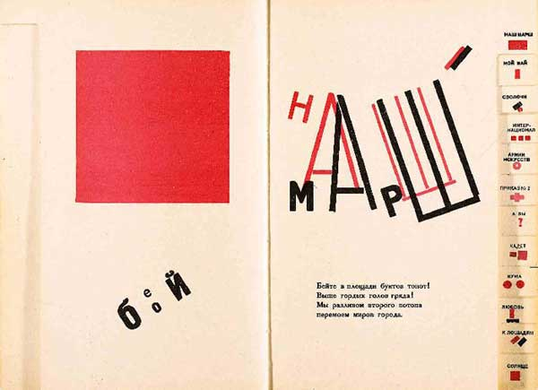

Slide 38
"The space must be a kind of showcase, a stage, on which the pictures make their appearance as actors in a drama (or comedy). It should not imitate a living space."

Slide 39
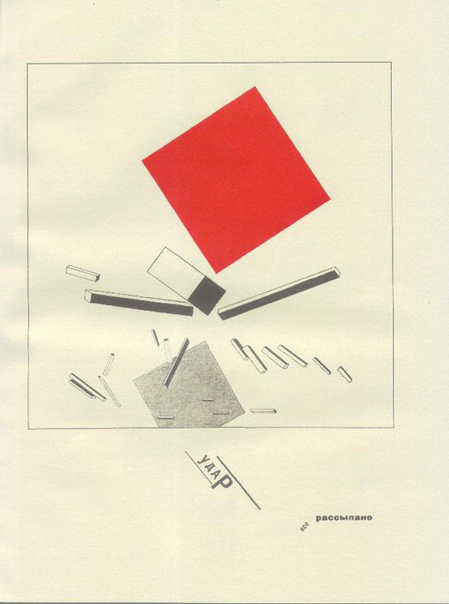
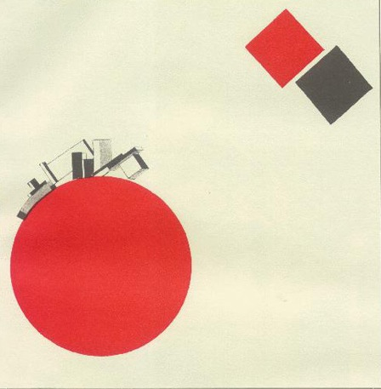
The Story of the Little Red Square

Slide 40

  Distinct break from conventional typography:

Slide 41
  Distinct break from old typography:
  discarding of decorative concepts
Sans-serif
Bold, basic colors
Use of photography
(new-ish technology)

Slide 42
  Distinct break from old typography:
  a turn to functional design (design functions as content)

Slide 43
El Lissitzky
major contributor to “new typography”
“Topography of Typography,” from the magazine Merz, 1922
“On the printed page words are seen, not heard.”
“Economy of Expression - visual, not phonetic.”
“The new book demands the new writer. Ink-pots and goose-quills are dead.”
“The printed page transcends time and space. The printed page, the infinity of the book, must be transcended. THE ELECTRO-LIBRARY.”

Slide 44

Aleksandr Rodchenko

Slide 45
Rodchenko, poster, 1924

Slide 46

Paperback Book Covers, 1924

Slide 47

Poster, 1923,
Text by V.Mayakovsky.

Slide 48

Aleksandr Rodchenko and Vladimir Mayakovsky,
Box for Our Industry caramels, 1923

Slide 49
fin

