Slide 1
Design in the Europe and the U.S.
late 1920s - 1940s

Slide 2
Paul Renner,
Futura
typeface,
1927

Slide 3
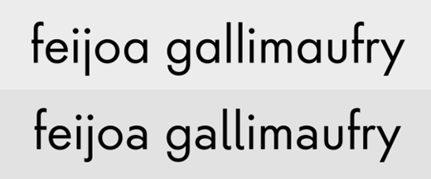
Top line: Finalized Futura letterforms.
Bottom line: rejected “humanist” versions.

Slide 4
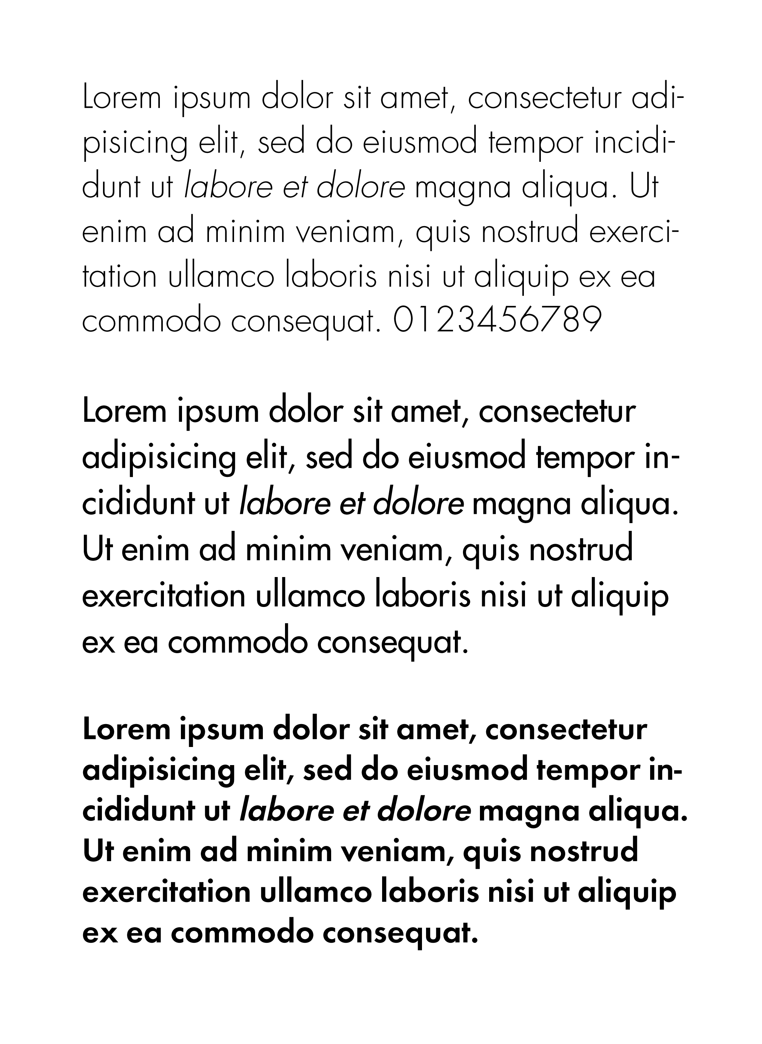
Paul Renner, Futura
light,
regular,
semi-bold

Slide 5

Comparison of ‘perfect’ geometry (light gray) and optical correction in Futura (dark gray)

Slide 6
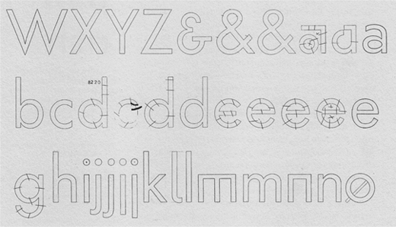
Several alternate letterforms from the development of Futura.

Slide 7
Paul Renner, Futura
typeface,
1927
modular
geometric

Slide 8
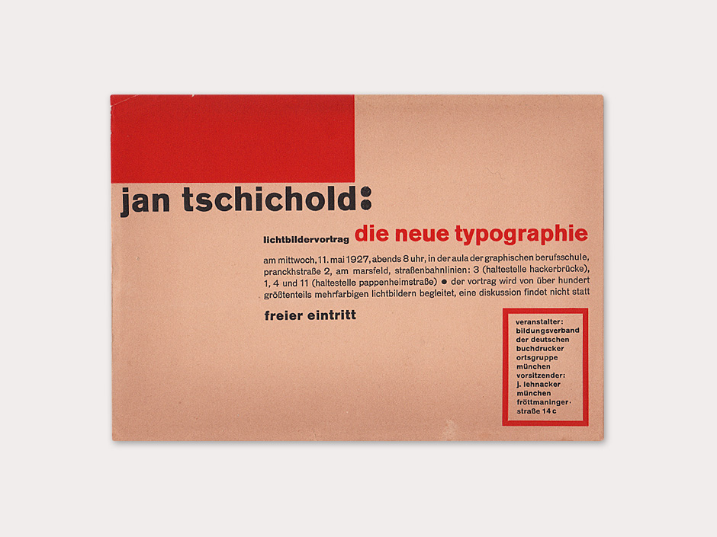
Jan Tschichold and the codification of the modern

Slide 9
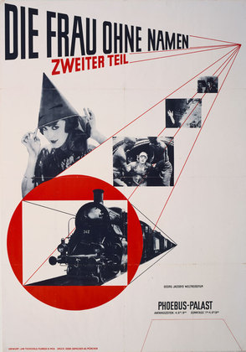
Jan Tschichold,
Poster for movie theater, 1927.
Offset lithograph,
48 3⁄4 x 34"

Slide 10
Tschichold,
Film poster
for movie theater
Letterpress, 1927

Slide 11
Tschichold,
poster for Constructivist exhibition in Basel, 1937

Slide 12
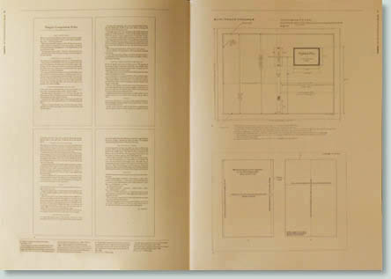

Slide 13
The new typography in England
The new roundel, c.1918

Slide 14


1935 edition
Design: Edward Young
1949 edition
Design: Jan Tschichold

Slide 15

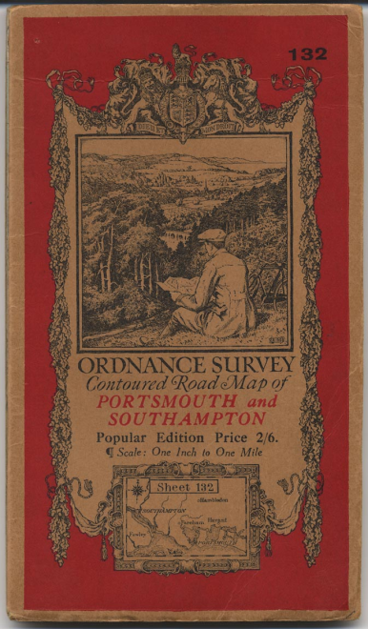


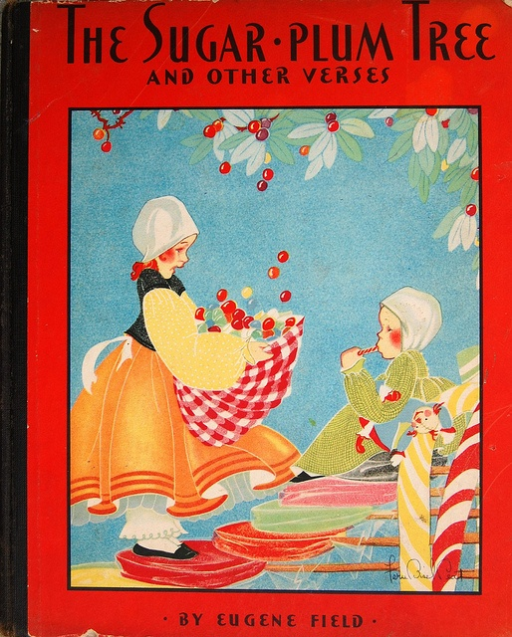
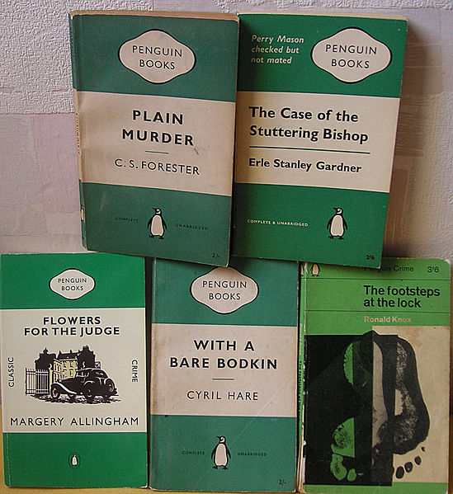

Slide 17
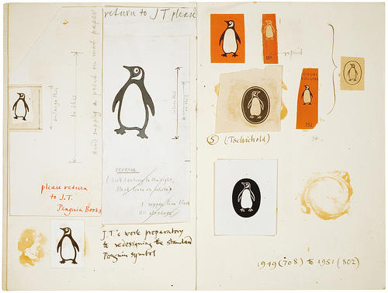

Slide 18

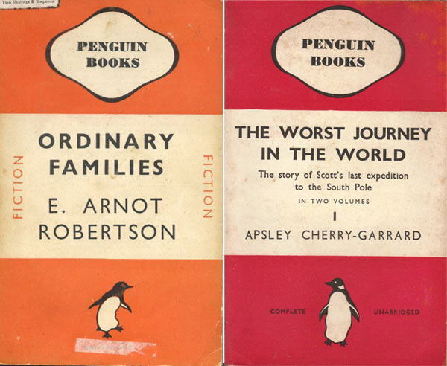

Slide 19
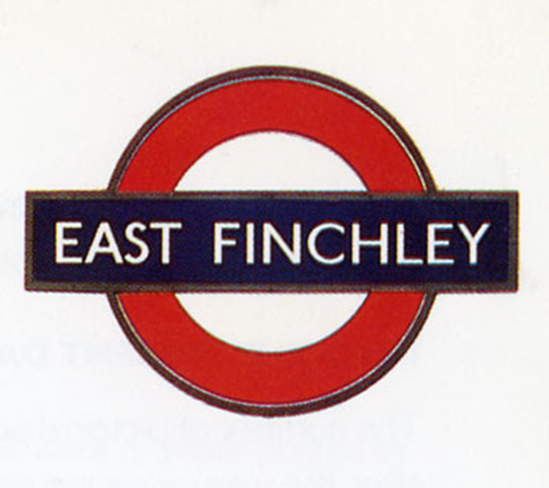

Slide 20
Edward Johnston, London Underground design

Slide 21
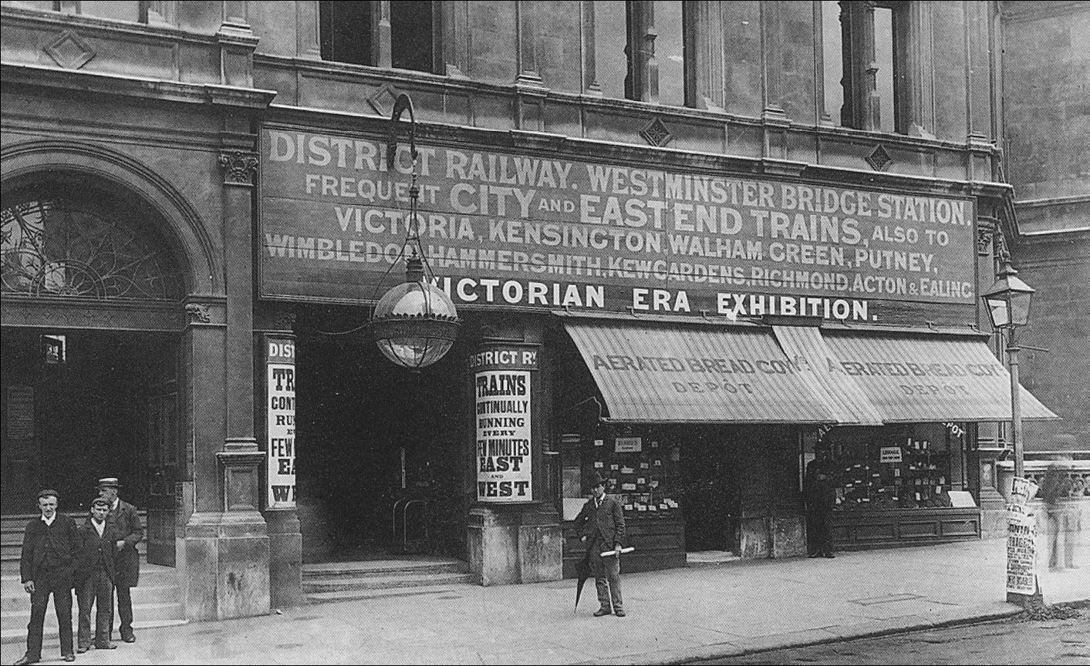
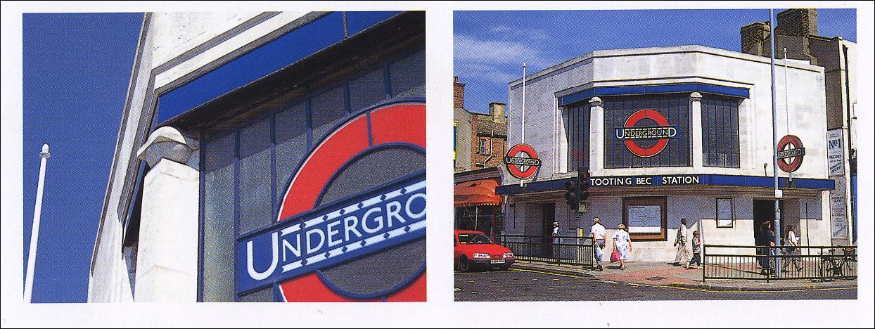
1902 station
1926 station

Slide 22
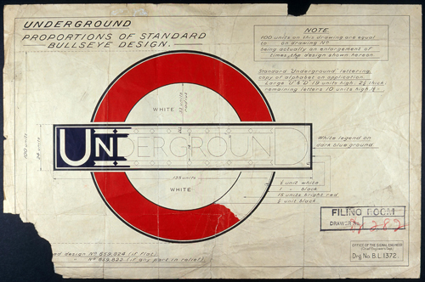

Slide 23
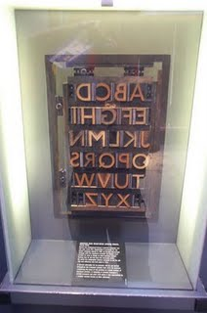
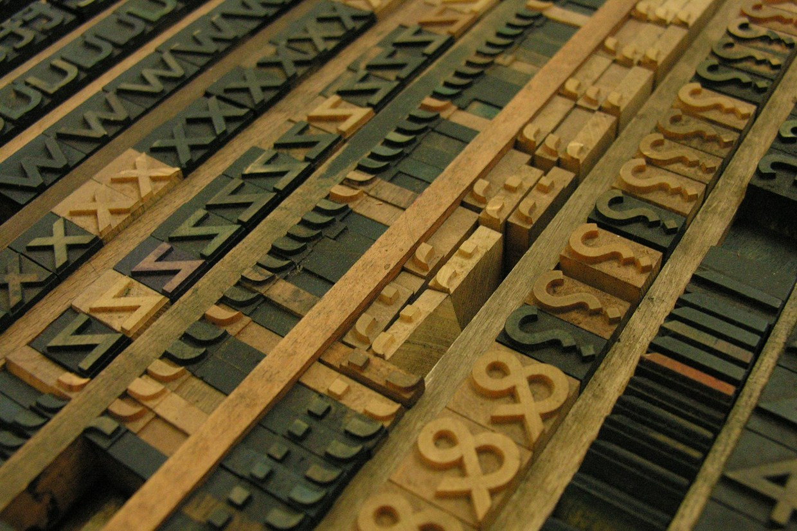
Johnston Sans
type

Slide 25
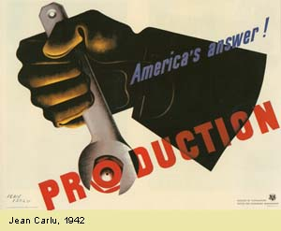

The spread of New Typography and the codification of the modern

Slide 26
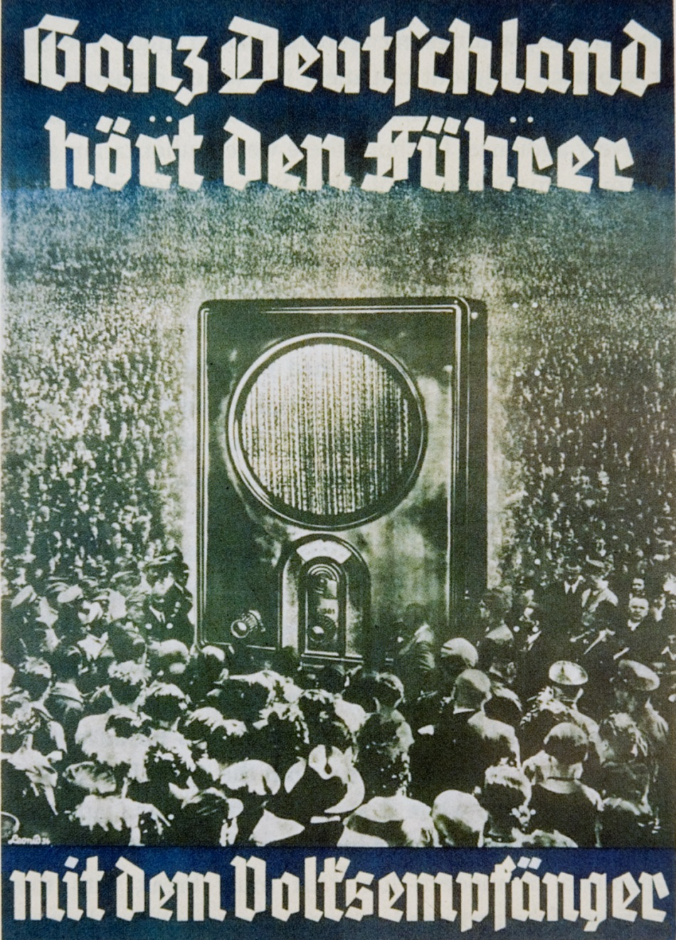
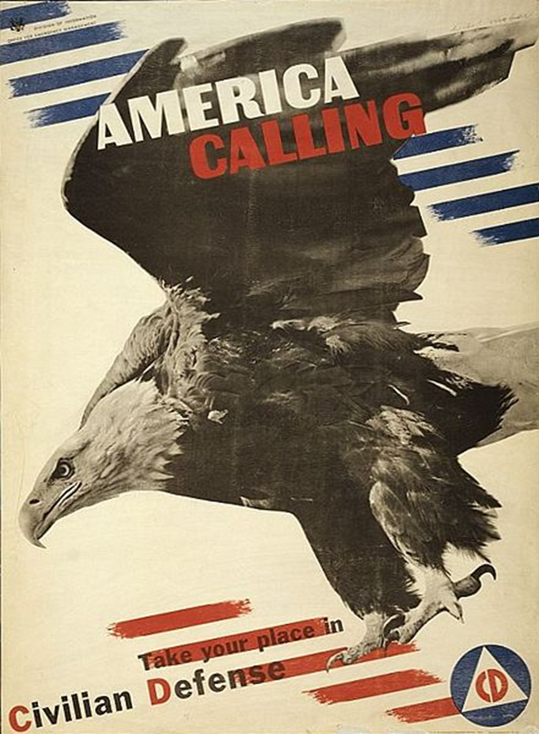

Slide 27

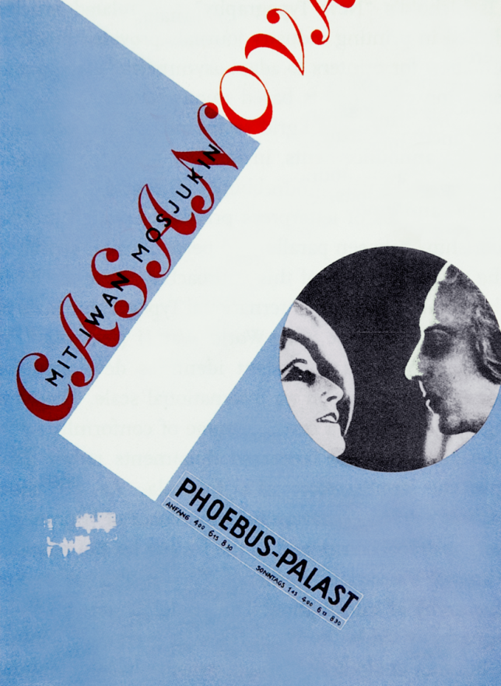
New Typography activity

Slide 28

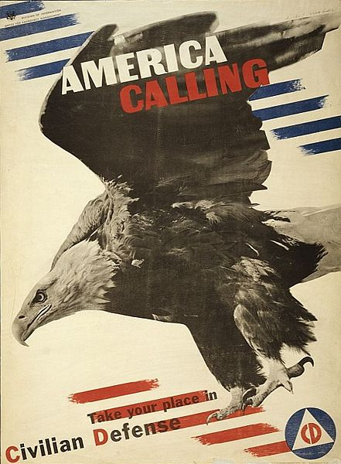

Slide 29


Slide 30
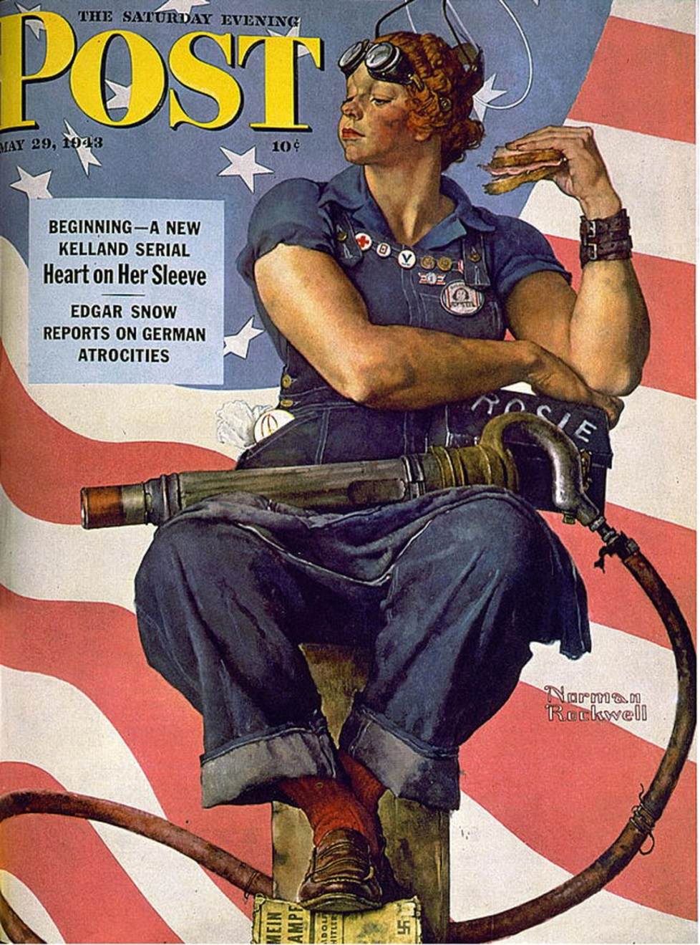


Slide 31


Slide 32


Slide 33
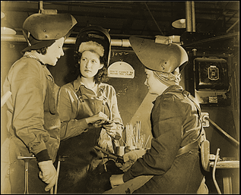

Slide 34
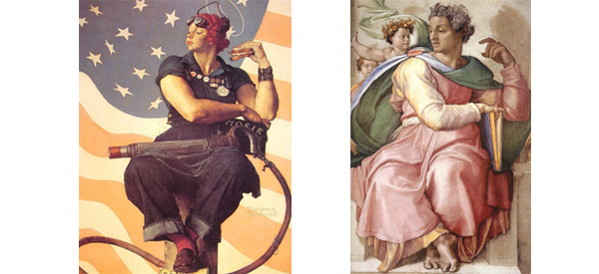

Slide 35
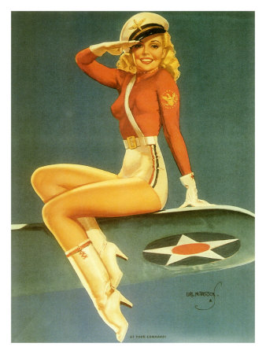


Slide 36
Norman Rockwell, Freedom from Want,
oil painting,
1943

Slide 37
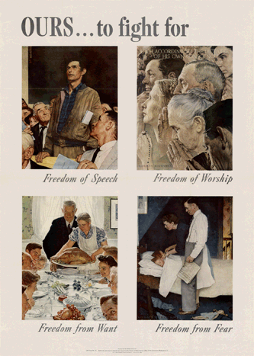


Slide 38
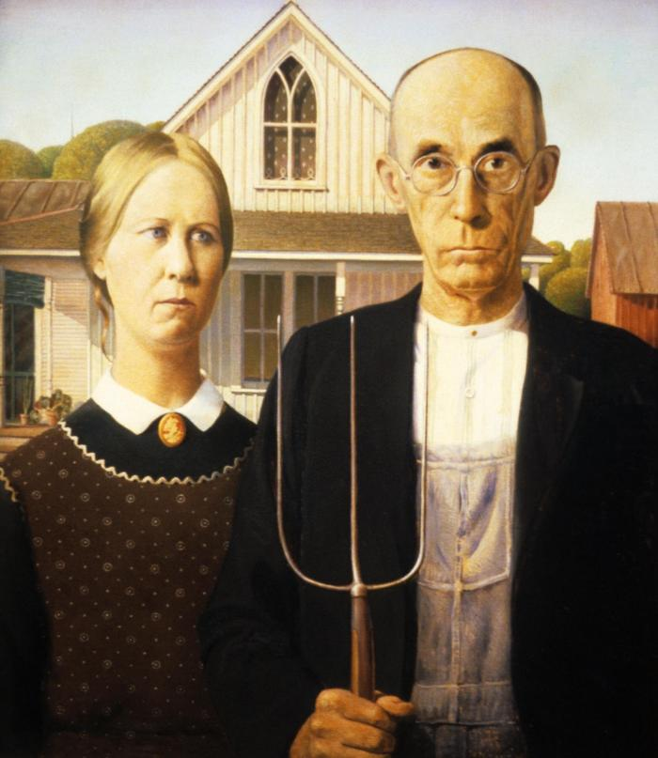
Grant Wood,
American Gothic, 1930

Slide 39
Eero Saarinen and Charles Eames, armchair

Slide 40
end

