Slide 1
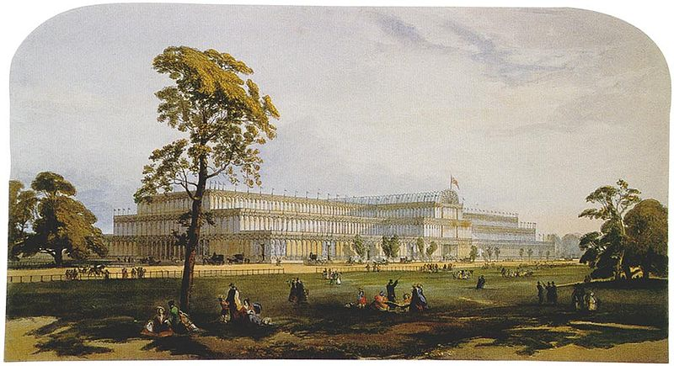
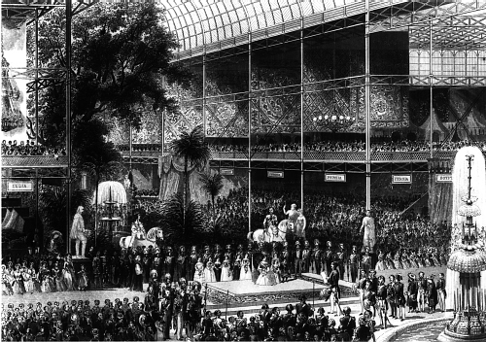
1851
The first World’s Fair
“The Crystal Palace”

Slide 2
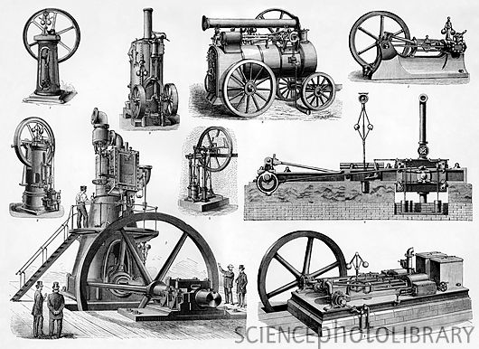
The new machinery…
shift from home or workshop production
to factory production
new processes lead to new factory machines
new factory machines/tools lead to new products

Slide 3
Cast iron
Bentwood
Electroplating

Slide 4
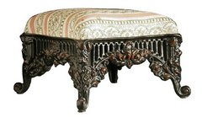
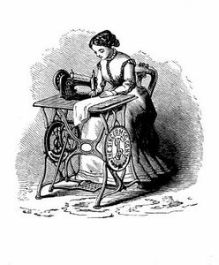
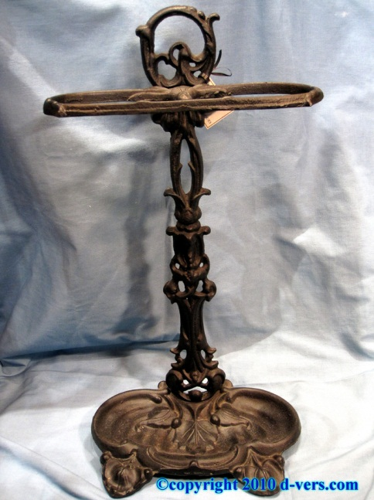
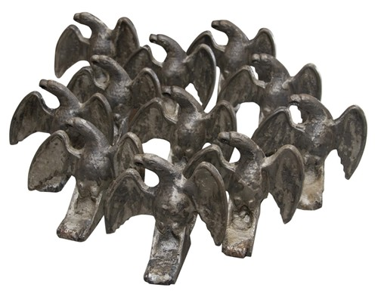
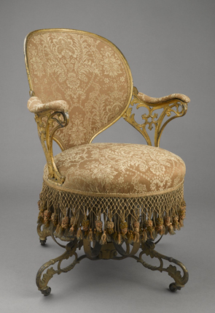
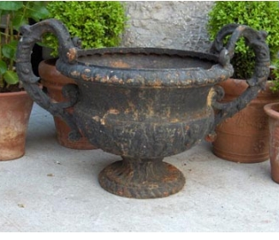
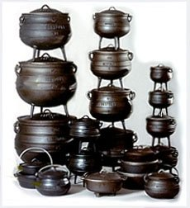
In the 1850s manufacturers produced a diverse range of cast-iron products for the household.

Slide 5
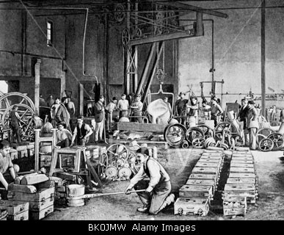
Iron casting works, Molitor und Co., Heidelberg. drawing, 2nd half 19th century

Slide 6
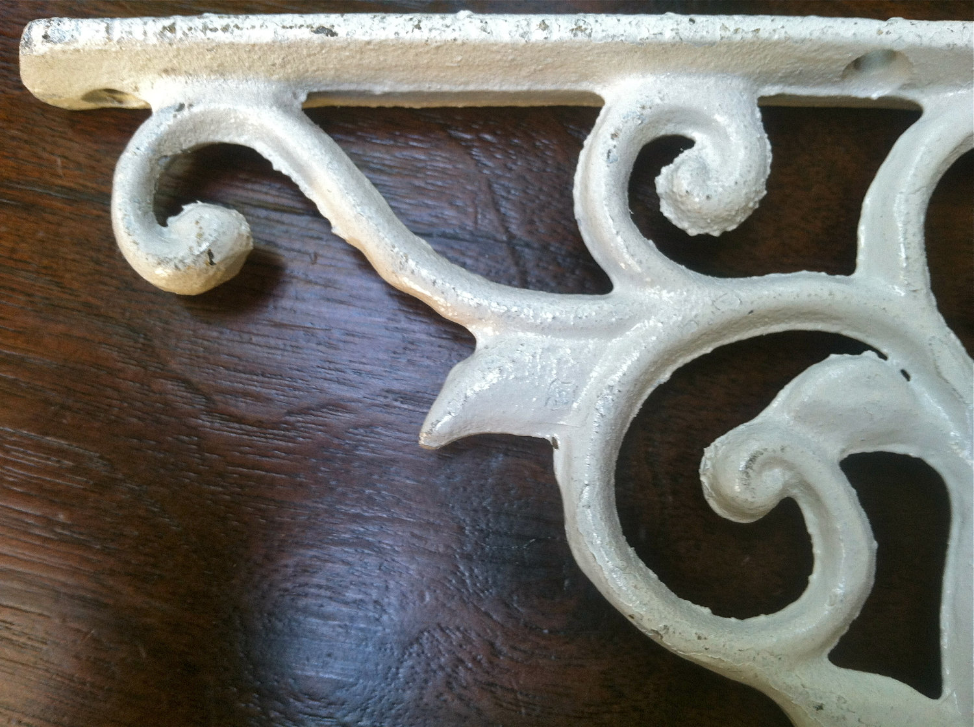

Slide 7
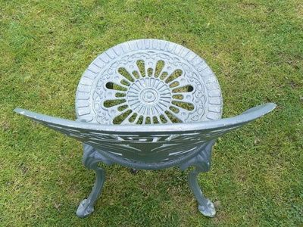
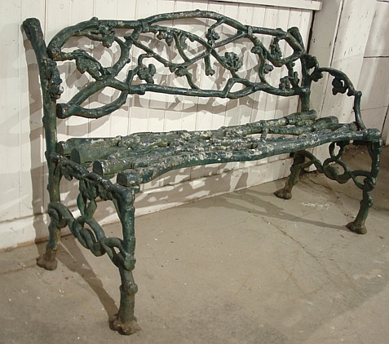
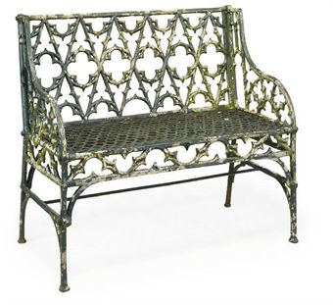
The most popular cast-iron products were chairs and benches.

Slide 8
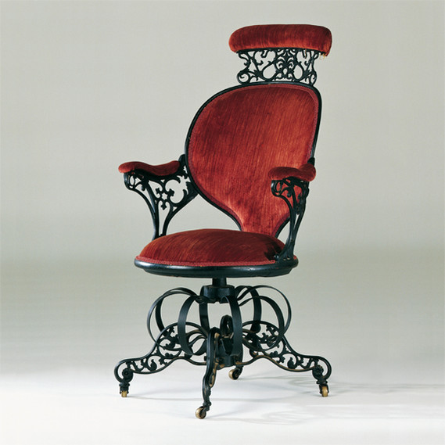
Thomas E. Warren (American, 1808–18?). “Centripetal Spring” Chairs,
American Chair Company (active 1829–1858).
Cast iron, sheet metal, wood,
modern upholstery, original fringe.

Slide 9
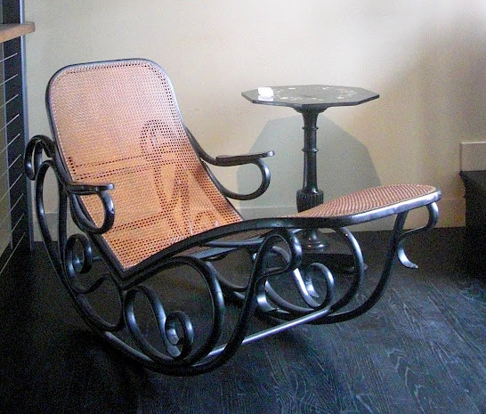
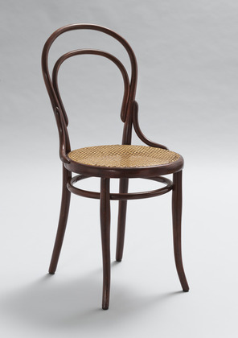
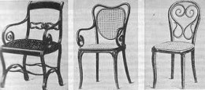
Bentwood
Michael Thonet
(Austrian, 1796–1871)
Chair No. 14
Collection of MOMA)
http://www.youtube.com/watch?v=eoy5QP3Jibg

Slide 10
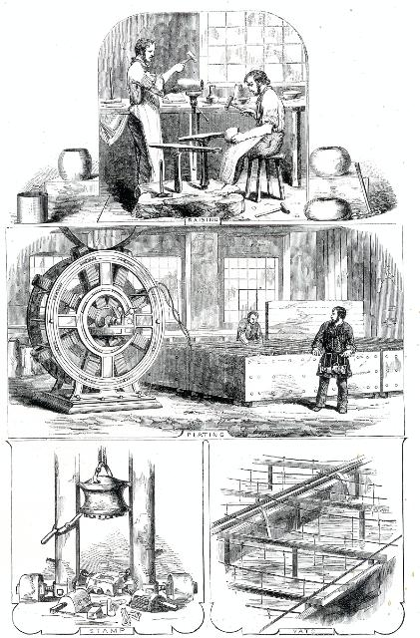
1840s - Silver electroplating patented and developed

Slide 11
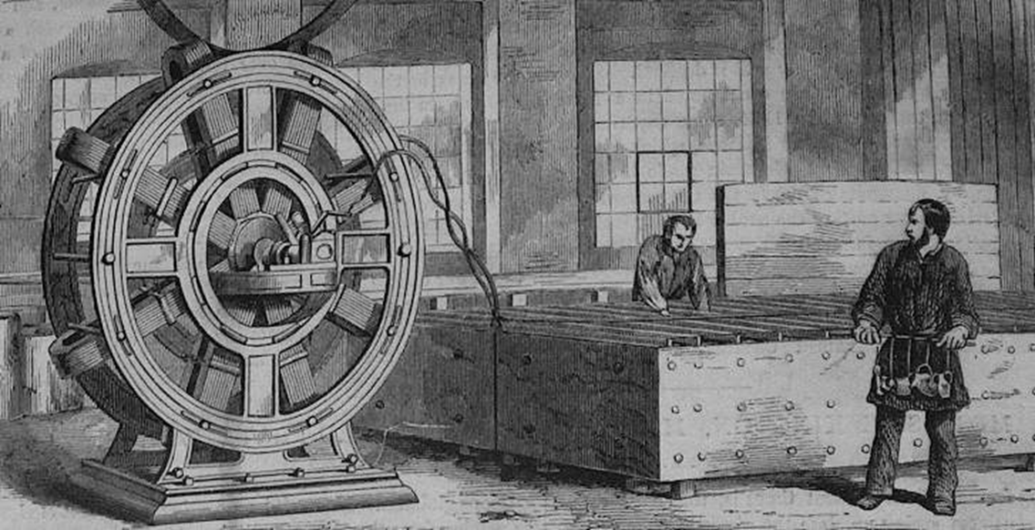

Slide 12
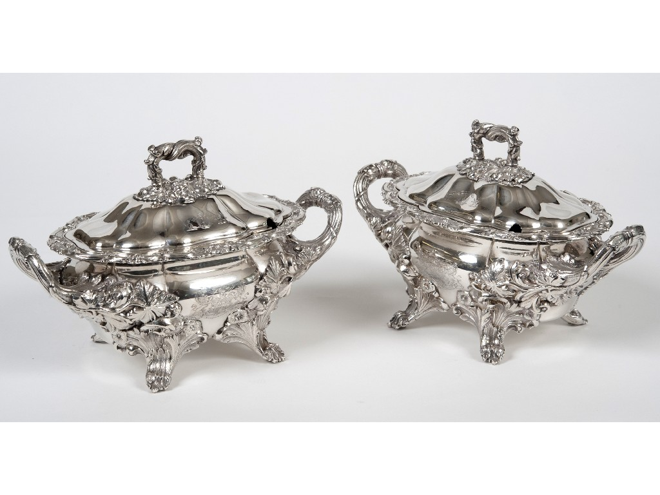

Slide 13
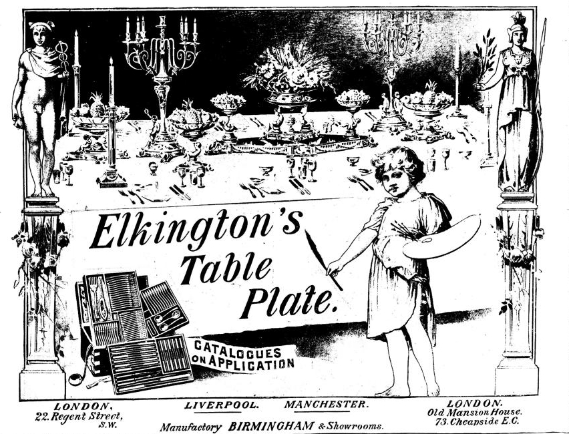
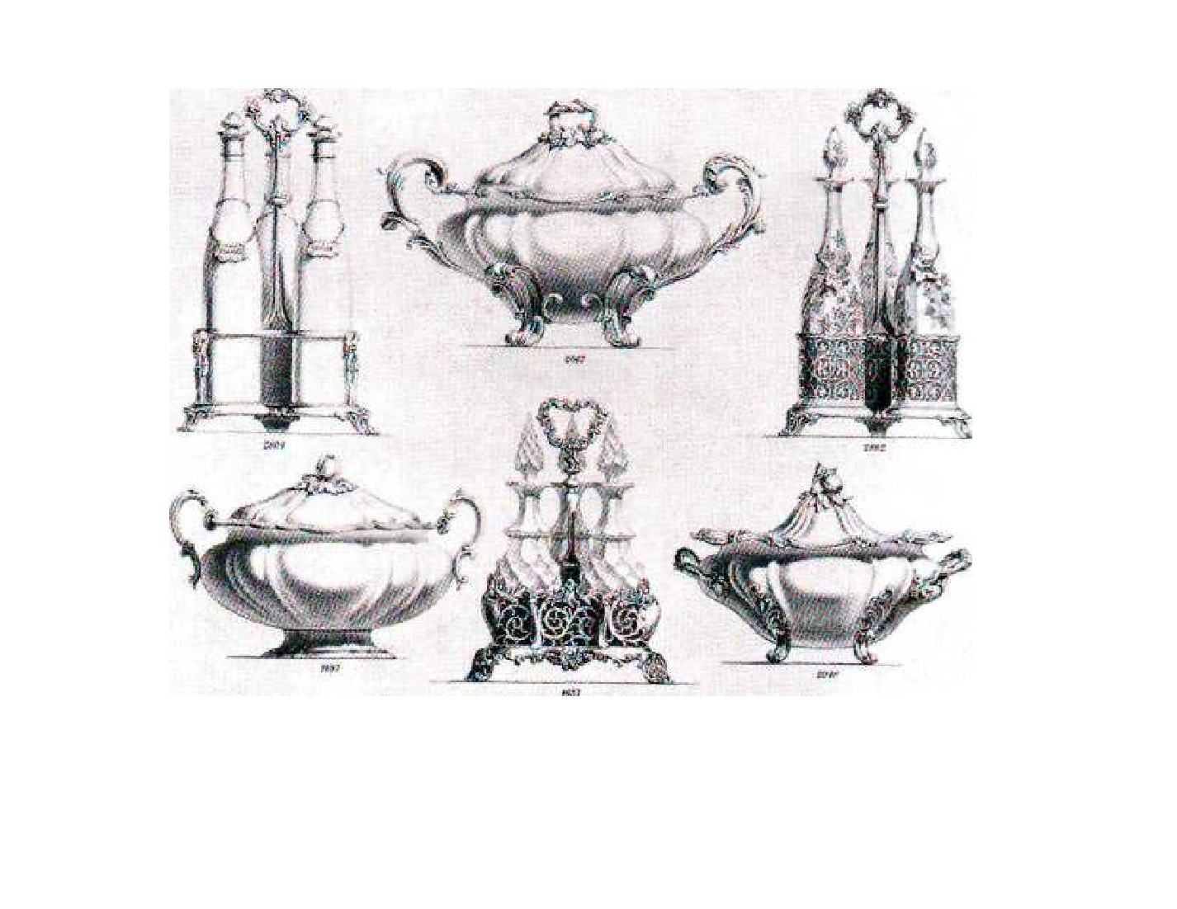

Slide 14
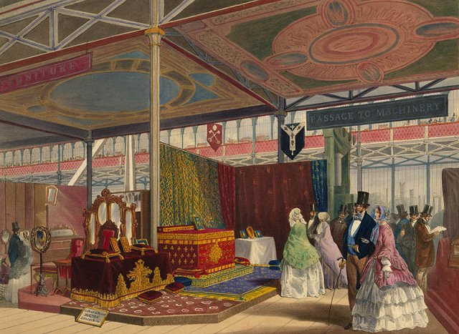
“Its grandeur does not consist in one thing, but in the unique assemblage of all things. Whatever human industry has created you find here.“
Charlotte Brontë, letter of 1851

Slide 15
1851
The first World’s Fair
“The Crystal Palace”

Slide 16
The “American System” of manufacture was also on display at the Crystal Palace

Slide 17
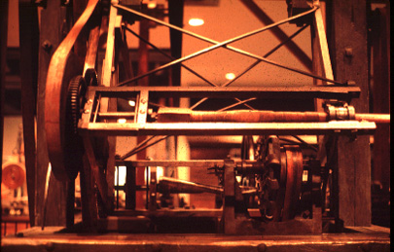
American System of Manufacture
division of labor
mechanization (special-purpose machine tools)
standardization
interchangeable parts
lathe machine
for cutting a gunstock to match a pattern

Slide 18
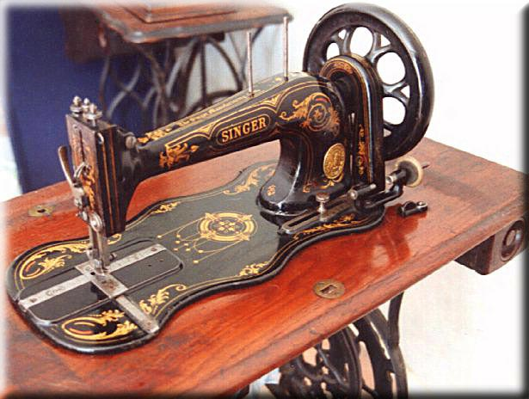
New machine tools revolutionized the manufacture of clocks, textile machinery, printing machines, locomotives, cash registers, typewriters, sewing machines, bicycles, and many more things…

Slide 19
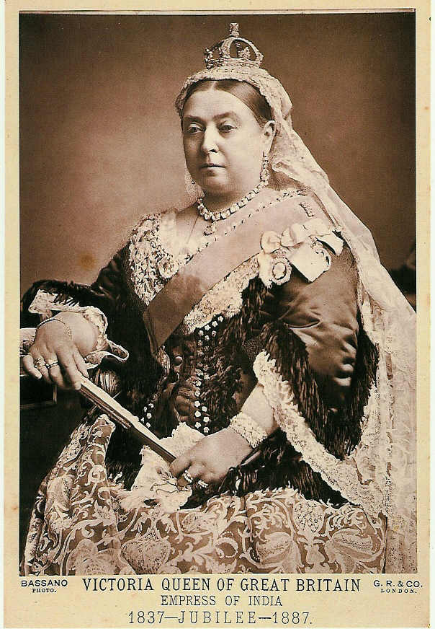
Victorian Taste
(Furniture and Interiors)
Queen Victoria
(reigned: 1837 – 1901)

Slide 20
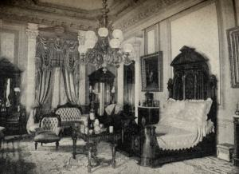
1850s and beyond…
Furniture got bigger, showier.
Interiors were more lavishly, more densely decorated.

Slide 21
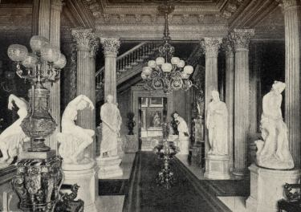
Entrance Hall, A. T. Stewart residence, New York City, 1870

Slide 22
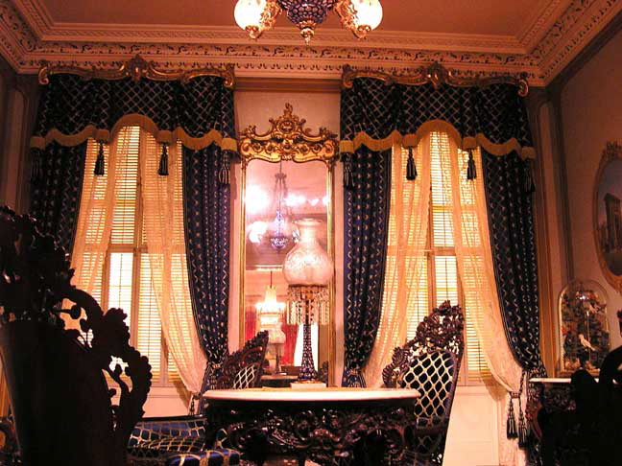
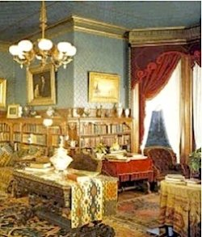
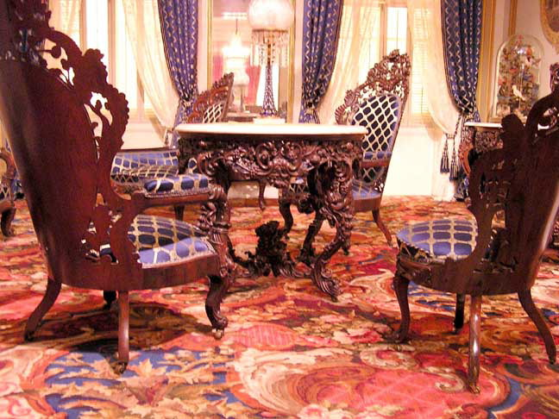

Slide 23
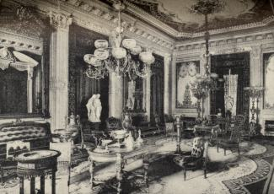
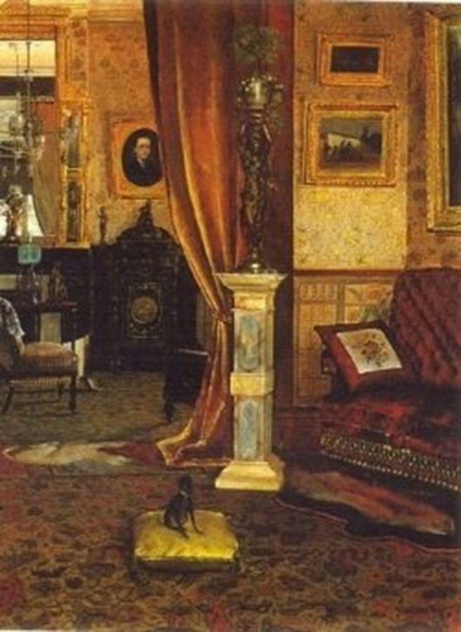
The formal drawing room or parlour

Slide 24
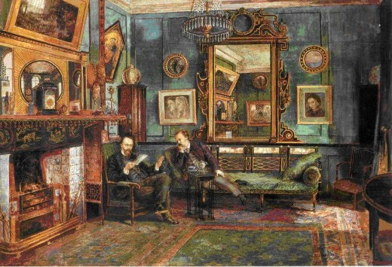
Watercolor depicting a more intimate sitting room

Slide 25
