Slide 1
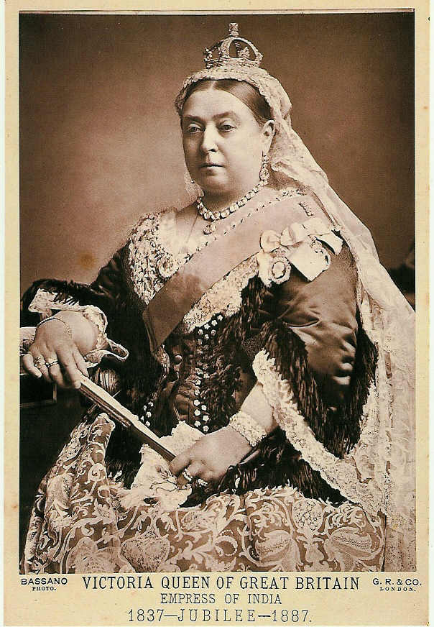
Victorian Taste
(Furniture and Interiors)
Queen Victoria
(reigned: 1837 – 1901)

Slide 2
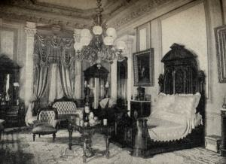
1850s and beyond…
Furniture got bigger, showier.
Interiors were more lavishly, more densely decorated.

Slide 3
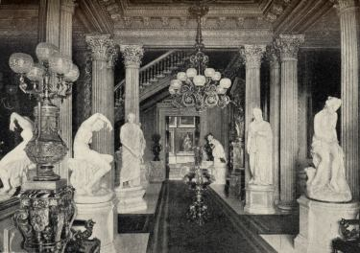
Entrance Hall, A. T. Stewart residence, New York City, 1870

Slide 4
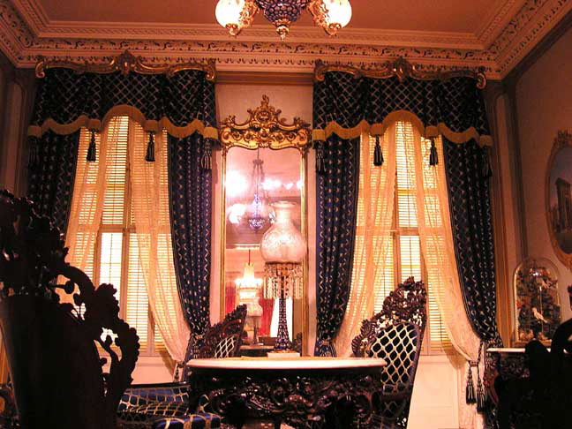
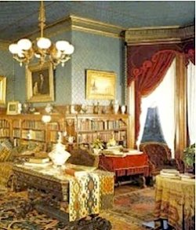
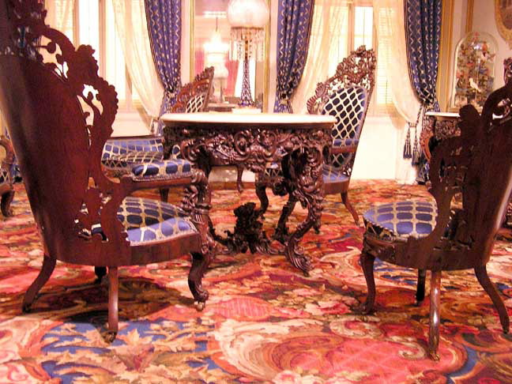

Slide 5
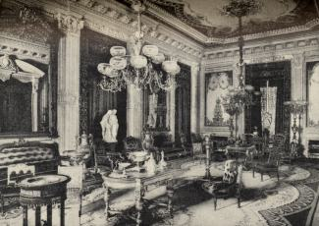
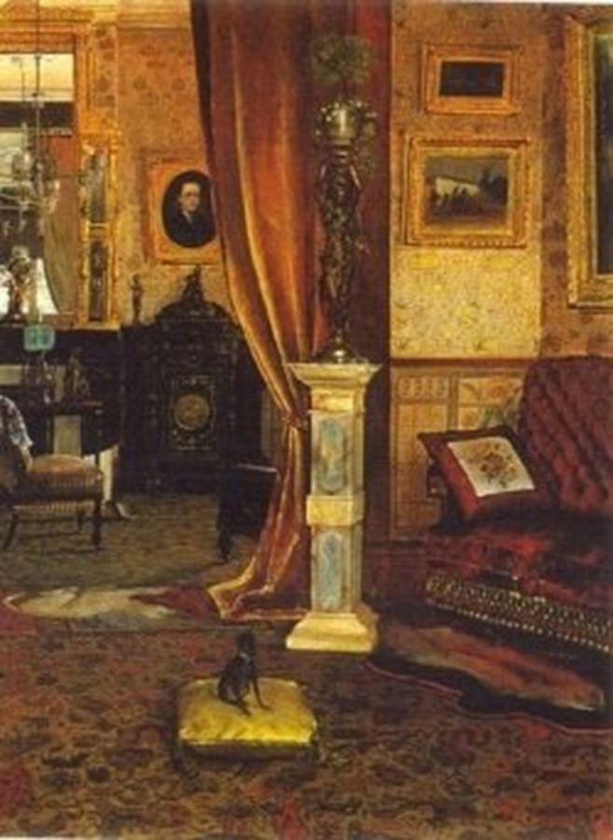
The formal drawing room or parlour

Slide 6
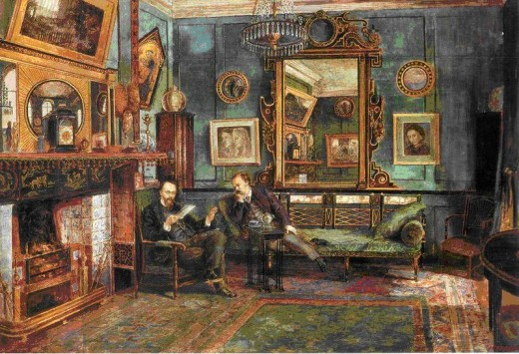
Watercolor depicting a more intimate sitting room

Slide 7
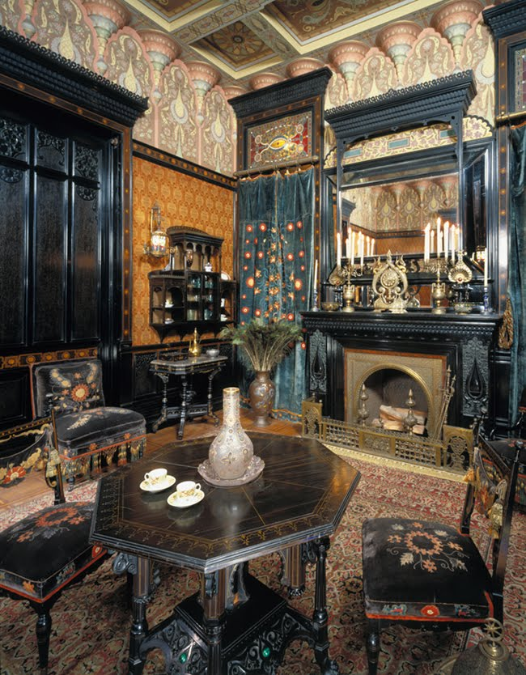

Slide 8
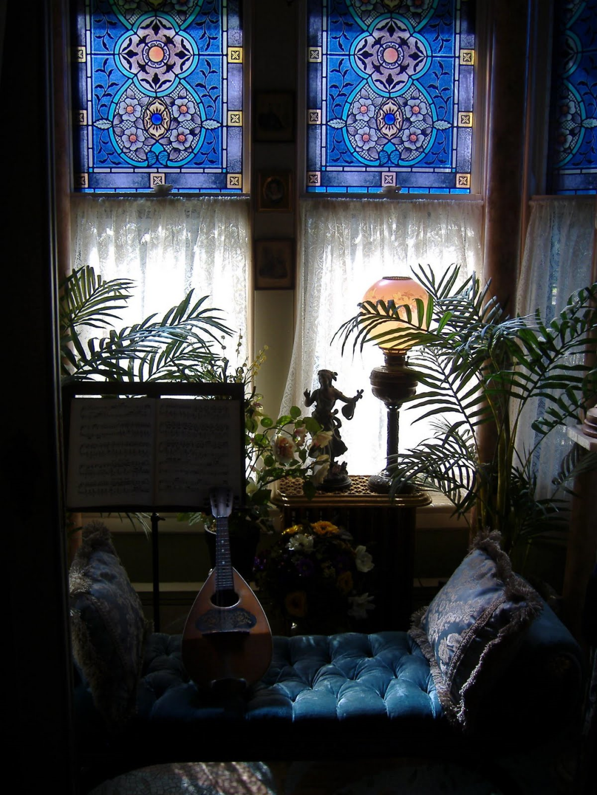
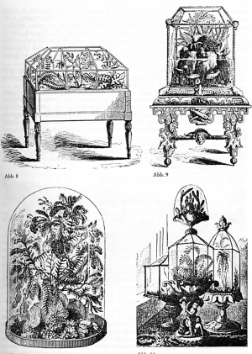

Slide 9
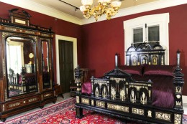

Slide 10
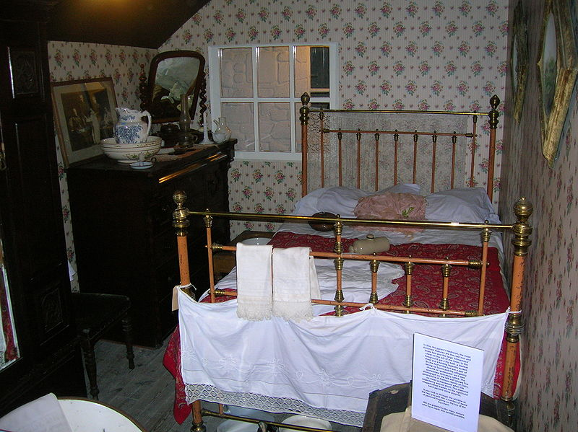
Victorian Bedroom exhibition, Dalgarven Mill, Ayrshire, Scotland

Slide 11
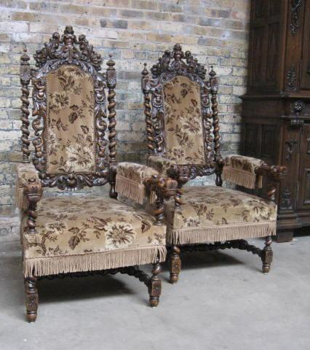
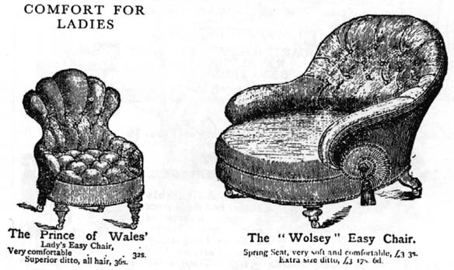
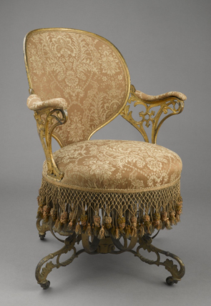
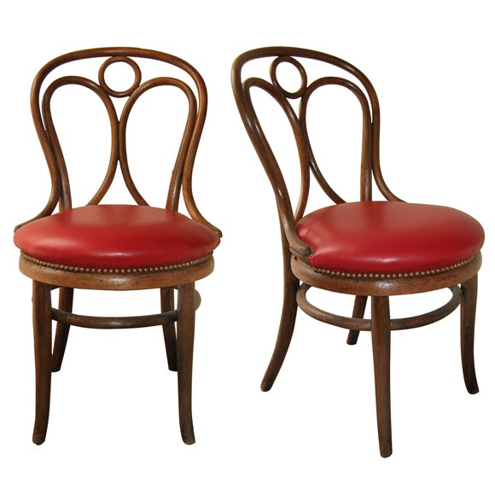
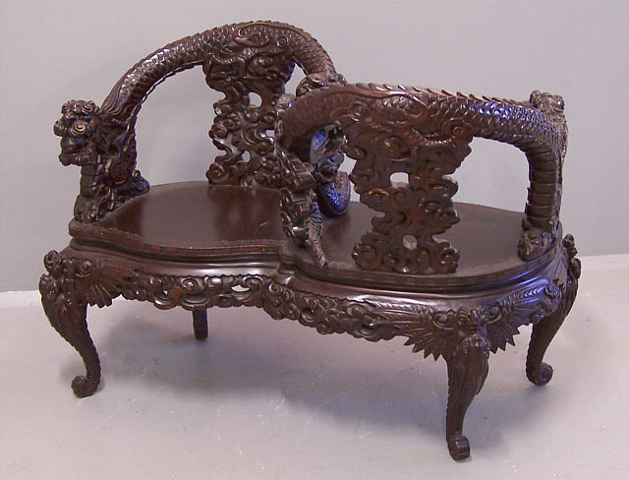
Furniture could be bought from the new department stores or in America by mail order.
Furniture companies used rich fabrics with added details like buttoning, tufting, pleating, and fringing to create sumptuous effects.
Variety and ornamentation ruled.

Slide 12
Victorian Architecture
Characterized by….eclecticism!
1. domestic architecture
2. the exotic
3. industrial age materials
4. eclectic historicism (revivalism)

Slide 13
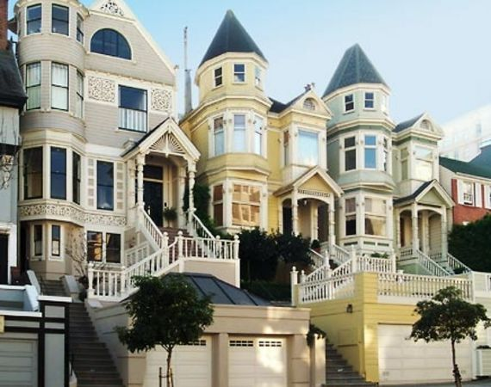
Victorian domestic architecture
Many different styles, including:
Queen Anne Style (below)

Slide 14
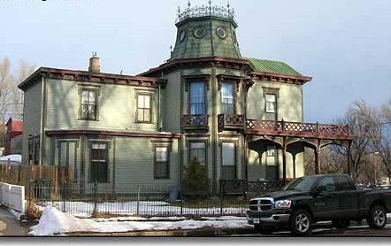
“Victorian” or “Victorian Composite”

Slide 15
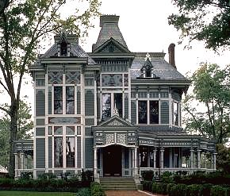

Slide 16
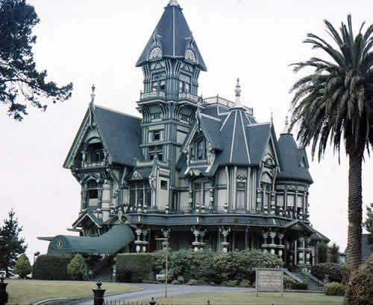
Carson Mansion,
Eureka, CA

Slide 17
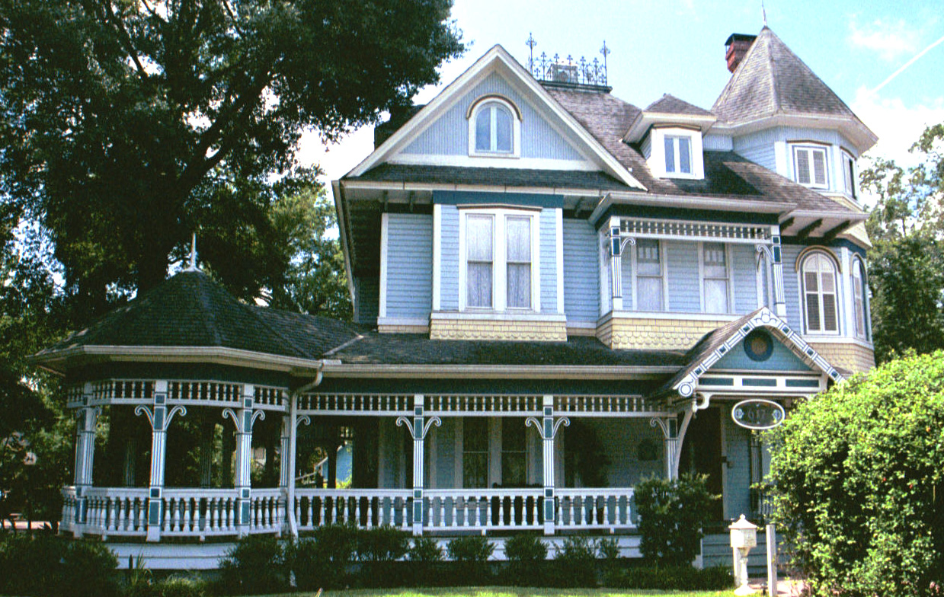
Sketch and label

Slide 18
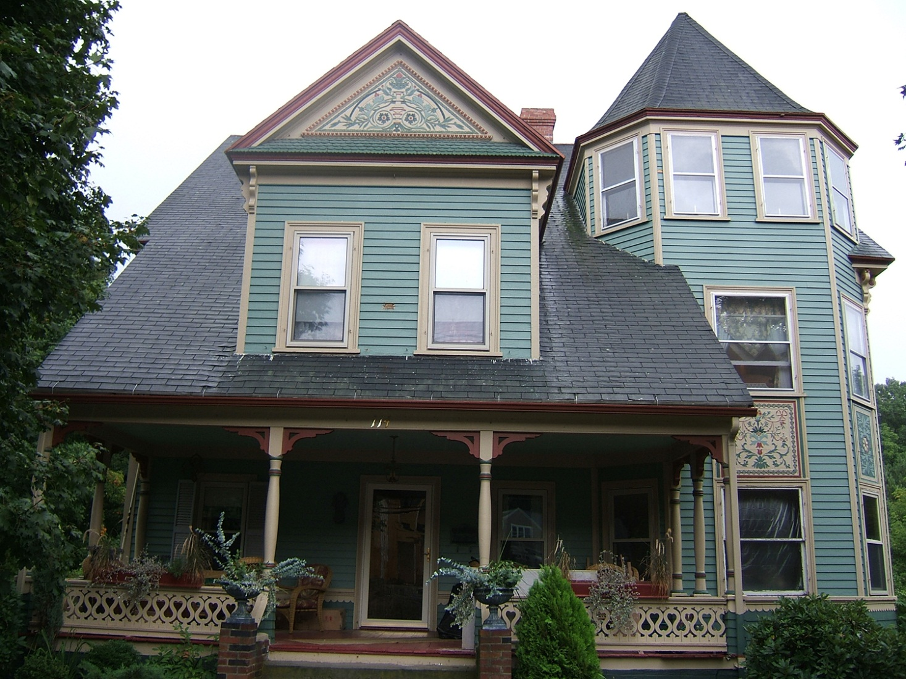
Eastlake style

Slide 19
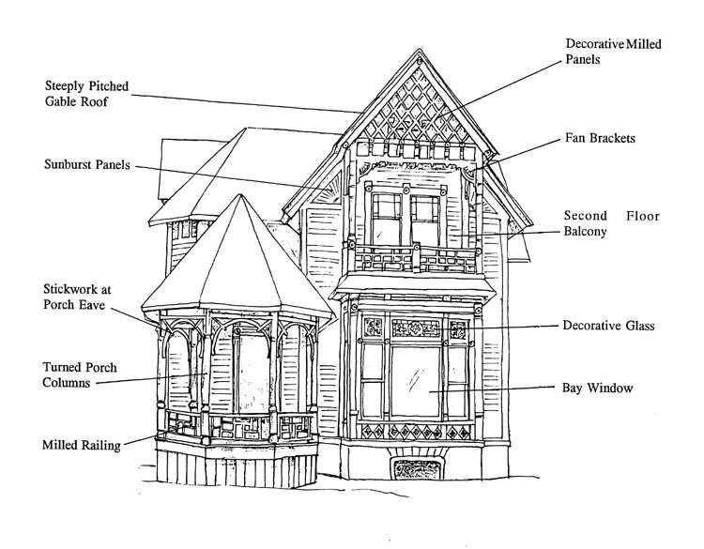
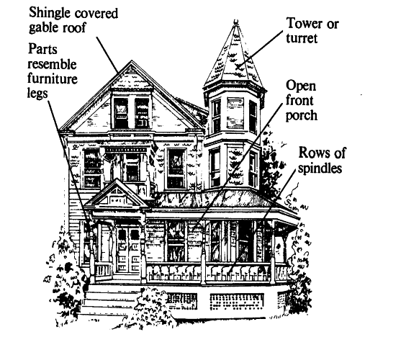
Eastlake-Stick style

Slide 20
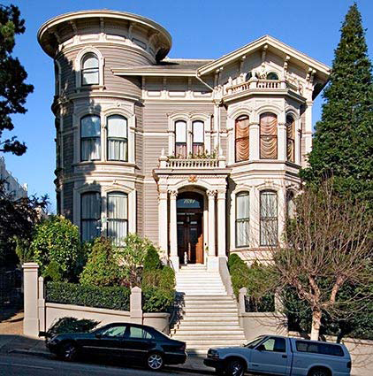
Composite Italianate and Queen Anne
Queen Anne Style

Slide 21
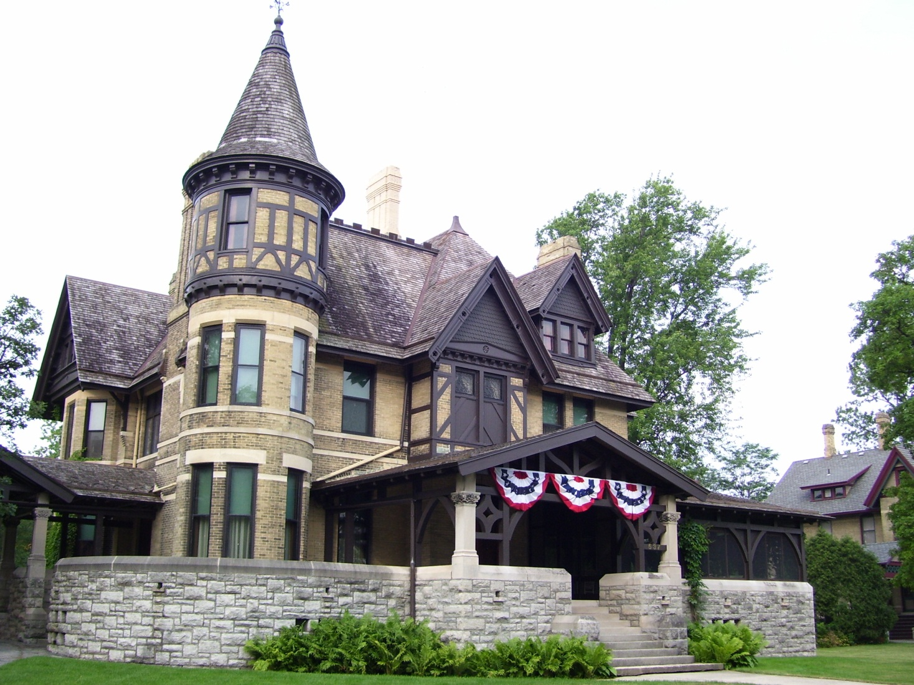
Composite of Tudor Revival,
Queen Anne, Stick, and Eastlake styles

Slide 22
Architecture that used
Industrial Age materials and techniques

Slide 23
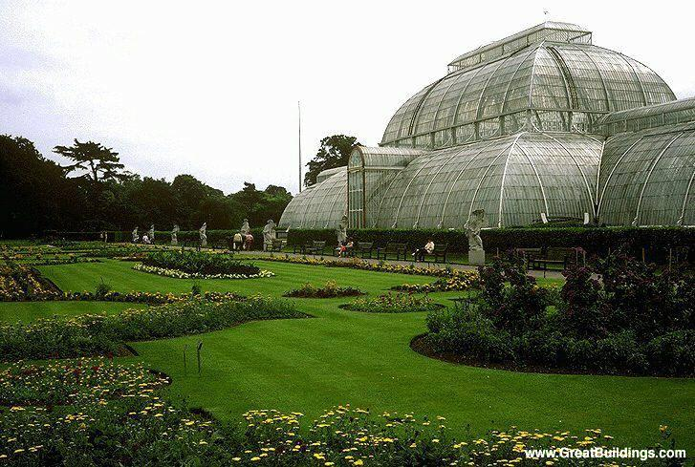
Palm House at Kew Gardens
(London)
The architect, Richard Turner, famous for his glasswork
Made from only
glass and iron
Natural light
Inspired the Crystal Palace

Slide 24
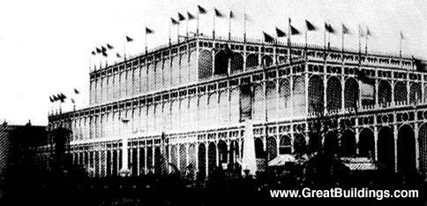
Crystal Palace
Built from cast iron and 49 inch glass sheets
Designed by Joseph Paxton
Built 1851 and relocated 1852

Slide 25
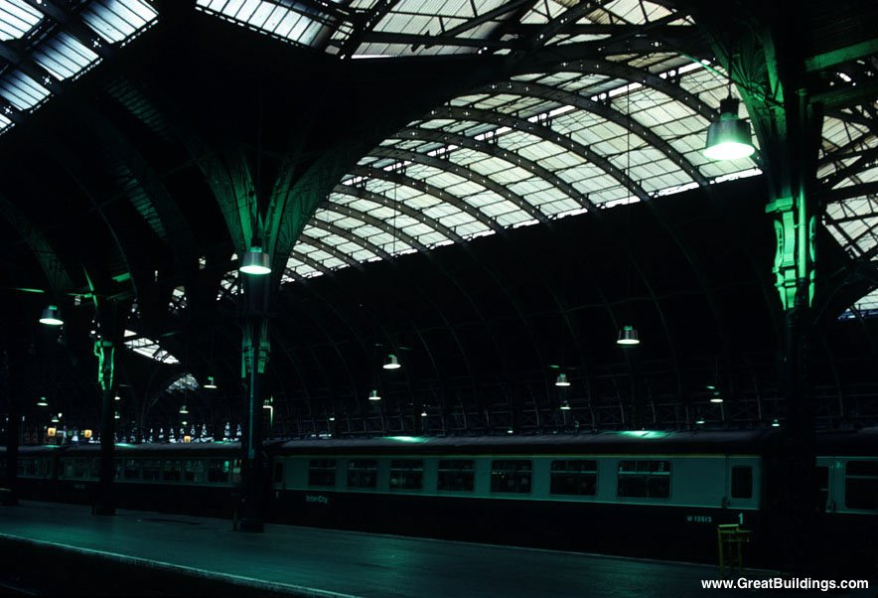
Paddington Station
(London, England)
1852-54
Built of cast iron and brick
- Natural light
- Little ornamentation

Slide 26
Architecture that combined
Industrial Age materials and techniques with familiar/fashionable styles and ornamentation

Slide 27
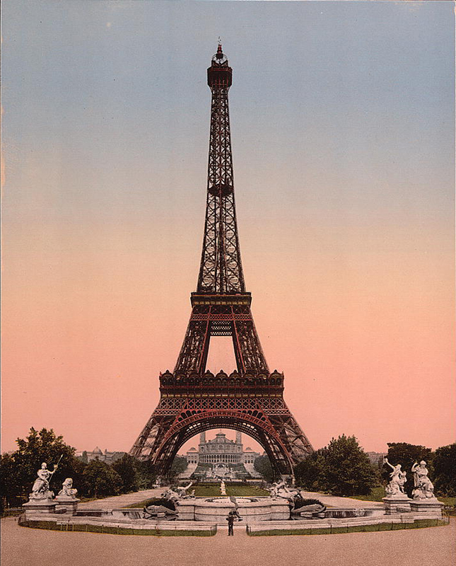
Eiffel Tower
Built from 1887 to 1889
Designed by Gustave Eiffel
Made of iron bridge pythons
Simple structure of four
curving iron piers for
great stability
Structural Expression

Slide 28
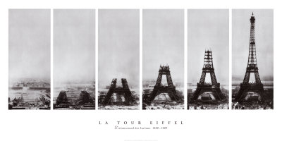

Slide 29
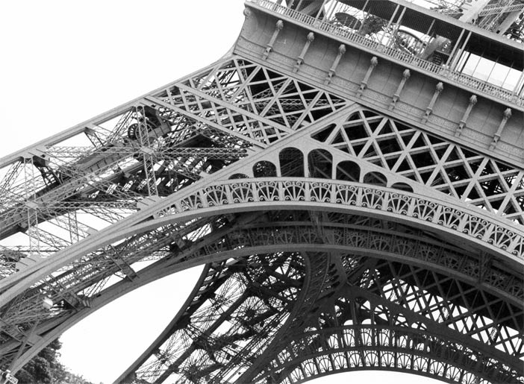

Slide 30
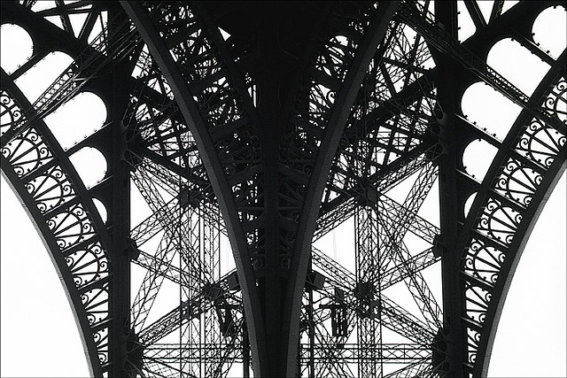

Slide 31
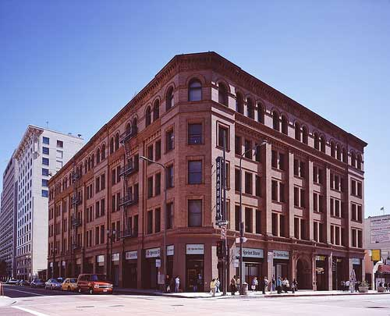
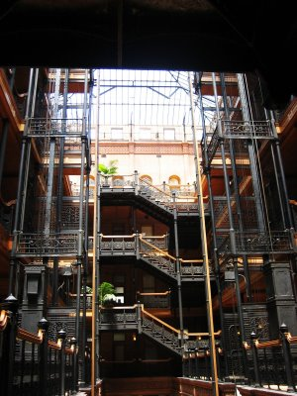
The Bradbury Building
(Los Angeles, CA)
Built 1889 -1893 Designed by George Wyman
Exterior: ______ Revivalist
Interior: Structural Expressionist

Slide 32
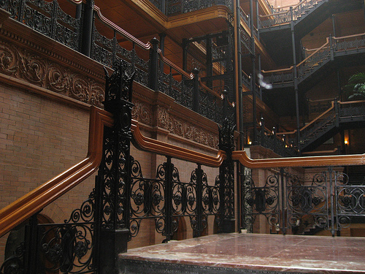
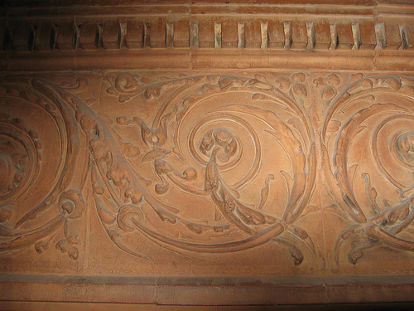

Slide 33
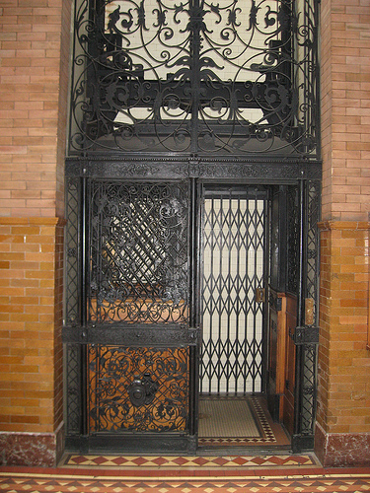
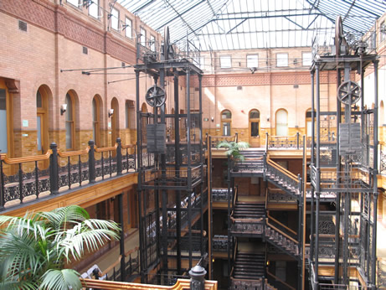

Slide 34
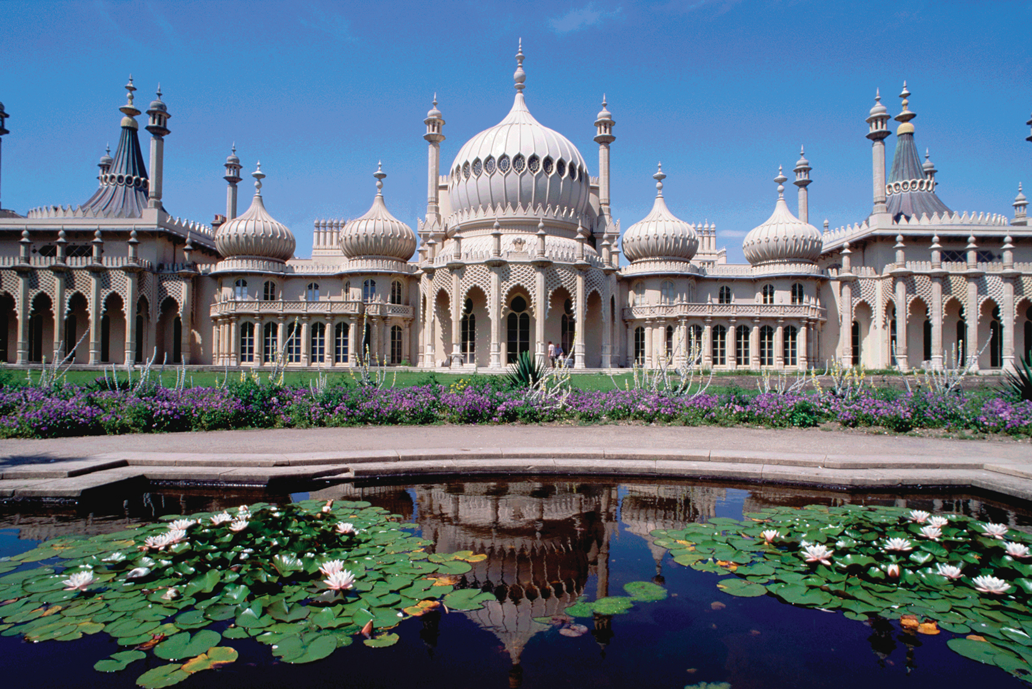
JOHN NASH,
Royal Pavilion, Brighton, England,
The Exotic

Slide 35
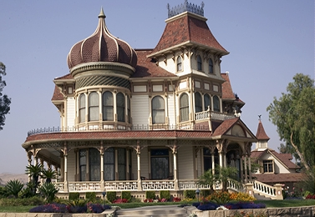
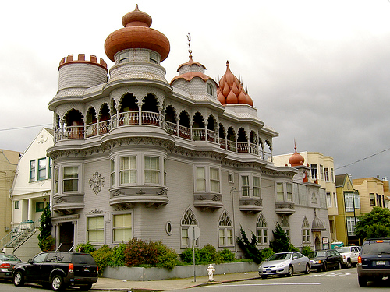

Slide 36
Revivalist Styles of Victorian Architecture
_(fill in the blank) _ Revival
- Classical (Greco-Roman)
Medieval
  Romanesque
  Gothic
Renaissance
Baroque

Slide 37
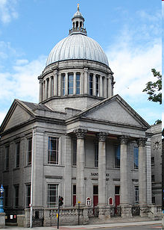
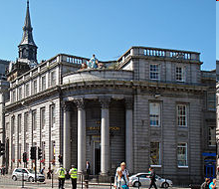
________ Revival
Archibald Simpson
North of Scotland Bank, Aberdeen
Alexander Marshall Mackenzie
St. Mark’s Church

Slide 38
Classical Revival
Archibald Simpson
North of Scotland Bank, Aberdeen
Alexander Marshall Mackenzie
St. Mark’s Church

Slide 39
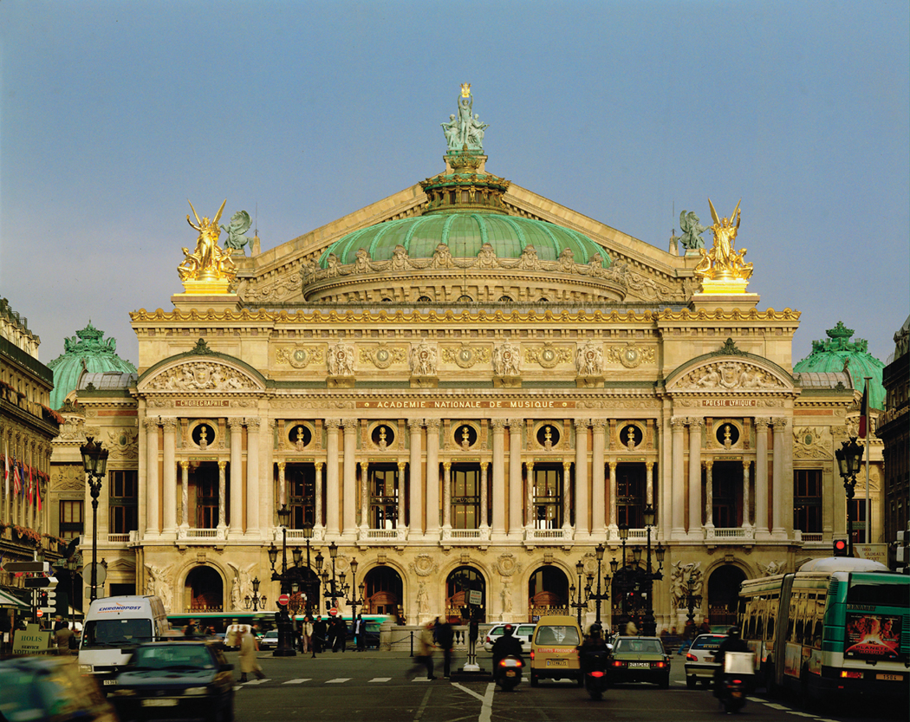
J. L. CHARLES GARNIER, the Opéra, Paris, France,
1861–1874.
________ Revival

Slide 40
J. L. CHARLES GARNIER, the Opéra, Paris, France,
1861–1874.
Baroque Revival

Slide 41
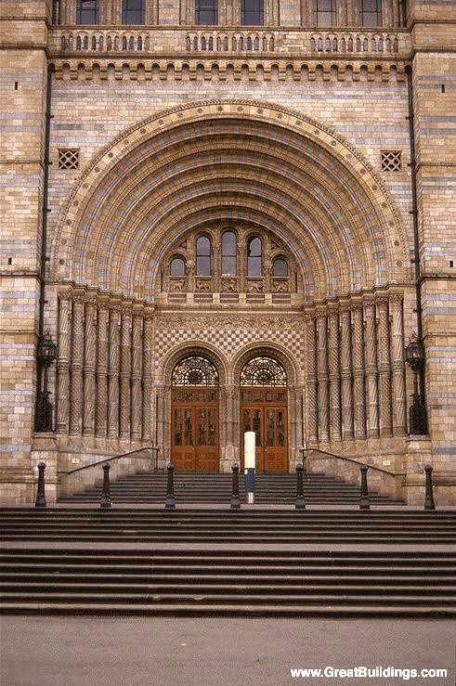
Museum of Natural History (London, England),
Built 1860 to 1880 designed by Alfred Waterhouse
__________ Revival

Slide 42
Museum of Natural History (London, England),
Built 1860 to 1880 designed by Alfred Waterhouse
Romanesque Revival
Made with concrete vaults and terra cotta cladding
w/modern elements:
Glass roof (natural light)

Slide 43
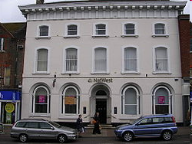
____________ Revival
National Westminster Bank

Slide 44
Renaissance Revival (1840–90)
National Westminster Bank

Slide 45

CHARLES BARRY and
A. W. N. PUGIN,
Houses of Parliament, London, England, designed 1835.
____________ Revival

Slide 46

Houses of Parliament
(Palace of Westminster),
London
Sint-Petrus-en-Pauluskerk,
Ostend, Belgium
Cathedral of Learning, Pittsburgh

Slide 47
The Gothic Revival (or Victorian Gothic)
a reflection of Design Reform ideals
and/or
a reflection of Romanticism and eclectic historicism

Slide 48

Illustration for Mary Shelley’s Frankenstein (1831 release)

Slide 49


1140 - 1400 “The French Style”
Later known as “Gothic”
19th Century Gothic Revival or Neo-Gothic

Slide 50

1140 - 1400
“The French Style”
Later known as “Gothic”
1980s – present “Goth”
19th Century “Gothic Revival” or “Neo-Gothic”

Slide 51

Cardiff Castle in Wales, designed by William Burges and completed in 1881

Slide 52


The summer and winter smoking rooms at Cardiff Castle

