Slide 1
New approaches to photography - Ella

Slide 2
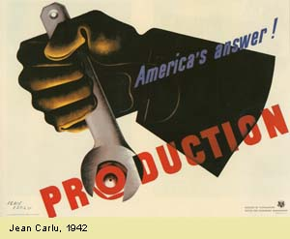
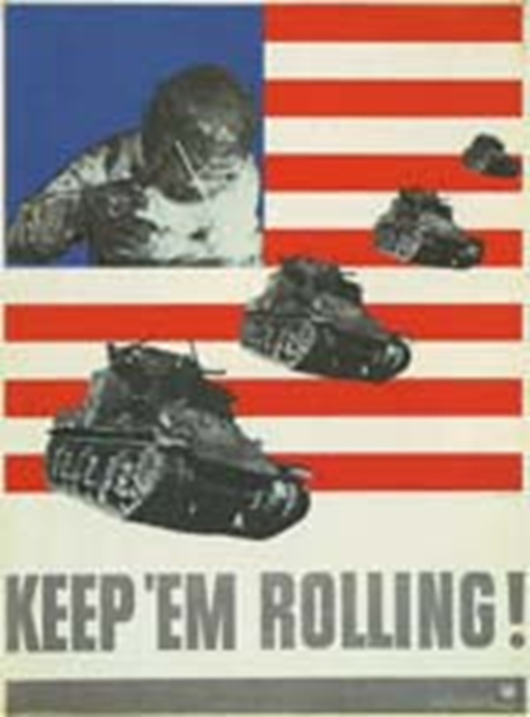
The spread of New Typography and the codification of the modern

Slide 3
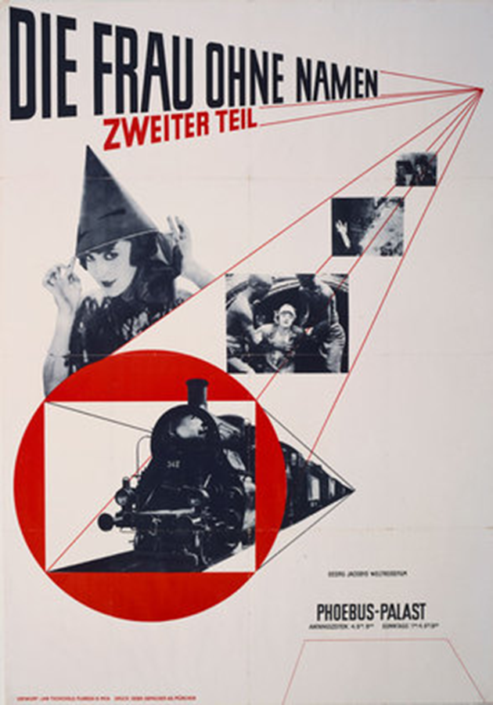
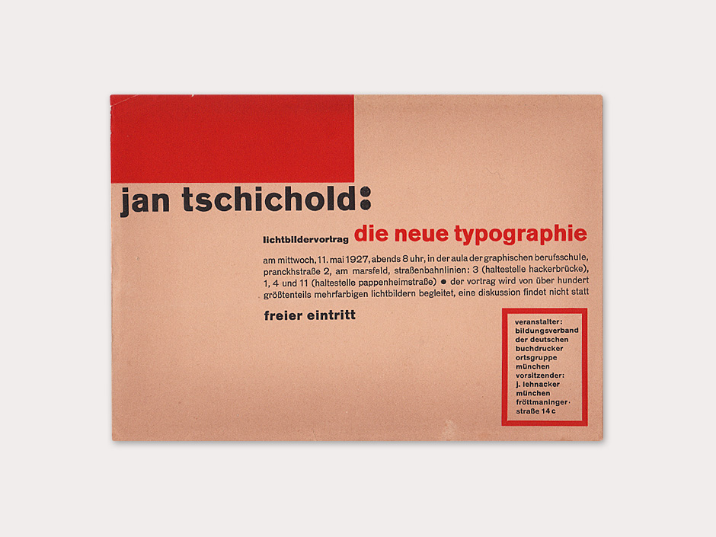
Jan Tschichold

Slide 4
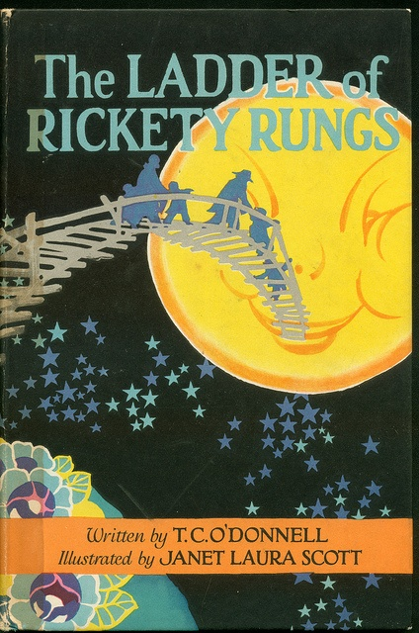
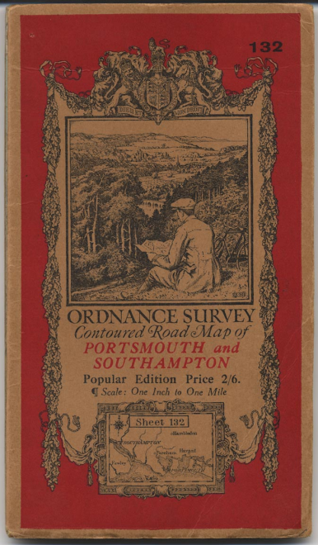
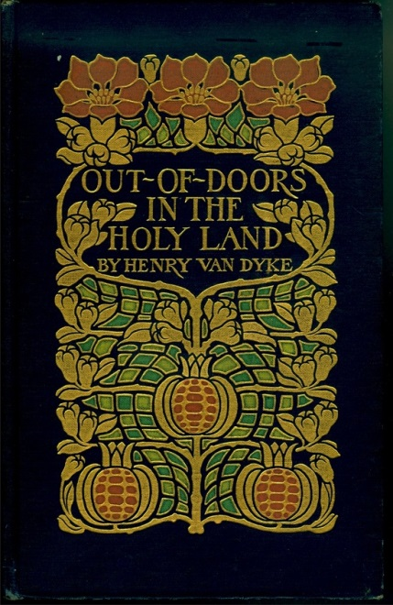
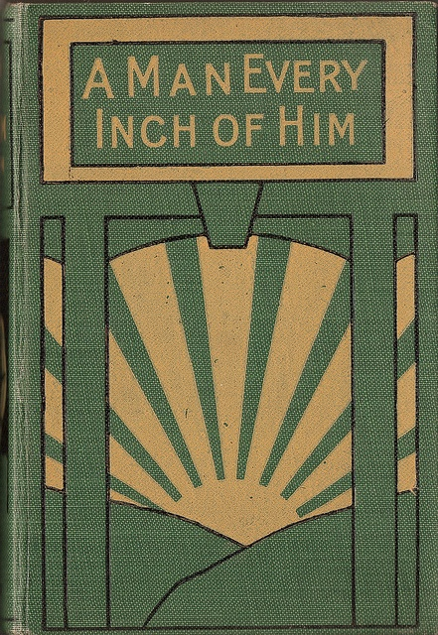
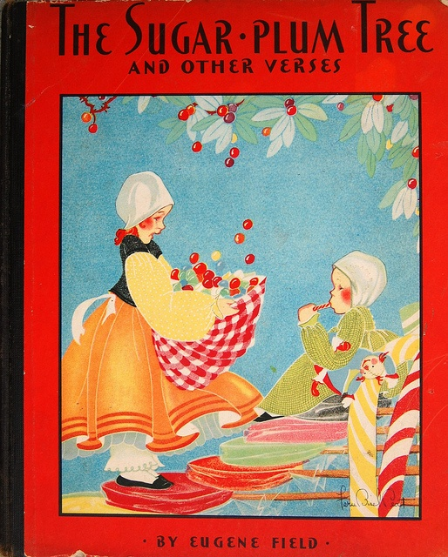
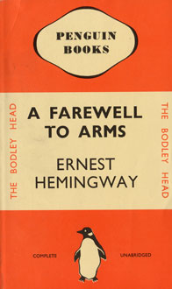

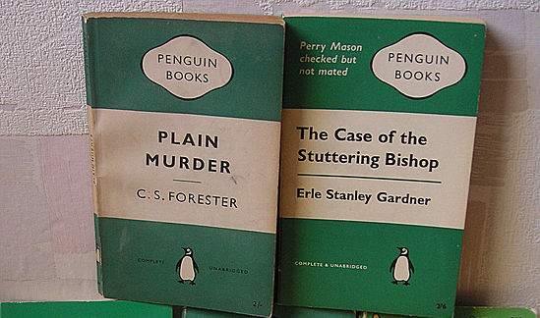

Slide 5
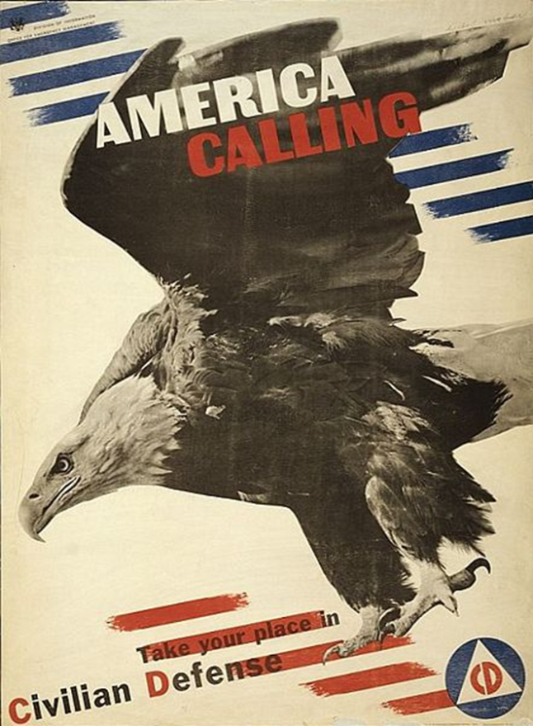
New Typography and
“The Modern Approach” in America

Slide 6
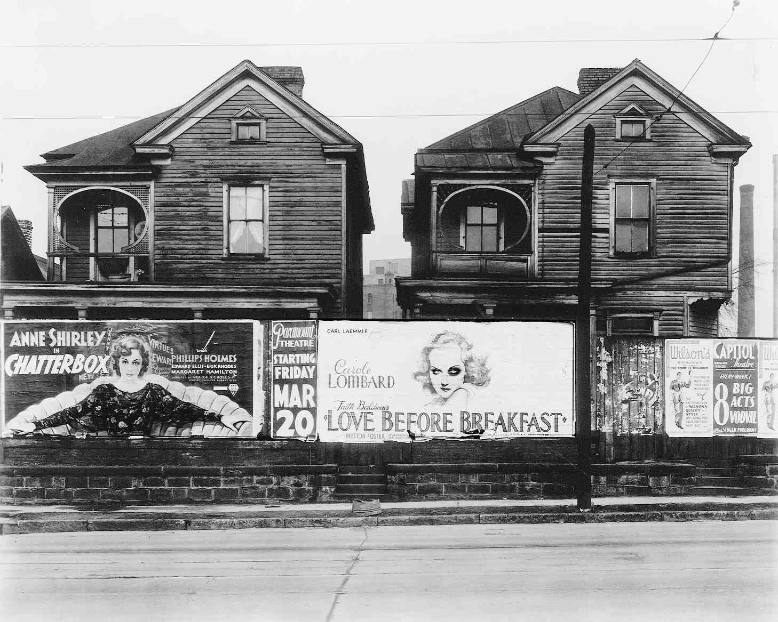
17-01
Notes:
Walker Evans, untitled, 1936. Evans’s Atlanta photograph contrasting decaying homes and Depression-era movie posters documents a chasm between reality and graphic fantasy.

Slide 7
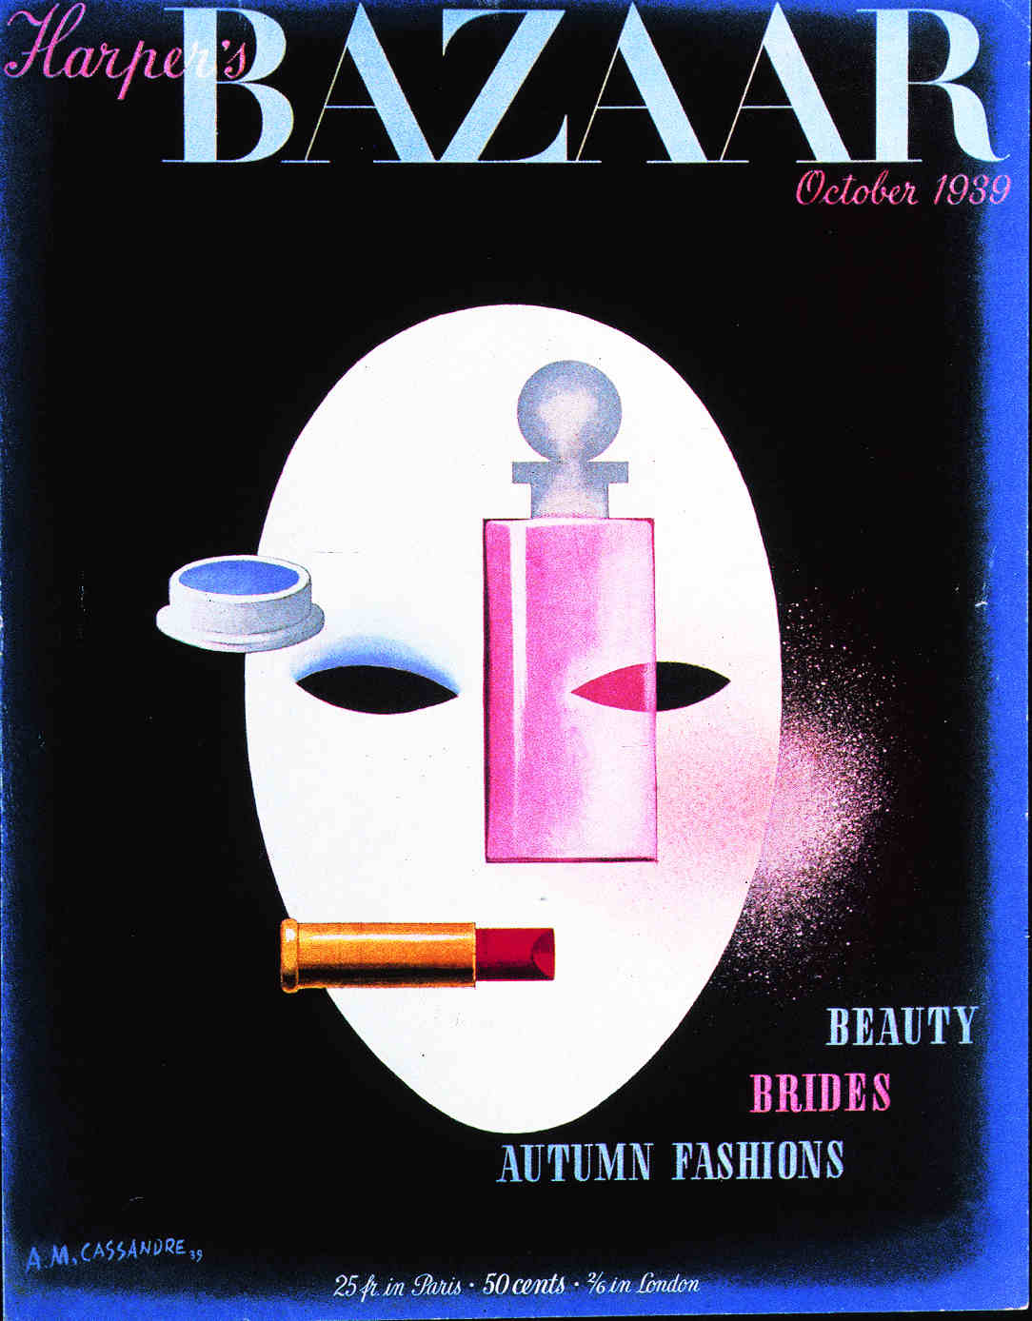

A. M. Cassandre, cover for Harper’s Bazaar, 1939.
Notes:
A. M. Cassandre, cover for Harper’s Bazaar, 1939. A perfume-bottle nose, lipstick mouth, and powder-puff cheek achieve simultaneity.

Slide 8
In America
The “Modern” approach to graphic design first appeared in:
Book design
Editorial design (fashion and business)
Promotional and corporate graphics
(not popular advertising) – why?

Slide 9
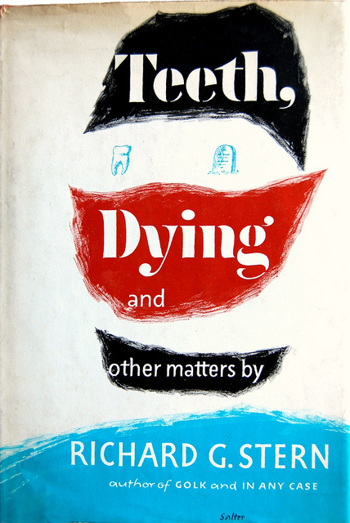
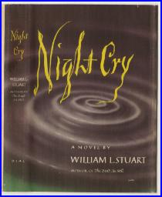
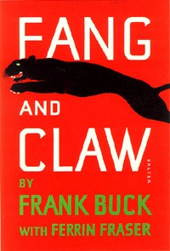

Book cover designs
by George Salter

Slide 10
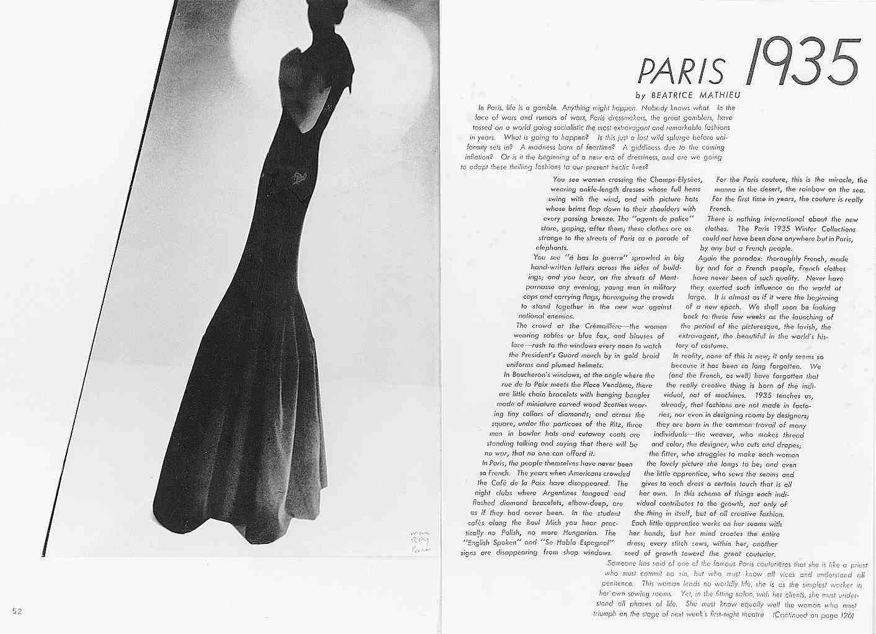
Alexey Brodovitch (art director) and Man Ray (photographer),
pages from Harper’s Bazaar, 1934.
Notes:
Alexey Brodovitch (art director) and Man Ray (photographer), pages from Harper’s Bazaar, 1934. The figure’s oblique thrust inspired a dynamic typographic page with several sizes and weights of geometric sans serifs.

Slide 11
And, soon, the modern approach appeared in public service posters
And a little later, in popular advertisements

Slide 12
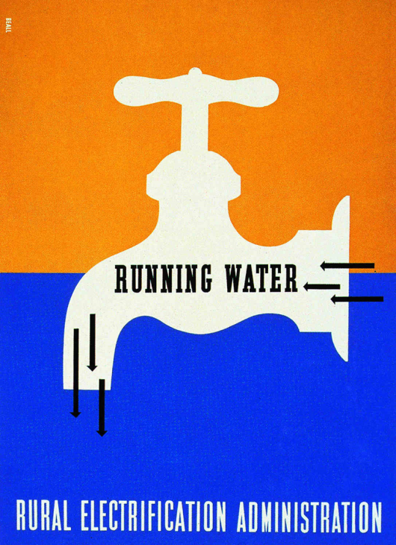
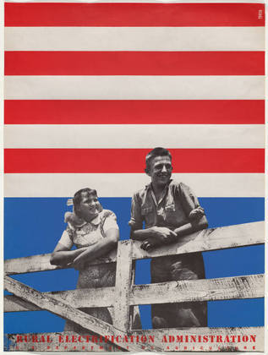
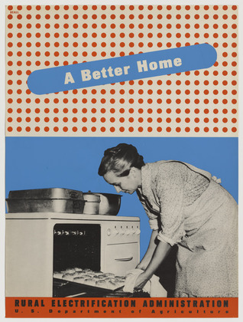
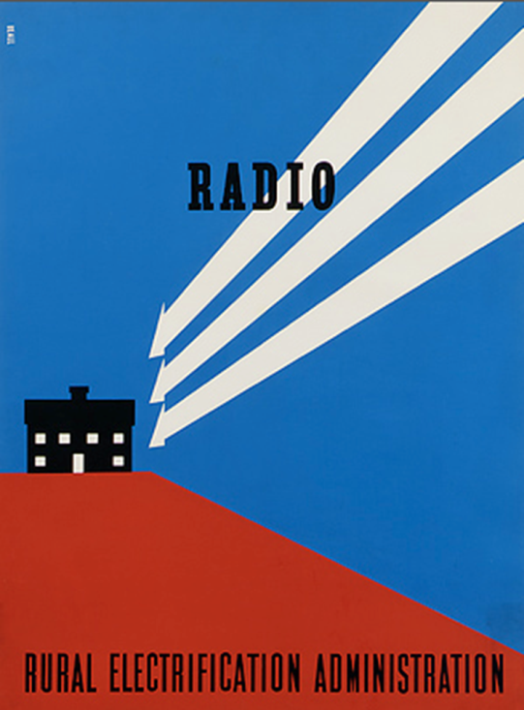
Lester Beall,
posters for the Rural Electrification Administration, c. 1937.
Notes:
Lester Beall, poster for the Rural Electrification Administration, c. 1937.

Slide 13
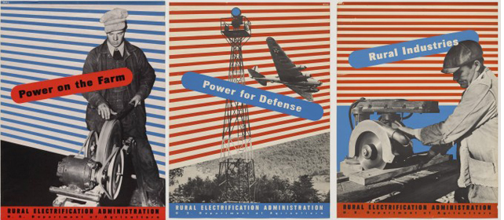

Slide 14
1930s WPA – Amanda

Slide 15
Late 1930s/1940s

Slide 16
New Typography the service of WWII

Slide 17
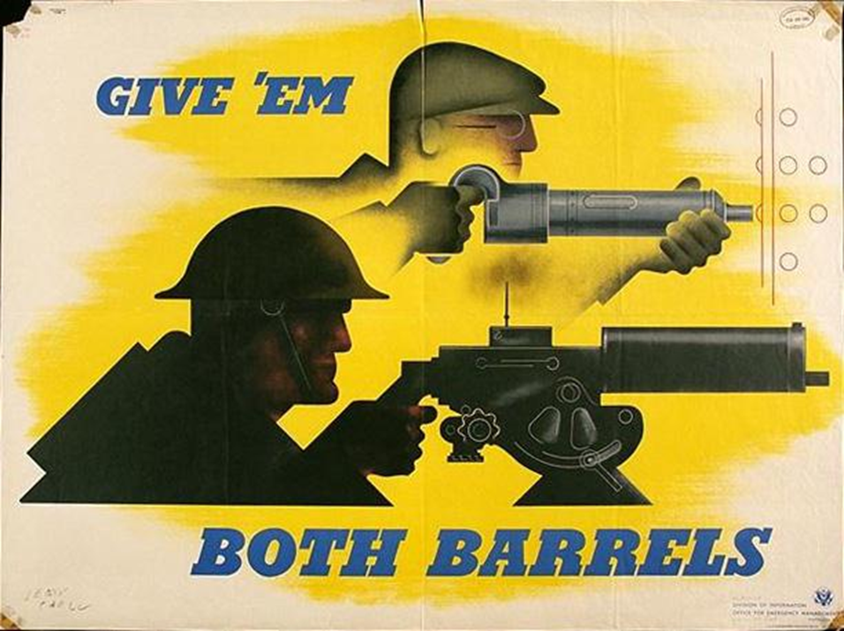

Slide 18
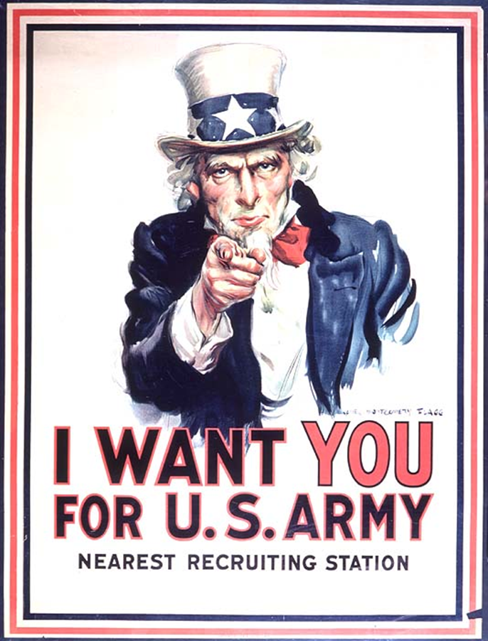
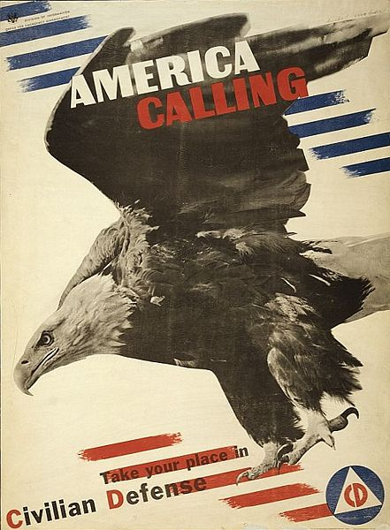

Slide 19
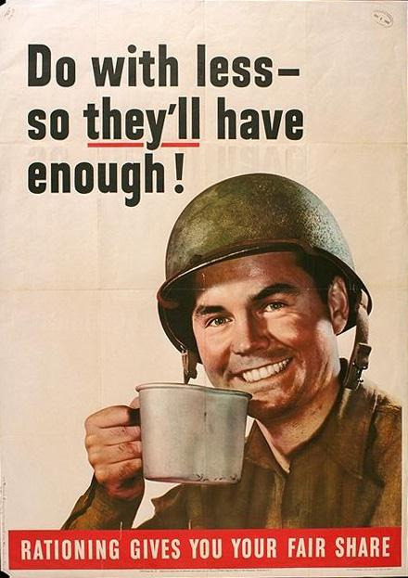
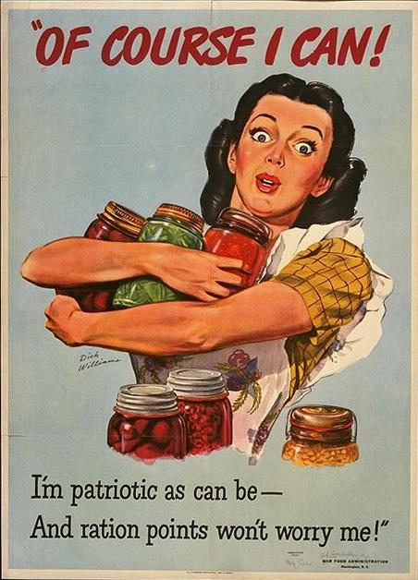

Slide 20
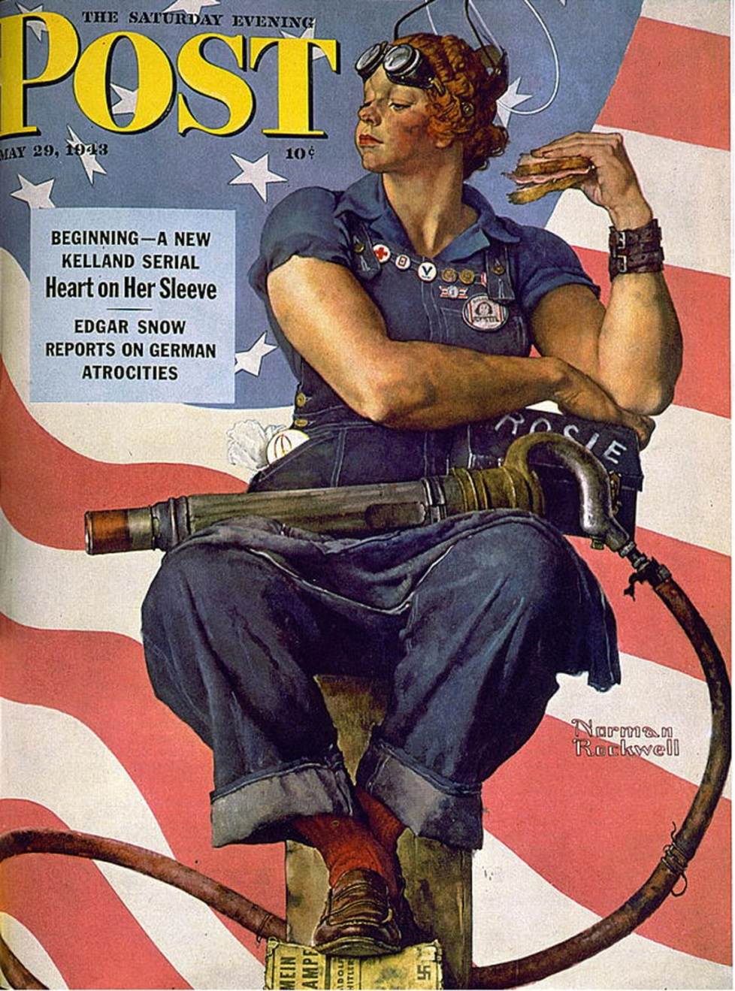
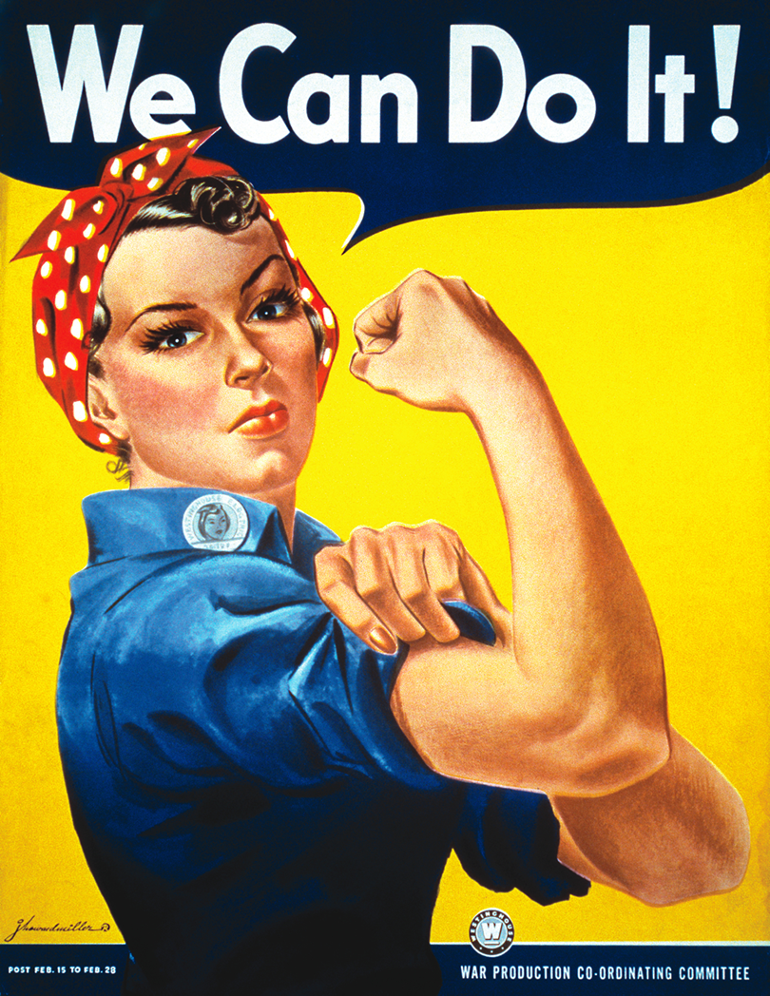

Slide 21


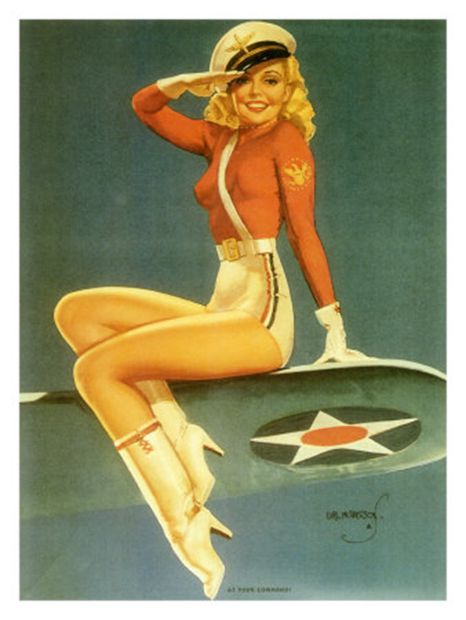

Slide 22
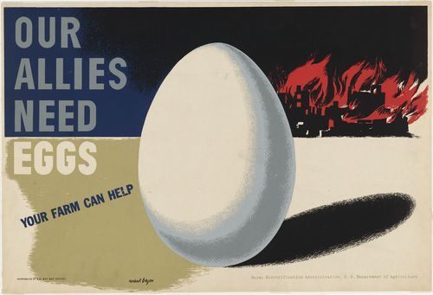
Herbert Bayer,
1943

Slide 23
1940s/50s
Heather - Informational and scientific graphics
Carolyn - New Swiss sans-serif typefaces
Brandon - International Typographic Style in America

Slide 24
Herbert Matter

Slide 25
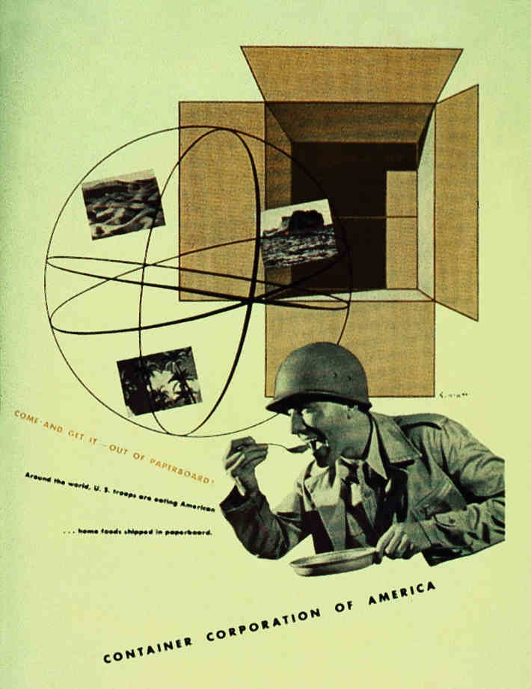
17-33
Herbert Matter, advertisement for CCA, 1943
Notes:
Herbert Matter, advertisement for CCA, 1943. A unified complex of images suggests global scope, paperboard boxes, and food for troops in harsh environmental conditions.

Slide 26
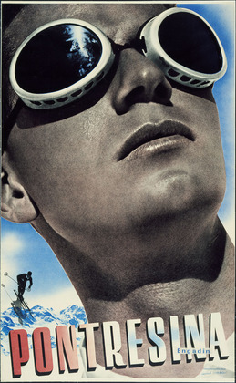
Herbert Matter,
Poster for Pontresina,
(1935)

Slide 27
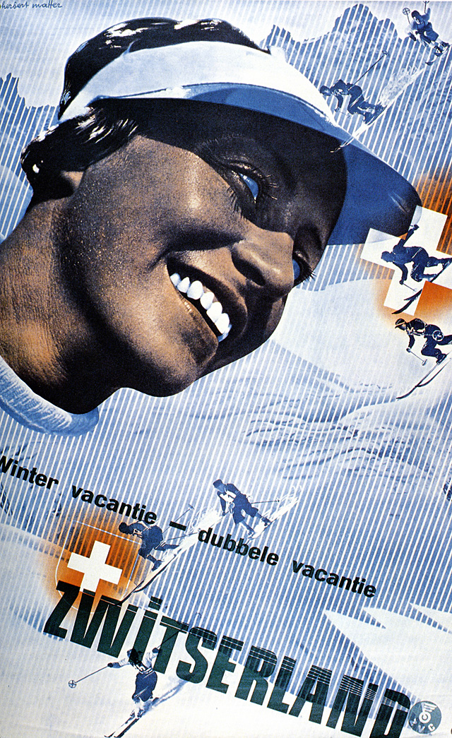
17-33
Notes:
Herbert Matter,

Slide 28
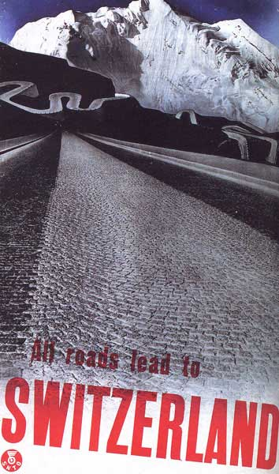

Slide 29
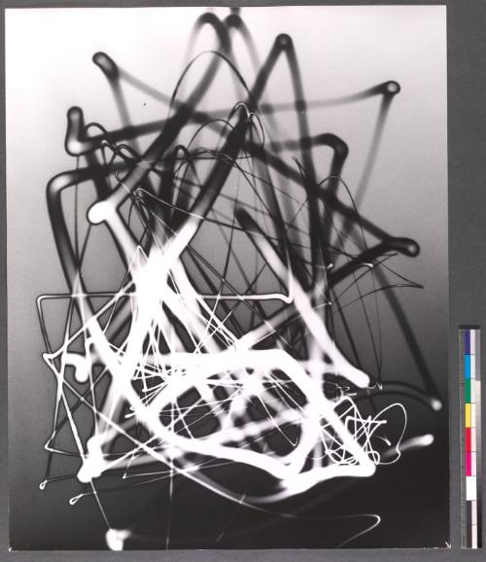
Light drawing, 1943, 6"x20"

Slide 30
END

Slide 31
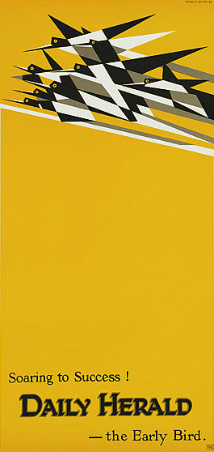
Notes:
E. McKnight Kauffer, poster “Flight”

Slide 32

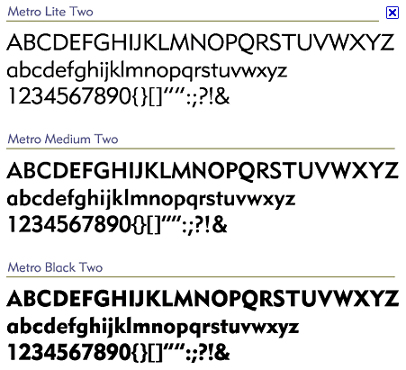
17-02
Notes:
William Addison Dwiggins Metro typeface.

Slide 33

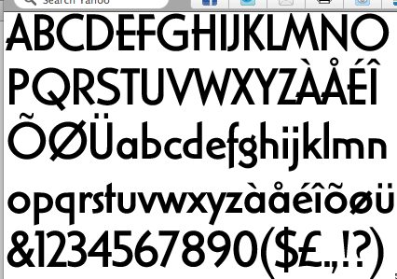
17-02
Notes:
William Addison Dwiggins Electra typeface.

Slide 34
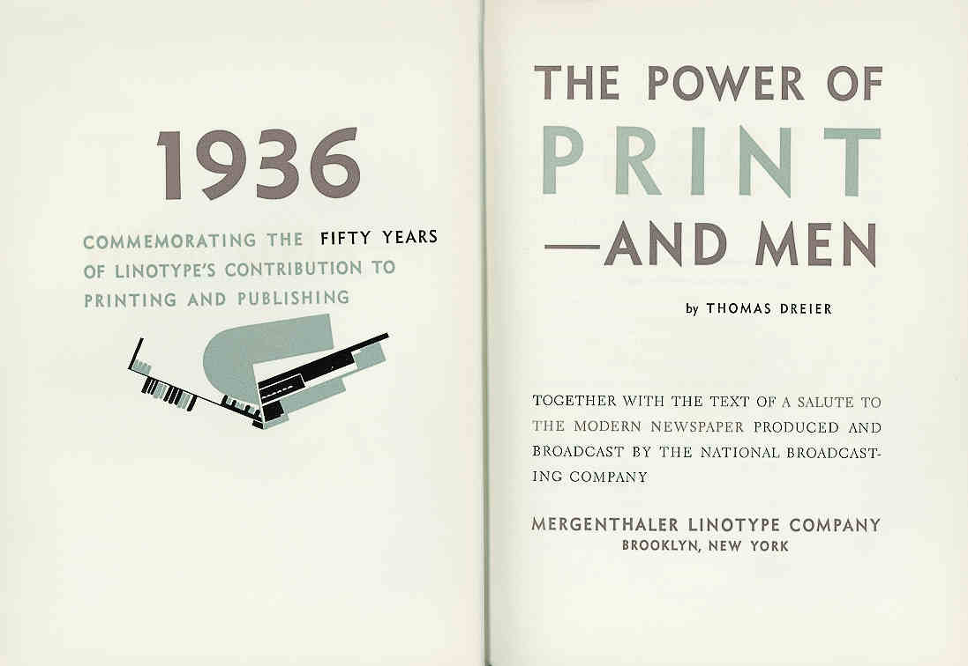
17-02
Excerpted from Meggs’ History of Graphic Design, Fourth Edition. Copyright 2005, All rights reserved. Published by John Wiley & Sons, Inc.
Notes:
William Addison Dwiggins, title pages from The Power of Print and Men, 1936. This title shows Dwiggins’s ornaments, his Metro and Electra typefaces, and his passion for subtle color combinations.

Slide 35
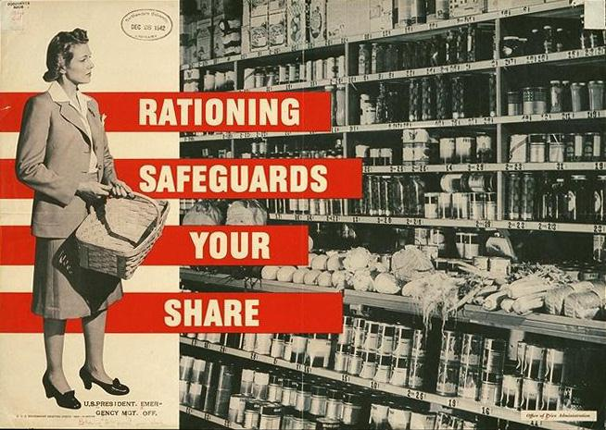

Slide 36
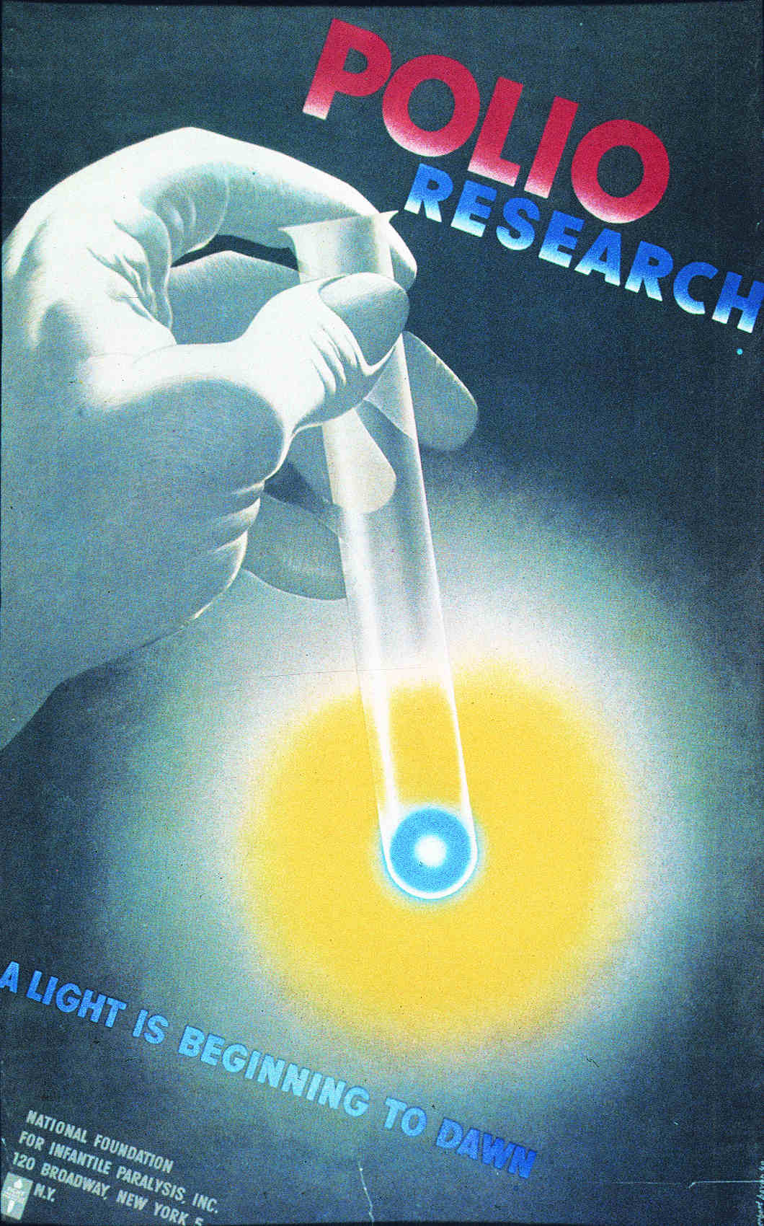
17-31
Herbert Bayer,
poster supporting polio research, 1949
Notes:
Herbert Bayer, poster supporting polio research, 1949. The diagonal shaft of the test tube leads the eye from the red and blue headline to the flowing yellow light that is beginning to dawn, linking the elements in the same manner as the thick black bars of Bayer’s Bauhaus work.

