Slide 1
American Art of 1800-1870
Real or Romantic?

Slide 2
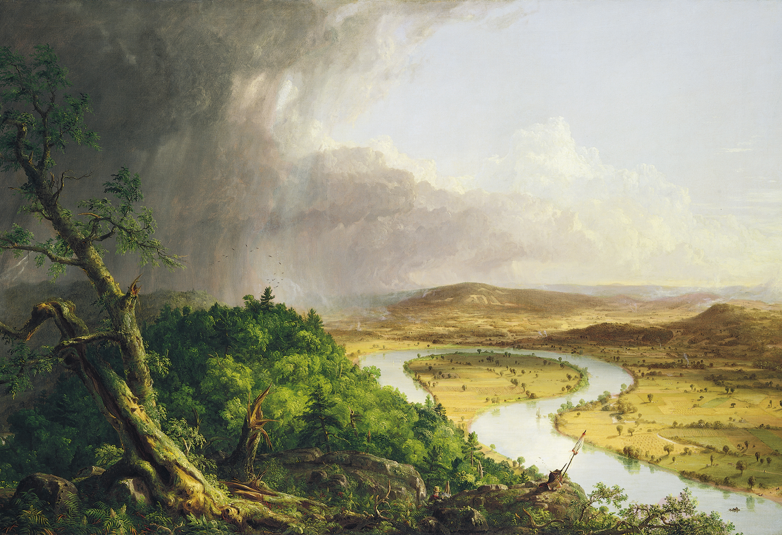
THOMAS COLE, The Oxbow (View from Mount Holyoke, Northampton, Massachusetts, after a Thunderstorm), 1836. Oil on canvas, 4’ 3 1/2” x 6’ 4”.

Slide 3
THOMAS COLE, The Oxbow, detail

Slide 4
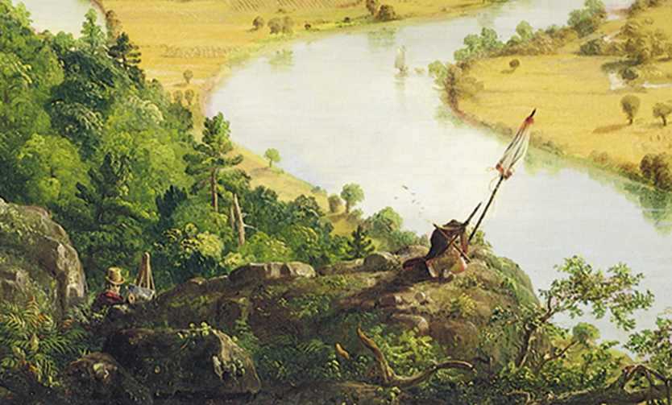

Slide 5
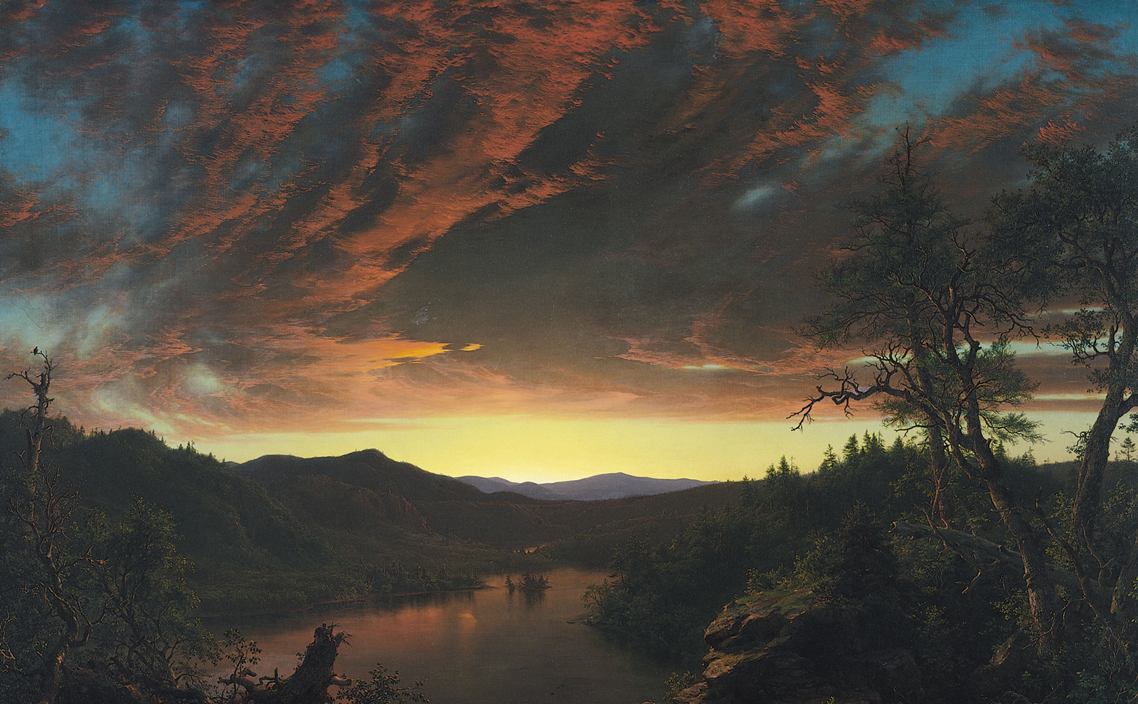
FREDERIC EDWIN CHURCH, Twilight In the Wilderness, 1860s. Oil on canvas, 3’ 4” x 5’ 4”.

Slide 6
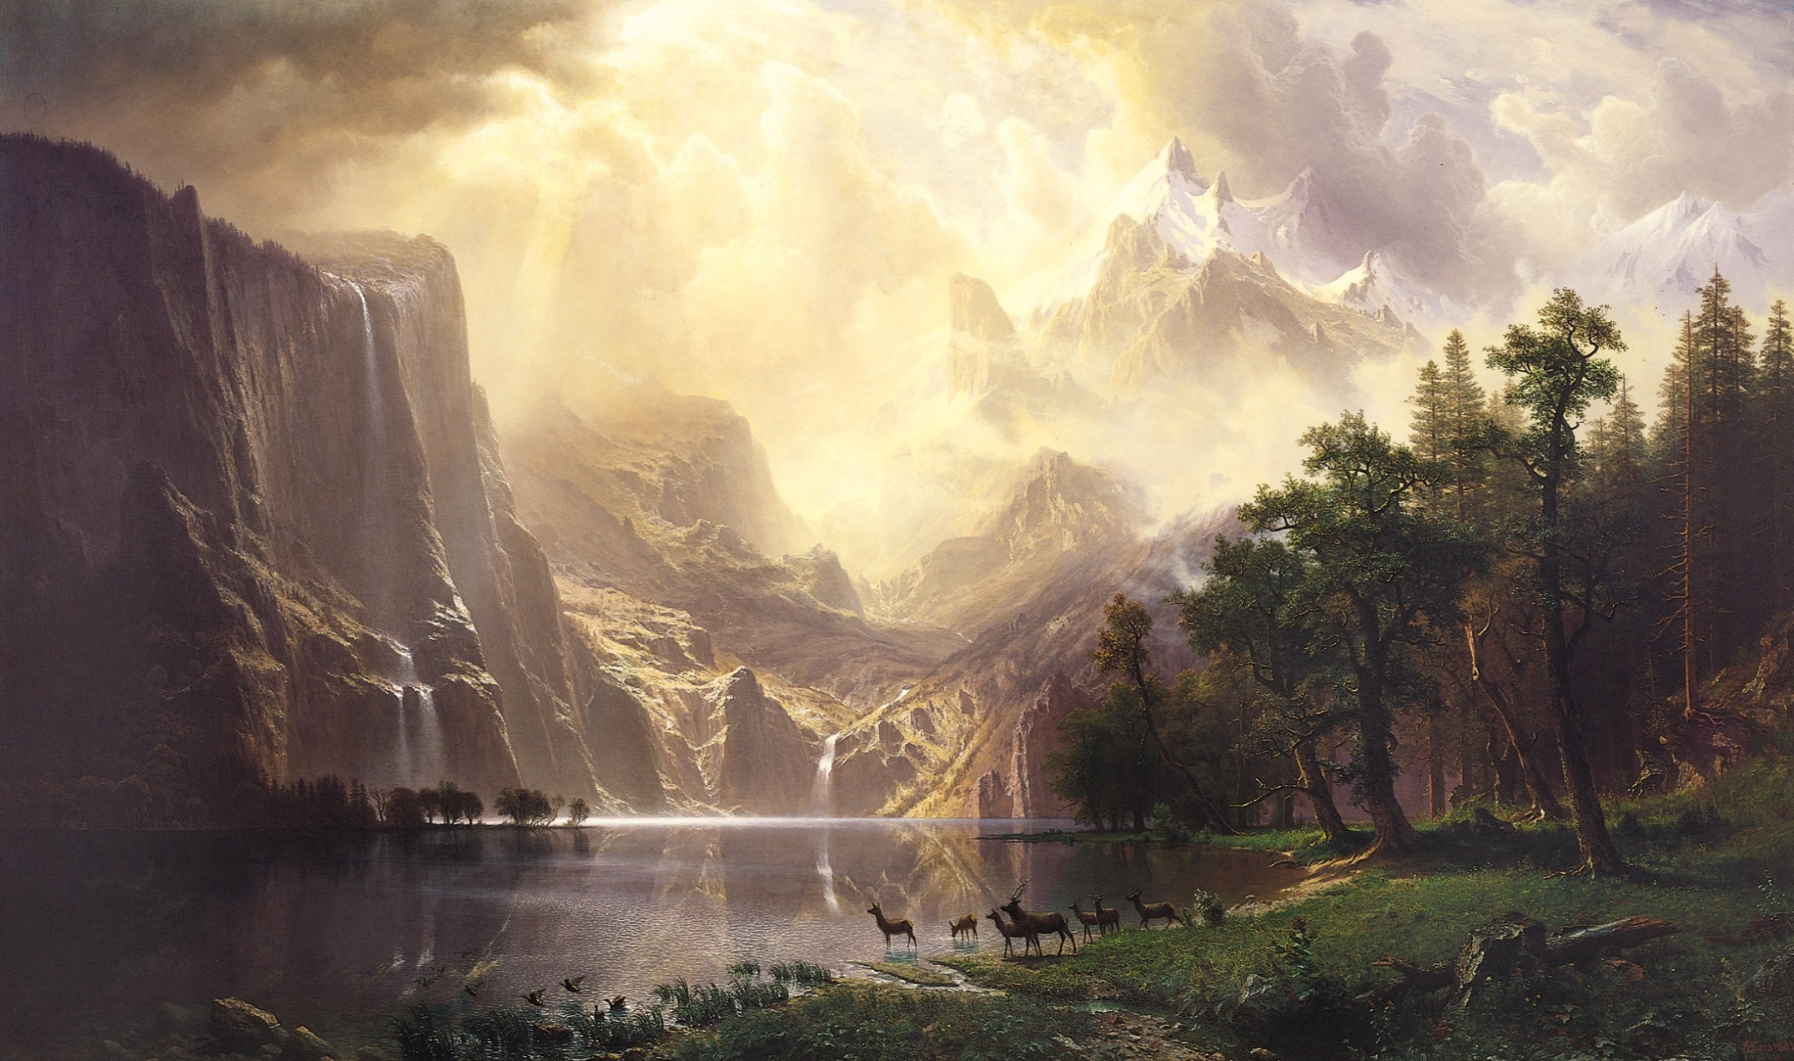
ALBERT BIERSTADT, Among the Sierra Nevada Mountains, California, 1868. Oil on canvas, 6’ x 10’.

Slide 7
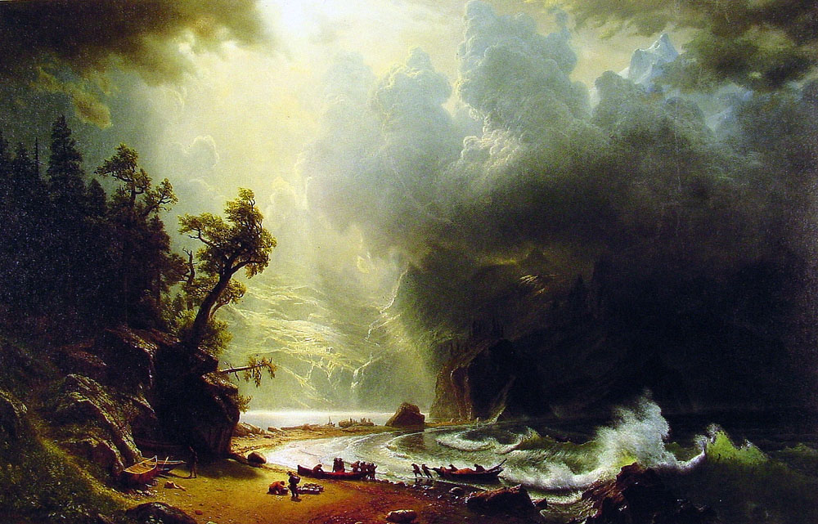
Puget Sound on the Pacific Coast, 1870
Oil on canvas, approx. 8 feet wide.

Slide 9
Representations of Native Americans,
Manifest Destiny, and The American West

Slide 10
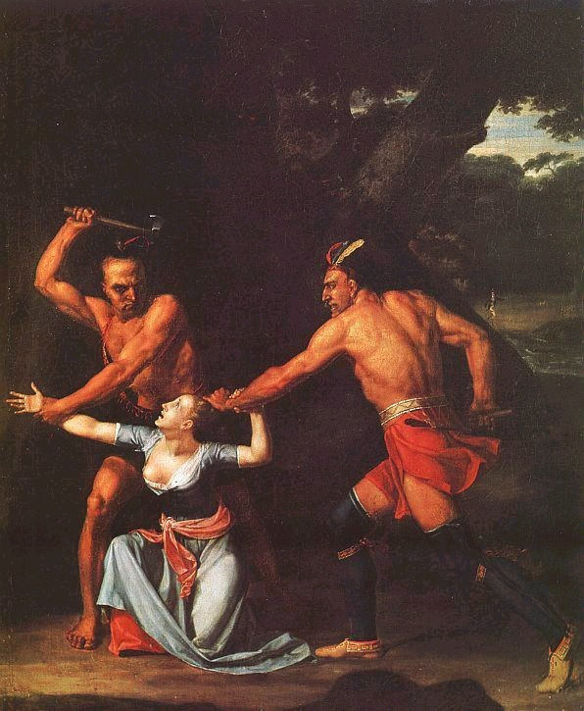
John Vanderlyn,
Murder of Jane McCrea,
1804

Slide 11
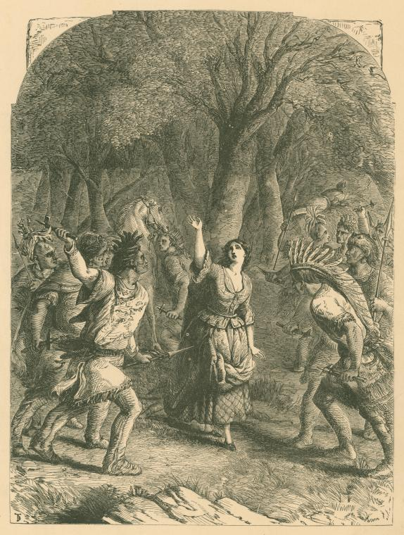
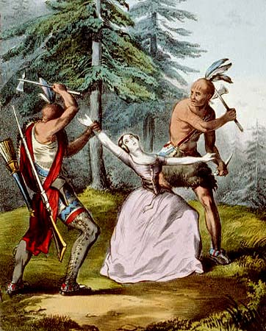
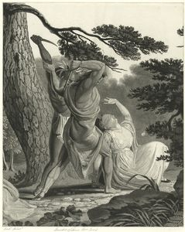

Slide 12
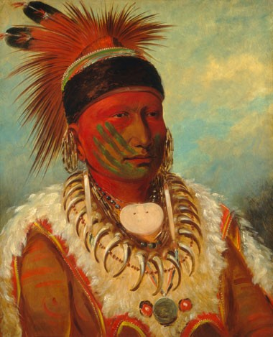
GEORGE CATLIN,
The White Cloud,
Head Chief
of the Iowas,
mid-19th century
(1844/1845),
Oil on canvas,
27 15/16 x 22 13/16 in.

Slide 13
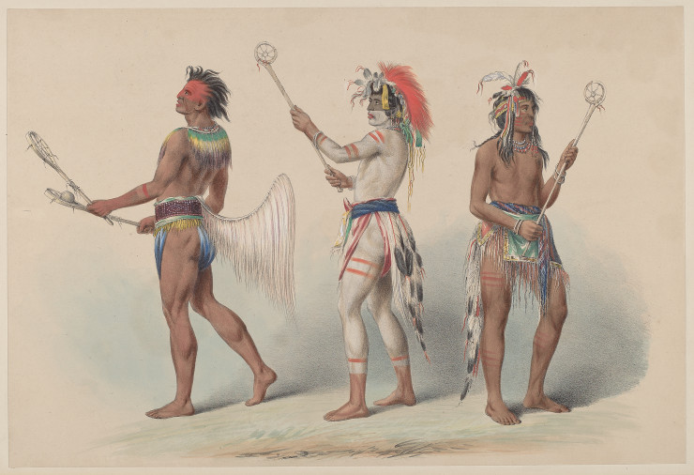
Catlin,
Ball Players, 1844
color lithograph, 17 x 12 in.

Slide 14
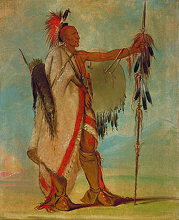
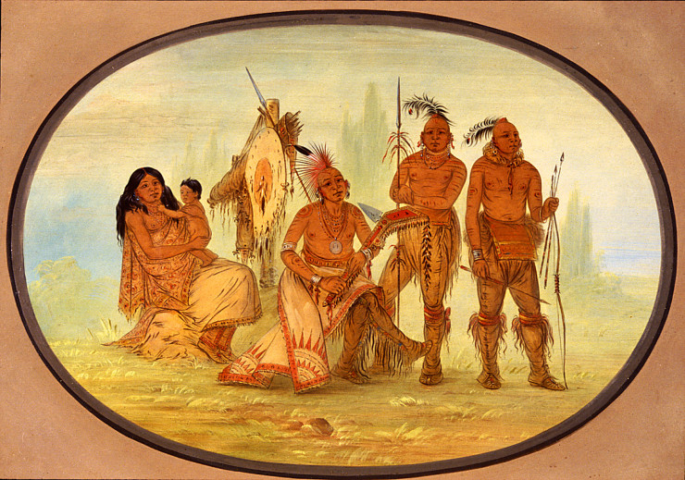
George Catlin
Osage Indians, 1861/1869
oil on card mounted on paperboard,
18 3/16 x 24 1/2 in

Slide 15
GEORGE CATLIN,
The White Cloud,
Head Chief
of the Iowas,
mid-19th century
(1844/1845)
Oil on canvas,
27 15/16 x 22 13/16 in

Slide 16
Representations of African Americans,
Slavery, and freedom

Slide 17
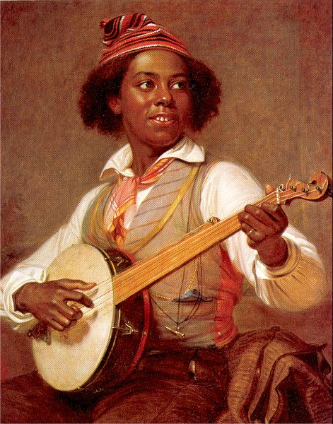
William Sidney Mount,
The Banjo Player, 1830
25 x 30 in

Slide 18
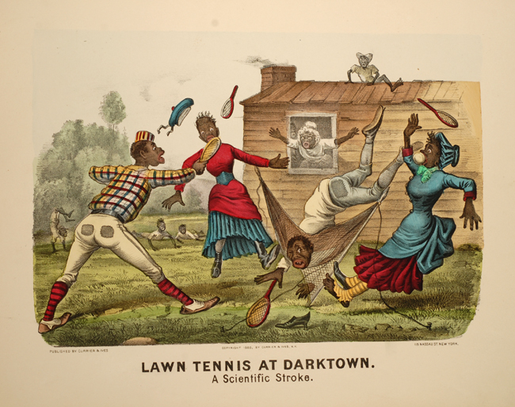
Currier & Ives chromo lithograph , 1888, from the “Darktown” series

Slide 19
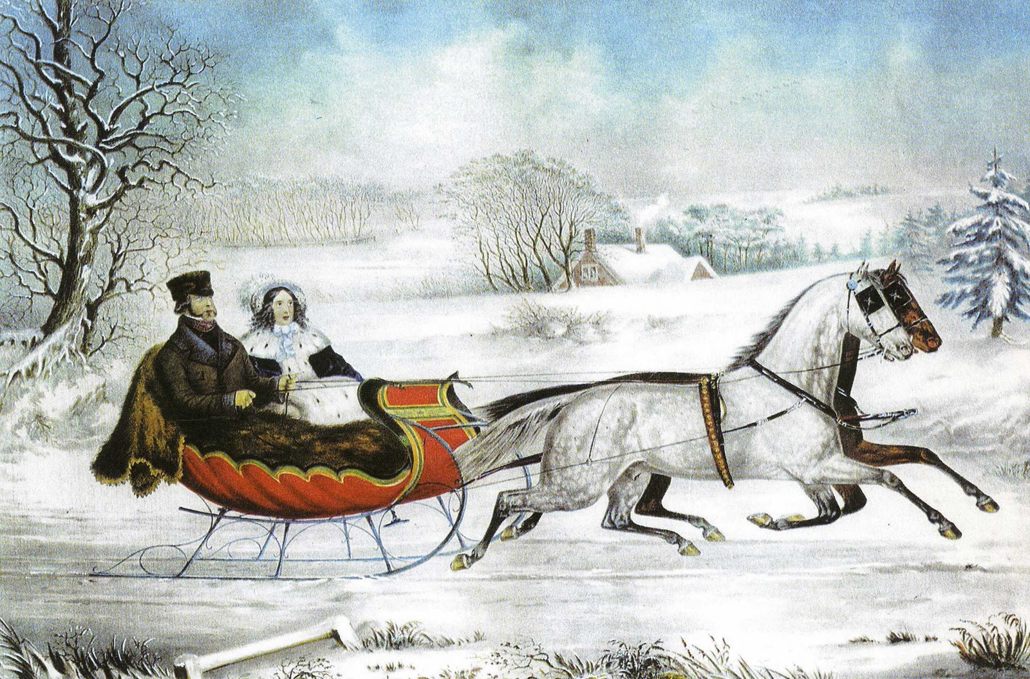

Slide 20
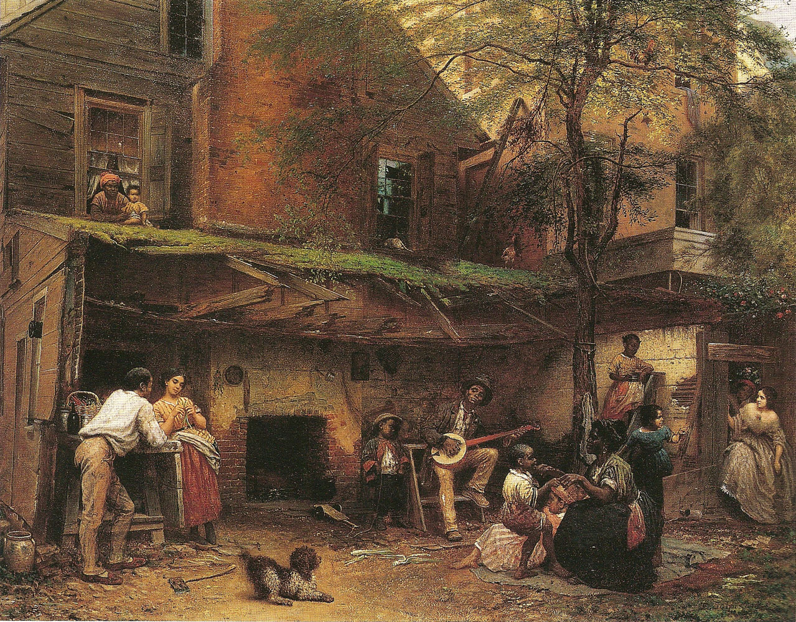
EASTMAN JOHNSON,
Old Kentucky Home: Life in the South,
mid-19th century, before the Civil War (1859)

Slide 22
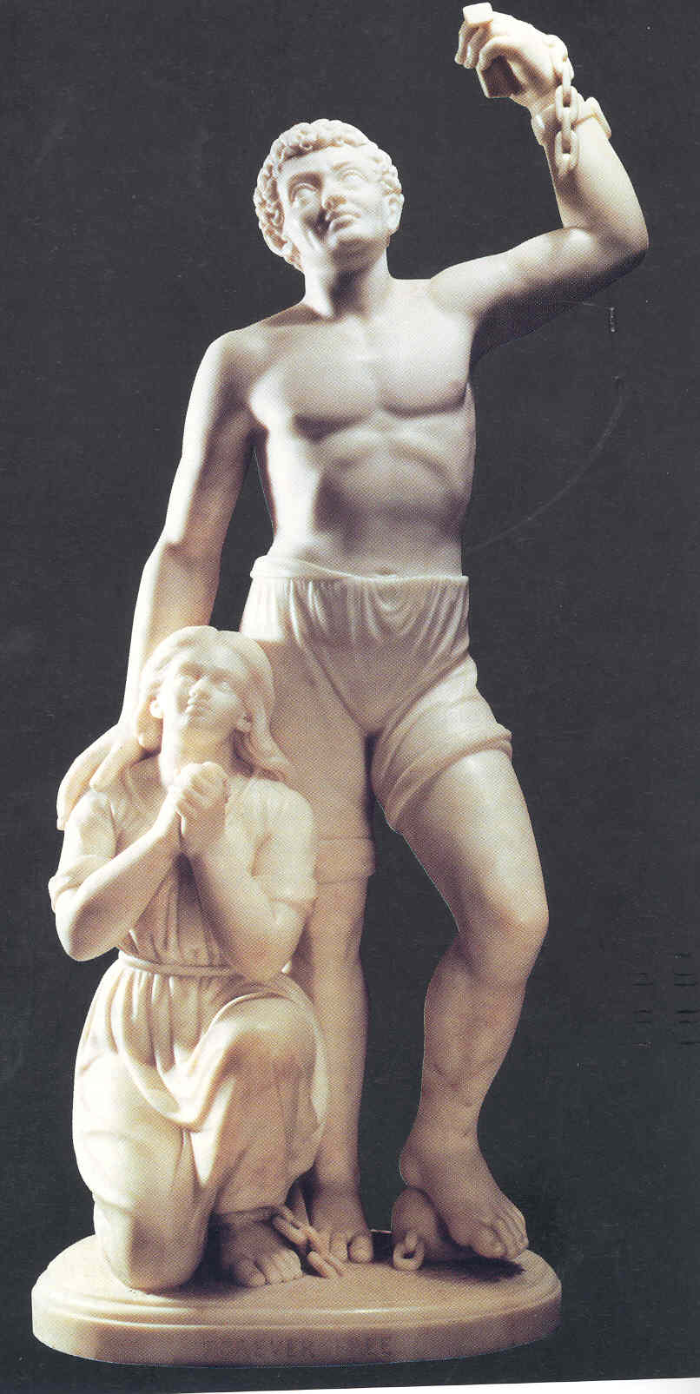
EDMONIA LEWIS,
Forever Free, mid-19th century, after the Civil War (c. 1867),
3 feet 4 in h.

Slide 23
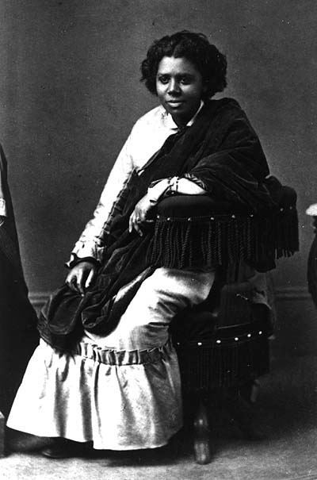
Edmonia Lewis (1845-1909)

Slide 24
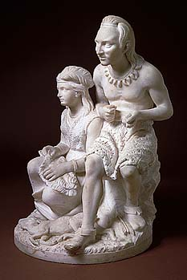
The Wooing of Hiawatha (Old Arrow Maker and his daughter) modeled 1866, carved 1872
21 1/2 x 13 5/8 x 13 5/8 in.

Slide 25
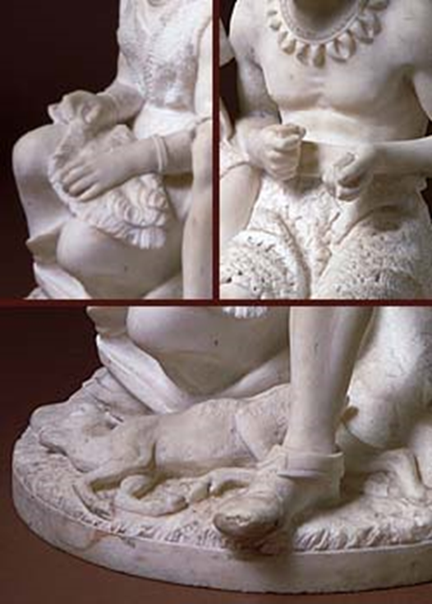


Slide 26
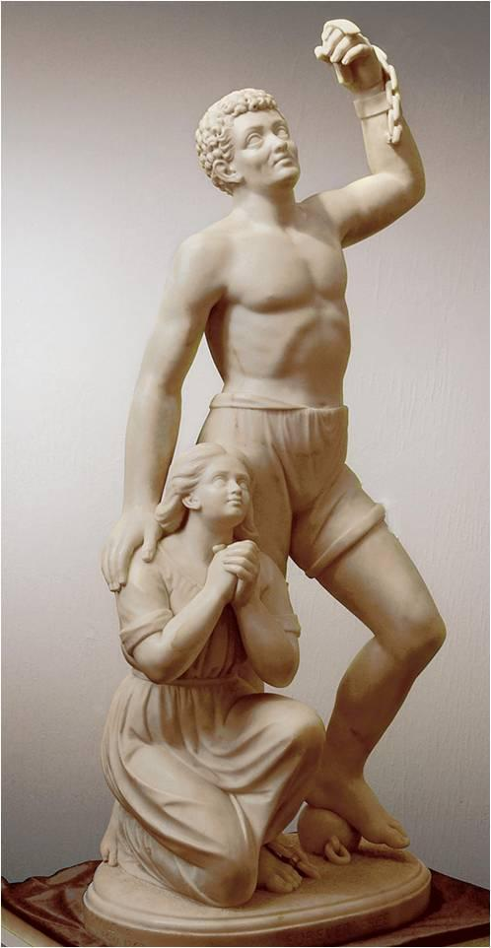
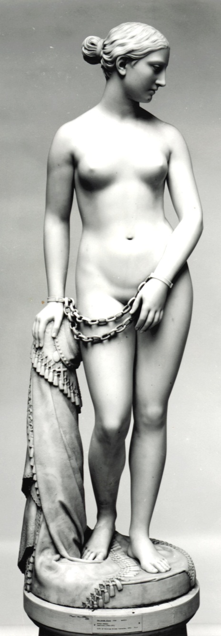
Hiram Powers (American),
The Greek Slave, 1846

Slide 27
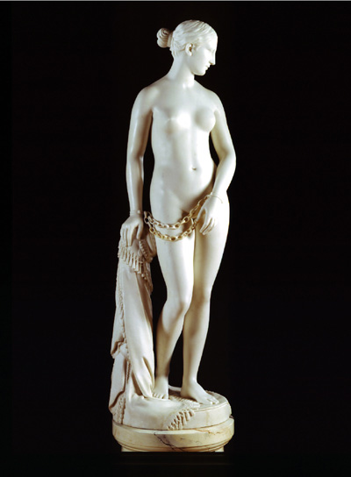
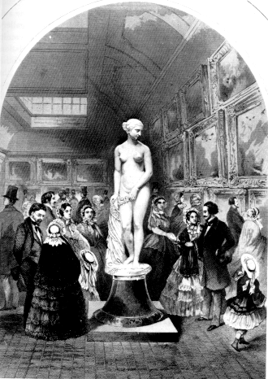
Hiram Powers (American), The Greek Slave, 1846

Slide 28
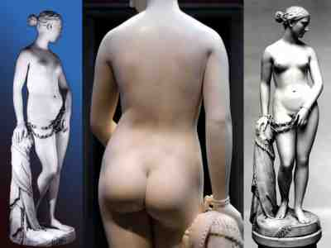

Slide 29
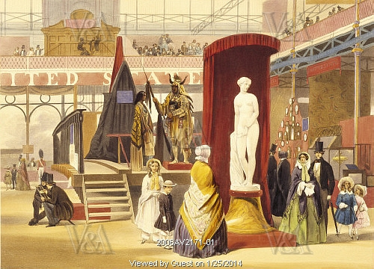
(artist’s name not required),
View of the Great Exhibition 1851, mid-19th century (1851)
V&A imprints and white text at bottom are not
part of the original (refer to copyright usage)

Slide 30
The erotic, the exotic, and “the other” in European art

Slide 31
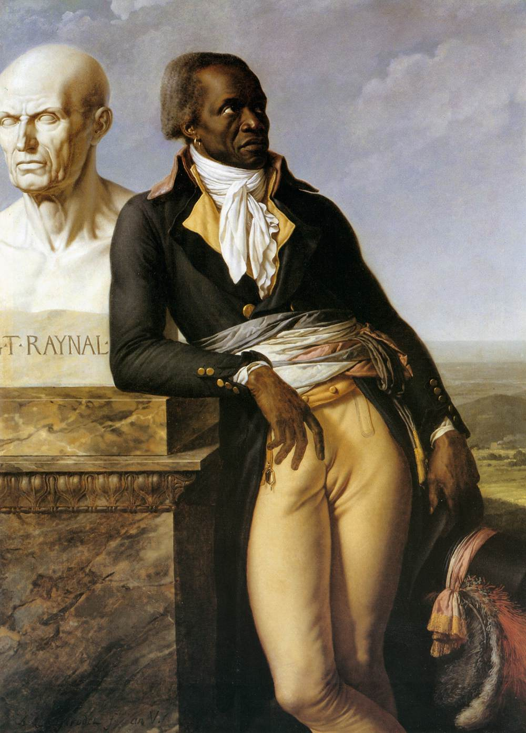
ANNE-LOUIS GIRODET,
Monsieur Belley
(Portrait de C.[itoyen] Jean-Baptiste Belley, ex-représentant
des colonies)
late 18th century (1797)

Slide 32
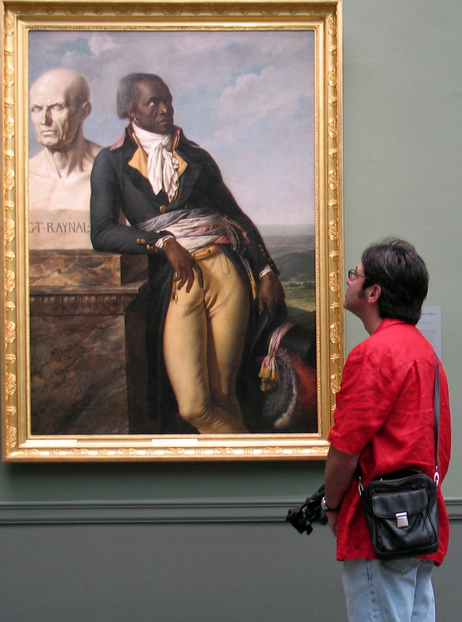

Slide 33


Slide 34
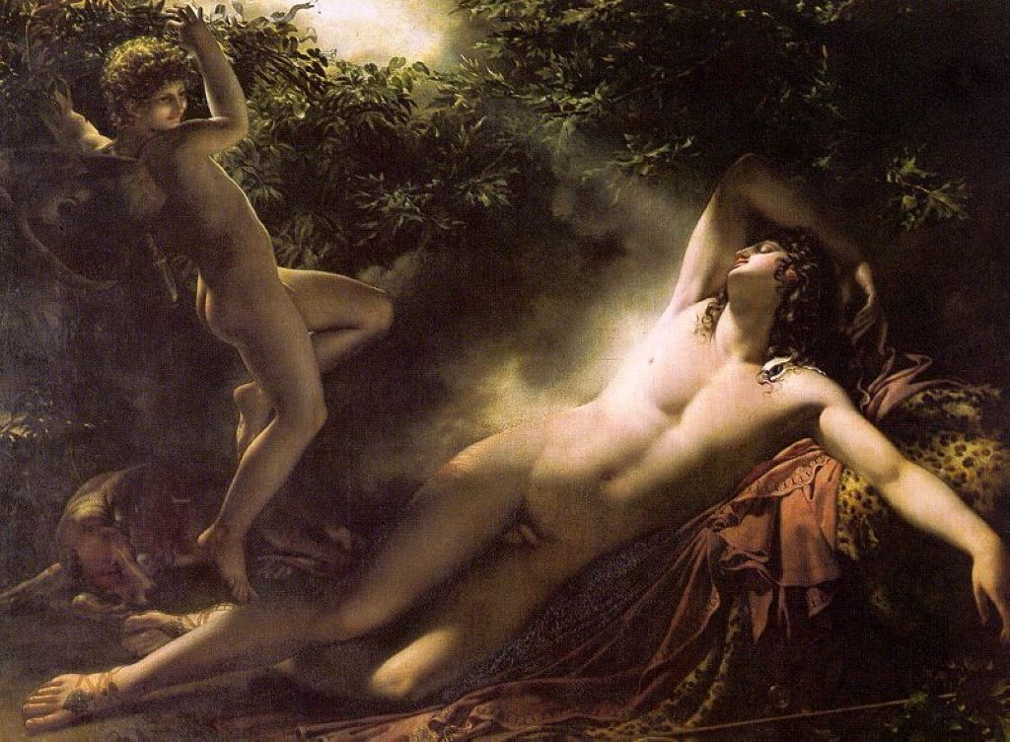
The Sleep of Endymion

