Slide 1
Photography
“writing with light”

Slide 2
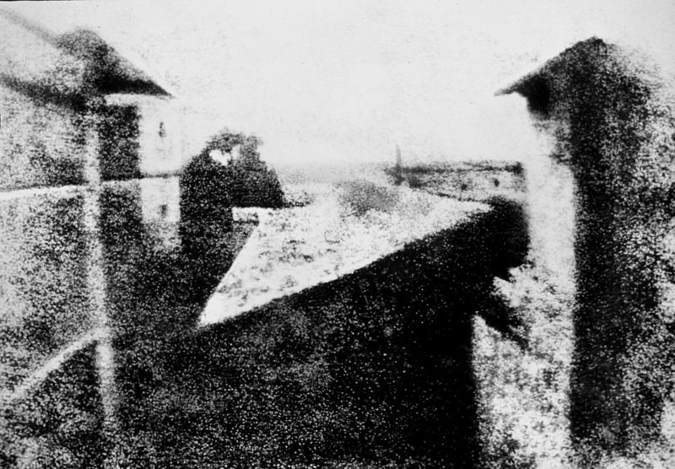
earliest surviving camera photograph

Slide 3


Joseph Nicéphore Niépce
View from the Window at Le Gras, 1826

Slide 4
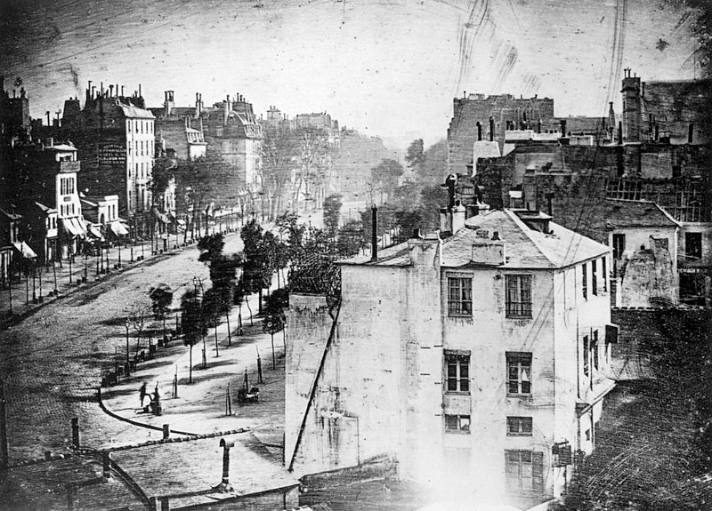
Boulevard du Temple, Louis Daguerre, 1838

Slide 5
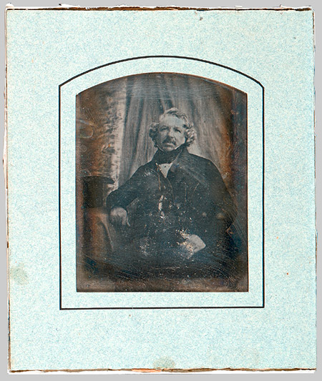
Louis-Jacques-Mandé Daguerre, ca. 1844
image taken by unknown Artist,
Daguerreotype; 3 1/2 x 2 3/4 in.
1839
Announcement of process…

Slide 6
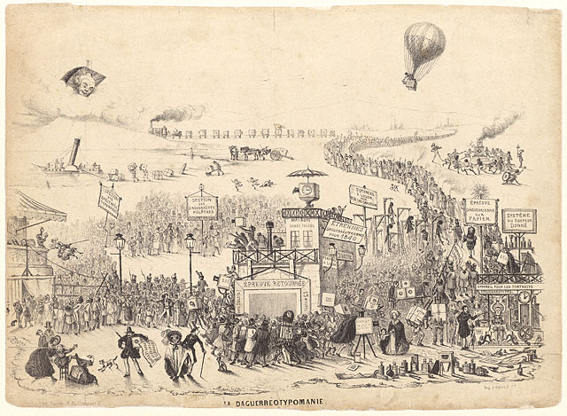

Slide 7
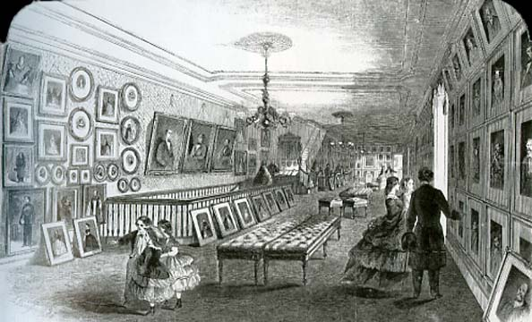
New Photographic Gallery, New York. 1861. Engraving

Slide 8
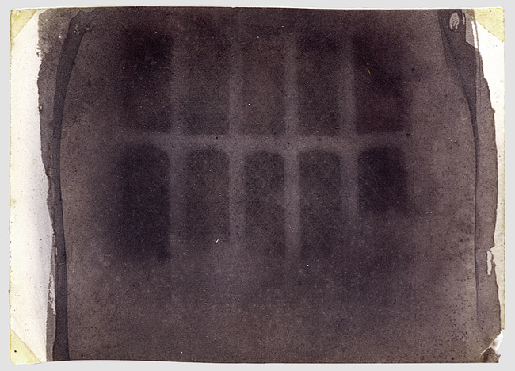
William Henry Fox Talbot (British, 1800–1877)
The Oriel Window, South Gallery, Lacock Abbey, 1835 or 1839
Photogenic drawing negative; 3 1/4 x 4 3/16 in.

Slide 9
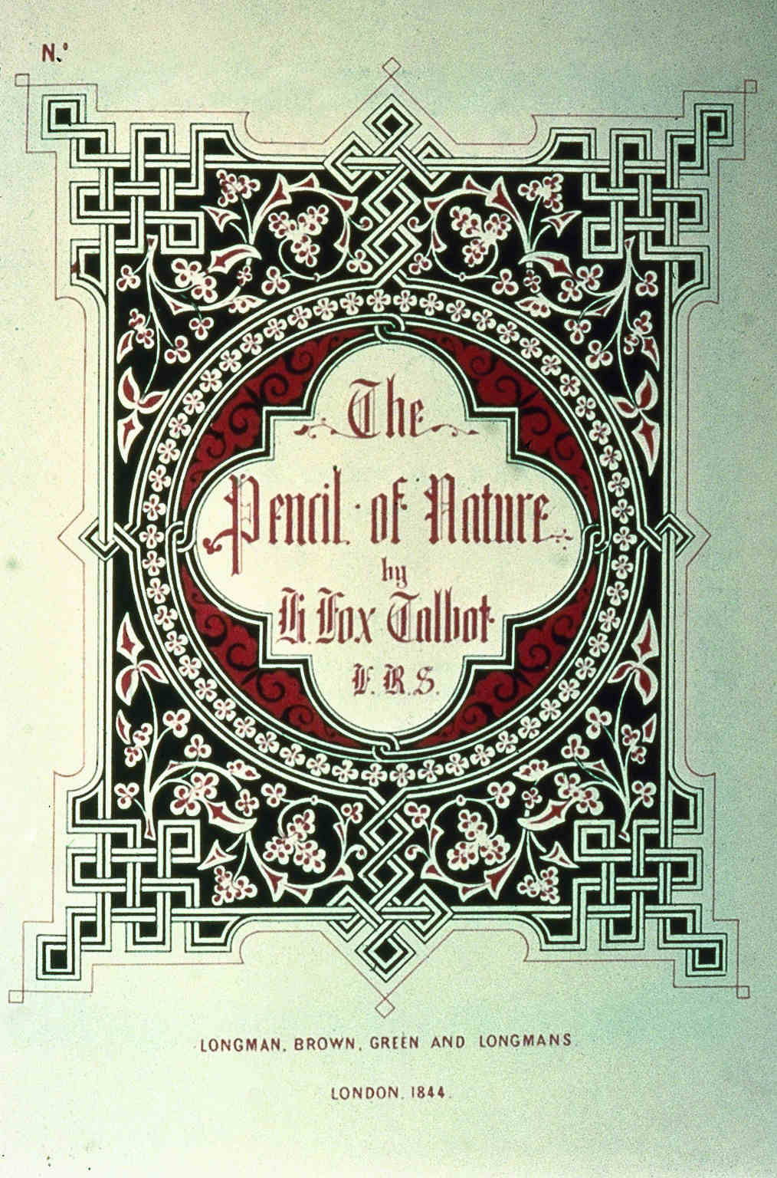
9-40
Talbot,
The Pencil of Nature, 1844

Slide 10
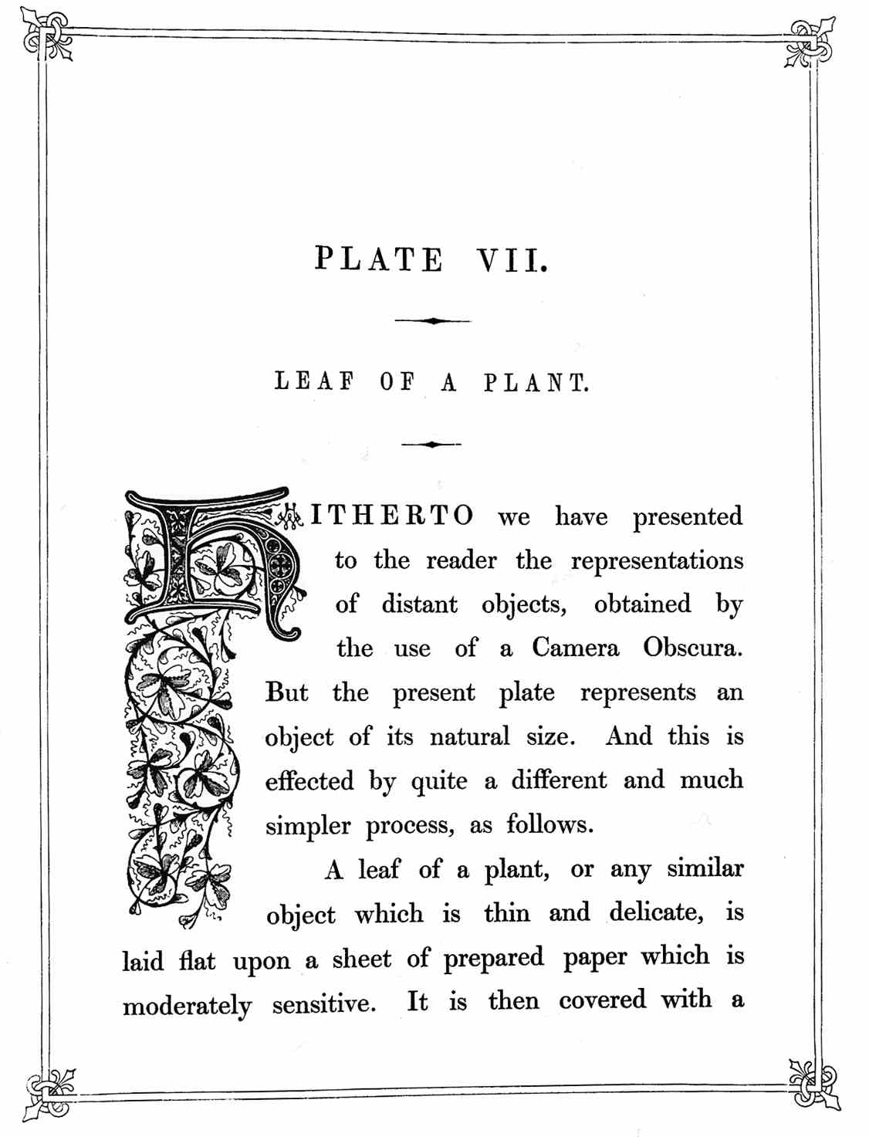
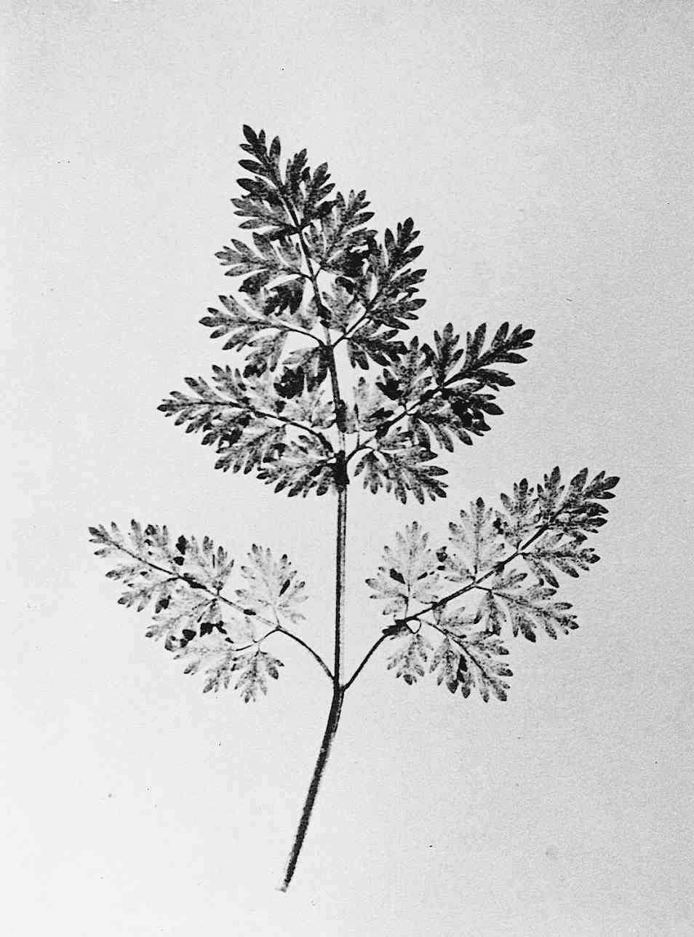
9-26B

Slide 11
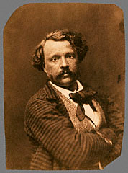
Nadar, self-portrait

Slide 12
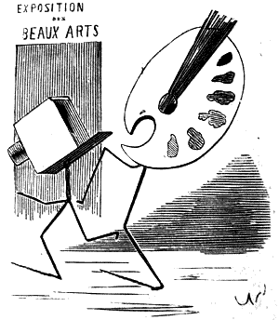
By Nadar

Slide 13
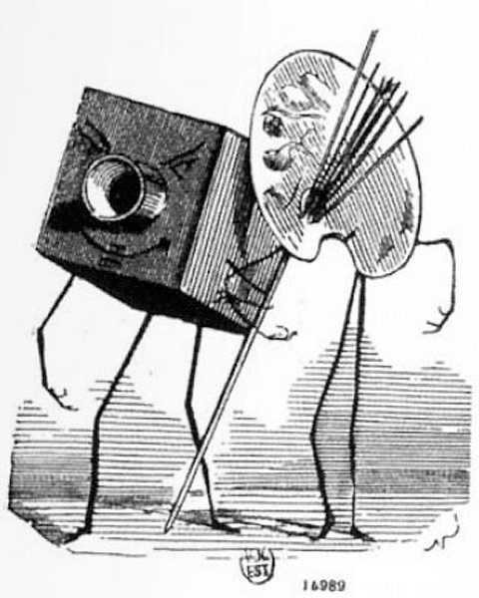

Slide 14
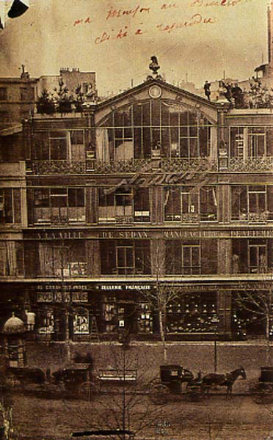
Nadar's Portrait Studio
on the
Boulevard des Capucines. 1860

Slide 15
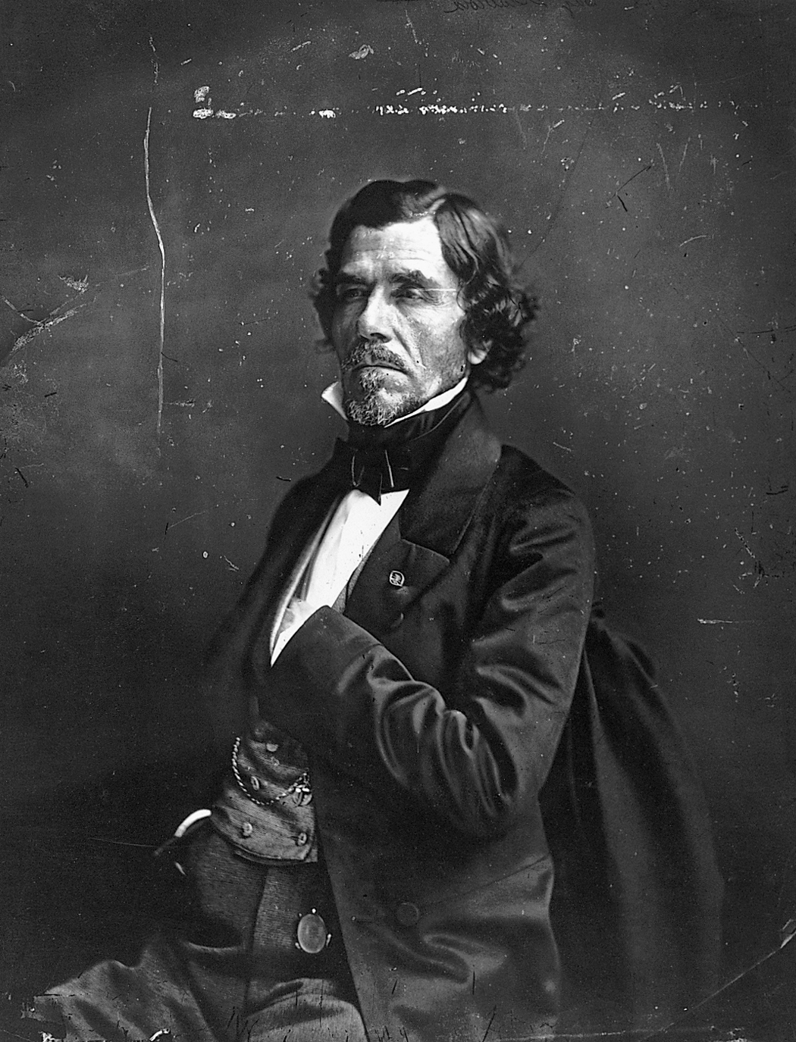
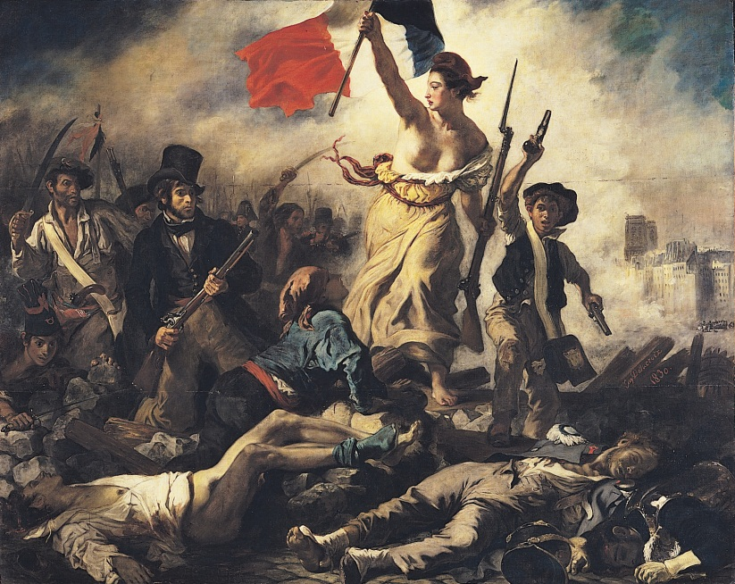
NADAR,
Eugène Delacroix, ca. 1855.
EUGÈNE DELACROIX, Liberty Leading the People, 1830. Oil on canvas,
approx. 8’ 6” x 10’ 8”.

Slide 16
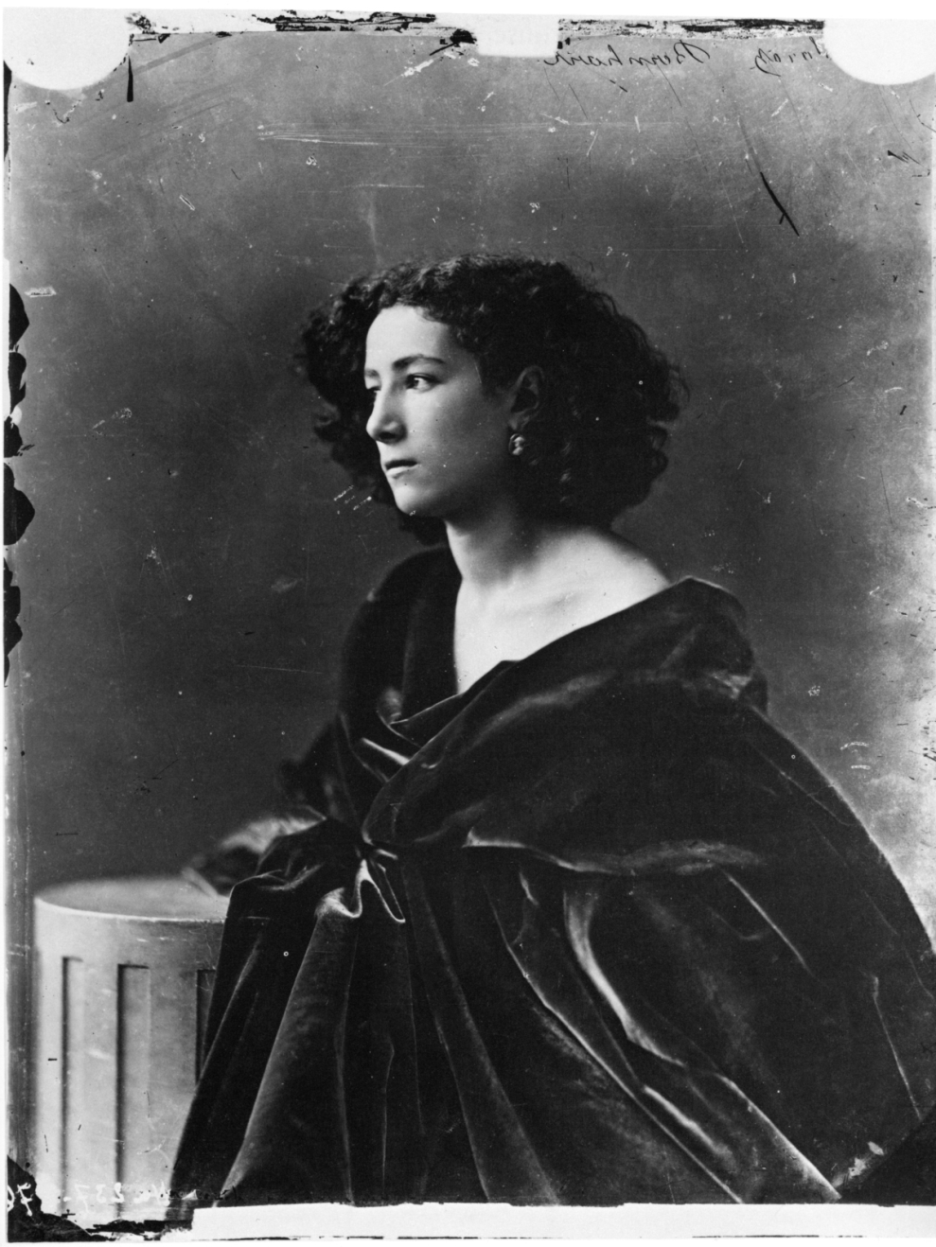
Nadar,
Sarah Bernhardt,
Gelatin silver print
8 5/16 x 6 3/8 in.,
1859

Slide 17
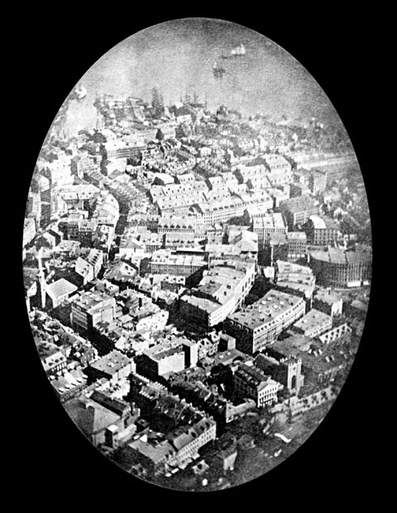
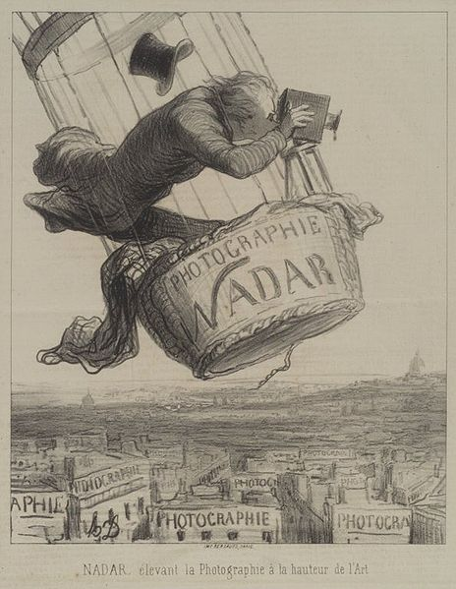
lHonoré Daumier, lithograph, 1862
“Nadar elevating Photography to the height of Art.”

Slide 18
Photography as Art
The impact of painting on photography

Slide 19
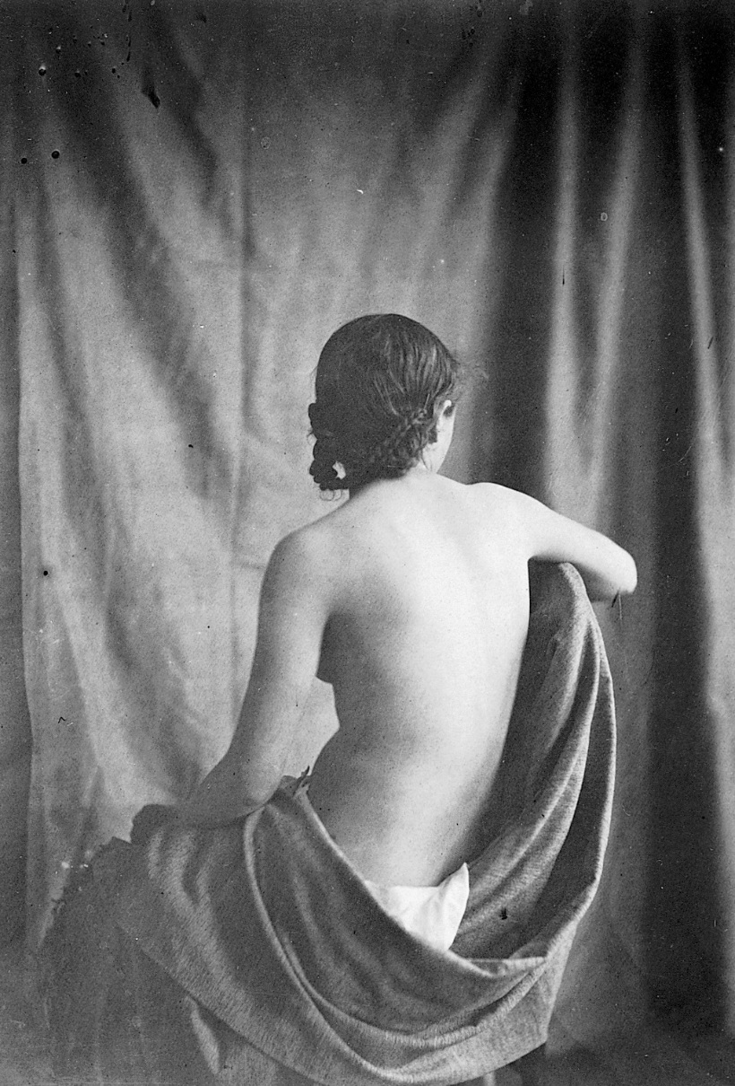
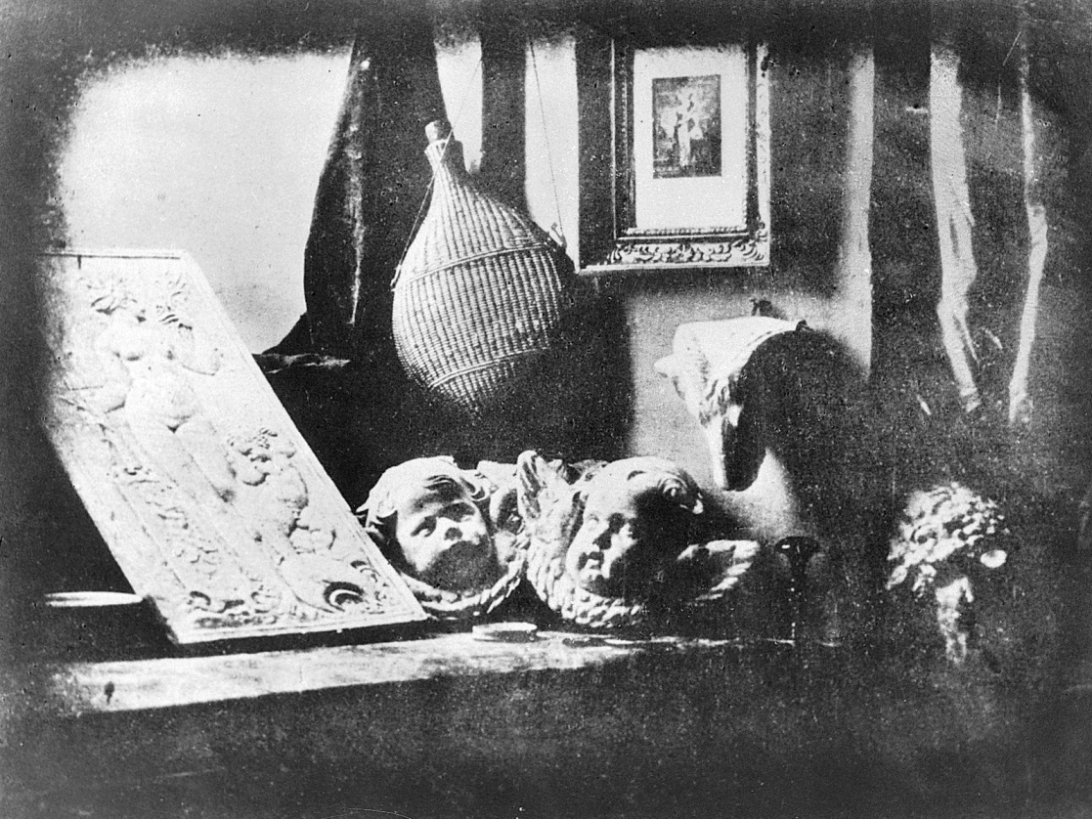
EUGÈNE DURIEU and
EUGÈNE DELACROIX, ca. 1854. Albumen print,
7 5/ 16” x 5 1/8”.
DAGUERRE, Still Life in Studio, 1837. Daguerreotype.

Slide 20
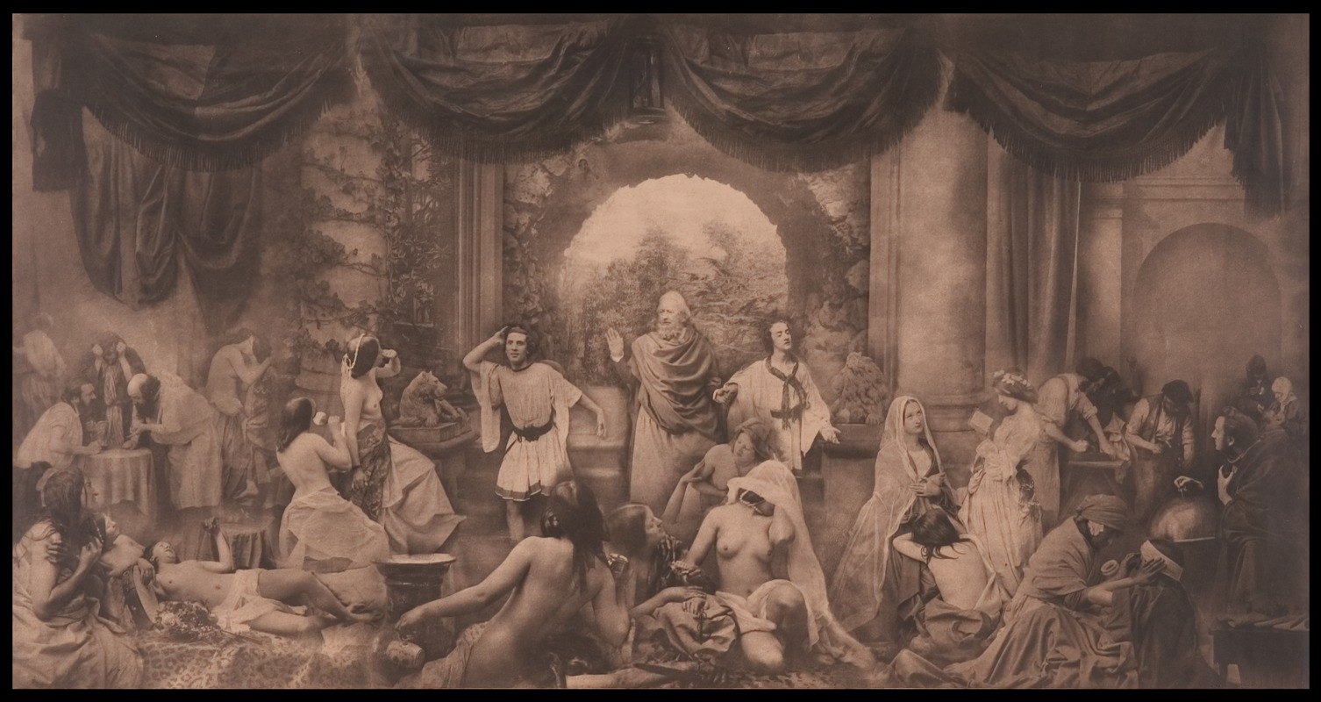
Oscar Gustav Rejlander, Two Ways of Life, 1857, 2” x 18”

Slide 21
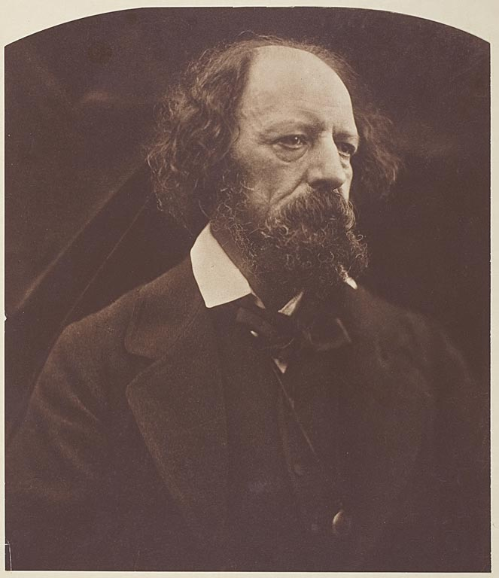
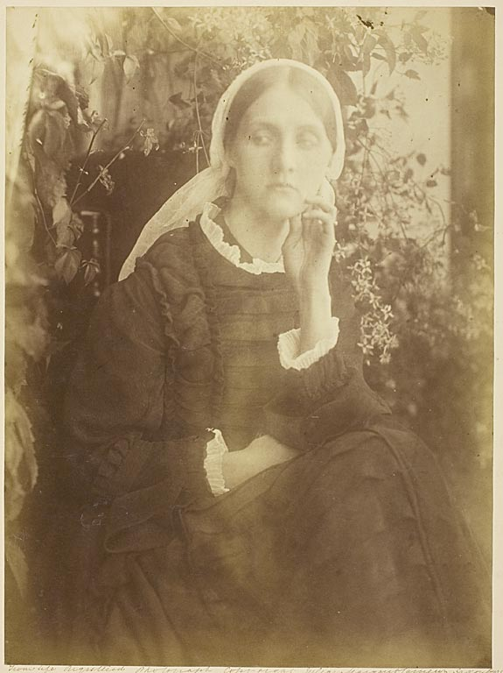
JULIA MARGARET CAMERON
Mrs. Herbert Duckworth, 1872
Alfred Lord Tennyson, 1869

Slide 22
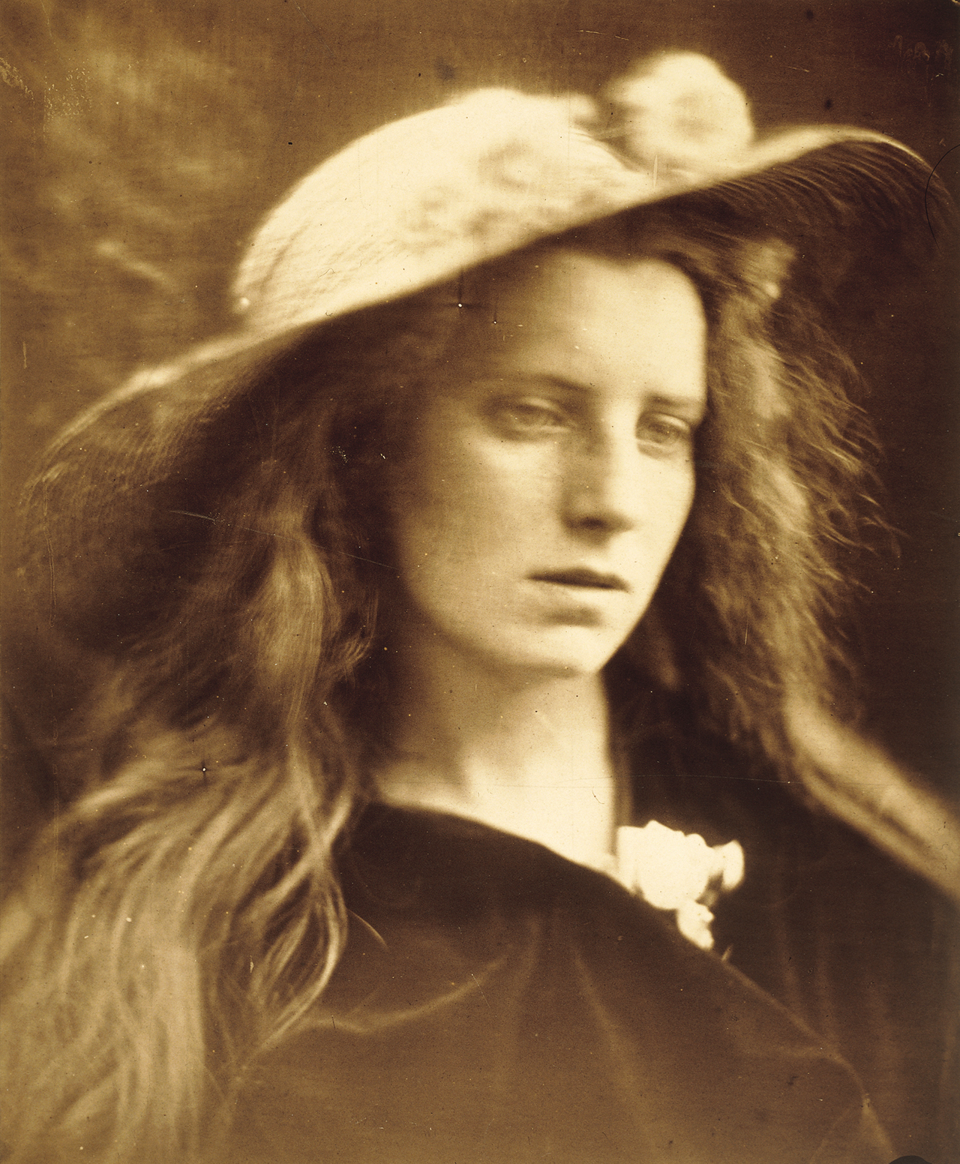
Ophelia, Study no. 2, 1867. Albumen print,
1' 11" x 10 2/3".

Slide 23
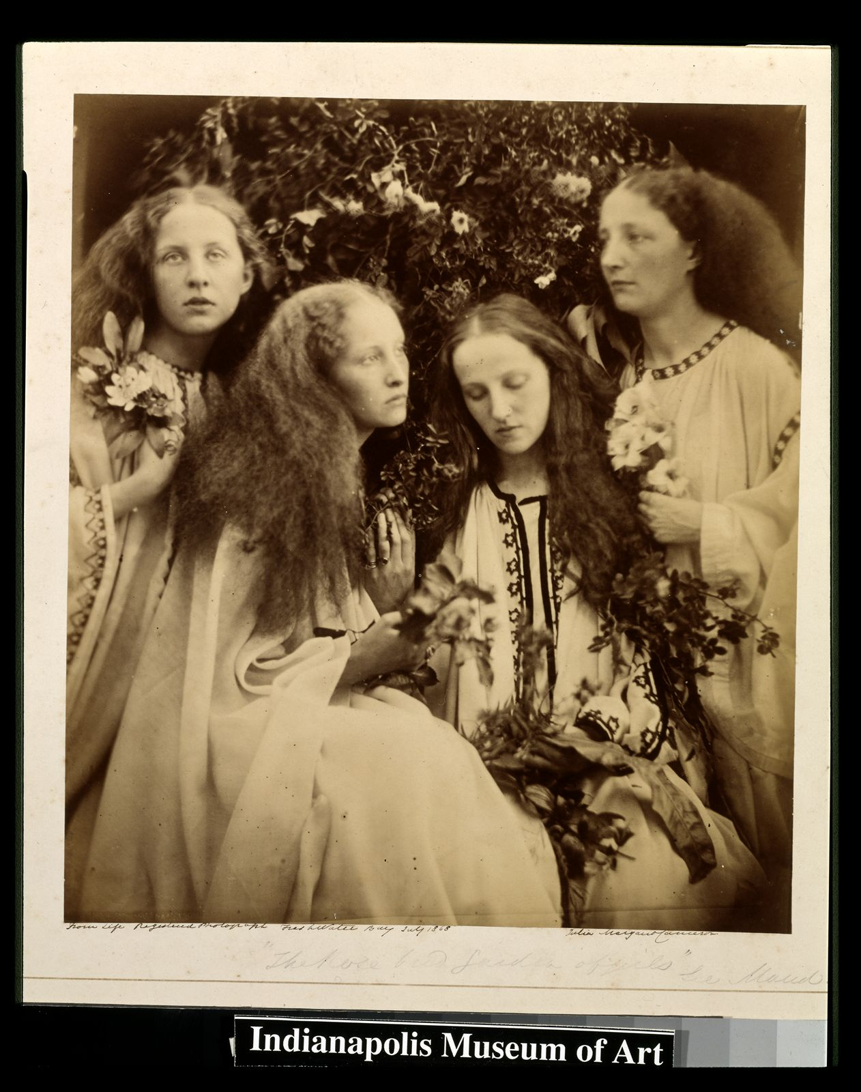
The Rosebud Garden
of Girls,
1868

Slide 24
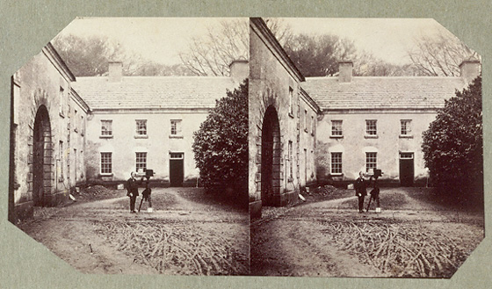
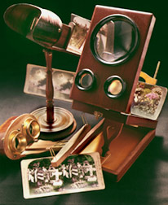
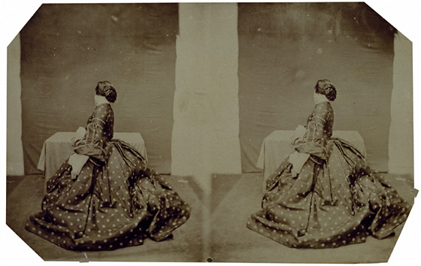
Lady Clementina Hawarden
c. 1857-1861
c. 1859-61

Slide 25
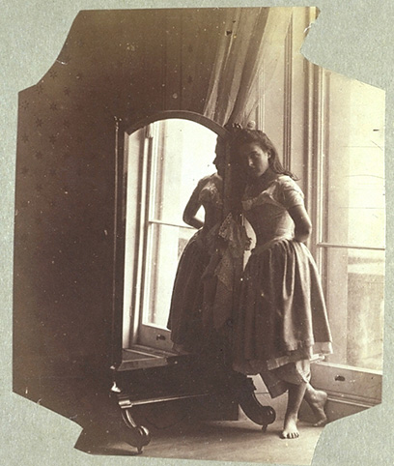
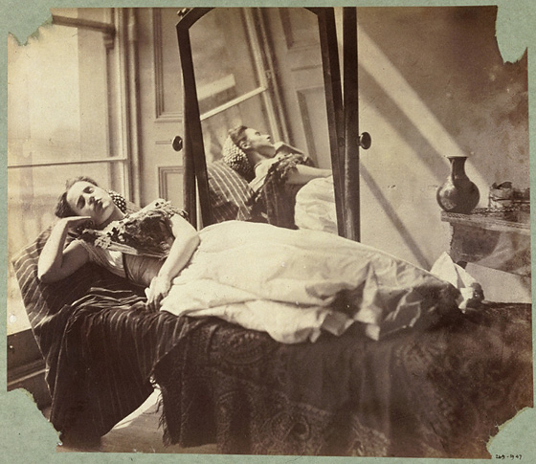
Lady Clementina Hawarden
Study from Life, c. 1862-3
Study from Life, c.1863-64

Slide 26
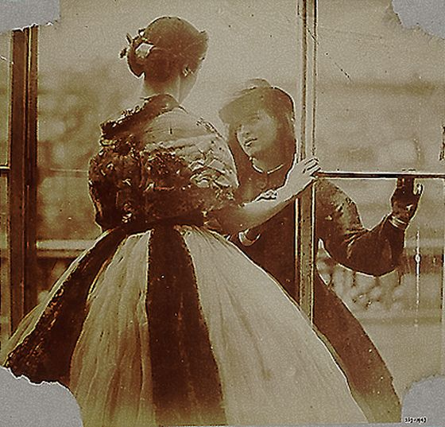
Study from Life, c.1860

Slide 27
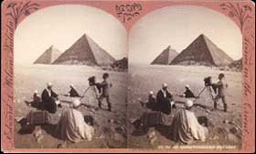
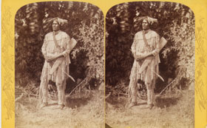
Misc. stereoscopic cards

Slide 28
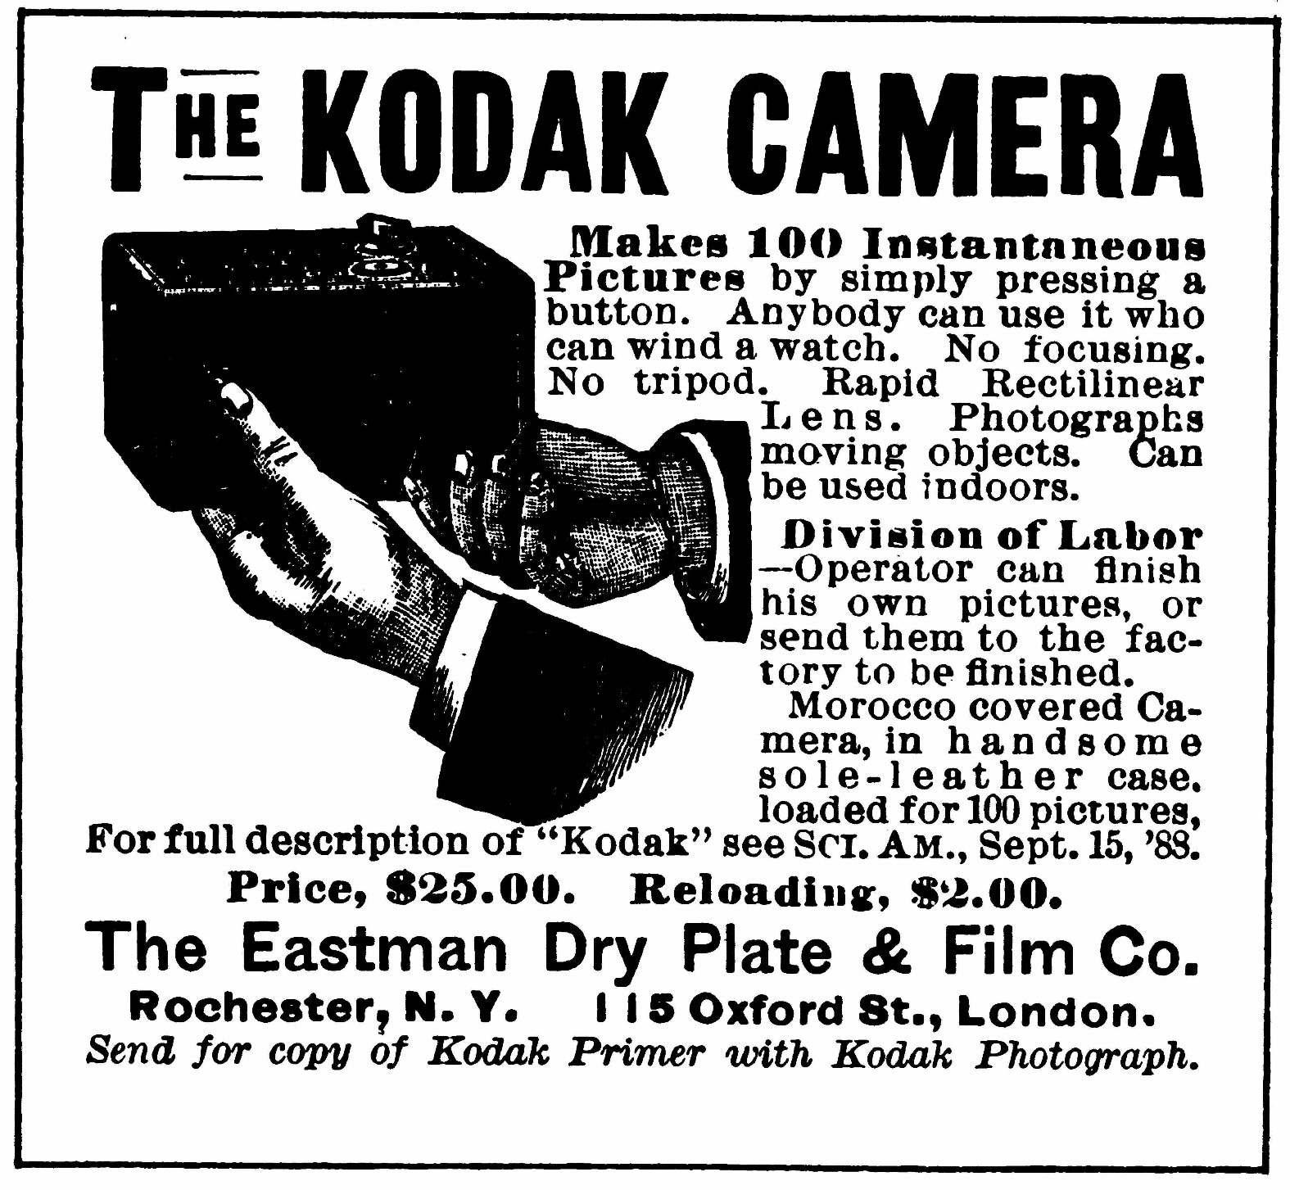
Advertisement for the Kodak camera, c. 1889.
Notes:
Advertisement for the Kodak camera, c. 1889. George Eastman’s camera, simple enough for anyone “who can wind a watch,” played a major role in making photography every person’s art form.

Slide 29
Photography as Documentation
“Reportage”

Slide 30
"My greatest aim has been to advance the art of photography and to make it what I think I have, a great and truthful medium of history."
- Mathew B. Brady

Slide 31
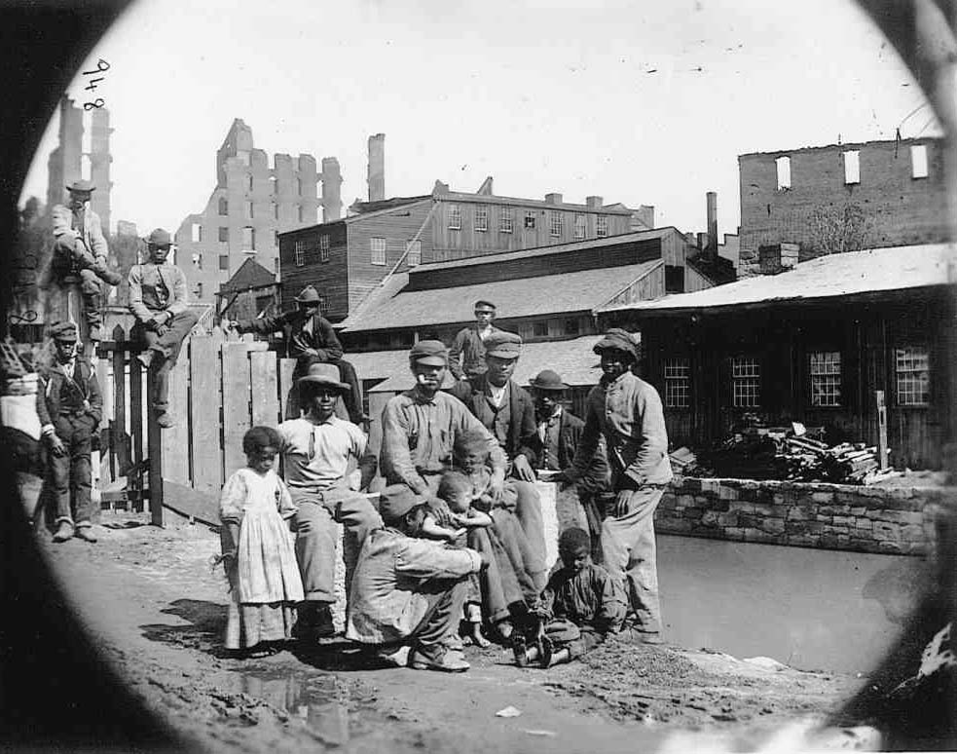
Mathew Brady
photograph,
“Freedmen on the Canal Bank
at Richmond,” 1865
Notes:
Attributed to Mathew Brady, photograph, “Freedmen on the Canal Bank at Richmond,” 1865. The photographer supplied the visual evidence needed by the illustrator to document an event.

Slide 32

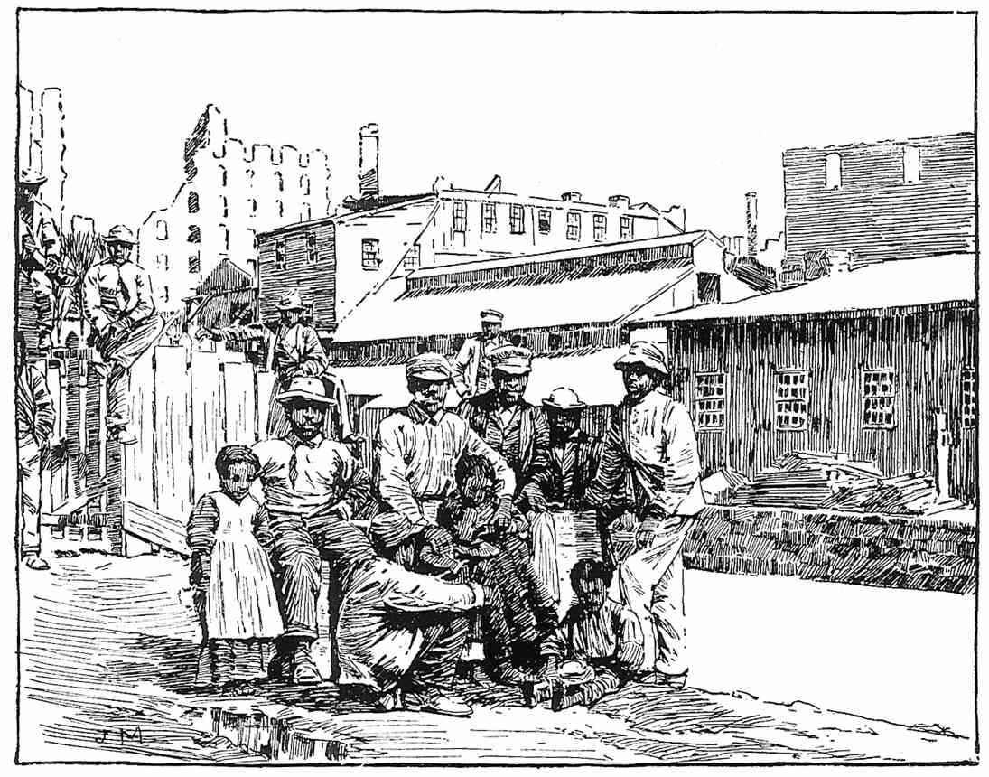
photograph,
“Freedmen on the Canal Bank
at Richmond,” 1865

Slide 33
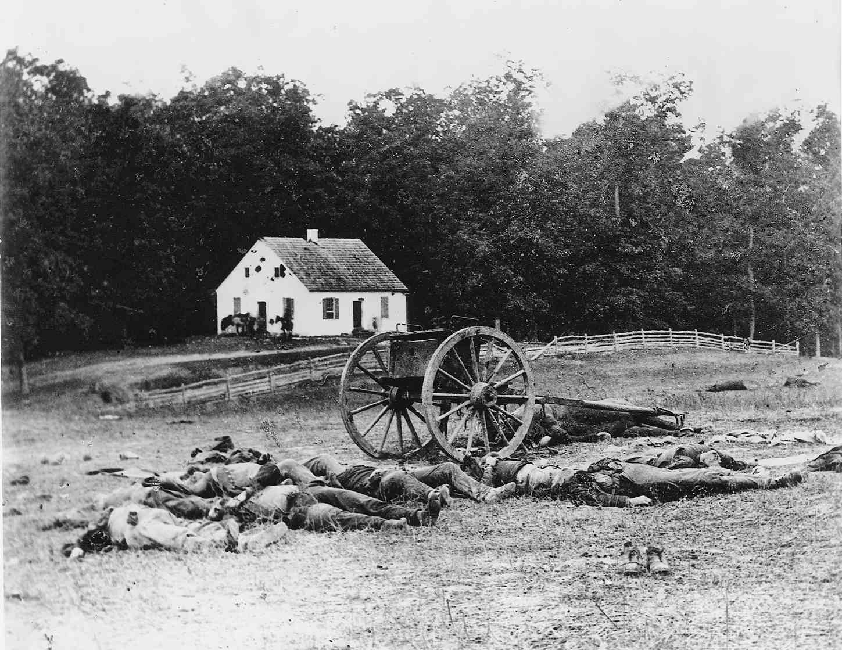
Mathew Brady or Alexander Gardner
“Dunker Church and the Dead,”1862

Slide 34
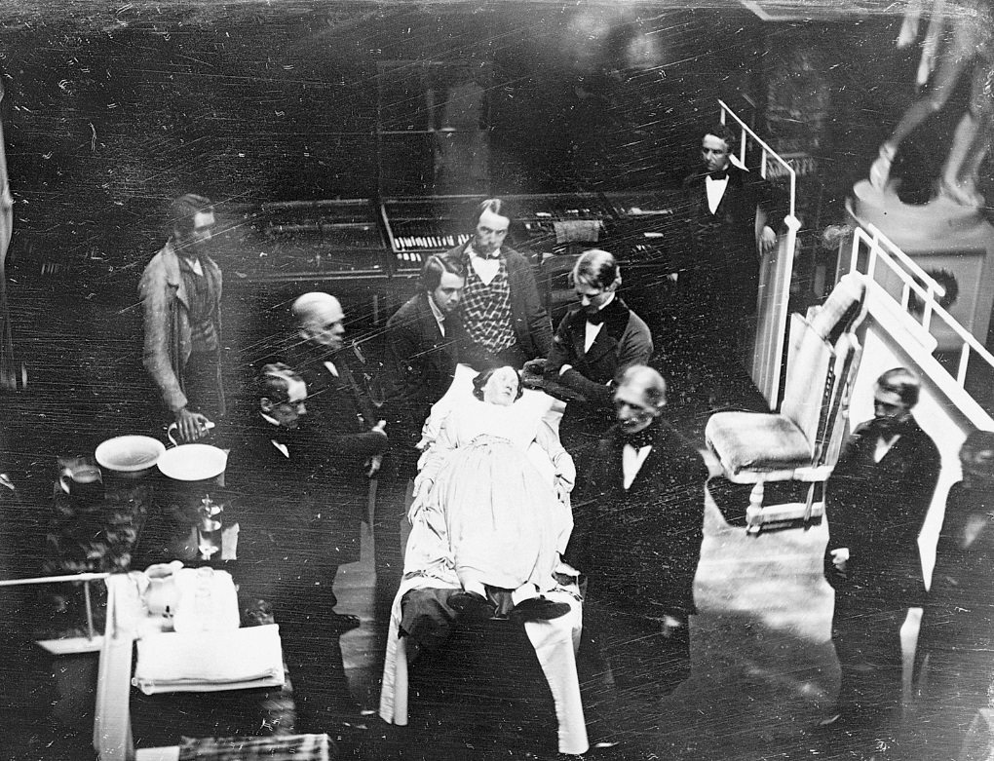
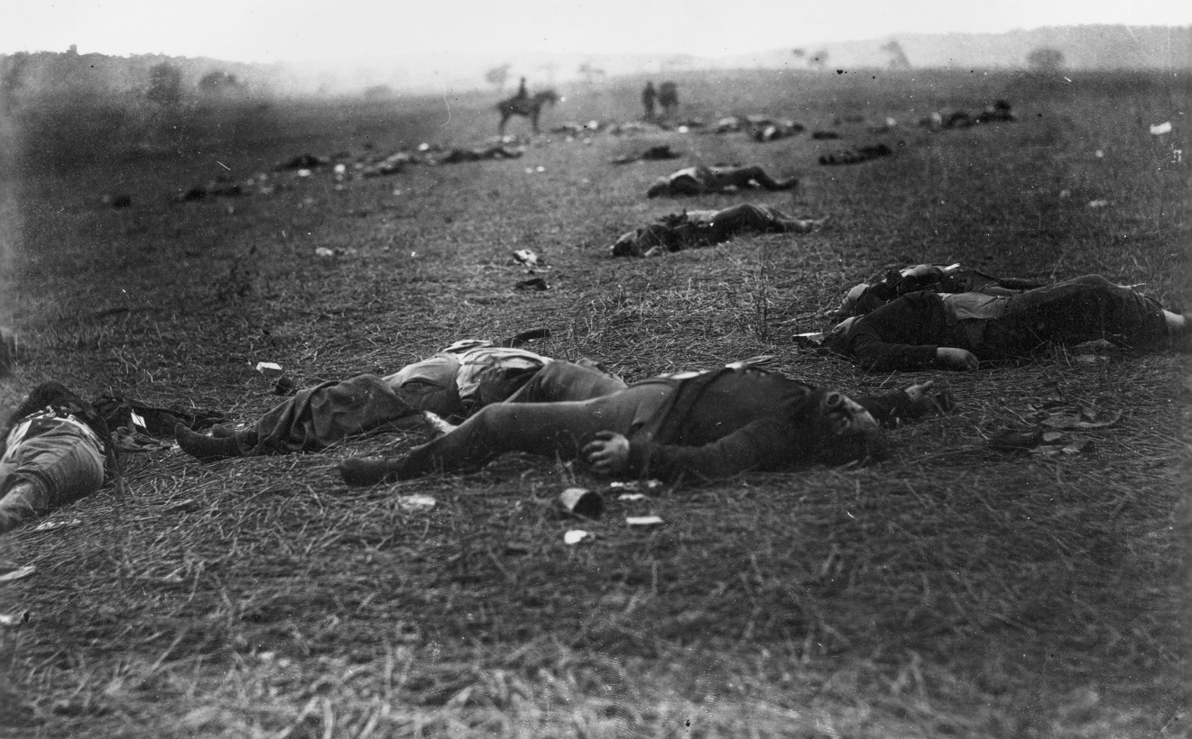
JOSIAH JOHNSON HAWES and
ALBERT SANDS SOUTHWORTH,
Early Operation under Ether, Massachusetts General Hospital, ca. 1847. Daguerreotype.
TIMOTHY O’SULLIVAN,
A Harvest of Death, Gettysburg, Pennsylvania, July 1863, 6 3/8" x 8 3/4".

Slide 35
Art as Documentary and Scientific Tool

Slide 36
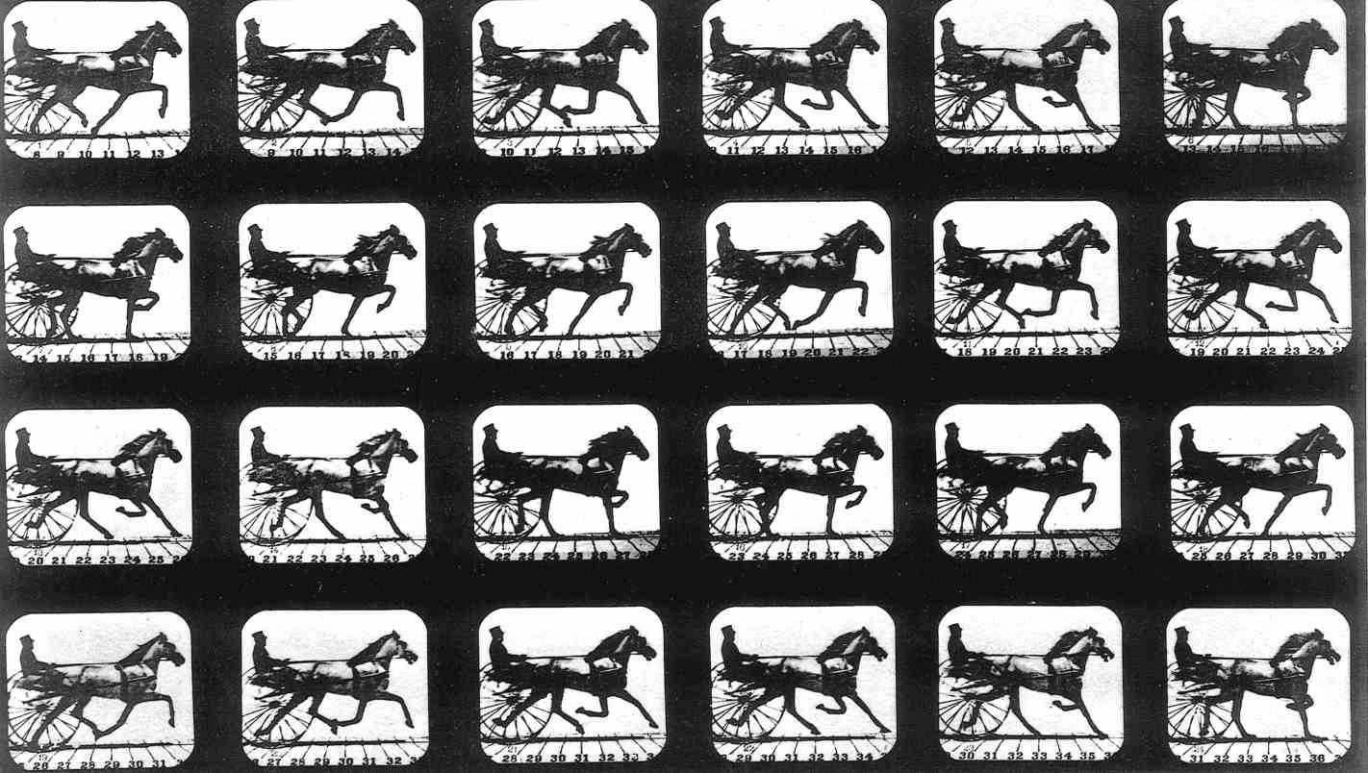
http://www.youtube.com/watch?v=FYKZif9ooxs
Eadweard Muybridge, plate published in The Horse in Motion, 1883

Slide 37
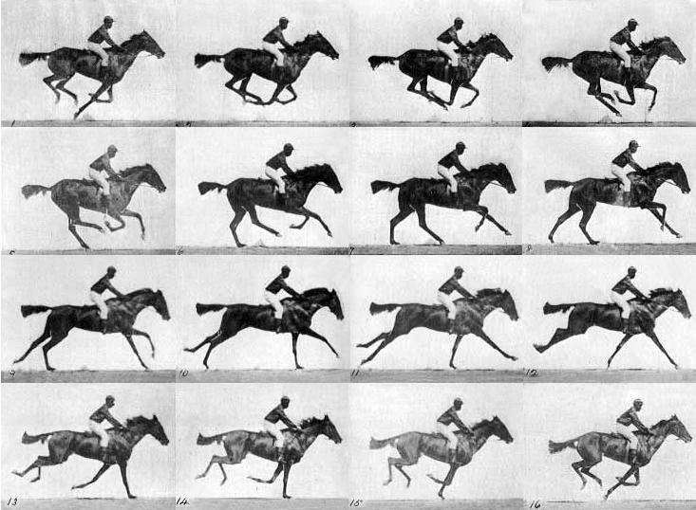
Eadweard Muybridge, Horse Galloping (The Horse in Motion ),
1878, 9 x 12”, Calotype print

Slide 38
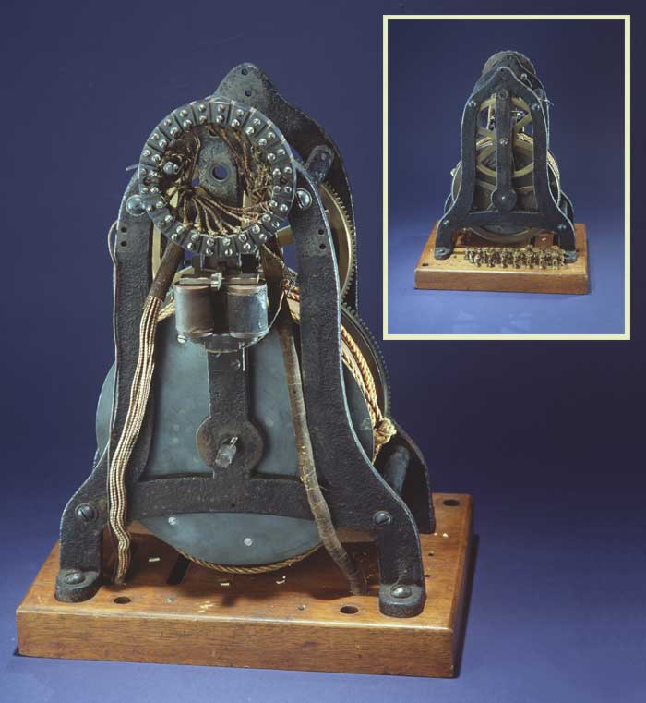
ELECTRONIC TIMING DEVICE USED BY MUYBRIDGE AT UNIVERSITY OF PENNSYLVANIA FOR ANIMAL LOCOMOTION
(FRONT AND REAR VIEW)

Slide 39
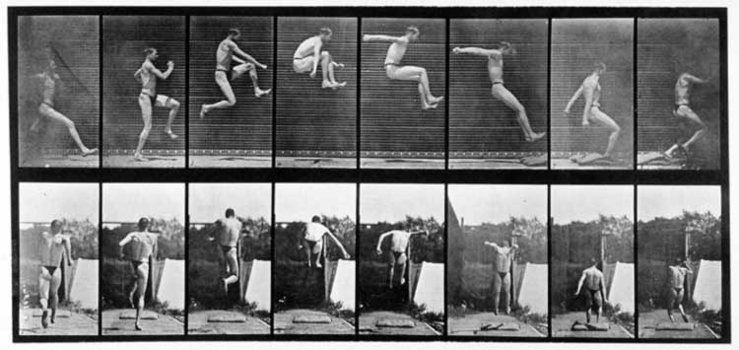
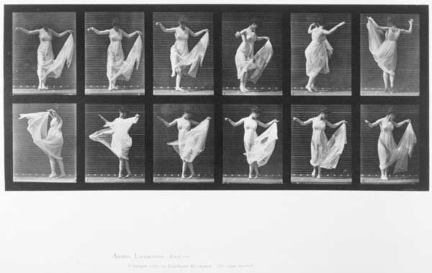

Slide 40
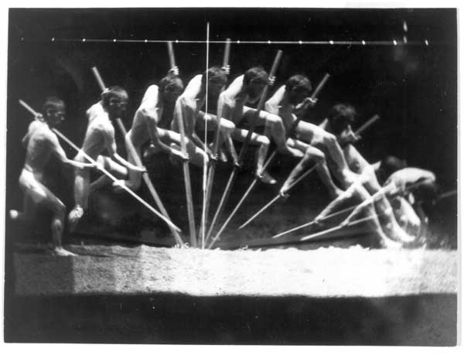
MOTION STUDY TAKEN WITH MAREY-WHEEL CAMERA,
BY THOMAS EAKINS

Slide 41

Videos used in class:
http://www.hrc.utexas.edu/exhibitions/permanent/firstphotograph/process/#top

