Slide 1

Realism
1830s-1880s

Slide 2
social and artistic commentary (Realism)

Slide 3
Realism
Realist art brought changes in form, style, and content:
Social commentary, occasionally shocking subject matter
It was important to “be of one’s time”

Slide 4
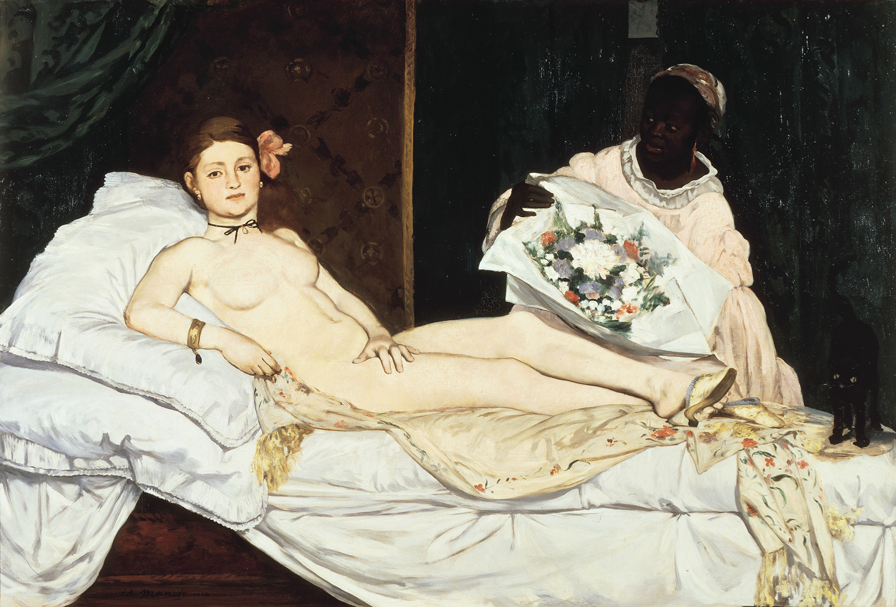
ÉDOUARD MANET, Olympia, 1863-5. Oil on canvas, 4’ 3” x 6’ 3”.

Slide 5

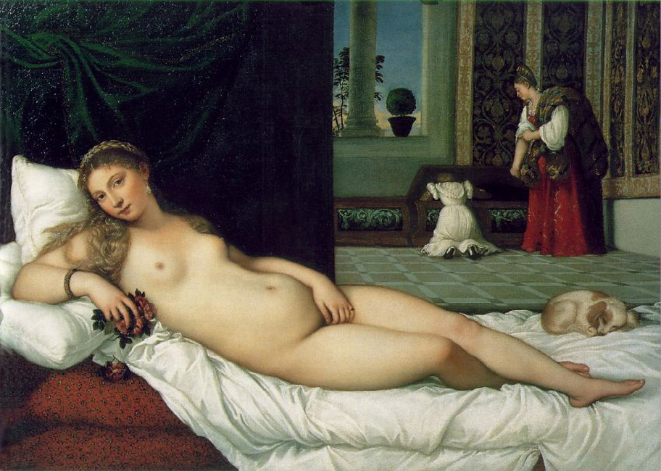
ÉDOUARD MANET, Olympia, 1865.
Oil on canvas,
4’ 3” x 6’ 3”.
TITIAN,
Venus of Urbino, 1538

Slide 6
Was “Realism” the beginning of “Modern Art”?
  changing role of the artist
  subjective selection of subject matter (rejection of academic art)
  calling attention to the “facts” of painting
  the rejection of Renaissance illusionistic space

Slide 7

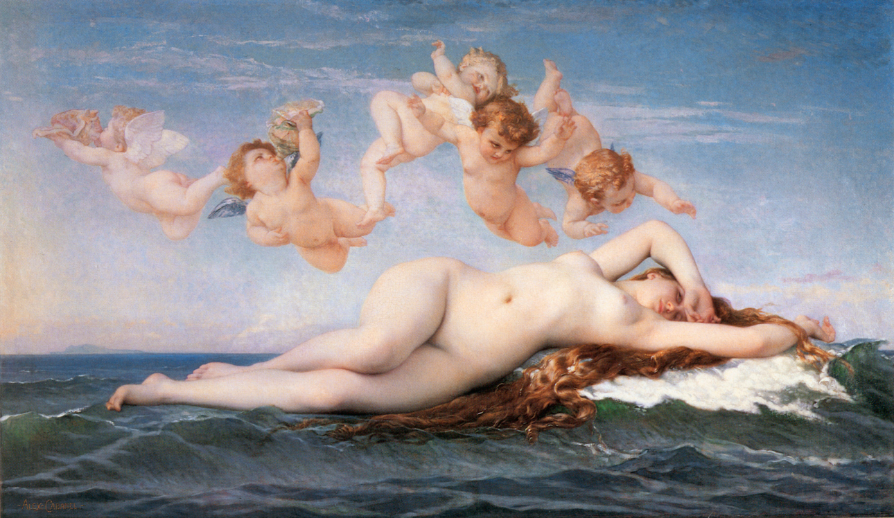
Alexandre Cabanel ,
The Birth of Venus, 1863

Slide 8
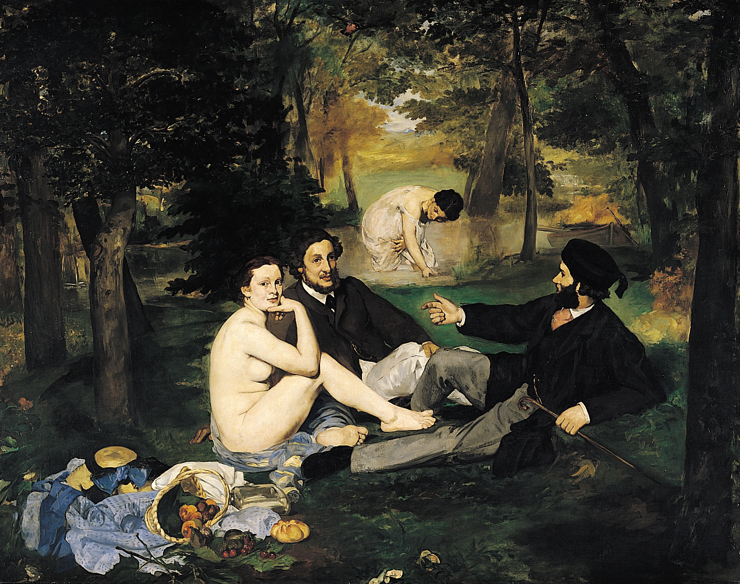
ÉDOUARD MANET, Le Déjeuner sur l’herbe (Luncheon on the Grass),
1863, Oil on canvas, approx. 7’ x 8’ 10”.

Slide 9

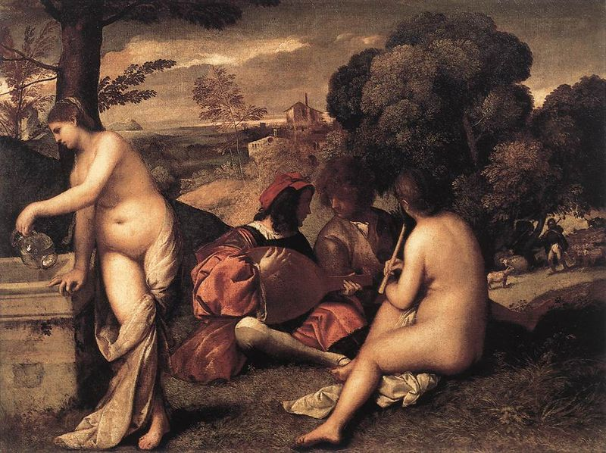
Titian (and Giorgione?)
Pastoral Concert,
c. 1510

Slide 10

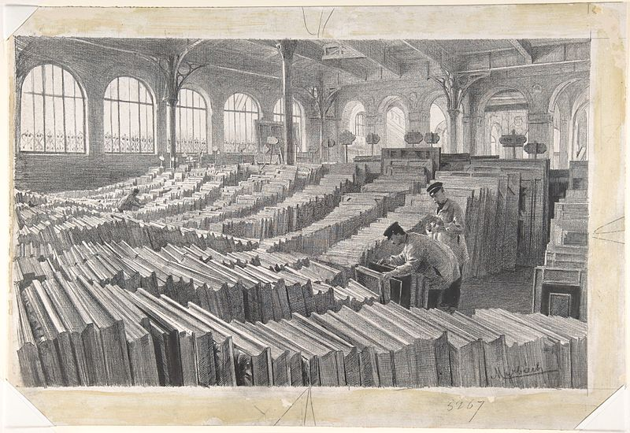
Candidates for Admission to the Paris Salon

Slide 11
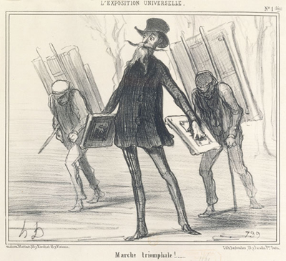
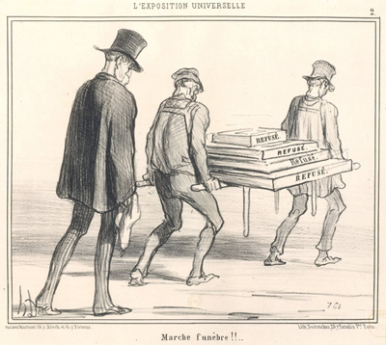
Daumier,
The Triumphal March, 1855
Funeral March

Slide 12
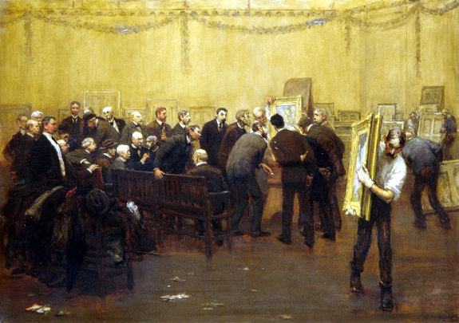
The National Academy Jury of 1907

Slide 13
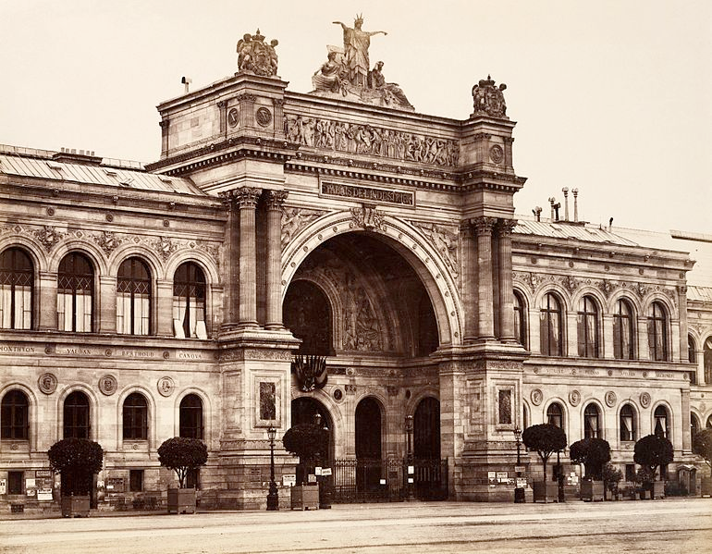
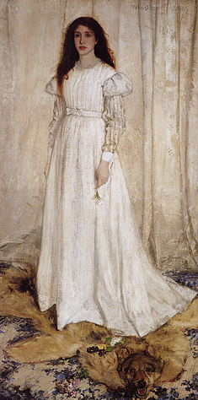

James Whistler

Slide 14
A new “system”
The Academy and the state were once patrons, arbiters of taste, educators of young artists, and publicists.
Artists creating increasingly on speculation
Dealers as the entrepreneurs/publicists
Critics as the publicists and theoreticians for the new art
A free market system

Slide 15
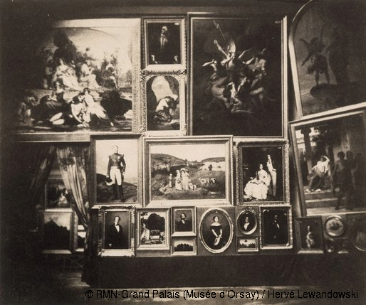
Salon of 1852, large north gallery
(center: "The Village Girls" by Gustave Courbet)

Slide 16
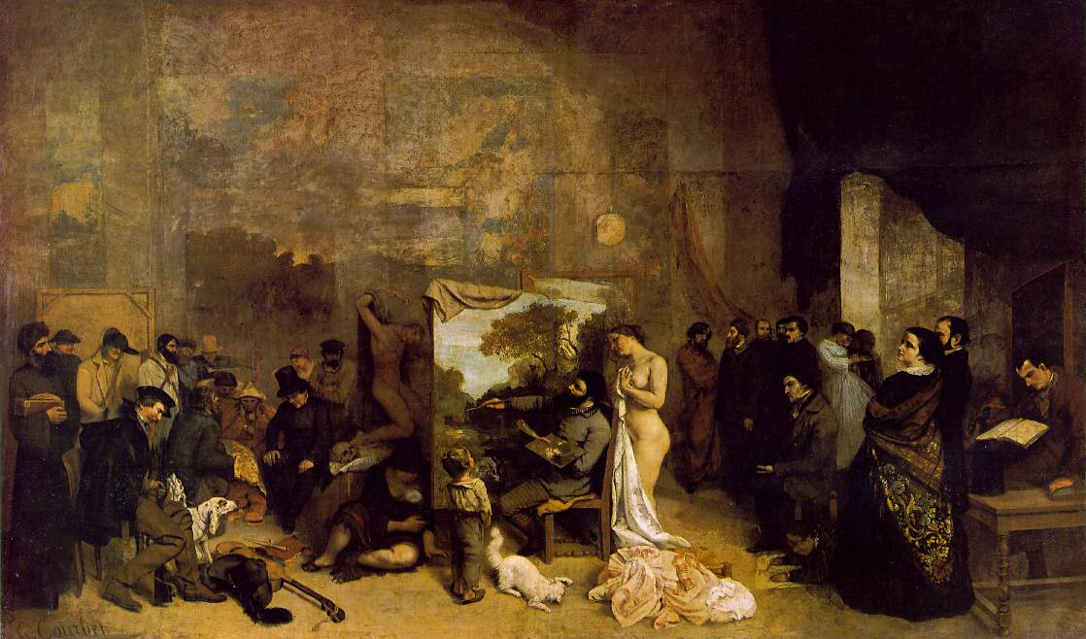
Gustave Courbet,
The Artist's Studio; A real allegory summing up seven years of my artistic and moral life,
oil on canvas, 1854-55, 11' 10 1/4" x 19' 7 1/2"

Slide 17
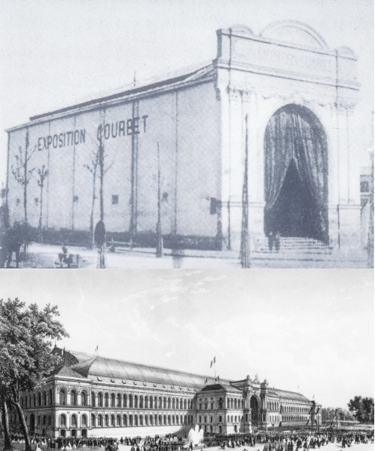

Slide 18
Gustave Courbet,
The Artist's Studio; A real allegory summing up seven years of my artistic and moral life,
oil on canvas, 1854-55, 11' 10 1/4" x 19' 7 1/2"

Slide 19
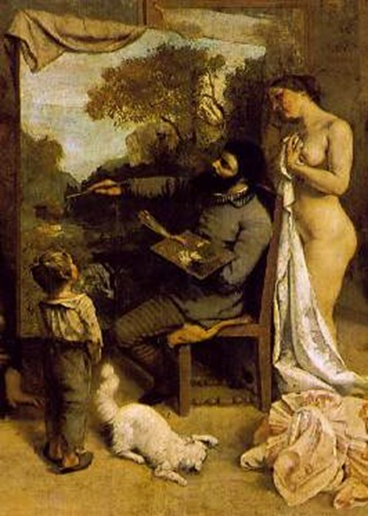

Slide 20
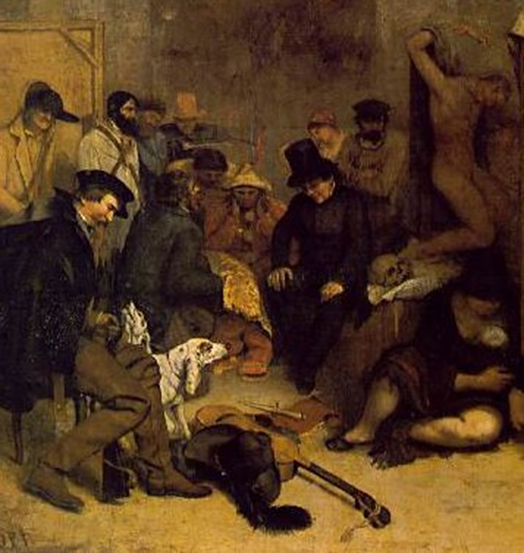

Slide 21
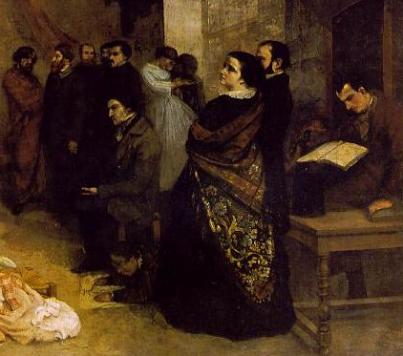

Slide 22

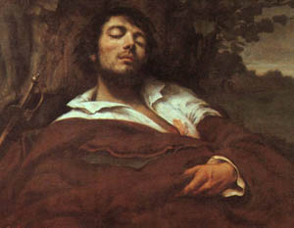
Courbet,
The Wounded Man

Slide 23
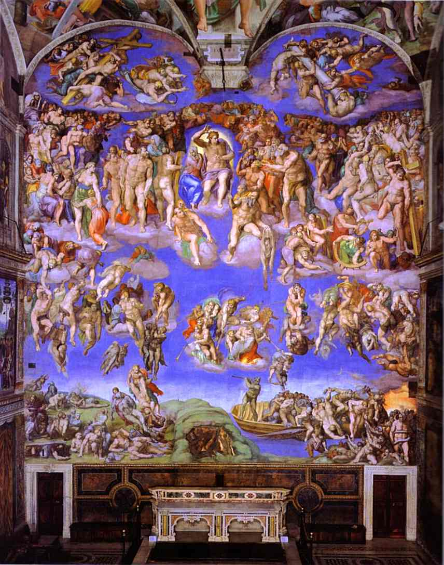
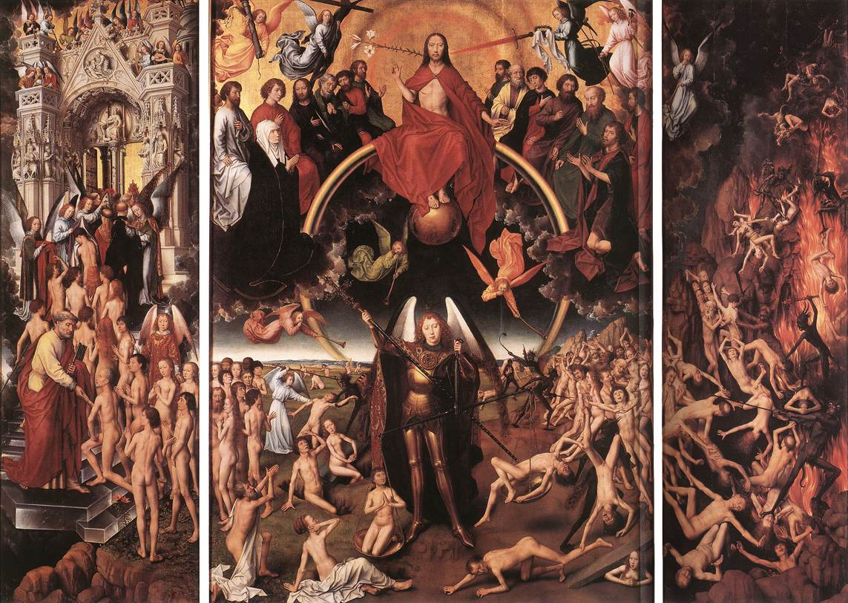
Michelangelo
Last Judgment, 1534 -41
Hans Memling
Last Judgment Triptych (open), 1467-71

Slide 24
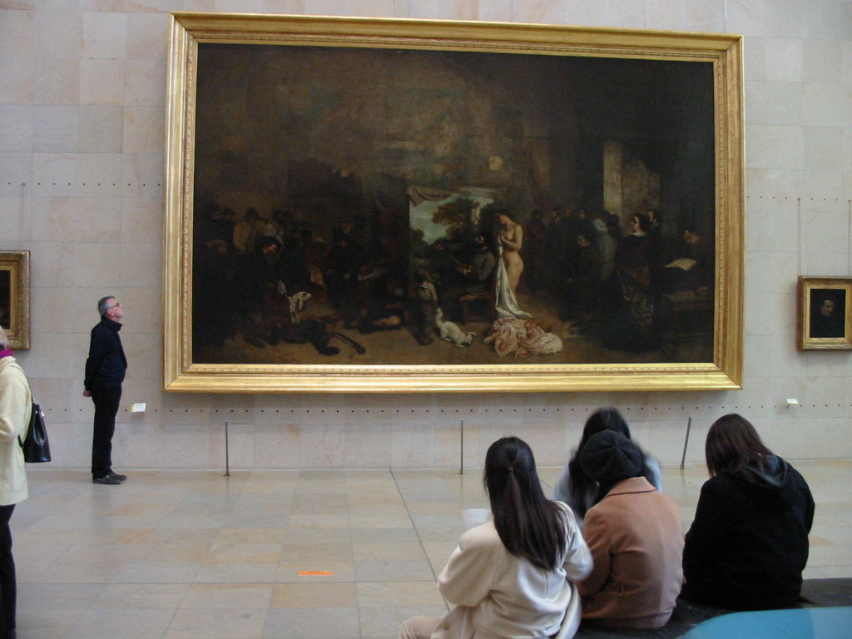

Slide 25
Getting out of the City
Realism
and
the Rise of Peasant Painting

Slide 26
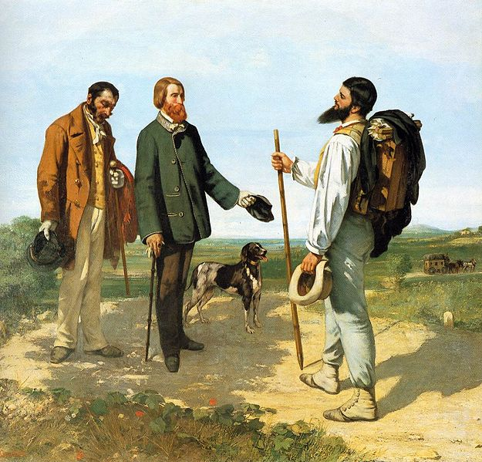
Gustave Courbet, The Meeting (Bonjour M. Courbet), oil on canvas, 1854

Slide 27
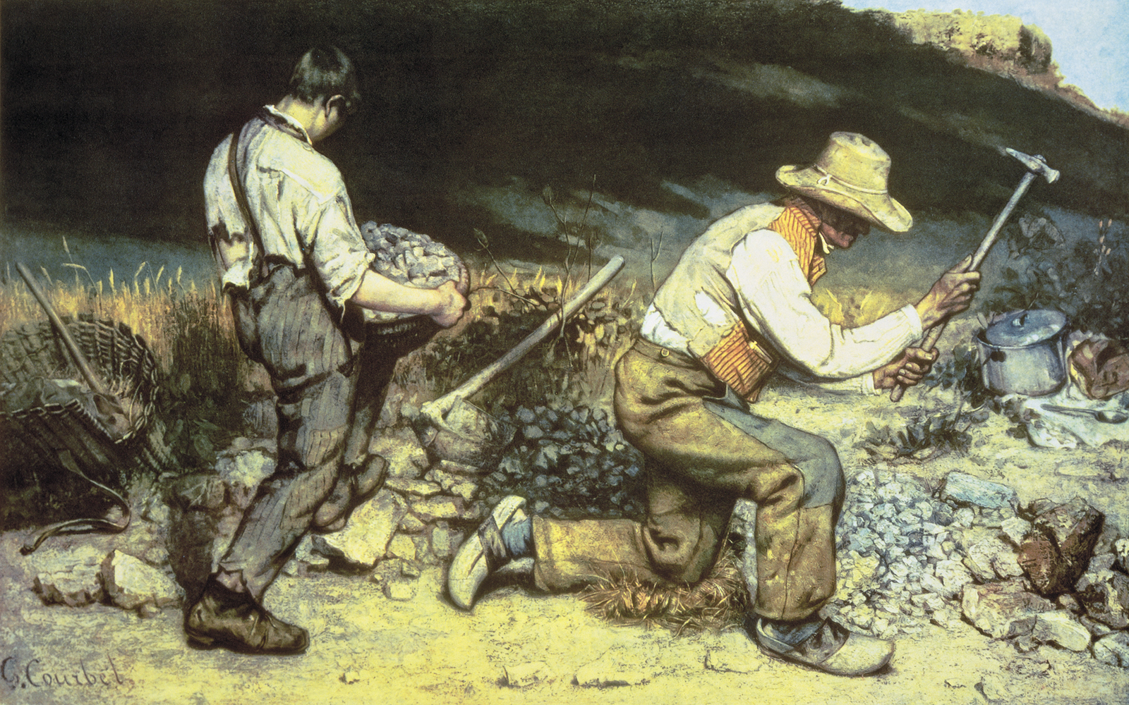
GUSTAVE COURBET, The Stone Breakers, 1849.
Oil on canvas, 5’ 3” x 8’ 6”.
(Formerly in Dresden, destroyed in 1945).

Slide 28
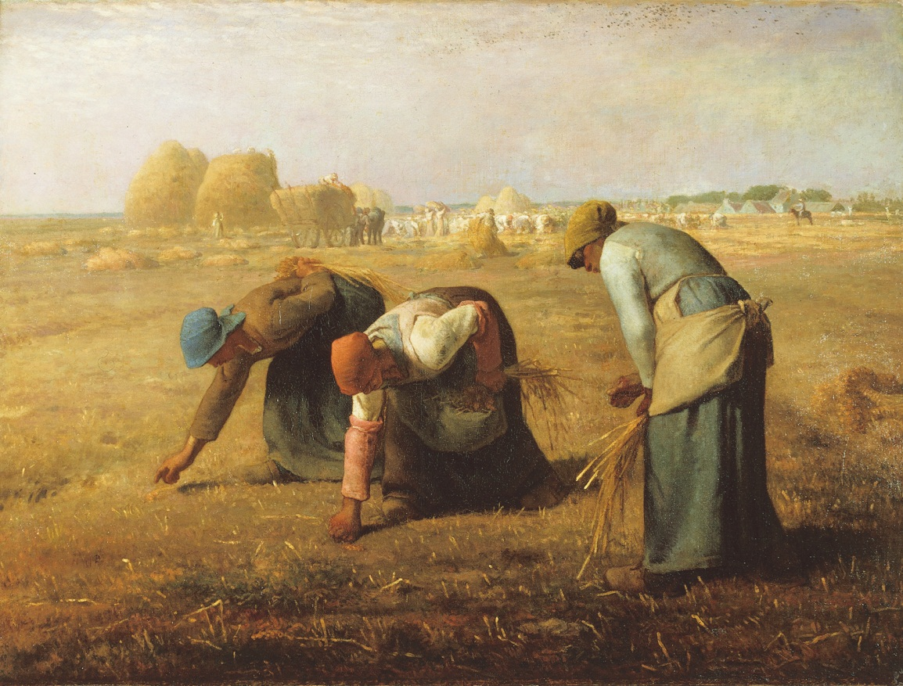

JEAN-FRANÇOIS MILLET,
The Gleaners, 1857.
Oil on canvas, approx. 2’ 9” x 3’ 8”.
GUSTAVE COURBET,
The Stone Breakers, 1849.
Oil on canvas, 5’ 3” x 8’ 6”.
Formerly at Gemäldegalerie, Dresden (destroyed in 1945).

Slide 29
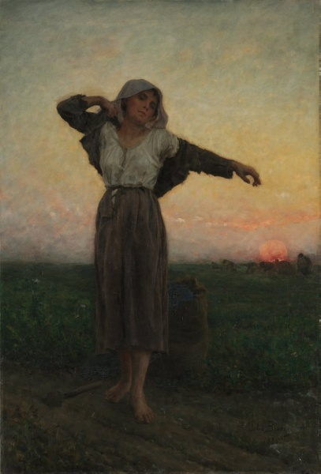
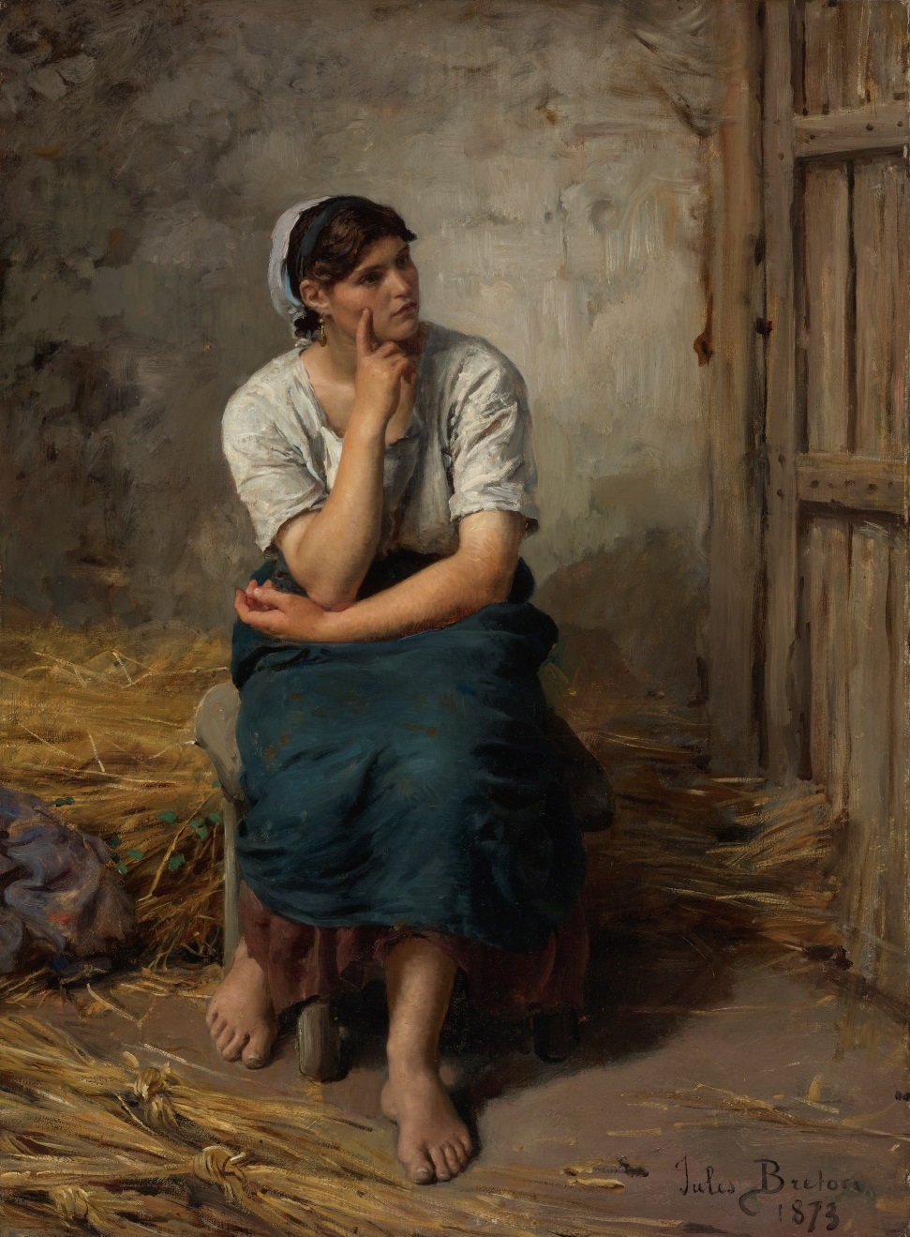
Jules Breton

Slide 30
JEAN-FRANÇOIS MILLET, The Gleaners, 1857. Oil on canvas, approx. 2’ 9” x 3’ 8”.

Slide 31
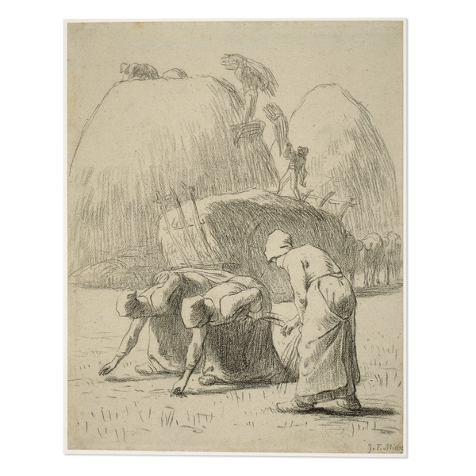
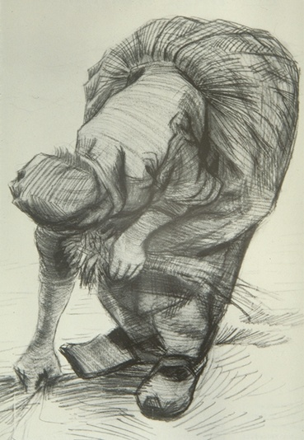

Slide 32
JEAN-FRANÇOIS MILLET, The Gleaners, 1857. Oil on canvas, approx. 2’ 9” x 3’ 8”.

Slide 33
JEAN-FRANÇOIS MILLET, The Gleaners, 1857,
Oil on canvas, approx. 2’ 9” x 3’ 8”.

