Slide 1
Videos used in class:
Letter press and Linotype https://www.youtube.com/watch?feature=player_embedded&v=bPCiWiLu-W4
Linotype http://redux.com/view/post/2176863/Linotype-The-Film-Official-Trailer
Lithography http://www.youtube.com/watch?v=JHw5_1Hopsc

Slide 2
History of Design
Instructor: Gayle Clemans

Slide 3
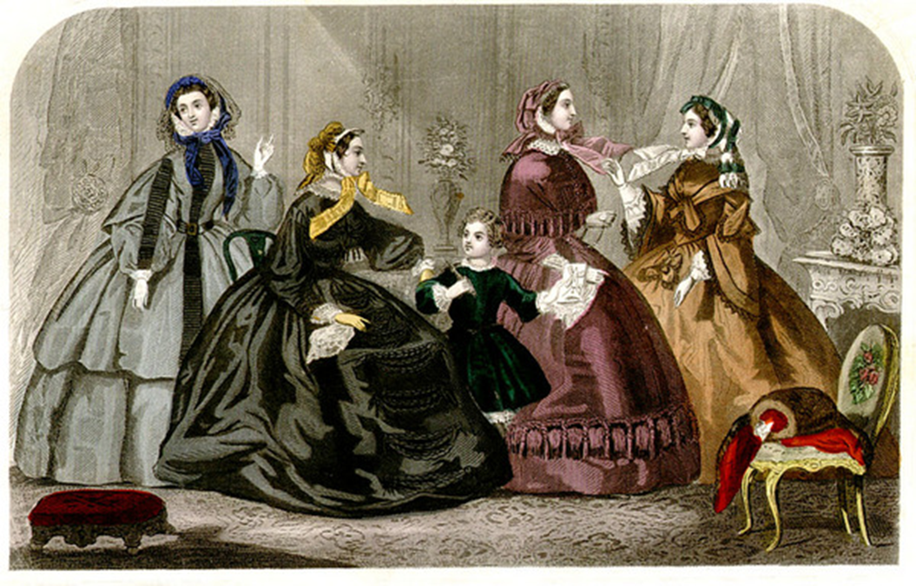
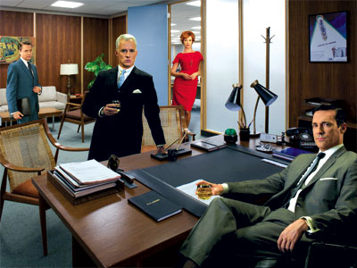
Instructor: Gayle Clemans
History of Design
1850s-1960s

Slide 4
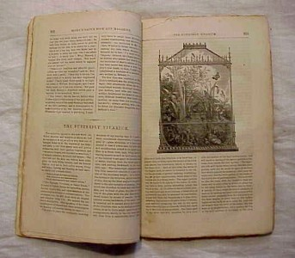
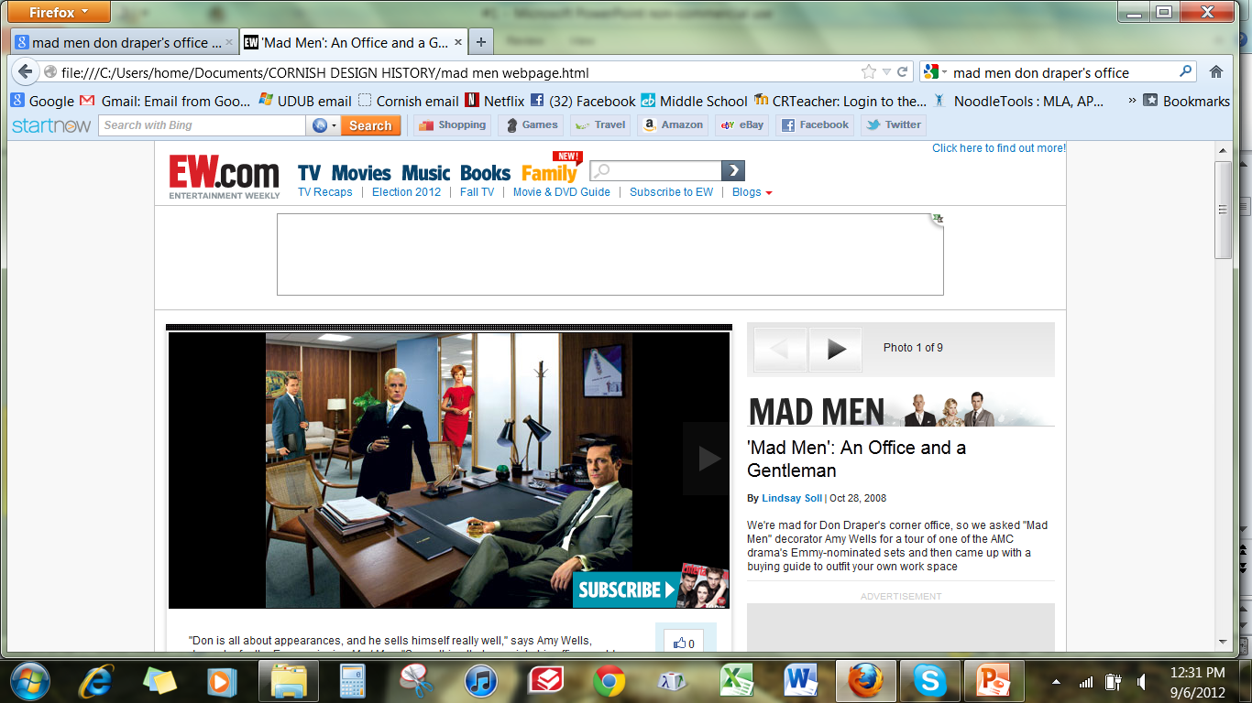

Godey's Lady's Book,
October 1859
Screenshot,
September 6, 2012

Slide 5
A Culture of Industry and Progress…and Taste!
Godey's Lady's Book,
October 1859

Slide 6
Relationship between design and new technology/new materials
Expansion of production
Growing demand for goods and furnishings
Expanded and elevated role of The Designer

Slide 7
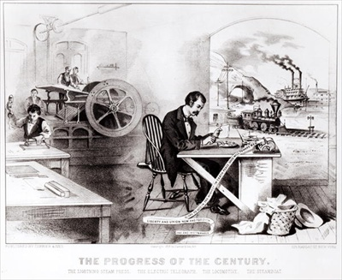
lithograph by Currier & Ives
Notes:
Currier & Ives, lithograph, 1876

Slide 8
lithograph by Currier & Ives
The Industrial Revolution generated a totally new social structure in America and Europe.
The forces of industrialization and urbanization dictated a new way of life for the population as a whole.

Slide 10
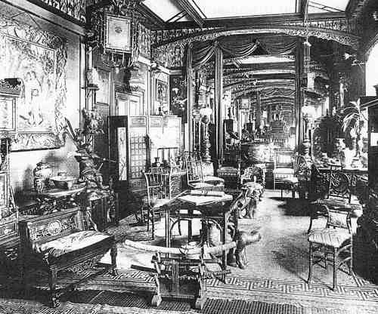
America and many European nations experienced increased industrialism and capitalism.
By the mid-nineteenth century, Britain led the world in terms of trade and enjoyed great prosperity.
The foundation of a capitalist economy spawned a thriving middle class anxious to express its new found prosperity in terms of visual culture.

Slide 11
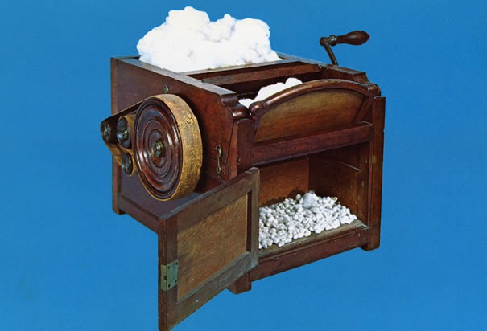

Slide 12

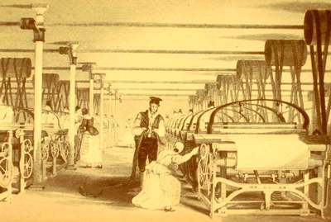
1793, invention of cotton gin by Eli Whitney early 1800s, introduction of steam power to spinning

Slide 13
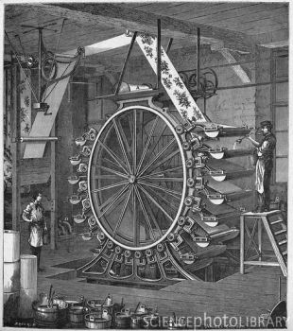
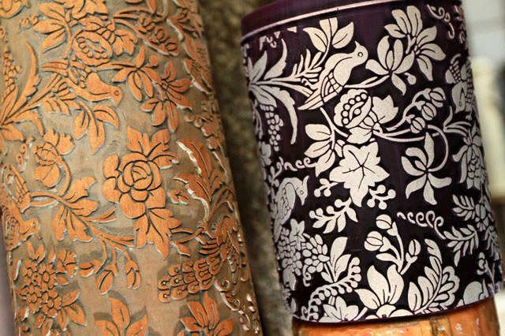
Steam-powered cylinder presses were used both in paper printing and in fabric printing

Slide 14
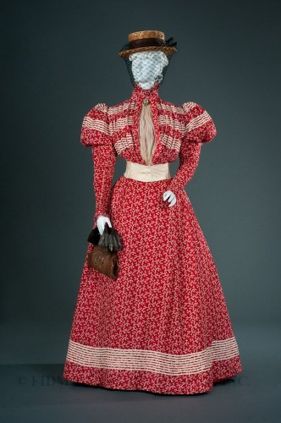
Printed cottons were at the center of the Industrial Revolution in fabrics.
Many more printed patterns and colors became available.
Improved transportation and communications combined with lower costs to allow fashions to be more widely adopted by those in the middle and lower classes, and encouraged fashions to change more quickly than before.

Slide 15
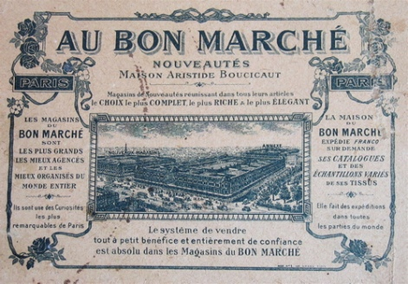
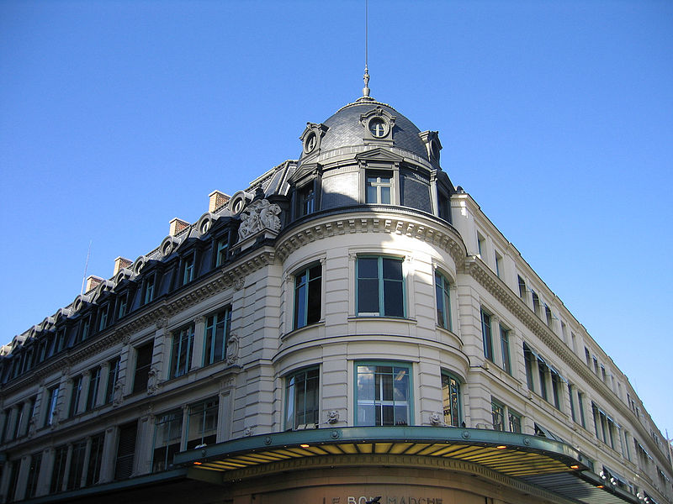
Rise of consumerism
Transition from making to buying
Transformation of retail shopping

Slide 16
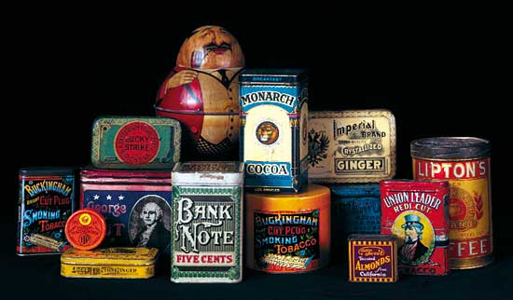
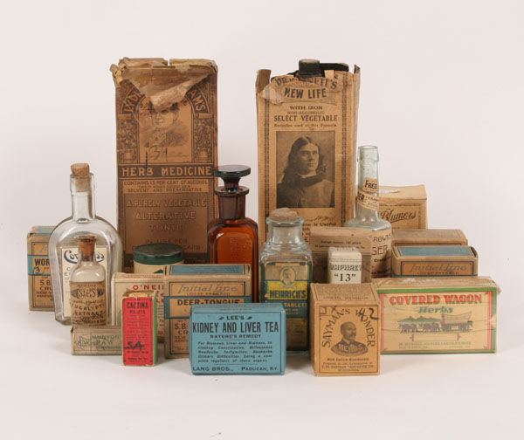
  Tin containers
  Paper labels

Slide 17
How do you encourage this new buying public to buy?

Slide 18
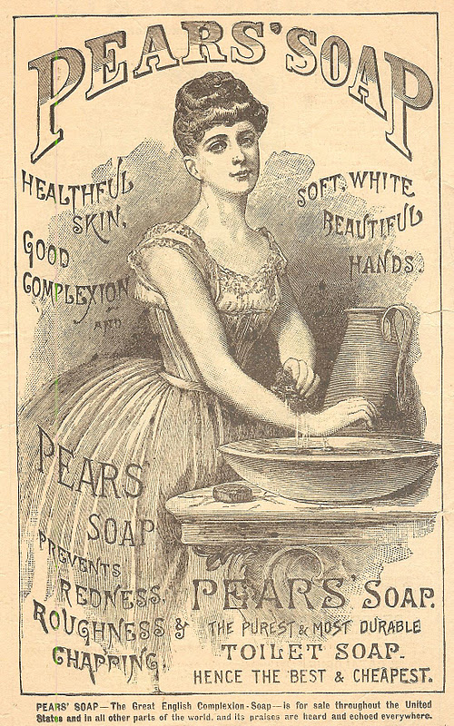
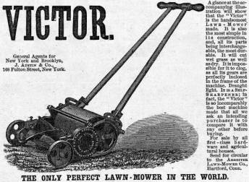
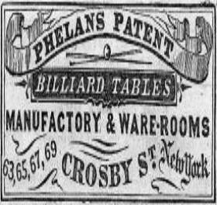


Slide 19
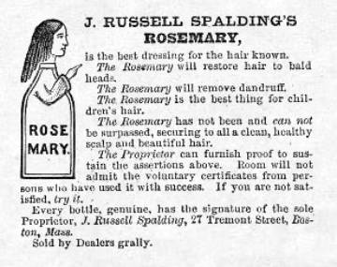
1886
Rosemary Hair Dressing
Harper's Weekly, March 26, 1859

Slide 21
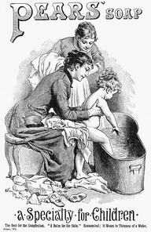
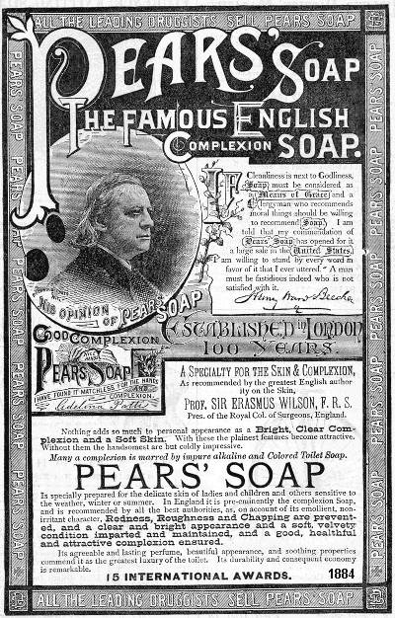

Slide 22
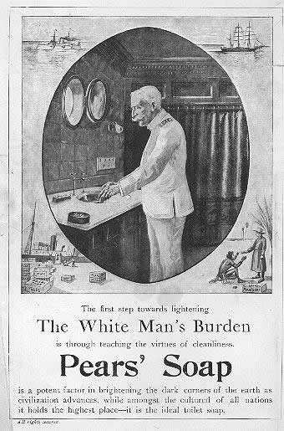
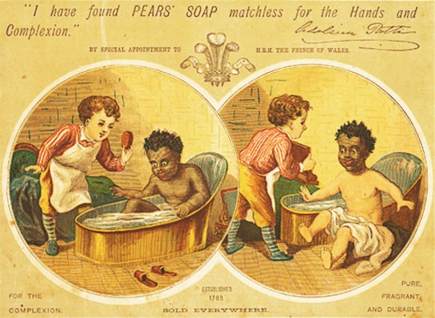

Slide 23
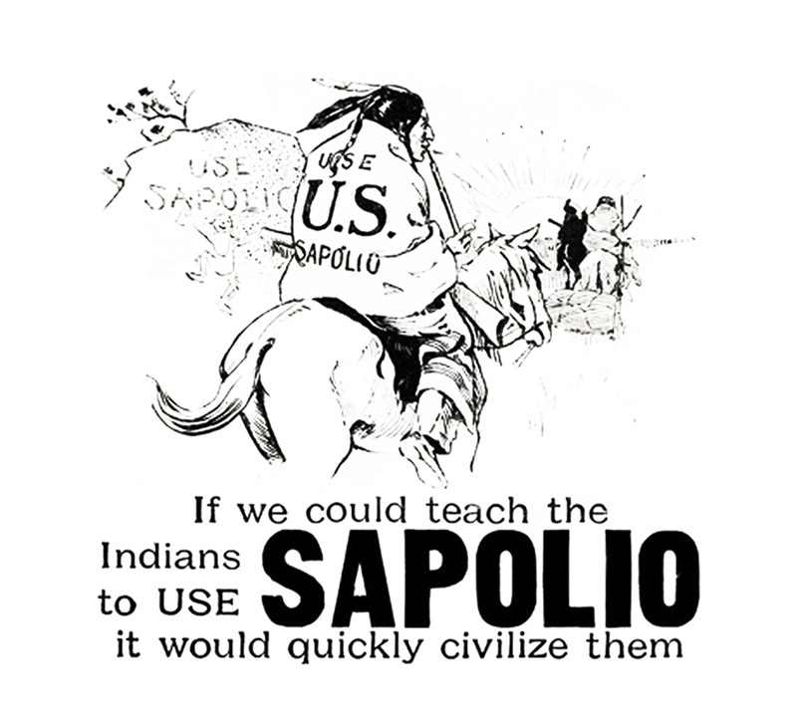

Slide 24
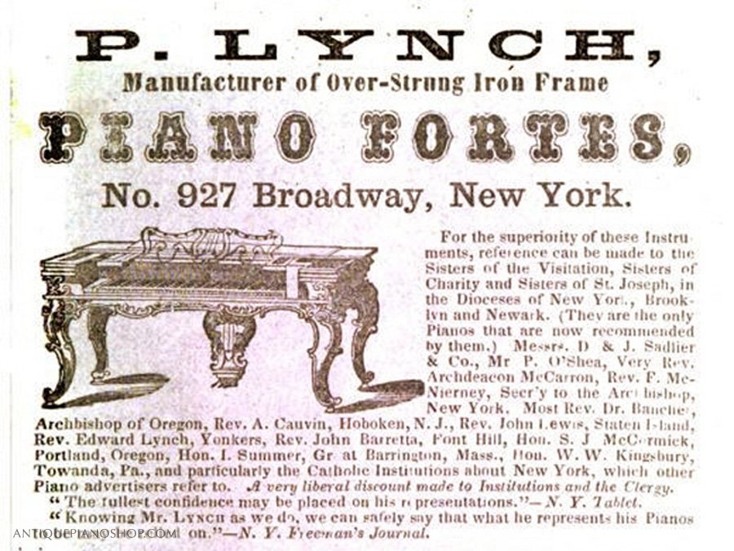
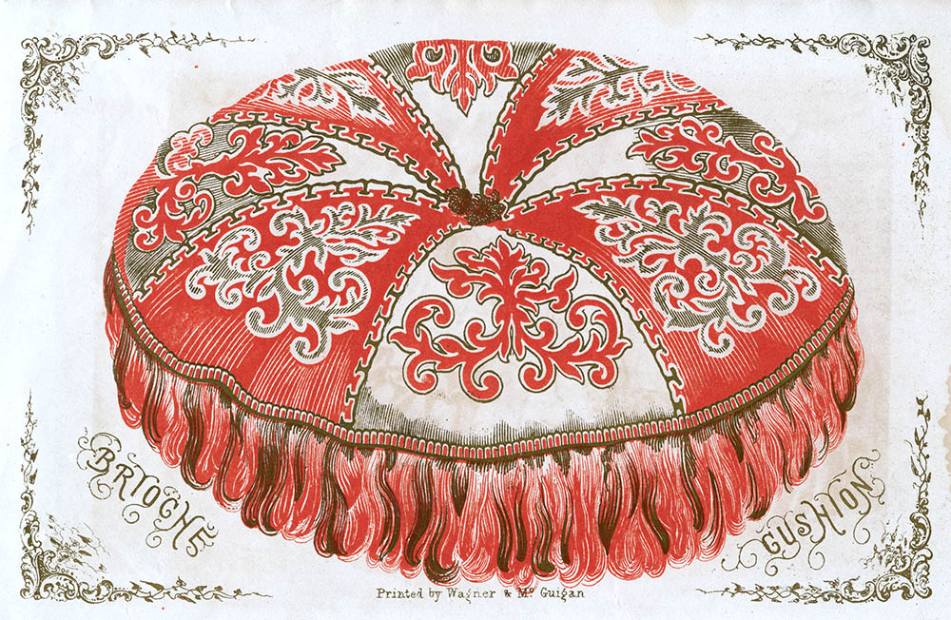
advertisement purchased by business owner for display in a periodical
“Editorial” image of cushion

Slide 25
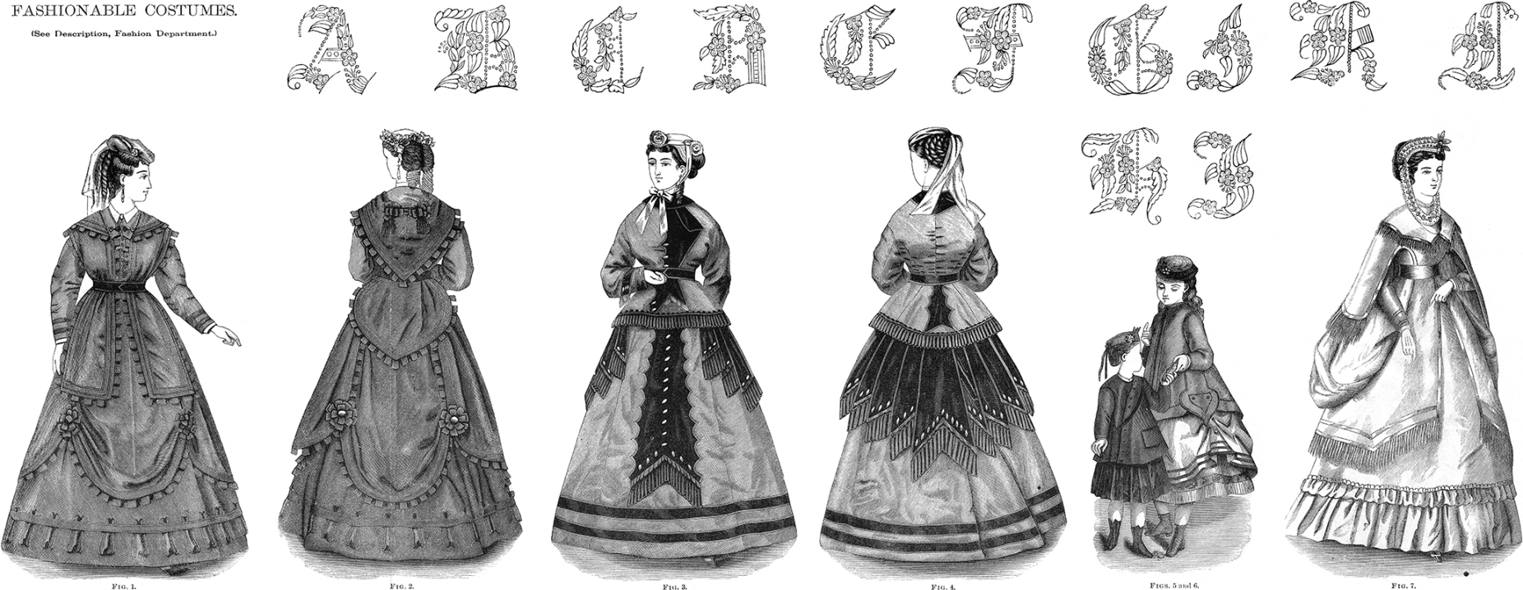
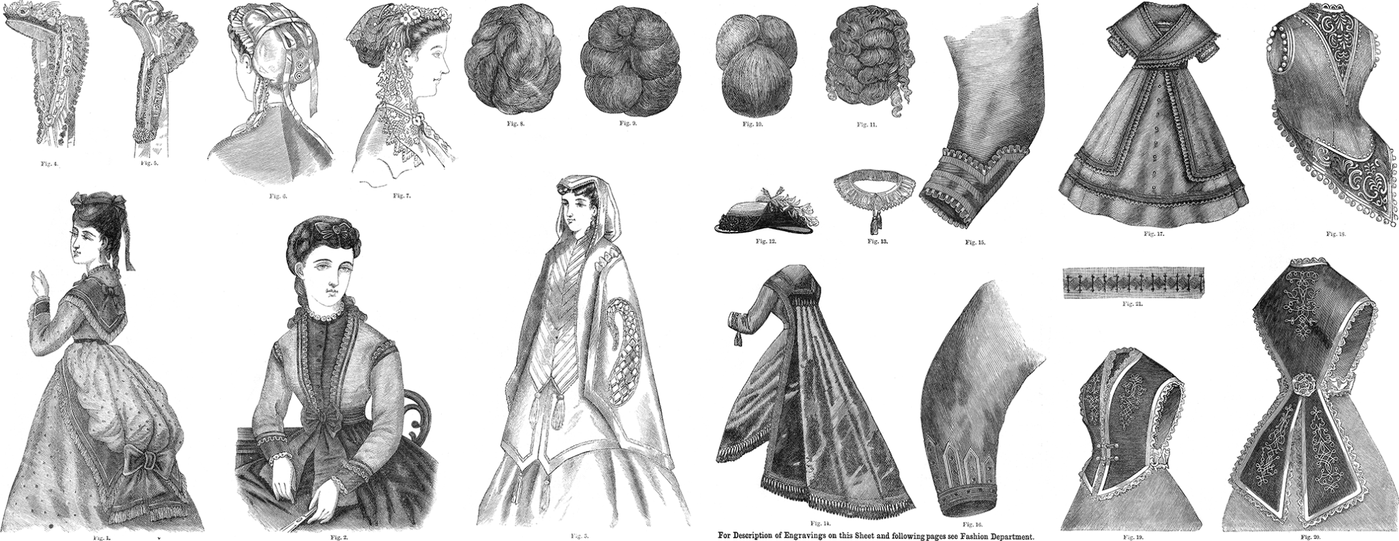

Slide 26
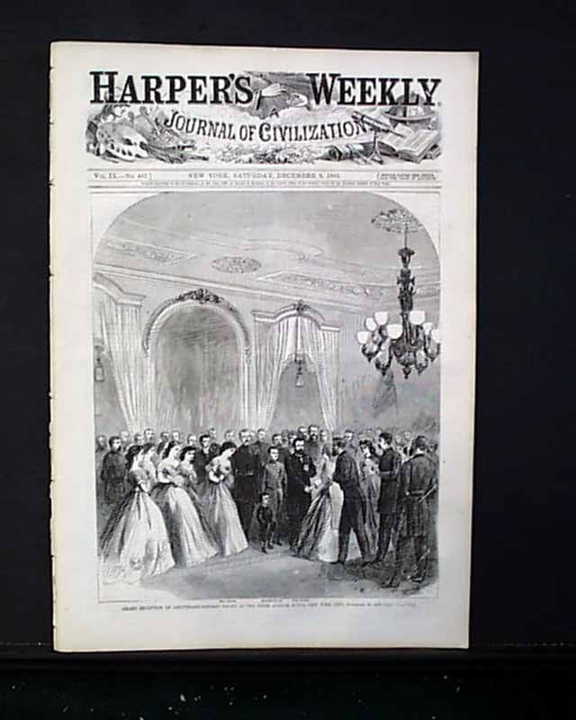
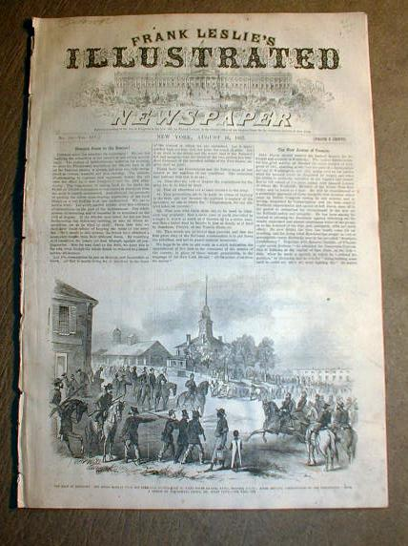

Slide 27
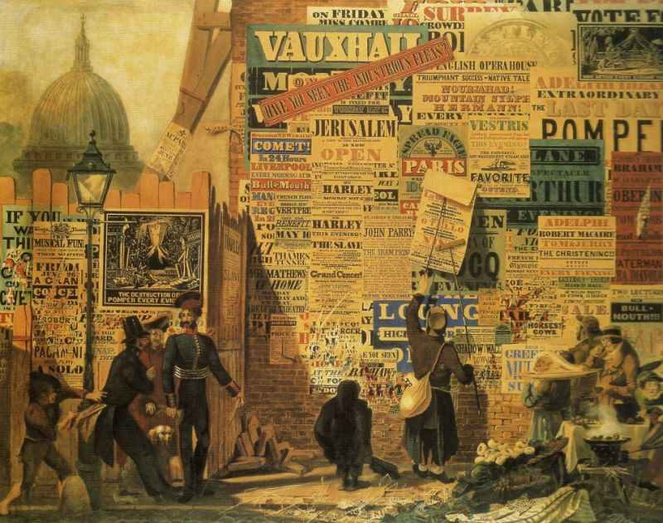
John Parry, London Street Scene, watercolor 30 x 43 in., 1835

Slide 28
A History of Graphic Design
Common approaches
to typography
in
the Victorian era

Slide 29
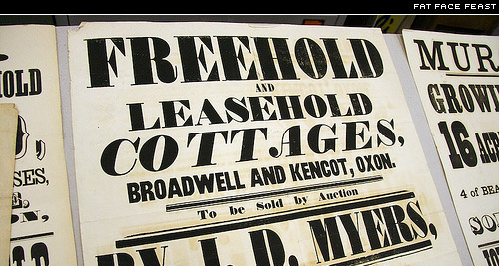
Fat Face

Slide 30
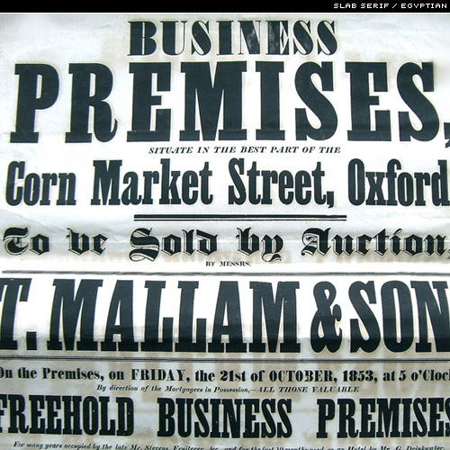
Slab Serif

Slide 31
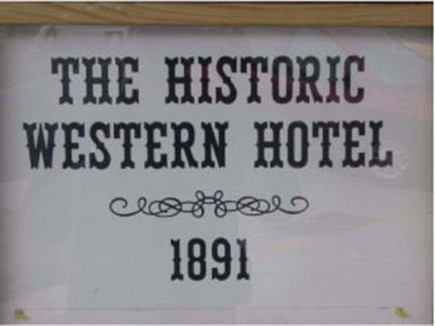
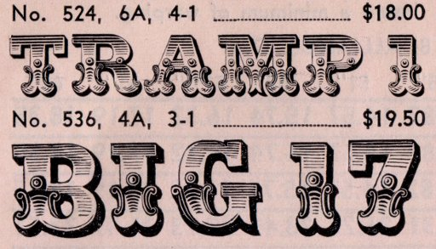
Tuscan-style letters serifs that are extended and curved, with a range of variation, often with bulges, cavities, and ornaments

Slide 32
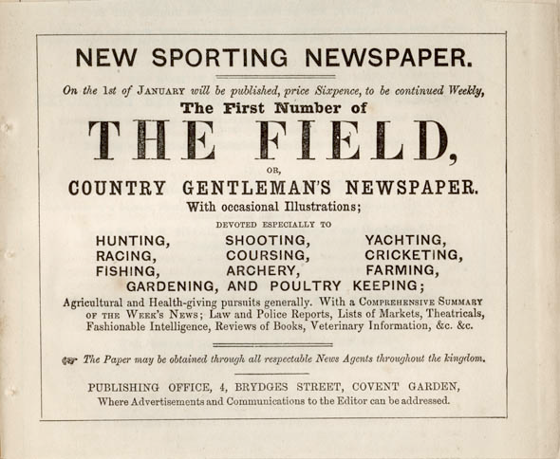
Includes Sans-serif
Can you spot it?
advertisement for a “The Field.”
Ad was published in a magazine, 1853

Slide 33
Find and sketch:
Slab Serif
Fat Face
Sans Serif
Reversing
(white letters on black - or other color - background)
Shadowing
Outlining
Weighty, solid appearance
Vertical stress

Slide 34
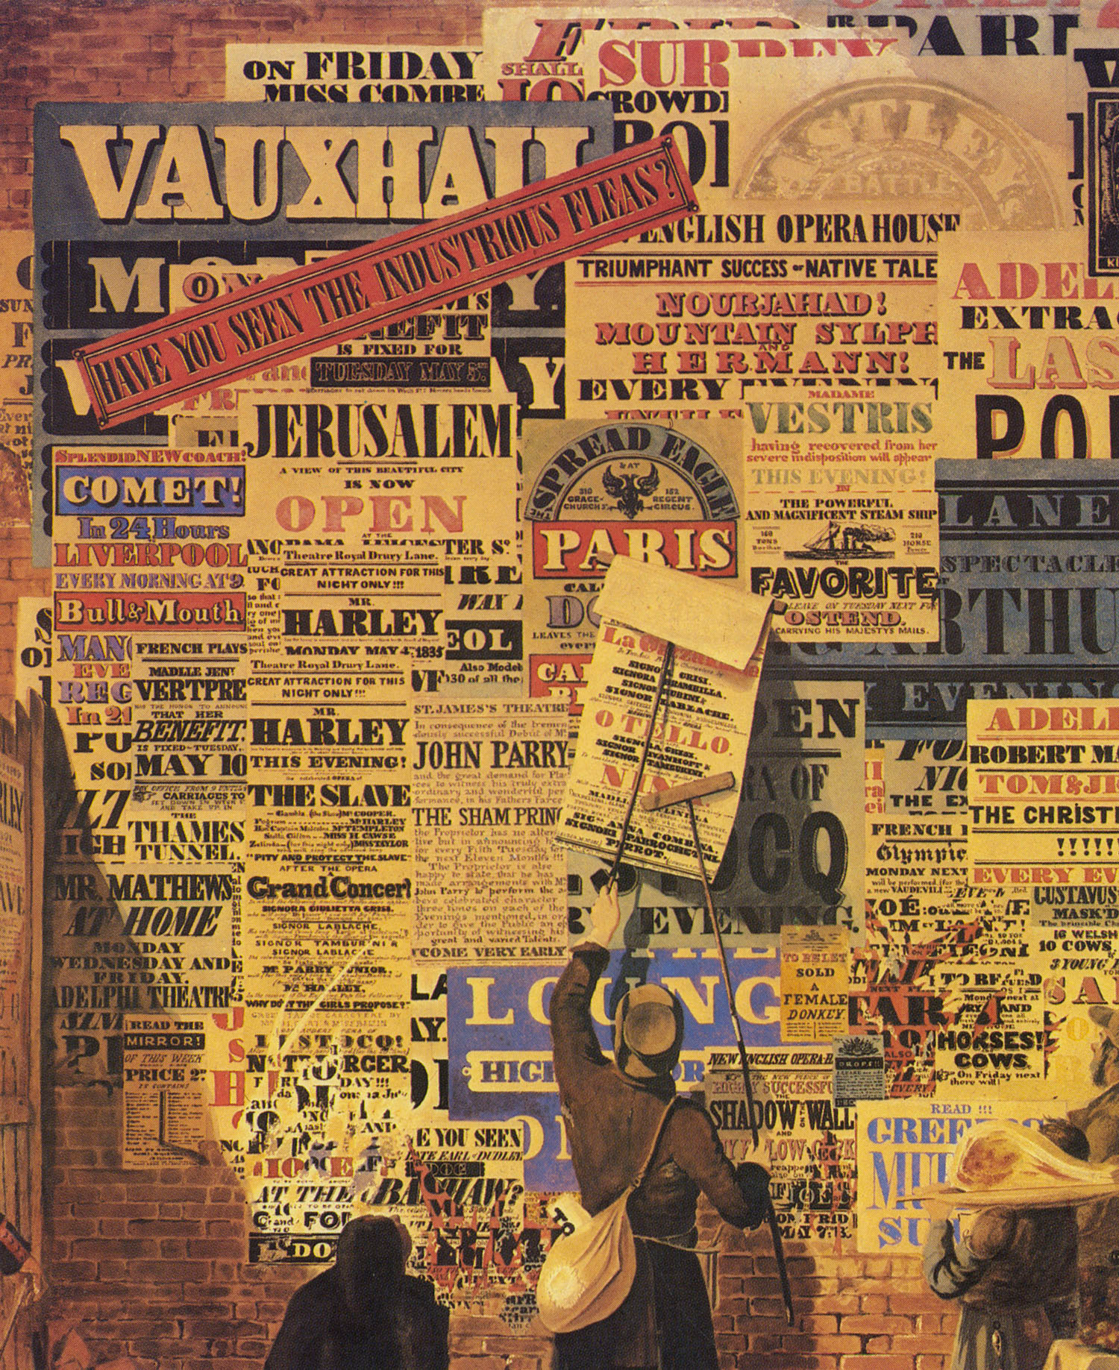

Slide 35
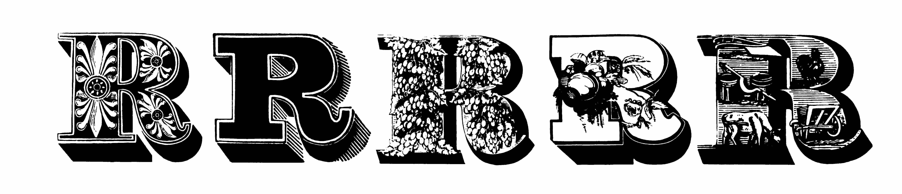
Notes:
Woods and Sharwoods, letters from ornamented fonts, 1838 ‑ 42. The wide fat‑face letterforms provided a background for pictorial and decorative elements.

Slide 36
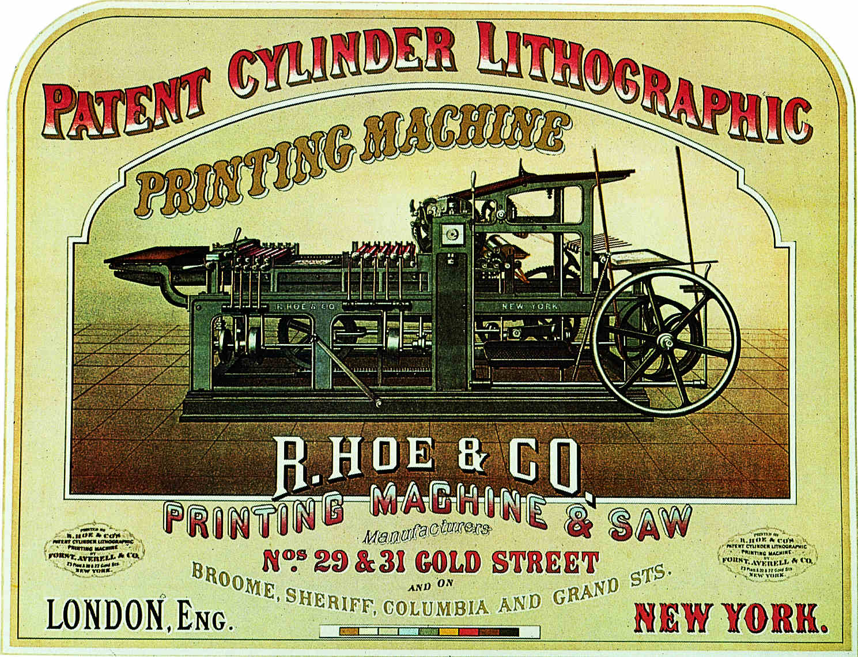
1870 poster
Notes:
Forst, Averell & Co., poster for the Hoe printing press, 1870. This press made mass editions of chromolithographs possible.

Slide 37
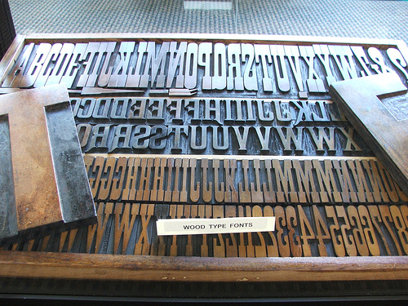

Slide 38
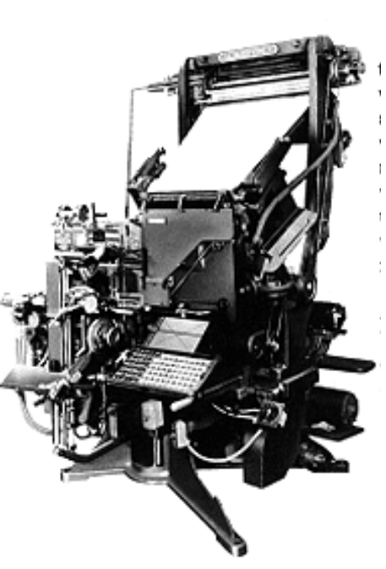
Typography and Printing
in the Industrial Age
Improvements to printing processes :
steam-power, cylinder presses, continuous –feed presses.
Paper-making machines
Mechanized typography (vs. setting type by hand)
as with the Linotype -
Typewriter like keys
  released a matrix that was put in a line
  and filled with melted lead, creating type!
  http://www.youtube.com/watch?v=G8cCS3o62iI

Slide 39
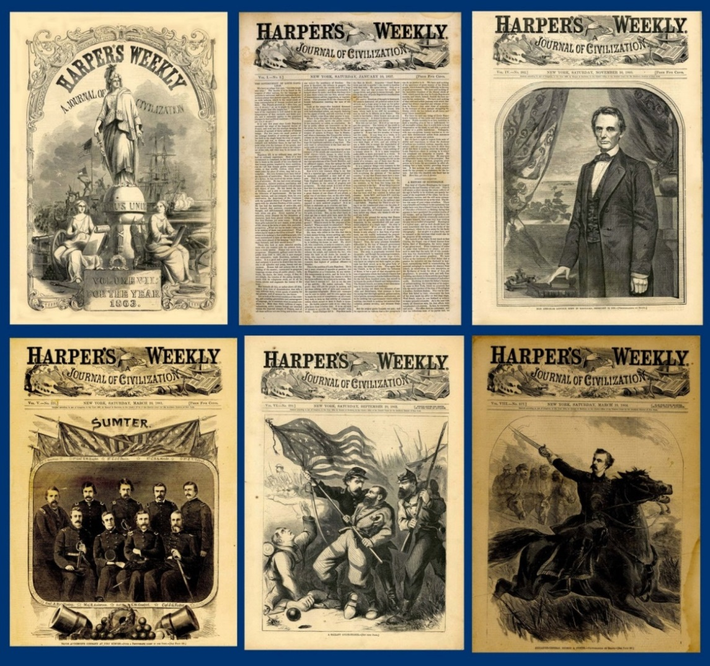
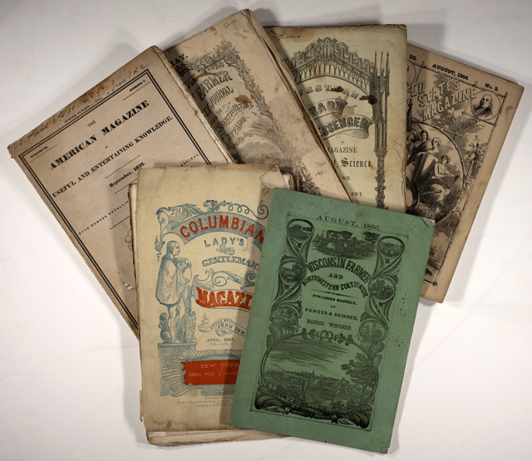
Taxes on paper and paper products were reduced.
Cost to consumers -- of newspapers, periodicals, and books --
was reduced.
Circulations increased.
Led to an age of mass communication

Slide 40
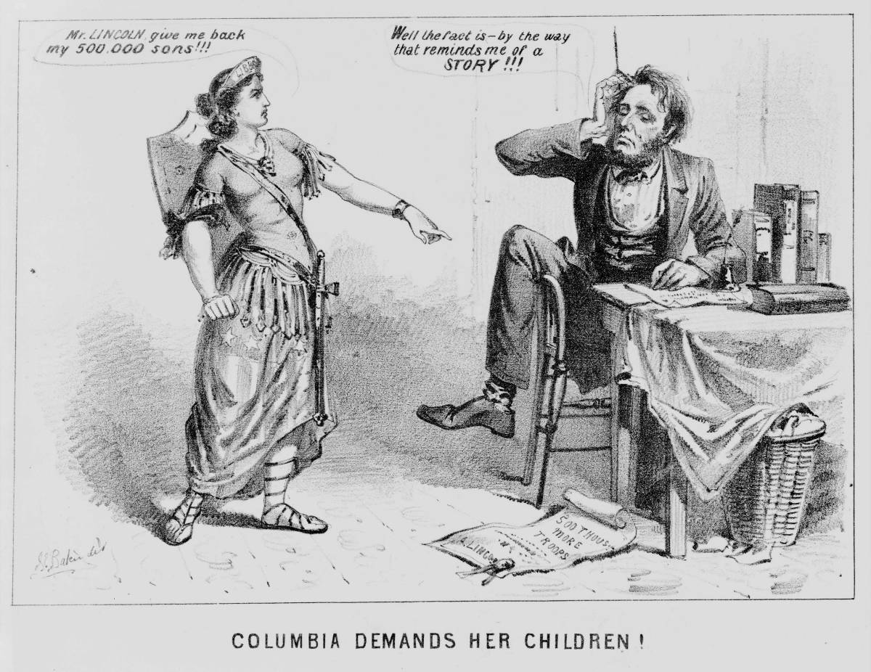

Slide 41
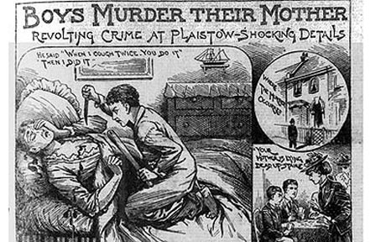

Slide 42
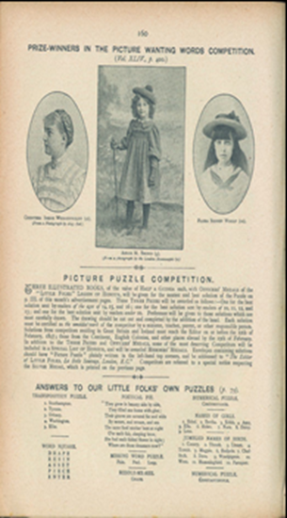
Boom in publications marketed toward women and children
Women as consumers
Changing concepts of childhood

Slide 43
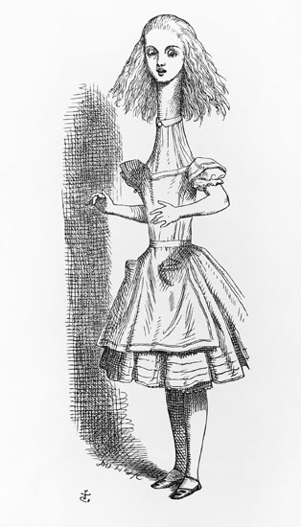
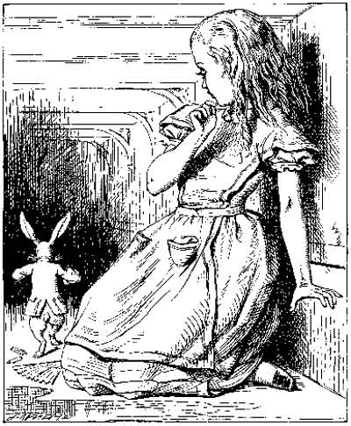

Slide 44
John Tenniel, illustrations from
Alice's Adventures in Wonderland,
by Lewis Carroll, 1866

Slide 45
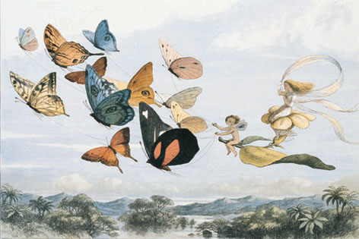
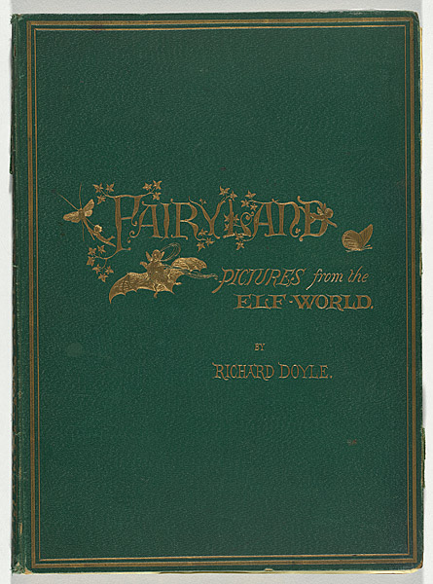

In Fairyland, by William Allingham, 1870
Illustrations by Richard Doyle,
wood engraving s

Slide 46


Kate Greenaway, author/illustrator
Under the Window, 1878

Slide 47



Slide 48


Slide 49


Slide 50

Other advances in printing technology:
Lithography
chromolithography

Slide 51


Slide 52


Slide 53

http://www.youtube.com/watch?v=JHw5_1Hopsc

Slide 54





Slide 55
Other forces/events that reflected and generated design

Slide 56

Railroads – construction boom in early to mid 1800s
Effects?

Slide 57
Railroads – construction boom in early to mid 1800s
Effects?
Increased ability to transport raw materials, factory equipment, and new consumer goods
Increase in travel/tourism
Contributed to growth of the new advertising industry
Contributed to the decline of the cottage and farming industries

Slide 58


Slide 59
end

